Slide 1

SA Municipality Income & Expenditure
TAWANDA CHIFAMBA
CLIFFORD XABA
MAIDI KHARONGA
XOLA NTLANGULA
Notes:
To use this title animation slide with a new image simply 1) move the top semi-transparent shape to the side, 2) delete placeholder image, 3) click on the picture icon to add a new picture, 4) Move semi-transparent shape back to original position, 5) Update text on slide.

Slide 2
Contents
Team Structure
Processes
Requirements
Design
Visualization
Demo
References.
Q&A.
Background.

Slide 4
Background
Municipalities in South Africa
Local, Districts and Metros
Income and Expenditure
Revenue spend and revenue income

Slide 5

Team Structure
Trusted source vs. untrusted Process (Xola)
Requirements (Maidi)
Design (Clifford)
Visualization (Tawanda)

Slide 6


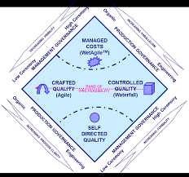


Process
Methodology
- CASM
Technologies
Trello
Zoom
Drop box
Github
Resource Allocation
CASM

Slide 7
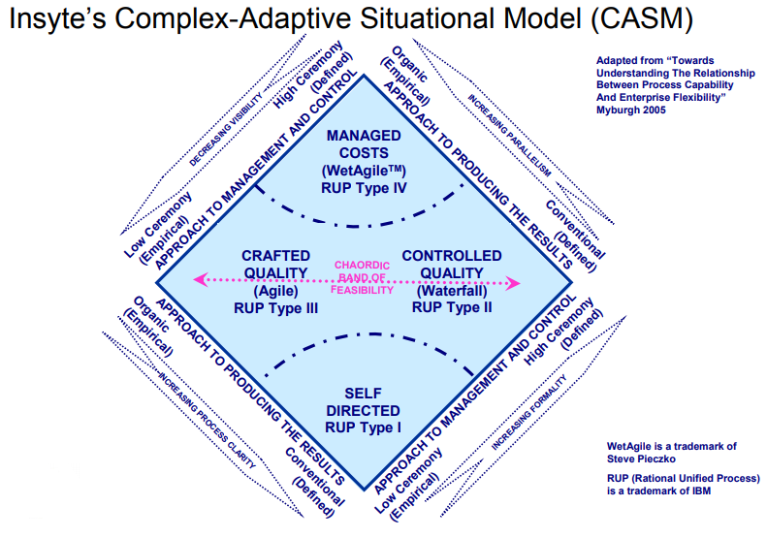
Agile : Continuous integration
Waterfall : following a process
Self directed quality
Wet Agile

Slide 8
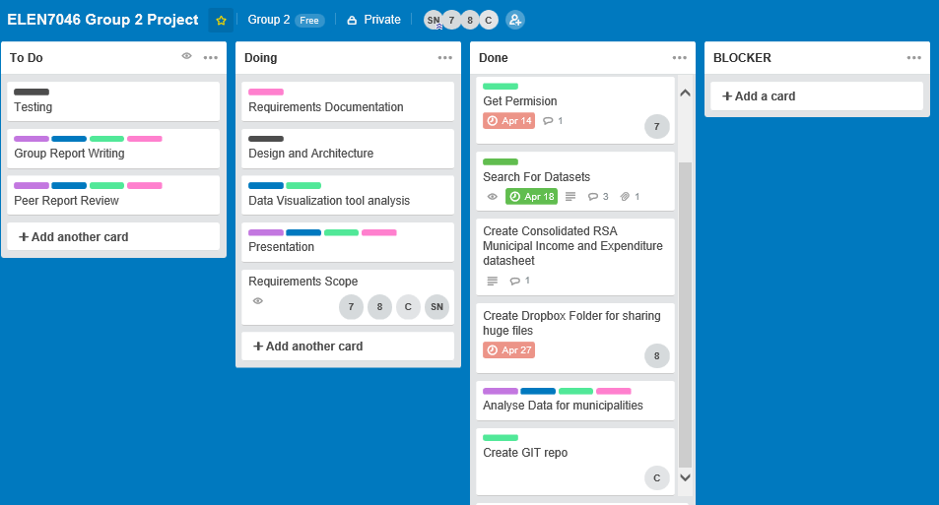
Trello

Slide 9

Requirements
Brainstorming Technique used to gather requirements
JAD session
Scope
User Acceptance Testing (UAT)
Visio for UML diagram

Slide 10
Scope
Display the INCOME & Expenditure
Category Municipality Category per year
Sub Category per Municipality Category per year
Category per Municipality Category Over a period Over a period of years
Sub Category per Municipality Category Over a period of years
Category for a Municipality over a period of time
Category for a Municipality over a period

Slide 11
Design
High-level design
DB design
Technologies
Azure SQL Database
MS SQL server

Slide 12
High-Level Design
Picture to be added here

Slide 13
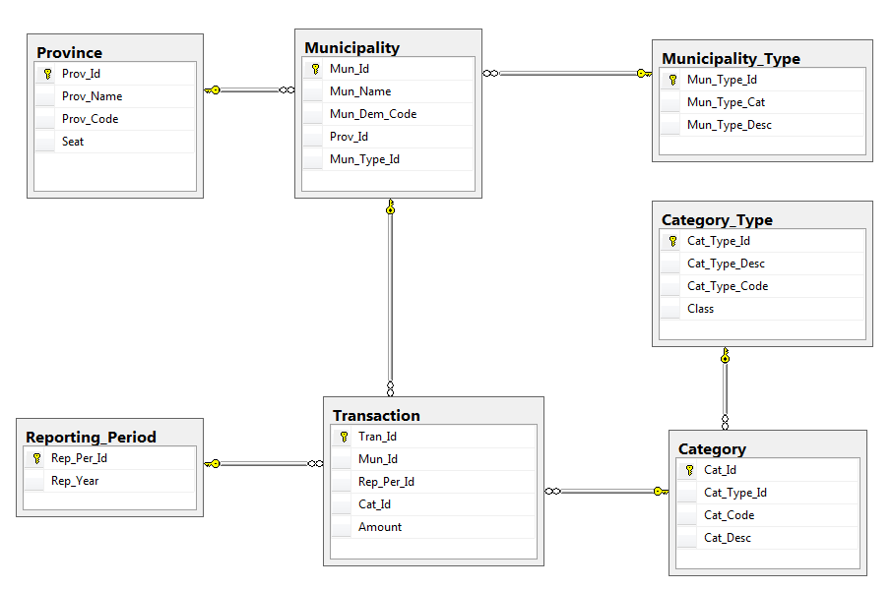
Entity Relationship Diagram

Slide 14
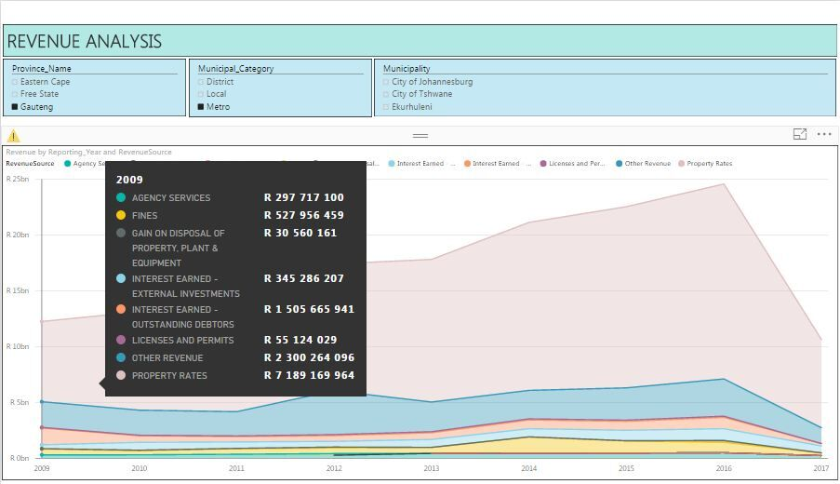


Visualisation

Slide 15


Slide 16
Challenges
Data import
Deciding on scope
Choosing technologies
Time management ( Schedule, procrastination)
Keeping the Trello board up to date
Unavailability of group members
Bugs in tools used

Slide 17
Lessons Learnt
Pair programming helps
Reliance in one Technology (PowerBI)
Being Agile not easy with a group of 4
We used SQL server and realized it was not practical and planning to move it to the cloud

Slide 18
References
https://powerbi.microsoft.com/en-us/desktop/
https://azure.microsoft.com/en-us/services/sql-database/
https://zoom.us/
https://docs.microsoft.com/en-us/power-bi/desktop-quickstart-learn-dax-basics

Slide 19


