Slide 1
Ph.D. Proposal Plan
Dec. 15th
Audio-Based Haptic Effects Synthesis for 4D Films
Jongman Seo
Advisor: Seungmoon Choi
Haptics and Virtual Reality Lab.
Pohang University of Science and Technology (POSTECH)

Slide 2
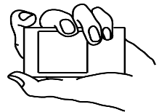
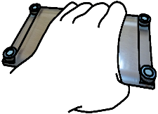
Research History
2009~2013
Vibrotactile Flows on a Mobile Device
2014~2016
Audio-Based Haptic Effects Synthesis for 4D Films

Slide 3
Research Overview
4D Film: visual + auditory + haptic
- Motion Chair, Vibration, Wind, ...
- The main focus of this research is vibration.
4D Fiims and
Haptic Effects
Auditory-to-vibrotactile conversion assuring perceptual consistency between modalities
Surround sound (multi-channel audio)
Audio Analysis

Slide 4
Goal of This Research
Long-Term Goal
- Automatically generating tactile effects for the given movie scene by analyzing its audio signal
Short-Term Goals
Event capturing (likely to be rendered in haptic)
Providing tactile effects having similar perceptual feeling of audio signal by studying auditory-to-tactile conversion
Providing spatiotemporal tactile effects to emphasize spatial variations of events by analyzing multi-channel audio signal

Slide 5
Black: Finished
Purple: Planned
Research Progress
1. Event Detection
1-1. Detection algorithm using psychoacoustic metrics
1-2. Quantitative Evaluation
2-1. Compensation method for auditory-to-vibrotactile conversion transparent to perception
2-2. Qualitative Evaluation
2. Auditory-to-tactile conversion
3-1. Source localization and spatiotemporal haptic rendering method
3-2. Qualitative Evaluation
3. Multi-channel audio

Slide 6
Event Detection

Slide 7
[gunshot, explosion], [collision], [exterior/interior vibration]
voice, background music
Events in Movie
Voice Removal
Done at audio recording level by removing the ‘Center’ channel, which contains voice
( = Sound quality metrics)
Depend on Perceptual nature of the sound
Psychoacoustic
Metrics
{Loudness, roughness, sharpness, booming}
Using psychoacoustic metrics is easy to detect events
i.e.) High value of sharpness when gunshot occurs

Slide 8
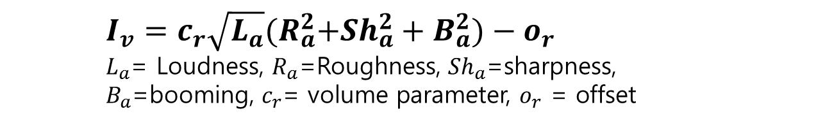
Intensity Model
$I_{v}=c_{r}\sqrt{L_{a}}{(R}_{a}^{2}+{Sh}_{a}^{2}+B_{a}^{2}{)−o}_{r}$
$L_{a}$= Loudness, $R_{a}$=Roughness, ${Sh}_{a}$=sharpness,
$B_{a}$=booming, $c_{r}$= volume parameter, $o_{r}$ = offset
Evaluation
of Event Detection
 | Lee’s model (2013) |  | This model
Test set | Movie | Movie + voice | Movie + voice
Hit Rate | 90.5% | 90% | 85.6%
False Alarm | 20.5% | 40% | 27.5%

Slide 9
Auditory-to-Tactile Conversion

Slide 10
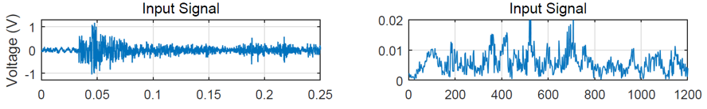
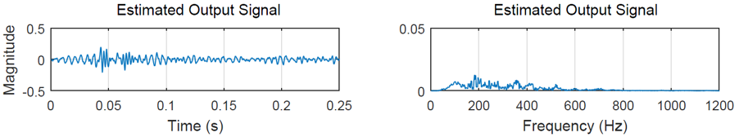
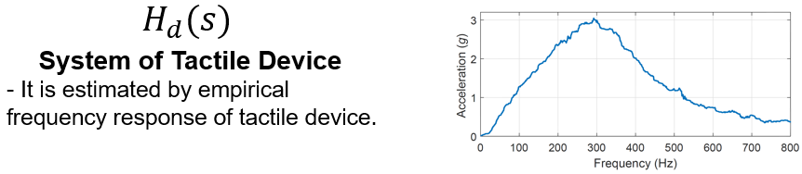
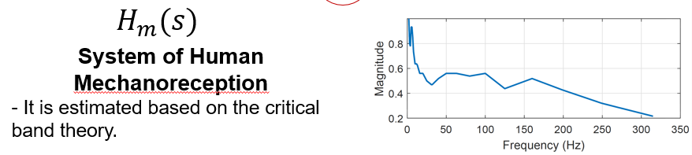
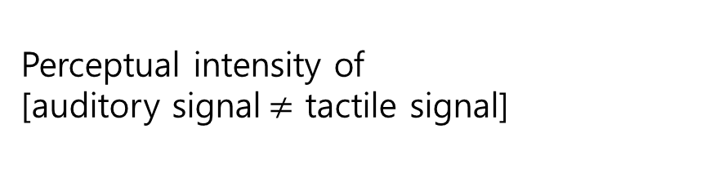
Perceptual intensity of
[auditory signal$≠$ tactile signal]
Ploblems
Conversion Process
Relatively weak

Slide 11
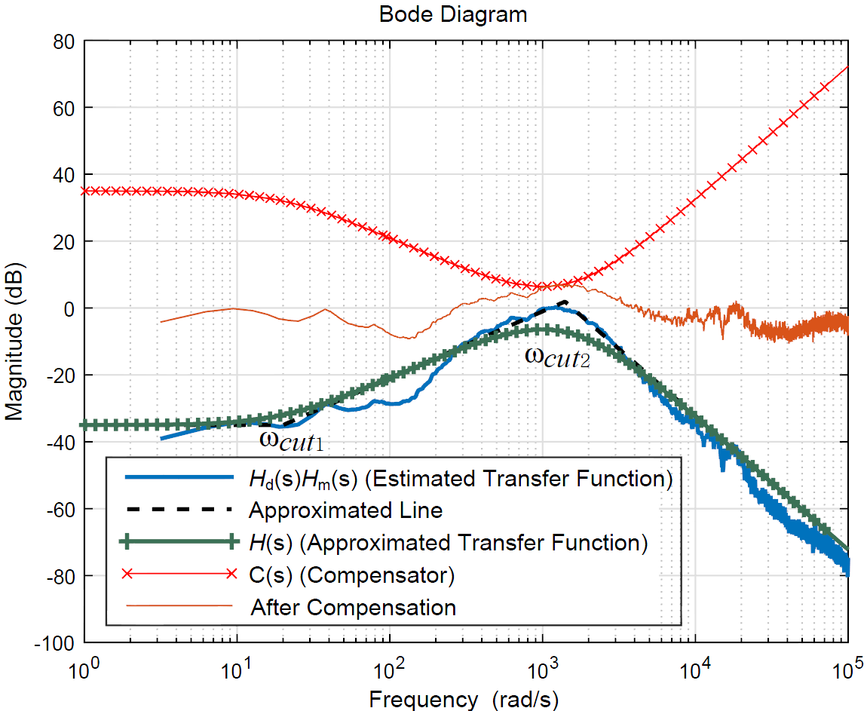
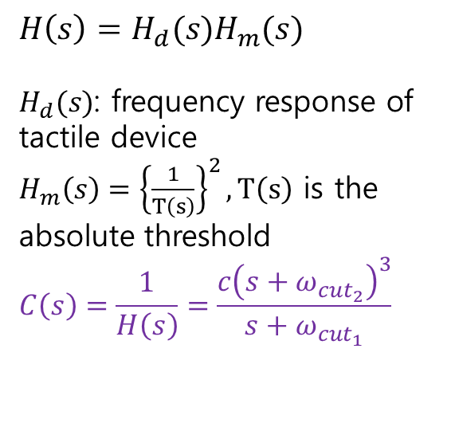
Feed-forward compensator to compensate for the effects of both tactile device and mechanoreceptor systems
Solves
$$H\left(s\right)=H_{d}(s)H_{m}(s)$$
$H_{d}(s)$: frequency response of tactile device
$H_{m}\left(s\right)={\left\{\frac{1}{T\left(s\right)}\right\}}^{2},T\left(s\right)$ is the absolute threshold
$$C\left(s\right)=\frac{1}{H\left(s\right)}=\frac{c{\left(s+ω_{{cut}_{2}}\right)}^{3}}{s+ω_{{cut}_{1}}}$$
Notes:
AL 실험으로 구한 내용 생략

Slide 12
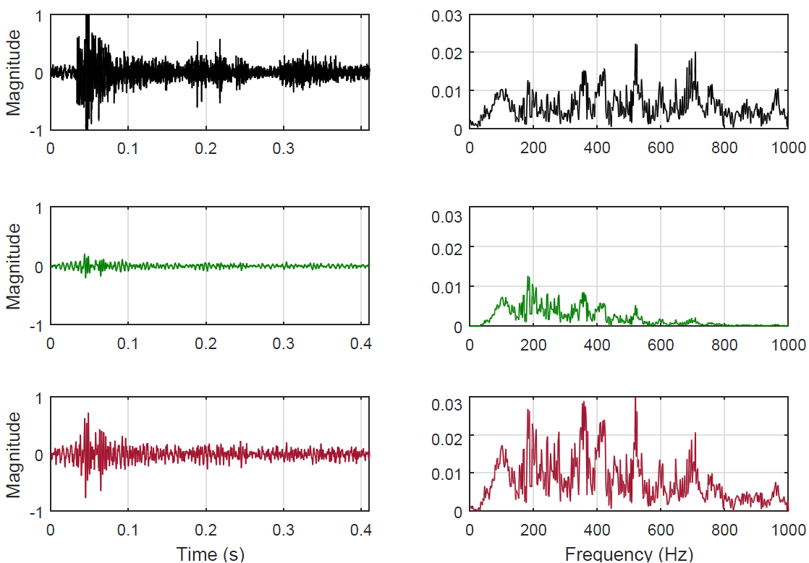
Results
Original audio signal
Perceived intensity
after conversion
without compensation
Perceived intensity
after conversion
with compensation

Slide 13
Multi-Channel Audio Analysis for Tactile Rendering

Slide 14
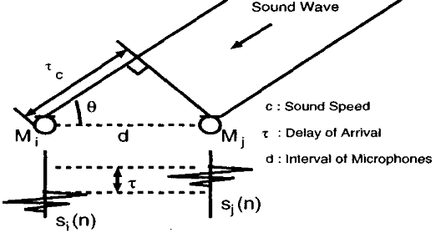
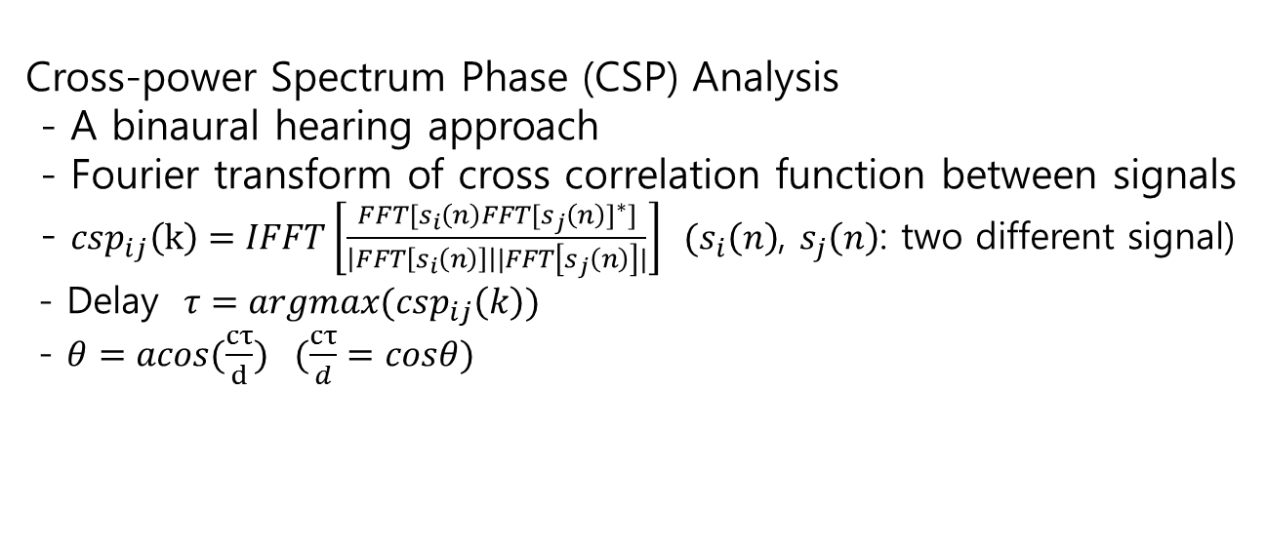
3D Source Localization
(Estimation of the source position)
Cross-power Spectrum Phase (CSP) Analysis
- A binaural hearing approach
- Fourier transform of cross correlation function between signals
- ${csp}_{ij}\left(k\right)=IFFT\left[\frac{FFT[s_{i}\left(n\right){FFT[s_{j}\left(n\right)]}^{∗}]}{\left|FFT\left[s_{i}\left(n\right)\right]\right||FFT\left[s_{j}\left(n\right)\right]|}\right] (s_{i}\left(n\right)$, $s_{j}\left(n\right)$: two different signal)
- Delay $τ=argmax({csp}_{ij}\left(k\right))$
- $θ=acos(\frac{cτ}{d})$ $(\frac{cτ}{d}=cosθ)$

Slide 15
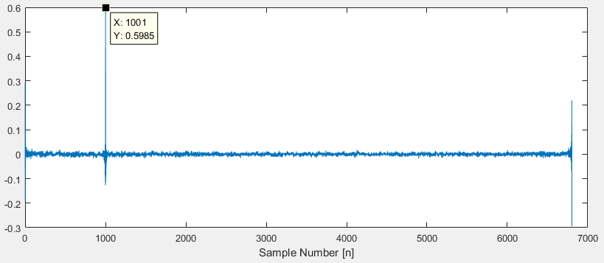
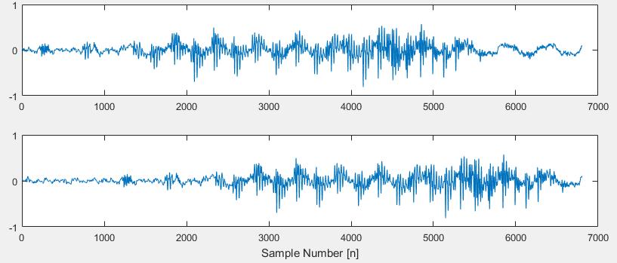
Input signal: x(n), x(n+1000)
Output of CSP has the maximum value at n=1000
Results of
Delay Estimation
Input
CSP

Slide 16
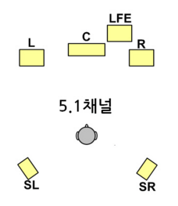
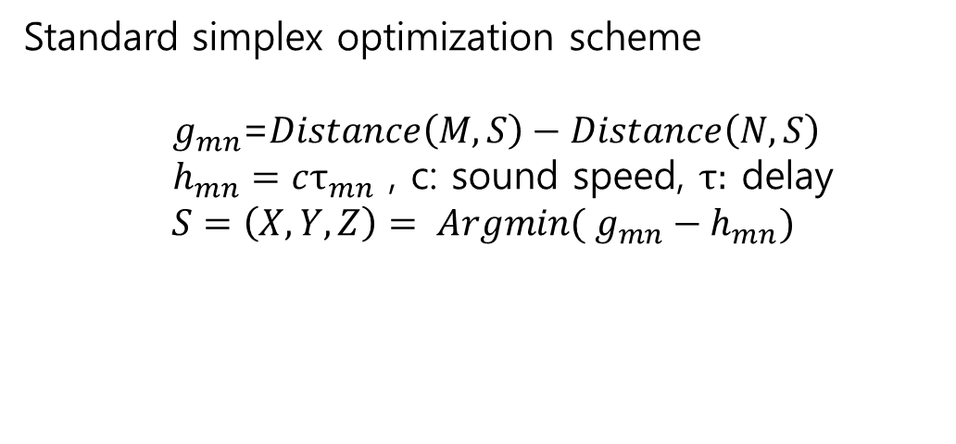
Using 4 channels of 5.1 channel
Front Left/Right
Side (Back) Left/Right
Center, LFE
Source Localization of 5.1 channel
Standard simplex optimization scheme
$g_{mn}$=$Distance\left(M,S\right)−Distance\left(N,S\right)$
$h_{mn}=cτ_{mn}$ , c: sound speed, $τ:$ delay
$$S=\left(X,Y,Z\right)= Argmin( g_{mn}−h_{mn})$$

Slide 17
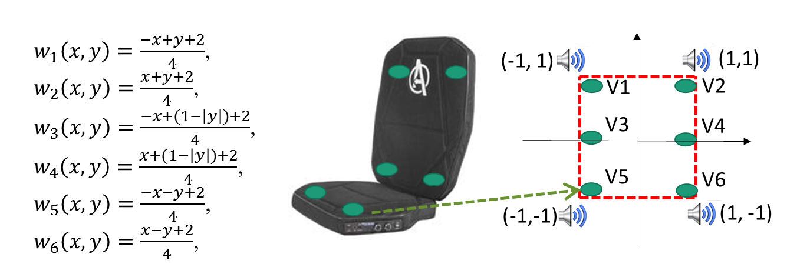
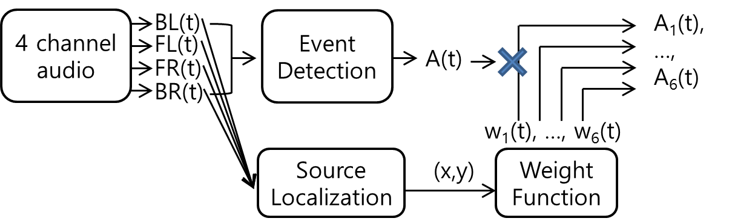
Using pad-type tactile device
Weight function multiplication for emphasizing spatial variation
Spatiotemporal Haptic Rendering
w₁(t), …, w₆(t)

Slide 18
Plan
1. Event Detection
2-1. Compensation method
2. Auditory-to-tactile conversion
2-2. Qualitative evaluation
3-1. Haptic rendering by analyzing 5.1 channel
3-1-1. Source localization
3-1-2. Hardware
3-1-3. Rendering algorithm
Improvement
3. Multi-channel audio
Improvement
3-1-4. Qualitative evaluation
3-2. Haptic rendering by analyzing VR sound (360˚)

