Slide 1
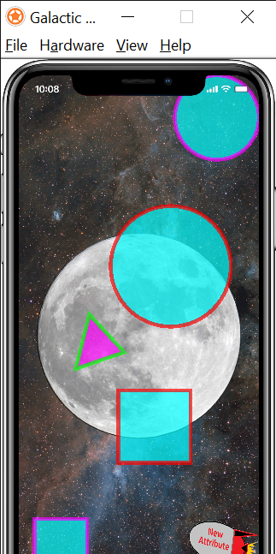
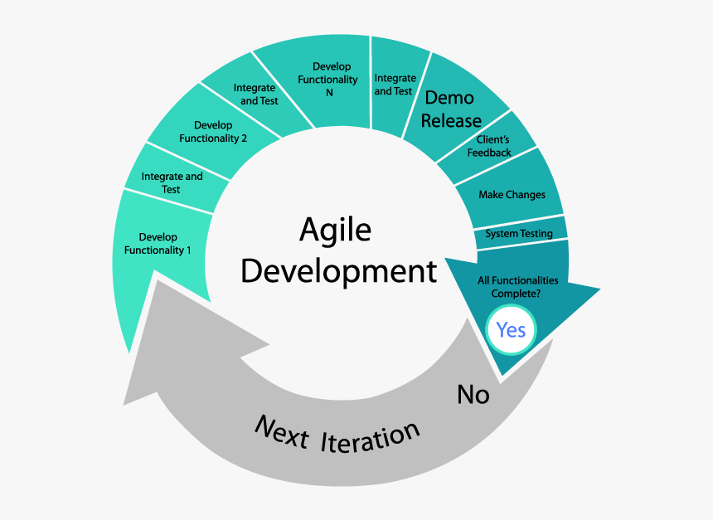
Galactic Attributes & Tangrams
Colton Martin, Matthew Martinez, Kyle Robinson, Kevin Villatoro
Sam Houston State University
Abstract
Methodology
Results
Galactic Attributes and Tangrams are Interactive Learning Modules designed to simplify an idea and help a young learner understand concepts that are related to mathematics, geometry or other scientific discipline. Galactic Attributes deals with different objects that can be categorized by certain attributes. These objects and placed in a certain area and react depending on the attributes of the object. An attribute to sort the objects based on is displayed on the screen. When the objects are moved onto the center of the screen (a moon, or planet), the object turns green or red depending on if it has the desired attribute or not.
To develop our application and
Add your information, graphs and images to this section.
Add your information, graphs and images to this section.
Introduction
Conclusion
Some aspects of science and mathematics can be difficult to understand for young students. A lot of the concepts can be simplified with visualizations that make understanding them easier. The National Library of Virtual Manipulatives was created in 1999 to provide a collection of interactive games to help young students with these concepts. The latest revisions of these games was in 2007. Gaming and Graphical User Interface software has made some major advancements since then. Although the ideas behind these games are great, the functionality and appearance of them are outdated and fail to keep the attention of young learners. The interactive functionality of the these games can be difficult to understand, and the directions can also be somewhat hazy. Galactic Attributes and Tangrams are recreations of two of the games in the
Add your information, graphs and images to this section.

