Slide 1
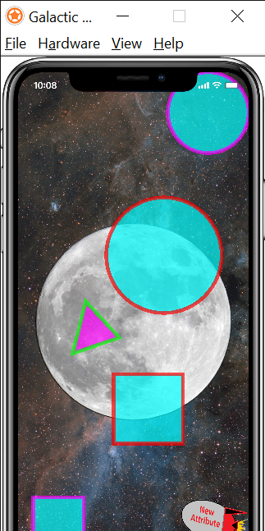
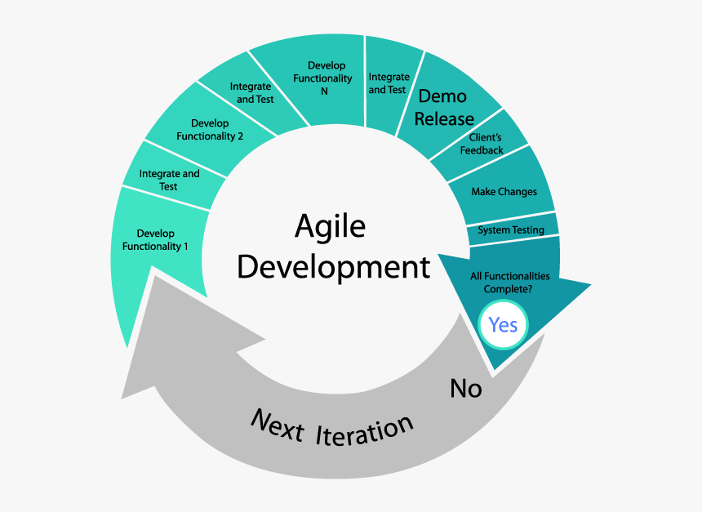
Galactic Attributes & Tangrams
Colton Martin, Matthew Martinez, Kyle Robinson, Kevin Villatoro
Sam Houston State University
Abstract
Methodology
Results
Galactic Attributes and Tangrams are Interactive Learning Modules designed to simplify an idea and help a young learner understand concepts that are related to mathematics, geometry or other scientific discipline. Galactic Attributes deals with different objects that can be categorized by certain attributes. These objects and placed in a certain area and react depending on the attributes of the object. An attribute to sort the objects based on is displayed on the screen. When the objects are moved onto the center of the screen (a moon, or planet), the object turns green or red depending on if it has the desired attribute or not.
Dr. Emma Bullock led us in the recreation of the new games. She provided expertise on methods essential for interactive learning techniques for young students. When creating the new games, we had to address some fundamental problems with the gameplay of the originals from the NLVM. Some specific critiques to Attribute Blocks (the former version of Galactic Attributes) being that the directions were vague and the game failed to accomplish the mission of learning different attributes. When the game started, it displayed a collection of shapes and the user had to guess what the attribute was, then move all of the shapes with that attribute to a circle in the middle of the screen. Having the user guess the attribute makes it a lot harder to learn the significance of the attribute to compare. The game failed to give guidance.
One of the main focuses of recreating games from the National Library of Virtual Manipulatives was to utilize touch screen functionality. The main goal of our project is to make the games very user friendly and fun to play with. Most importantly, we wanted to transition the learning module into a touch screen game. To develop the game we envisioned, we used a scripting language called Lua that is built on Standard C. Lua has to been utilized in in many popular tablet and smart phone games - most notably Angry Birds. We decided Lua would provide the touch screen functionality and visualization that we desired to improve.
Add your information, graphs and images to this section.
Introduction
Conclusion
Some aspects of science and mathematics can be difficult to understand for young students. A lot of the concepts can be simplified with visualizations that make understanding them easier. The National Library of Virtual Manipulatives (NLVM) was created in 1999 to provide a collection of interactive games to help young students with these concepts. The latest revisions of these games were in 2007. Gaming and Graphical User Interface software have made some major advancements since then. Although the ideas behind these games are great, the functionality and appearance of them are outdated and fail to keep the attention of young learners. The interactive functionality of the these games can be difficult to understand, and the directions can also be somewhat hazy. Galactic Attributes and Tangrams are recreations of two of the games in the National Library of Virtual Manipulatives that aim to meet the latest standards of today’s interactive games.
Add your information, graphs and images to this section.

