Slide 1
Predicting NCAA Football Games
Chi Jin & Connor Masini

Slide 2
Problem Overview
Predict the scores of NCAA football games using a neural network with parameters evolved by a genetic algorithm
Particularly difficult due to the high rate of player turnover each year
Want to optimize 3 different statistics:
Straight Up: Which team wins the game
Spread: Point differential between the two teams
Over/Under: Total number of points scored by the two teams

Slide 3
Dataset
Data was taken from Seldom Used Reserve
Included all games from the 2011-2018 seasons
Used all basic box score average statistics from teams over a 2-year period
Ex. Rushing yards, number of turnovers, yards allowed, etc.
Also generated some statistics that have been found to be indicative of team success
RPI, Strength of Schedule, Glicko, etc.

Slide 4
Multilayer Perceptron Model
output result
input layer
layer 1
layer 2
layer n
Notes:
Here’s the architecture of the multilayer perceptron model implemented using keras
input layer is a matrix of the dimensionality as the number of samples around 12000 games times about 66 features as the game statistics
all hidden layers are set identical with the same number of neurons and activations
the output is a length 2 vector representing the prediction of the game score

Slide 5
Hyper Parameters to Evolve
# of neurons per layer ∊ {16,32,64,128}
# of layers ∊ {1,2,3,4}
activation function ∊ {relu, elu, tanh, sigmoid}
optimizer ∊ {rmsprop, adam, sgd, adagrad,adadelta, adamax, nadam}
Notes:
The tunable hyper parameter are …

Slide 6
Fitness Function
Notes:
The fitness score of a good predict should be as closer to 1 as possible, but in the real cases fitness scores are all smaller than 1.

Slide 7
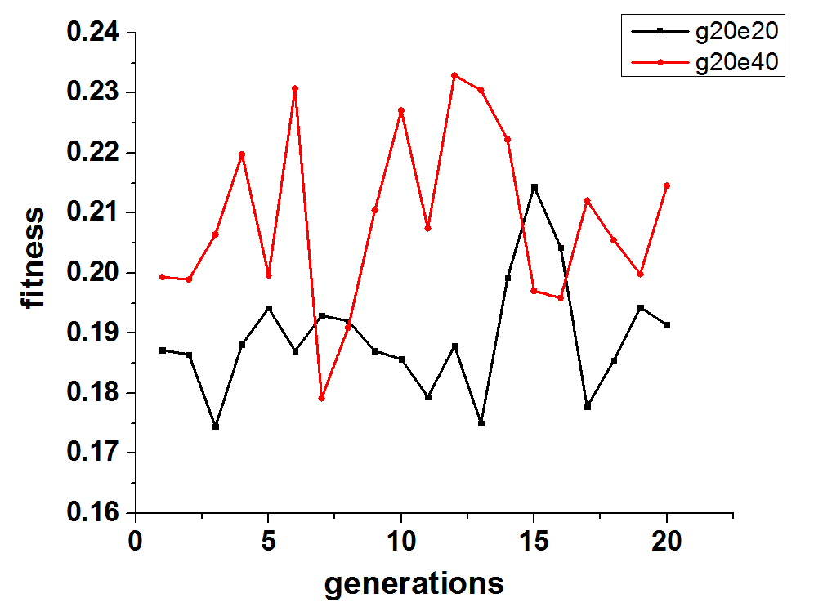
Resulting Accuracies

Slide 8
Conference Championships Case Study
Team 1 | Team 2 | Predicted Score | Actual Score | Predicted Over/Under | Actual Over/Under
Michigan | Northwestern
Alabama | Georgia
Washinton | Utah
Texas | Oklahoma
Clemson | Pitt
IF we have time, we should see what the model predicts for these games which are happening this weekend

Slide 9
Outlook
differentiate layers in the same network
vary dropout values for the models
test different crossover/mutation rates
try on convolutional networks, vary # of filters and filter sizes
predict exact score of the games
Notes:
Out future is plan is to assign different numbers of neurons on different layers of one network
vary number of neurons and the activation functions on different layer

