Slide 1
What is the effect of longer selection on the GSP1 fitness landscape?
Mavor
20180503
Lab Meeting

Slide 2
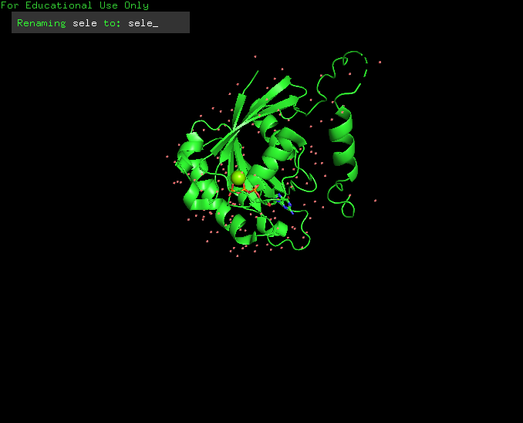
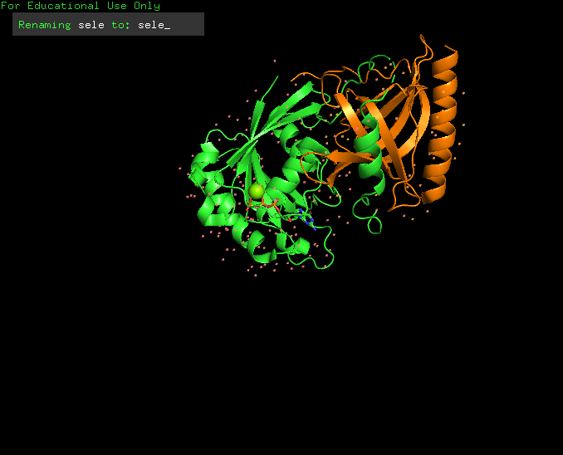
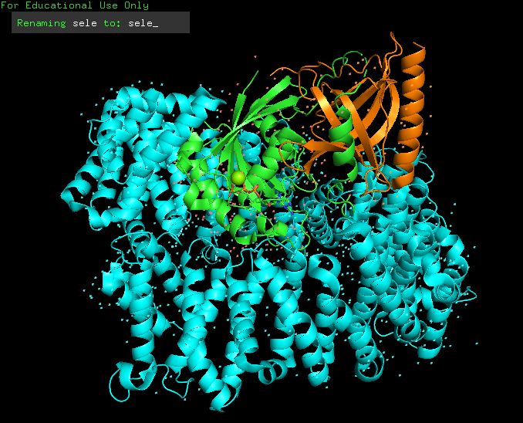
What is Ran/GSP1?
CAS
Karyopherins
Nuclear import cycle
Mitosis
GTP
Ran
GDP
Active
GEF
GAP
Inactive
GDP
P
GTP
Ran
Nucleus
Cytoplasm
NTF2
Stewart, 2007; Clarke and Zhang, 2008
PDB: 3M1I
Notes:
CAS = nuclear export factor
NRF2 = nuclear import factor
Karyopherins = proteins involved in nuclear transport: importins and exportins (14 in yeast, 20 in mammals)
GAP = GTPase activating protein
GEF = guanadine exchange factor

Slide 3
What is Ran/GSP1?
Karyopherins
Nuclear import cycle
CAS
GDP
Mitosis
GTP
Ran
GEF
GTP
Active
GDP
GAP
Ran
Nucleus
P
Cytoplasm
NTF2
Inactive
Stewart, 2007; Clarke and Zhang, 2008
PDB: 3M1I
Notes:
CAS = nuclear export factor
NRF2 = nuclear import factor
Karyopherins = proteins involved in nuclear transport: importins and exportins (14 in yeast, 20 in mammals)
GAP = GTPase activating protein
GEF = guanadine exchange factor

Slide 4
Experimental Design
GSP1
GSP1
GSP1
GSP1
Ura
GSP1
GSP1
Ura
Ura
His
GSP1
His
GSP1
His
His
Ura
GSP1
GSP1
SD –His –Ura
SD –His
His
His

Slide 5
Experimental Design
FACS
(Florescence-Activated Cell Sorting)
SD –His –Ura
SD –His
16 hours
Data Analysis
Deep Sequencing

Slide 6

Data Analysis
$$\log_{2}{(\frac{mutant reads}{WT reads})}$$
Slope = “Fitness score”
0
16
Time (hour or generation)
Hietpas et al., 2011; Rubin et al., 2017

Slide 7
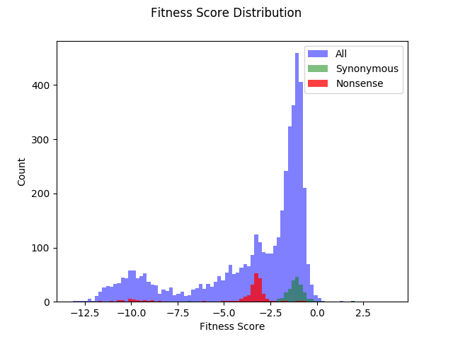

Slide 8
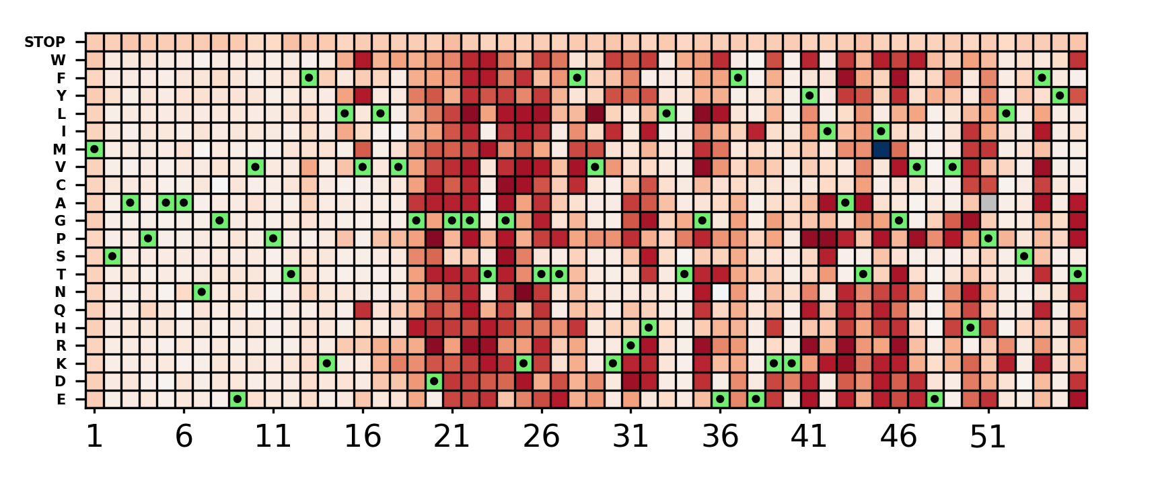
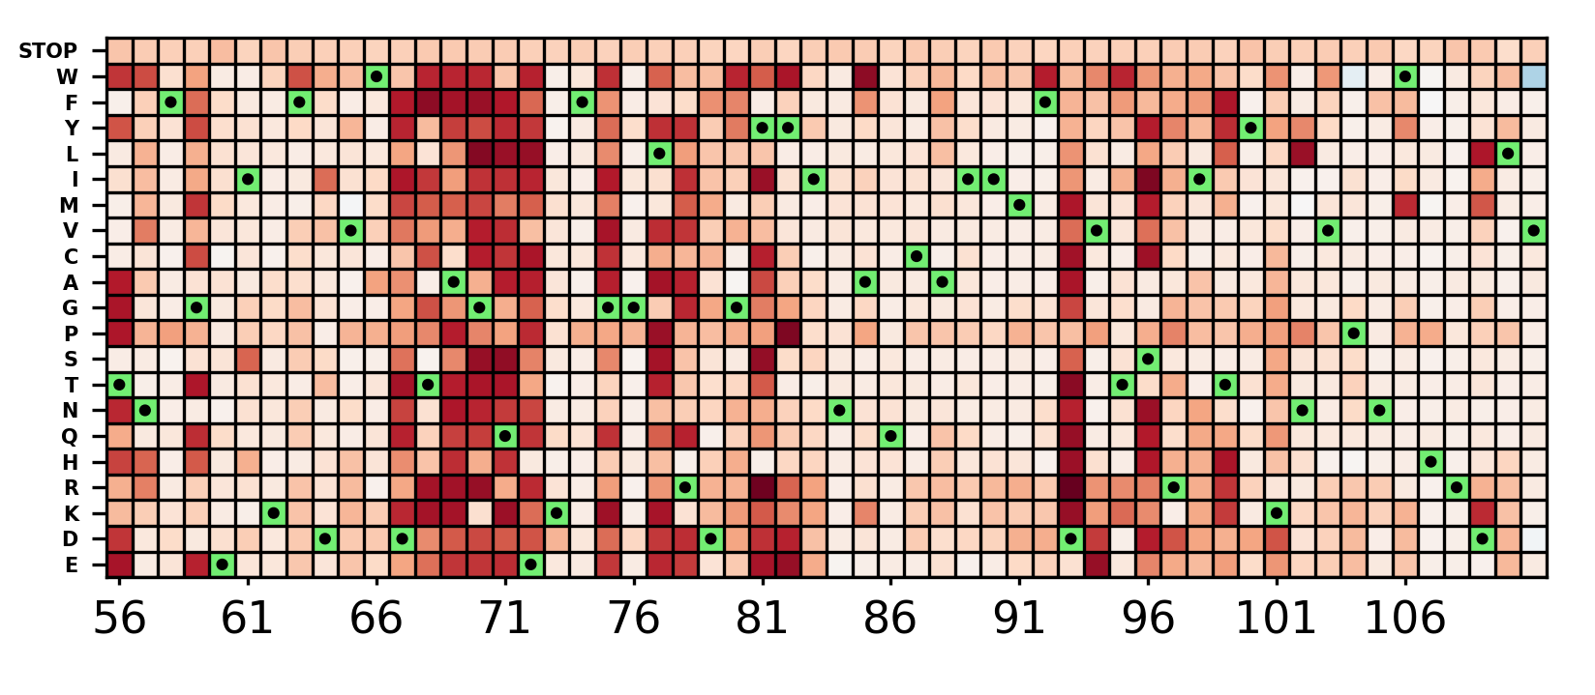
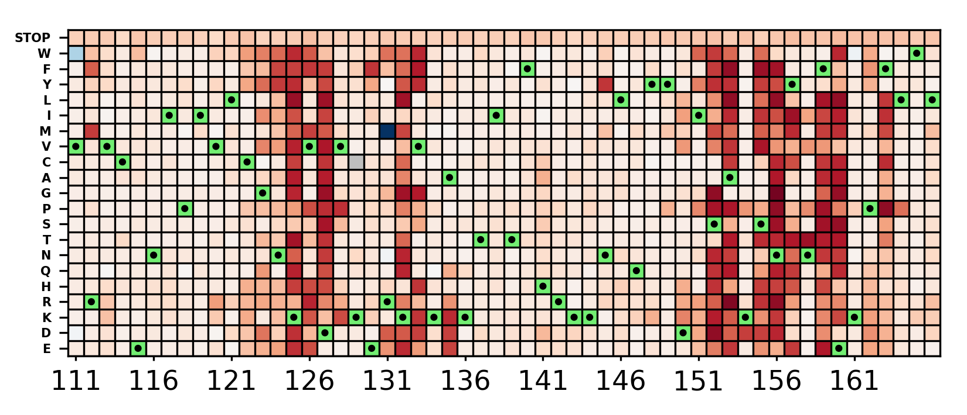
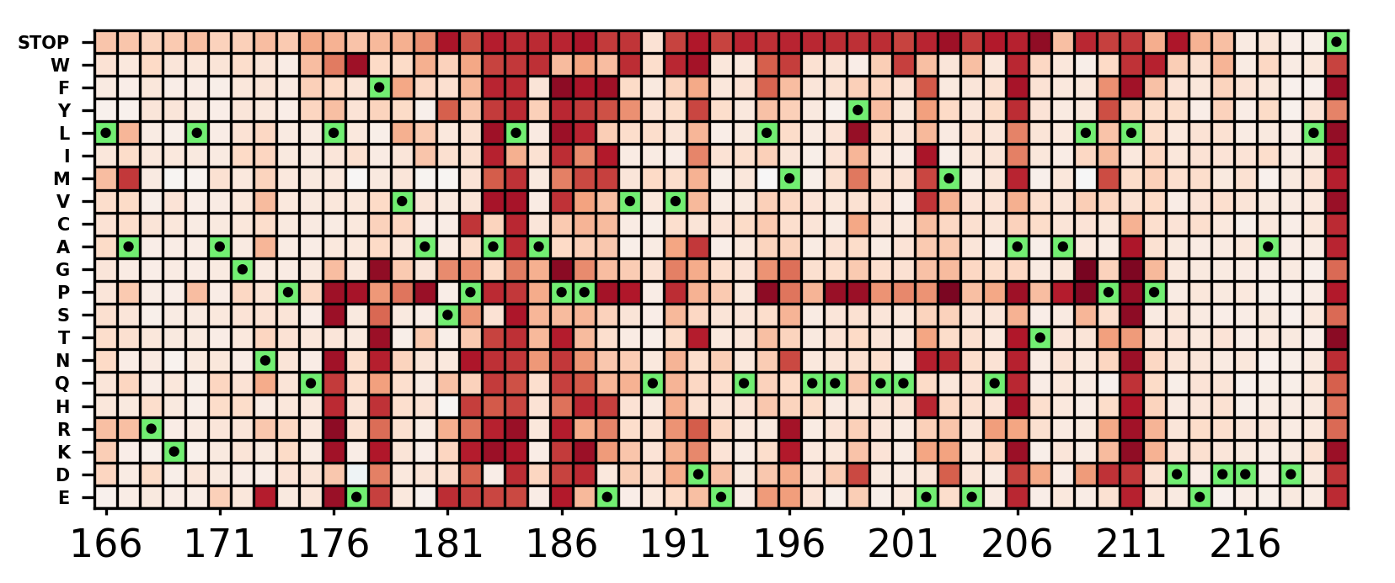
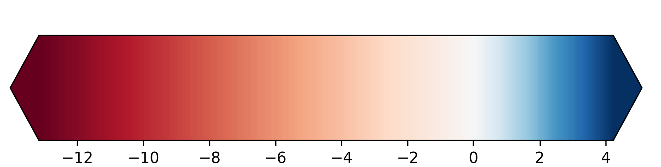
GSP1 – Parul’s Data
Fitness Score

Slide 10

Experimental Design
50 hrs = 20 generations
45 hrs = 18 generations
FACS (Florescence-Activated Cell Sorting)
37.5 hrs = 15 generations
25 hrs = 10 generations
20 hrs = 8 generations
(16 hrs = 6.4 generations)
SD –His –Ura to SD –His
12.5 hrs = 5 generations
7.5 hrs = 3 generations
5.0 hrs = 2 generations
2.5 hrs = 1 generations

Slide 11
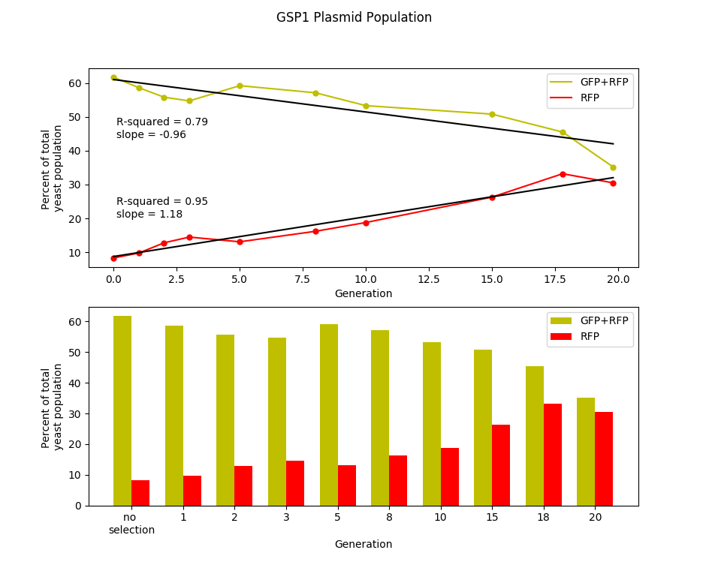

Slide 12

Can we change our indexing strategy and save a few $?

Slide 13
GSP1 PCR product for Sequencing
PE1
N18
ID
Primer2
100 bp read

Slide 14
Custom Indexing Read
GSP1 PCR product for Sequencing
PE1
N18
ID
Primer2
50 bp read

Slide 15
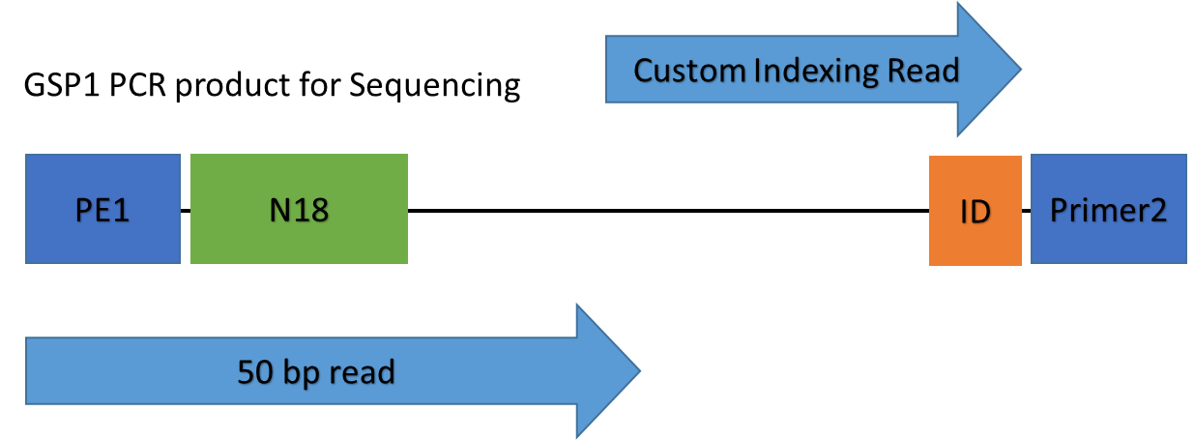
GSP1 PCR product for Sequencing
PE1
N18
ID
Primer2
100 bp read
Is there a difference in quality between the two strategies?

Slide 16
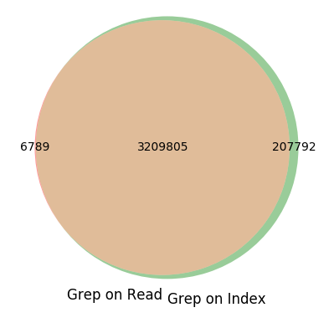
Number of Sequences
Separate sequences either by the sequence in the direct read or by the indexing read

Slide 17
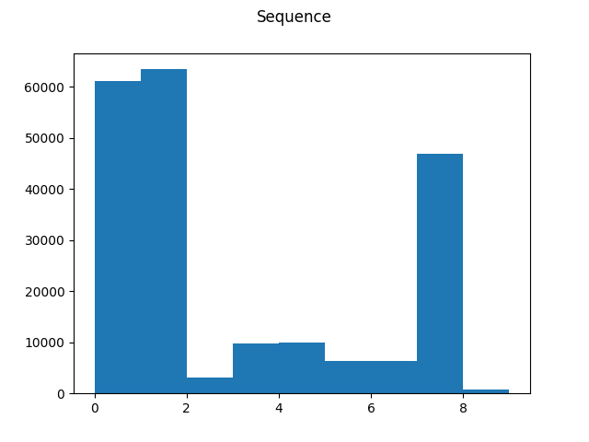
Number of Sequences
Hamming Distance

Slide 18
Number of Sequences
Hamming Distance
778 sequence could have been miss assigned

Slide 19


Slide 22
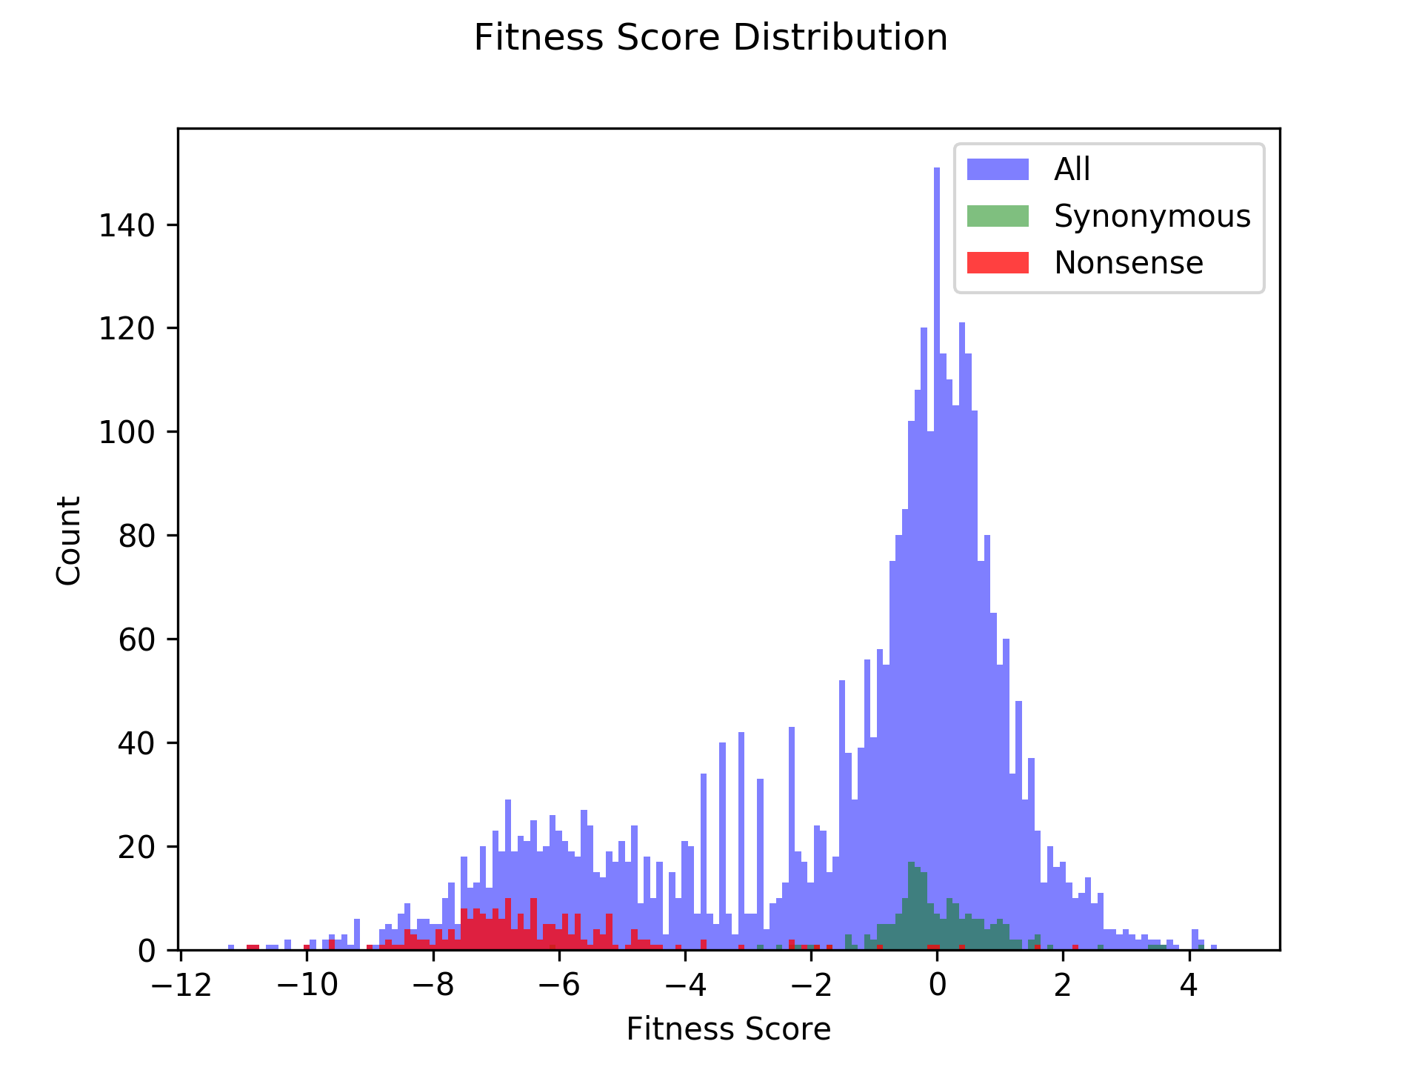
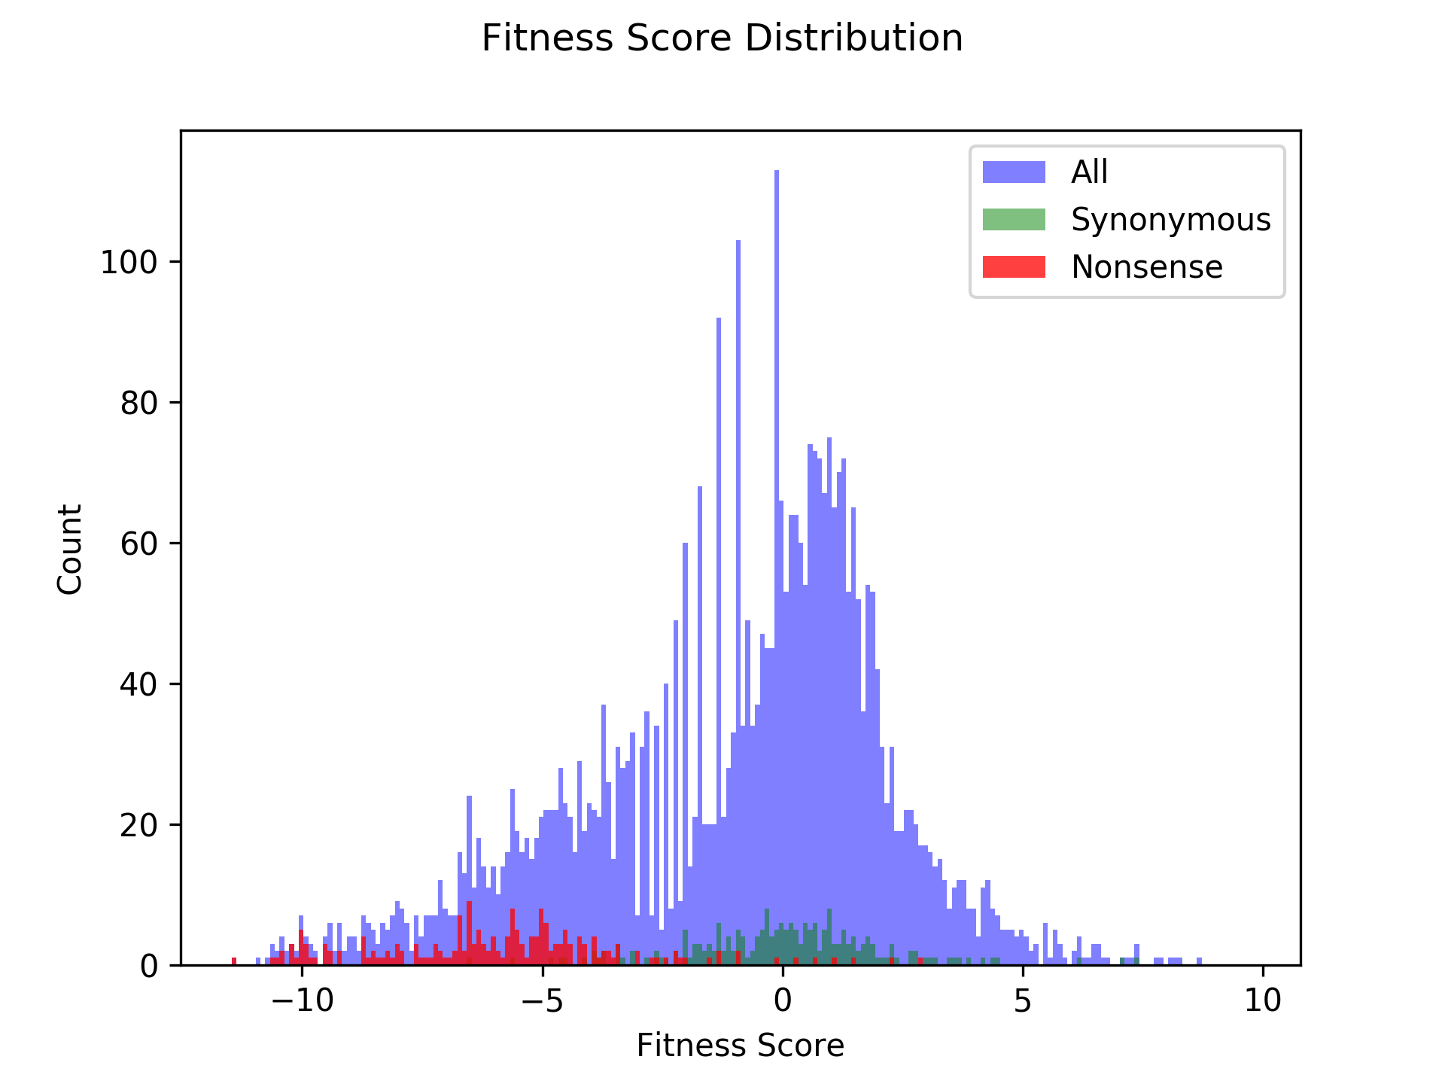
15 Generations
20 Generations

Slide 23
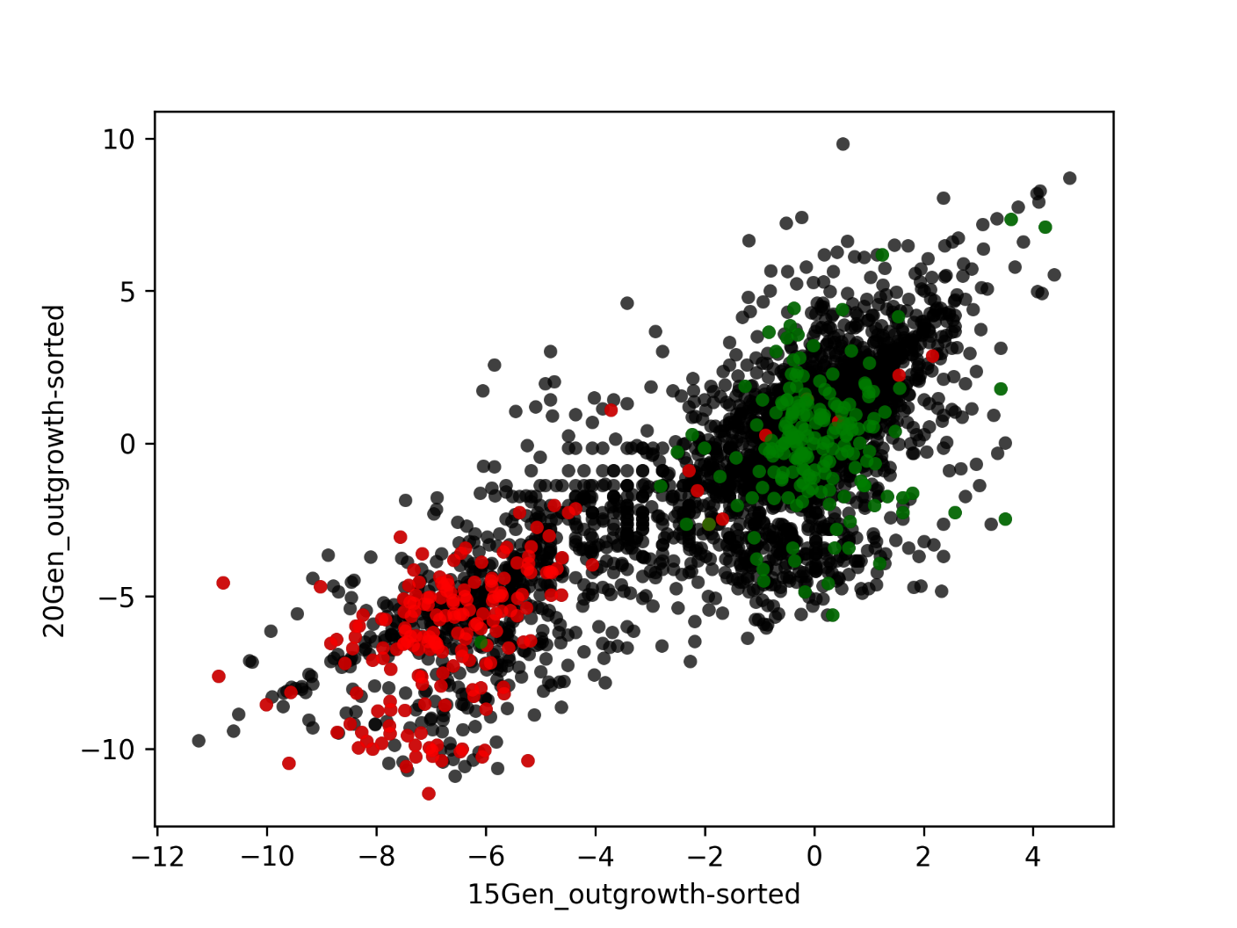

Slide 24
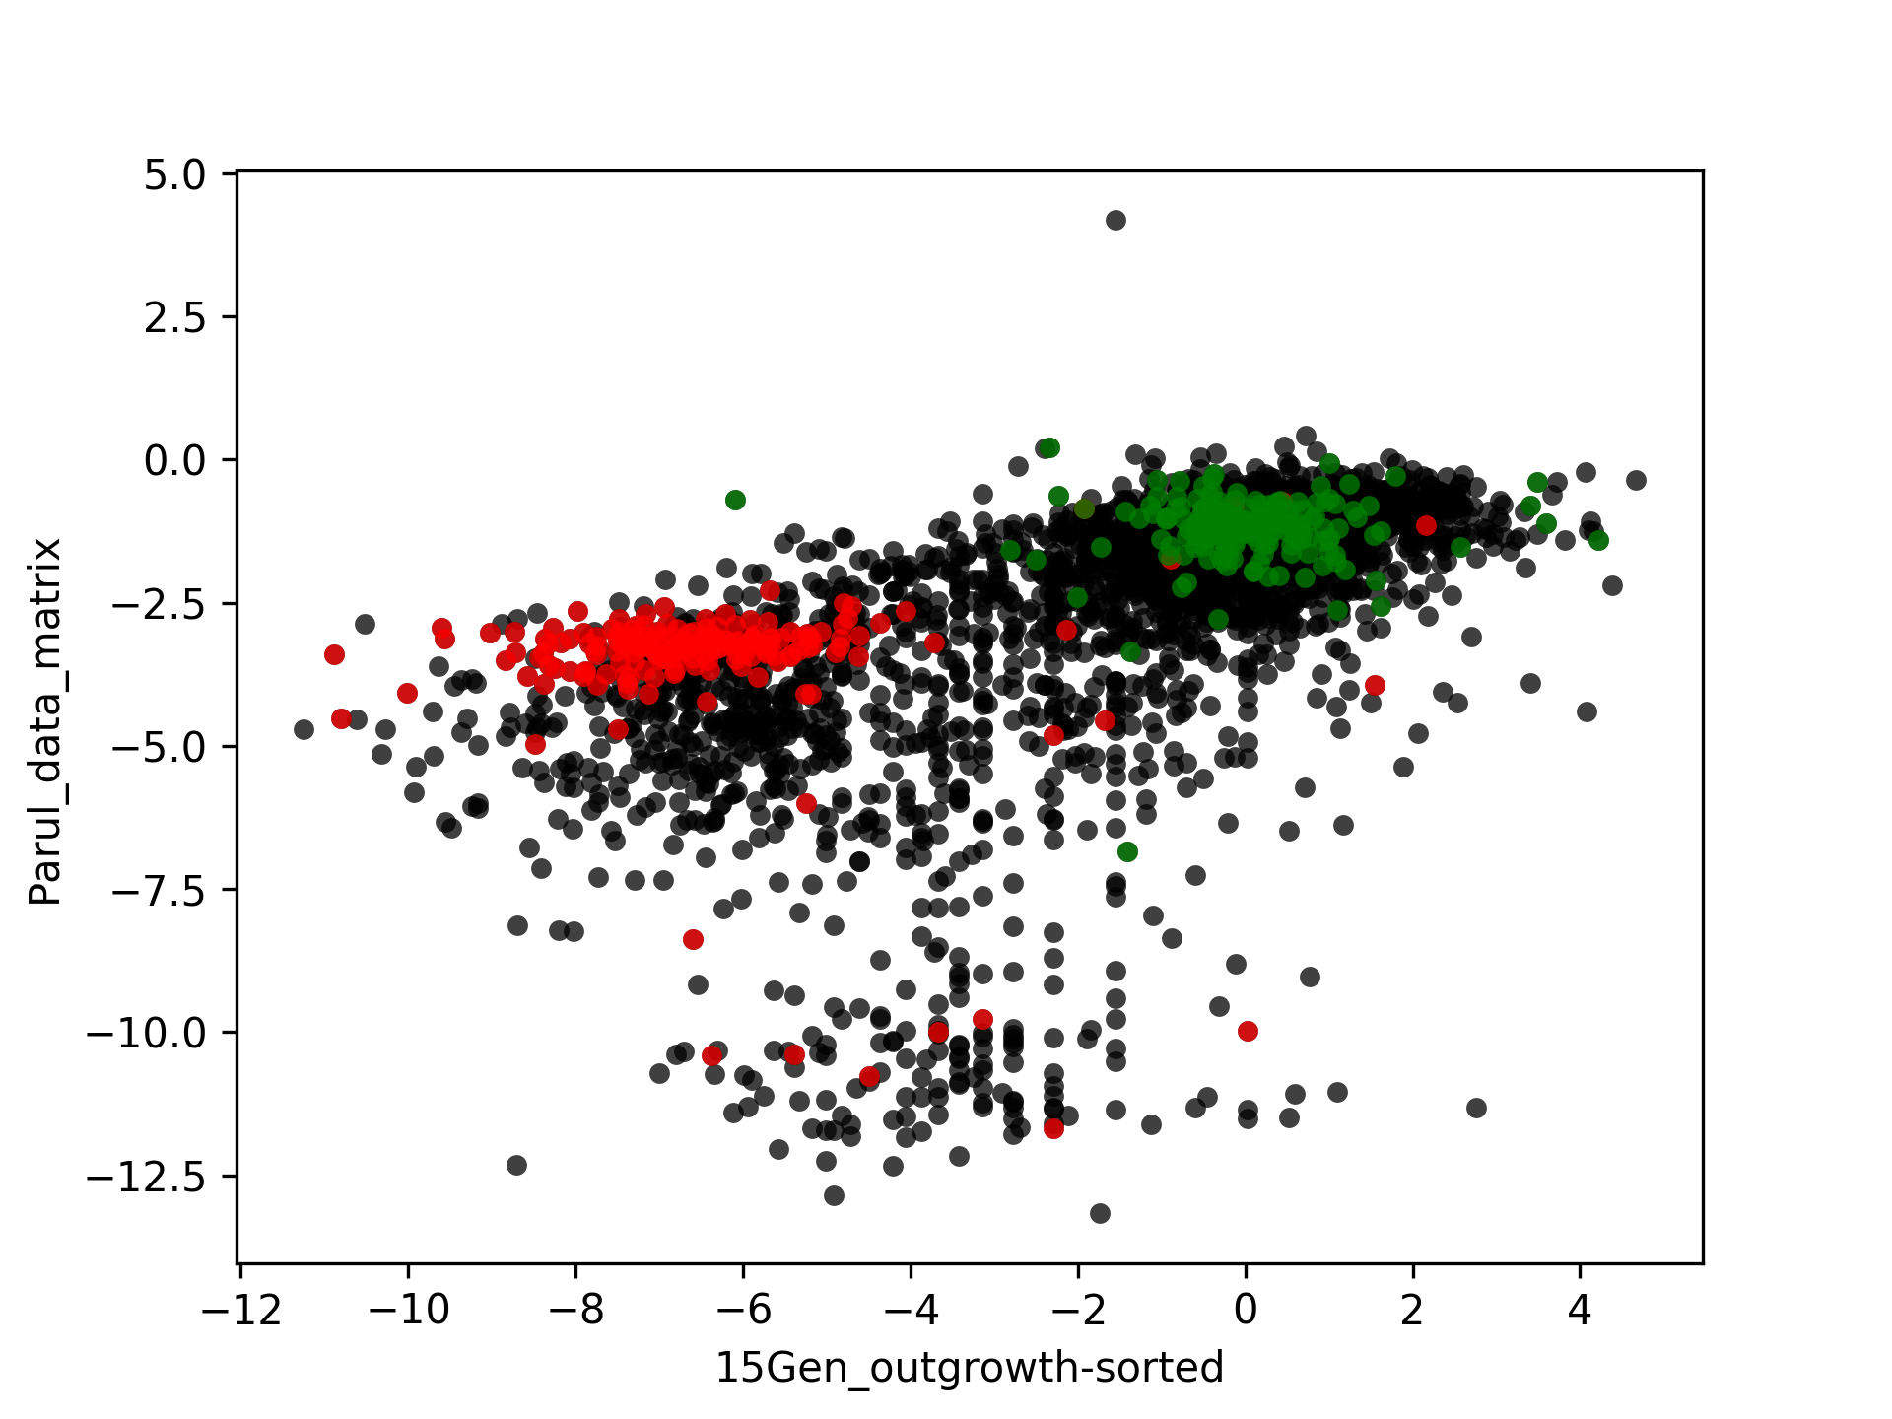

Slide 25
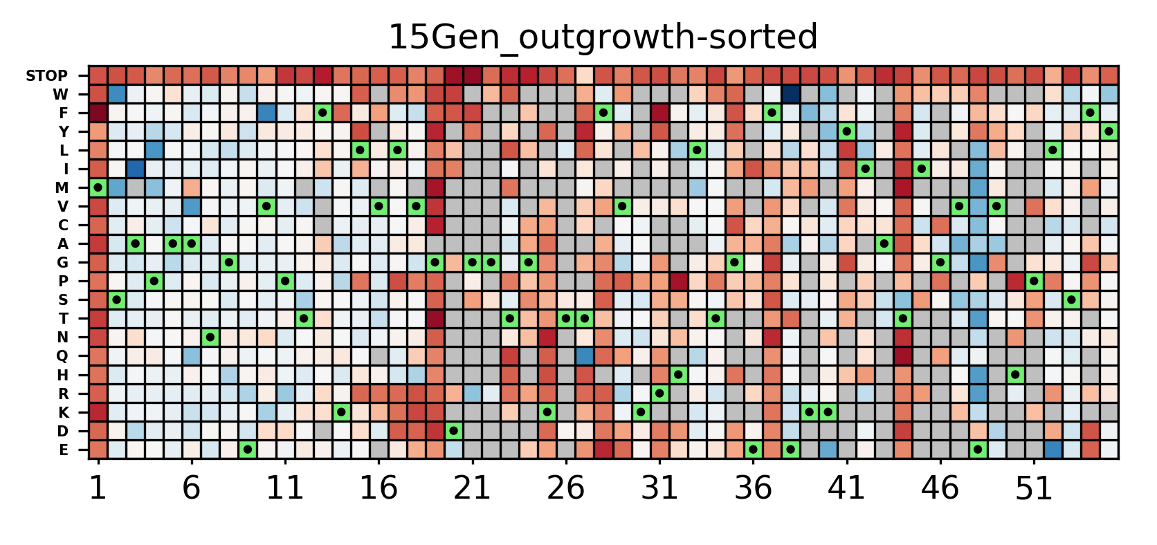
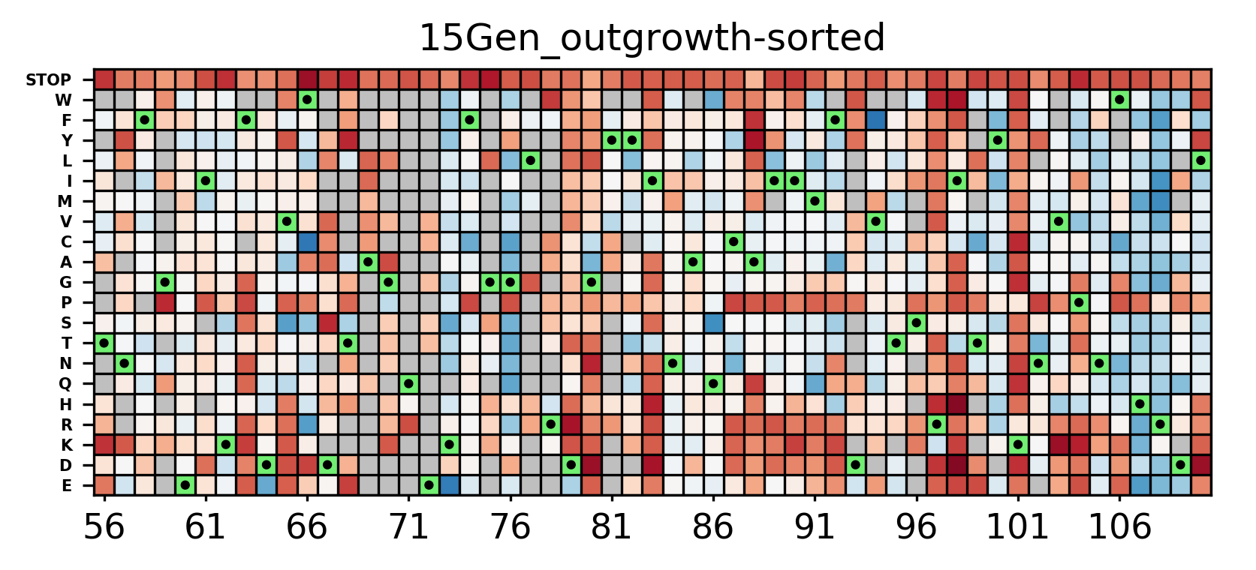

Slide 26
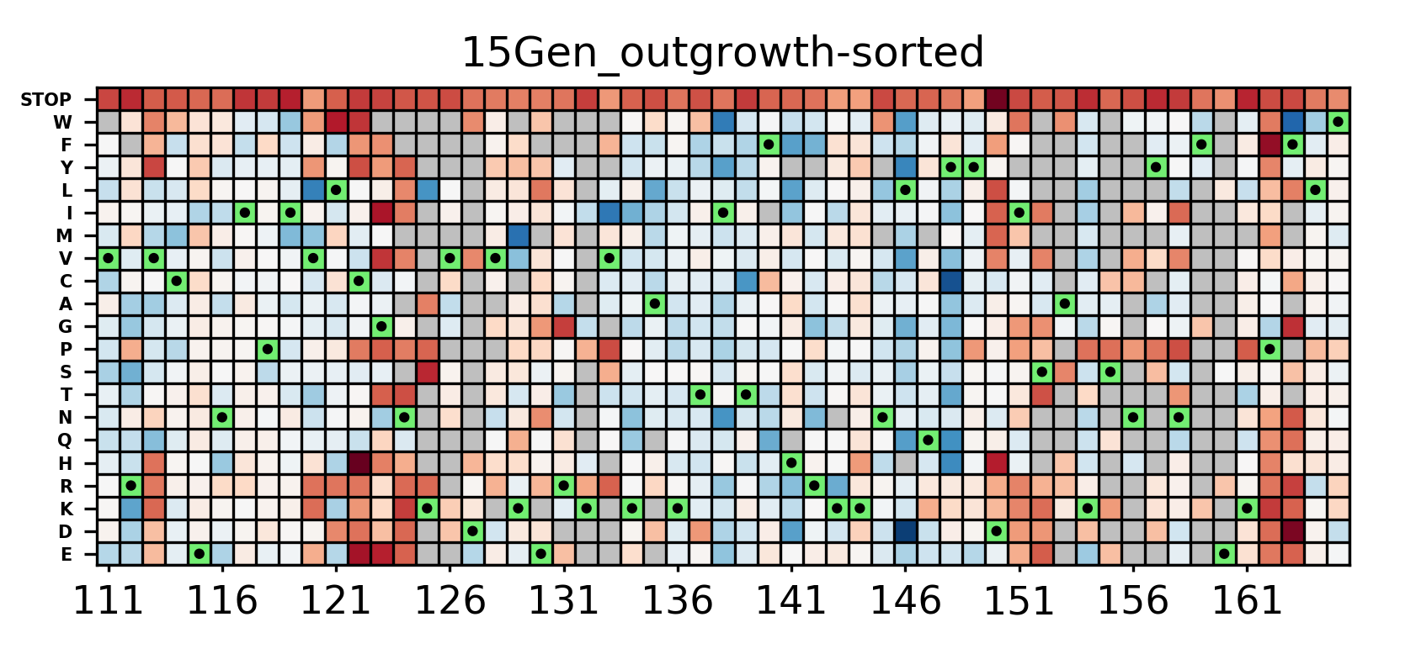
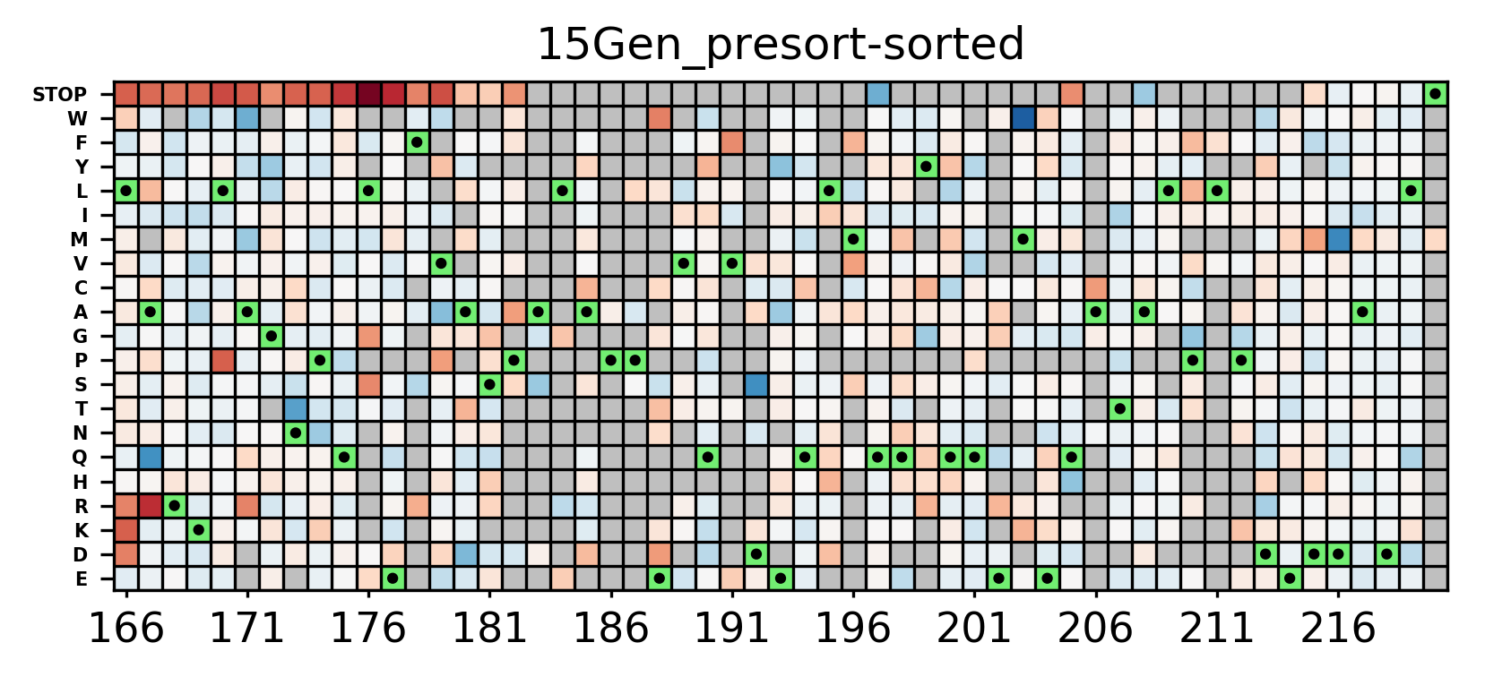

Slide 27
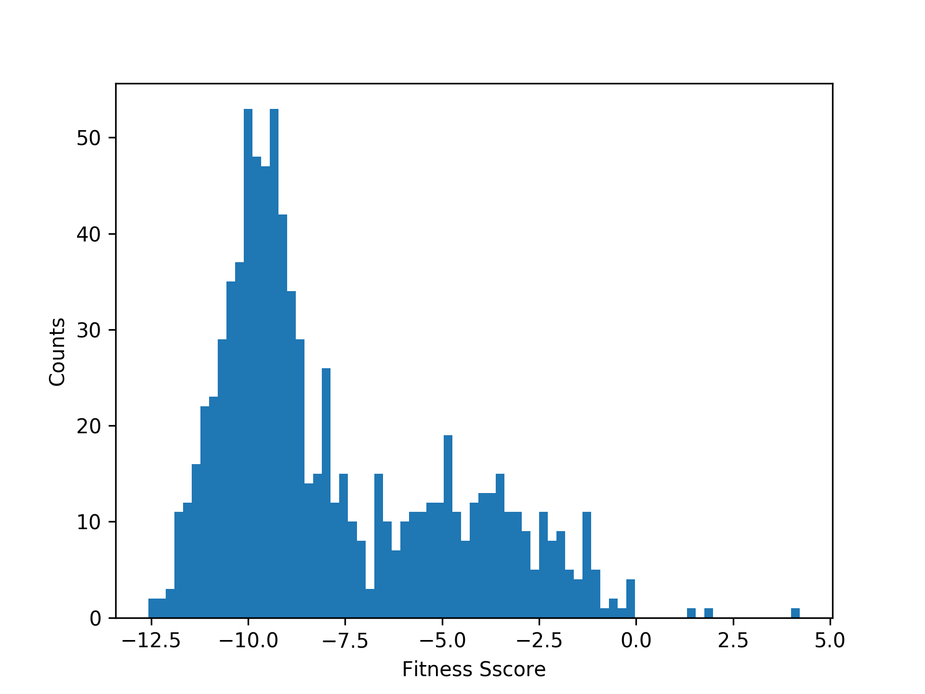
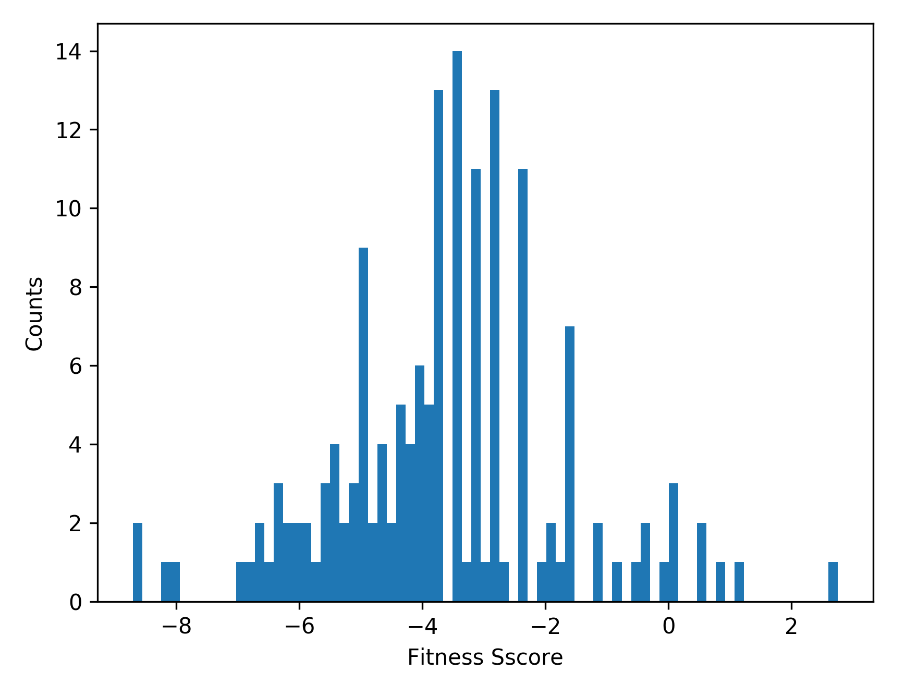
Parul Fitness Score for data missing in 15Gen
15 Gen Fitness score at “Low” Parul score
574 of 733 are missing

Slide 28
