Slide 1
Breslow et al fitness distributions for GSP1 gene sets

Slide 2
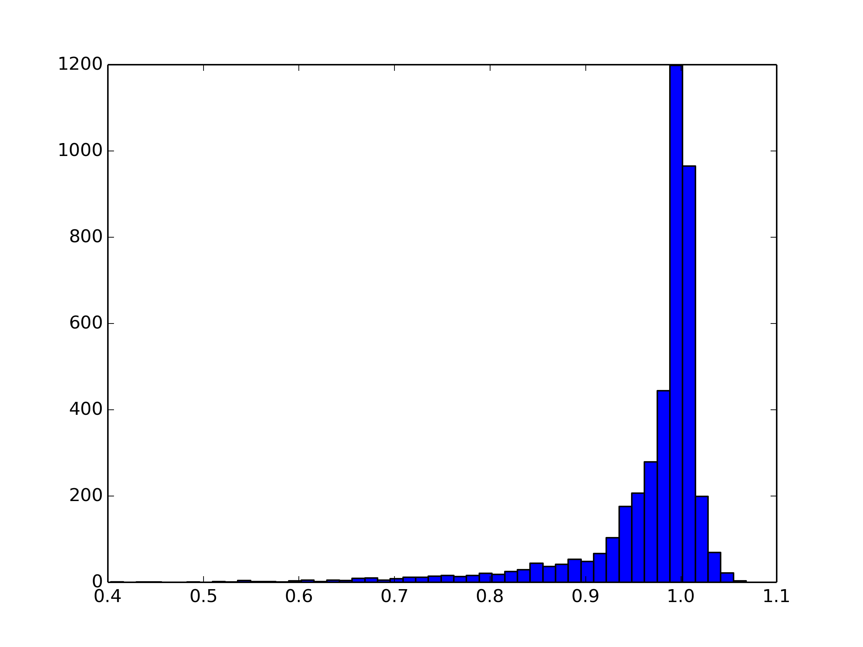
Breslow Fitness Distribution - KOs

Slide 3
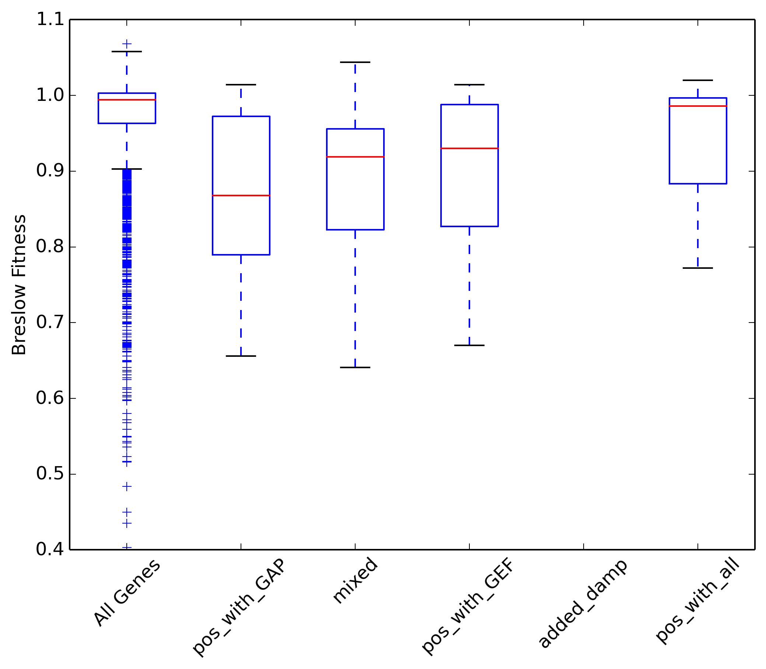
All Genes 4199
pos_with_GAP 43
mixed 31
po_swith_GEF 53
added_damp 0
pos_with_all 15

Slide 4
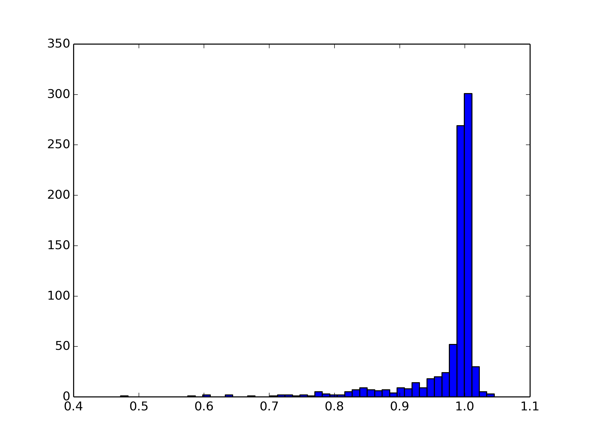
Breslow Fitness Distribution - Damps

Slide 5
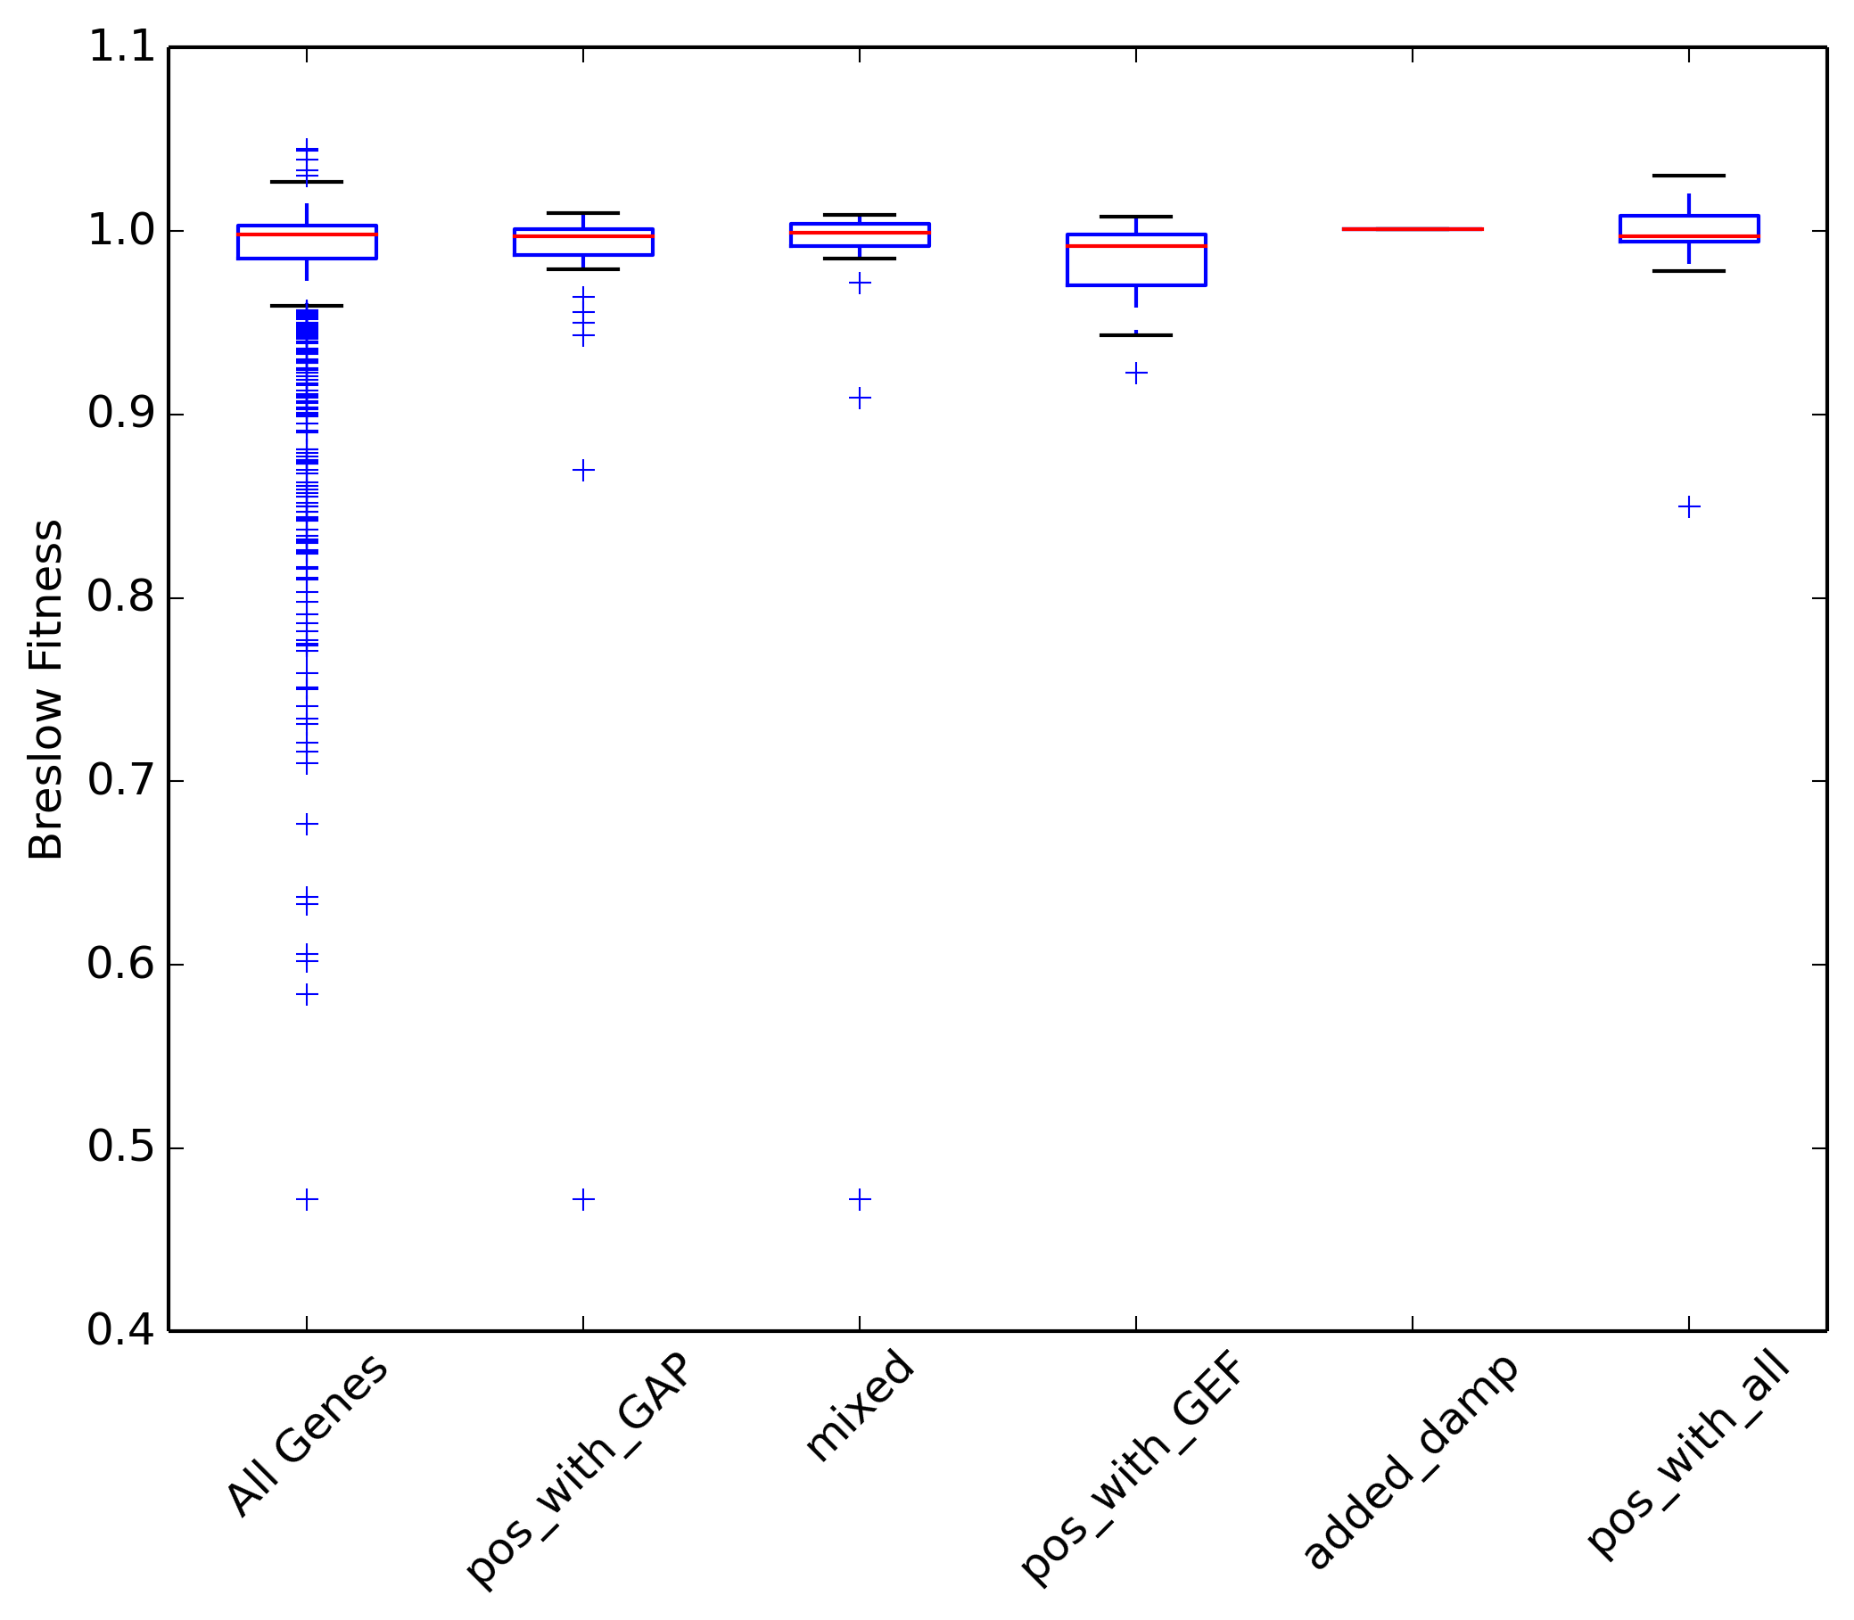
All Genes 835
pos_with_GAP 48
mixed 25
pos_with_GEF 22
added_damp 1
pos_with_all 11

Slide 6
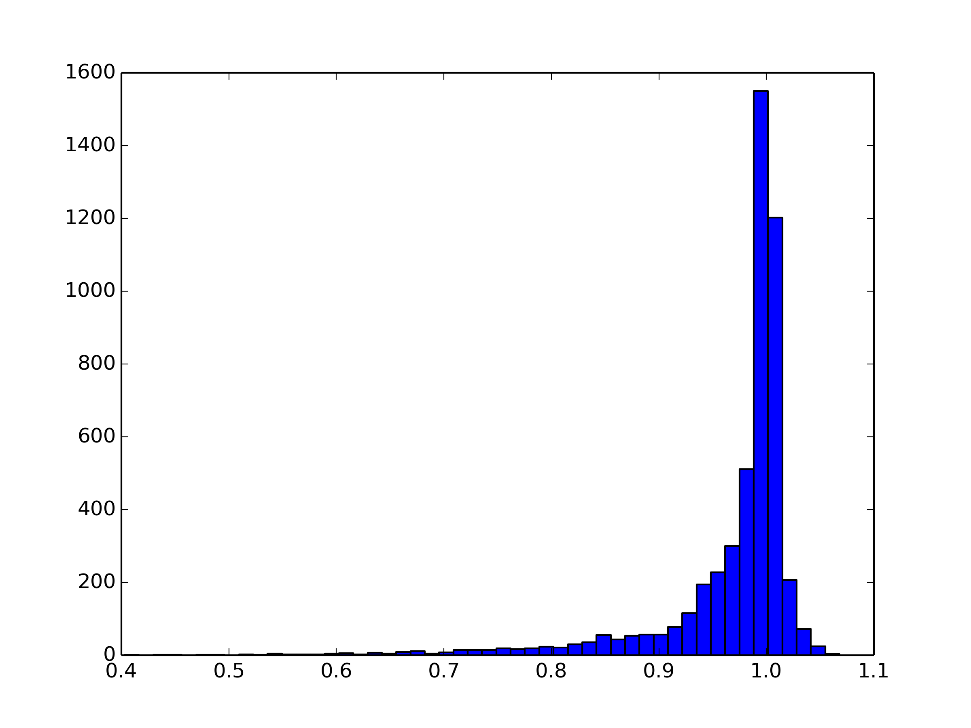
Breslow Fitness Distribution – All data

Slide 7
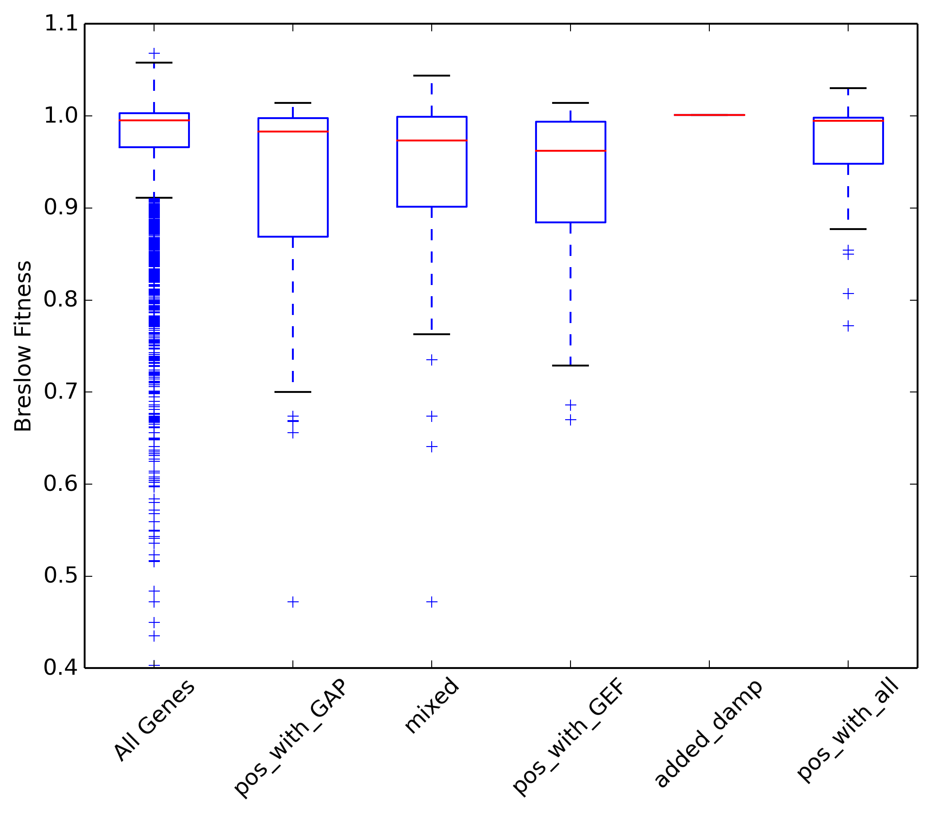
All Genes 5034
pos_with_GAP 91
mixed 56
pos_with_GEF 75
added_damp 1
pos_with_all 26

Slide 8
Pos with GAP – 48/91 damp alleles – 53%
Pos with GEF – 22/75 damp alleles – 29%
All Data
KOs

