Slide 1
Machine learning approaches for Bayesian optimization of dynamic pathways
Charlotte Merzbacher
MSc Thesis
CDT in Biomedical AI

Slide 2
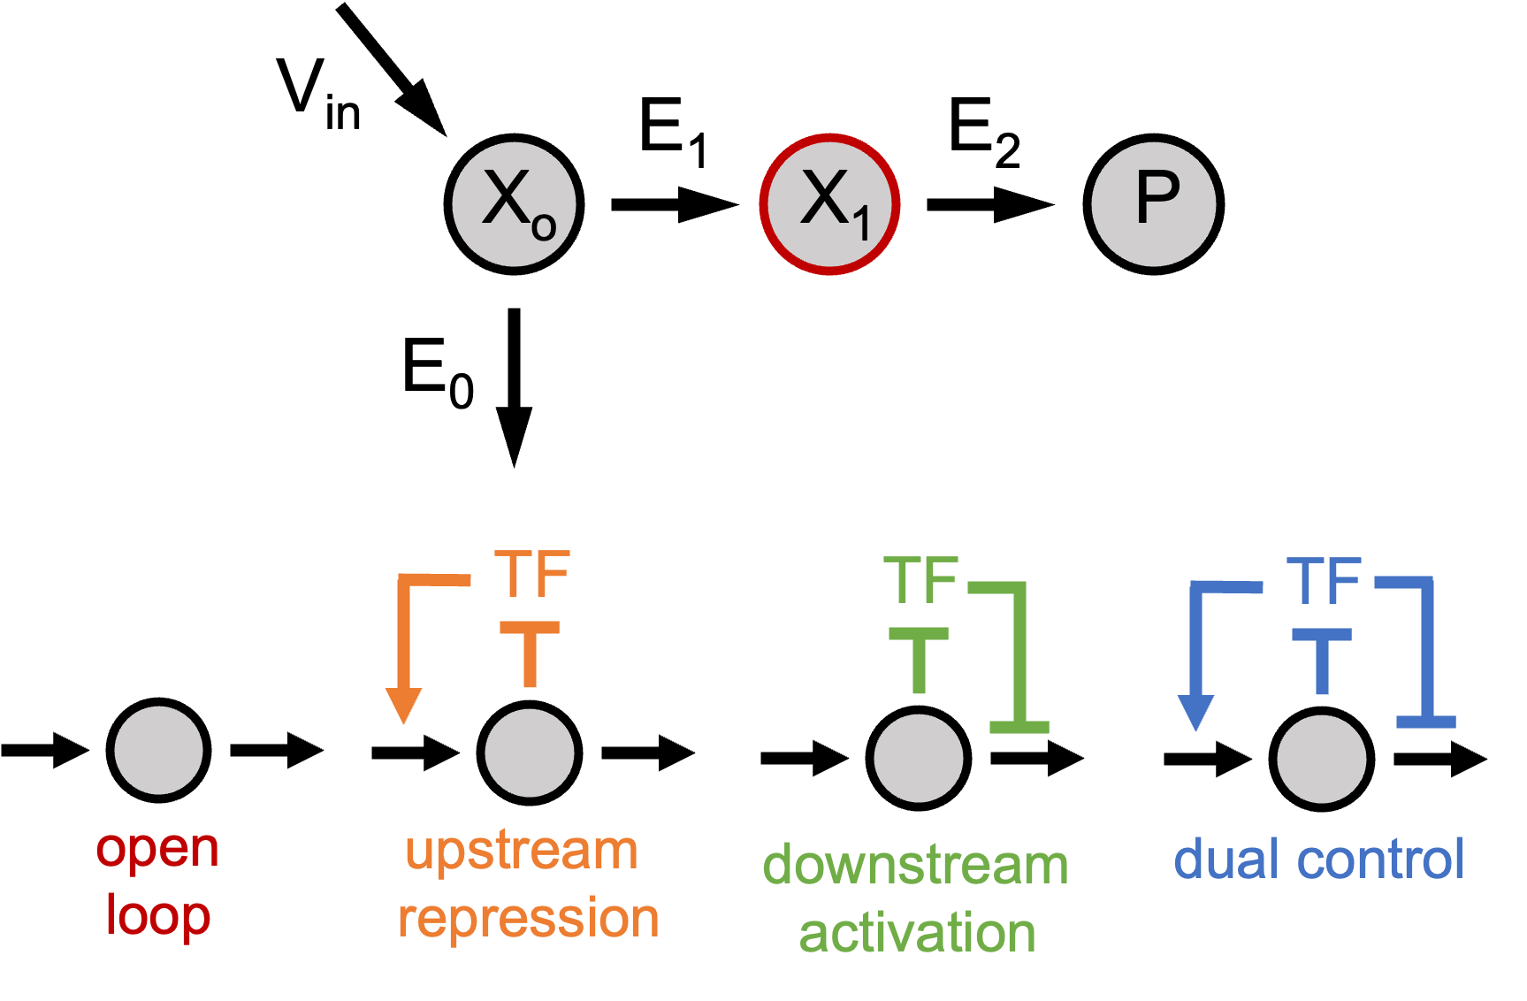
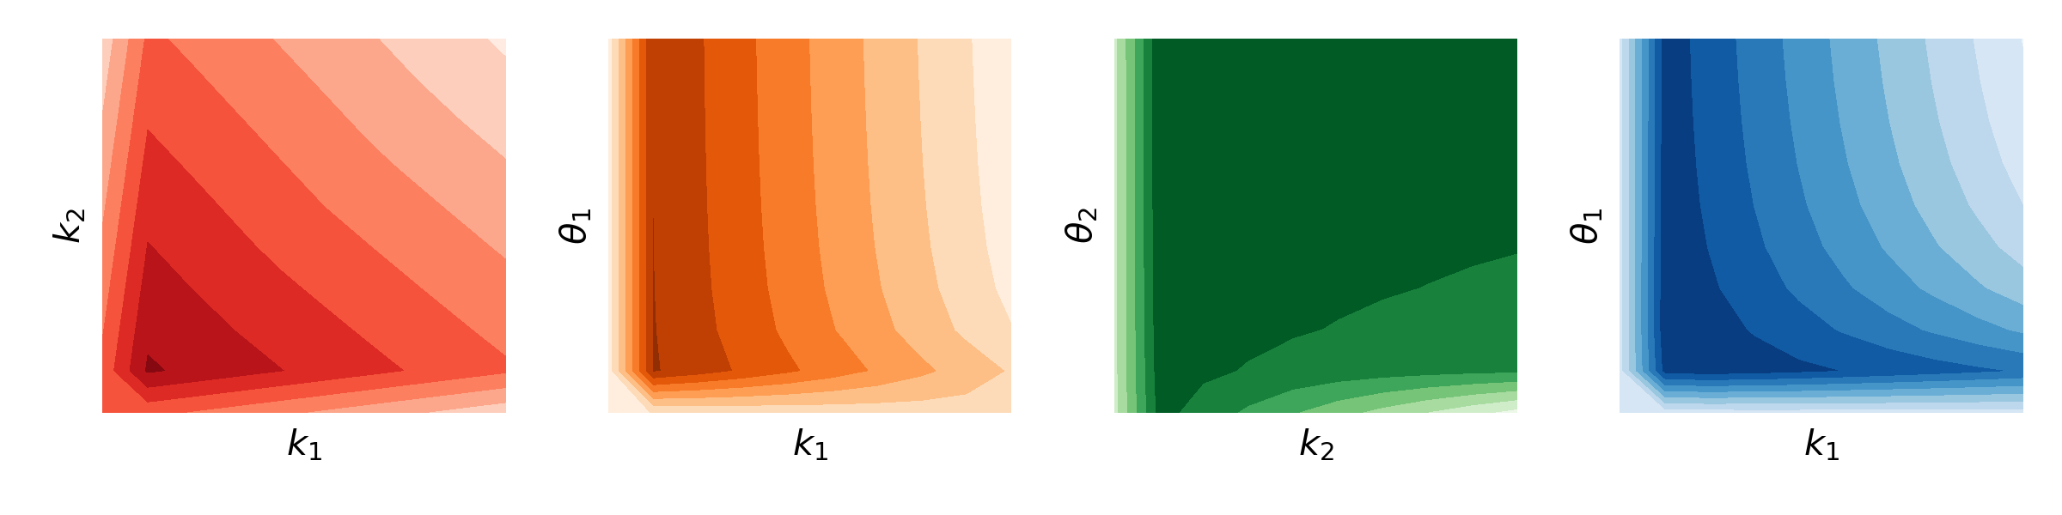
Sample parameter space
Solve ODE and compute objective function
Fit landscape with nonparametric model
Determine next sample balancing exploration and exploitation

Slide 3
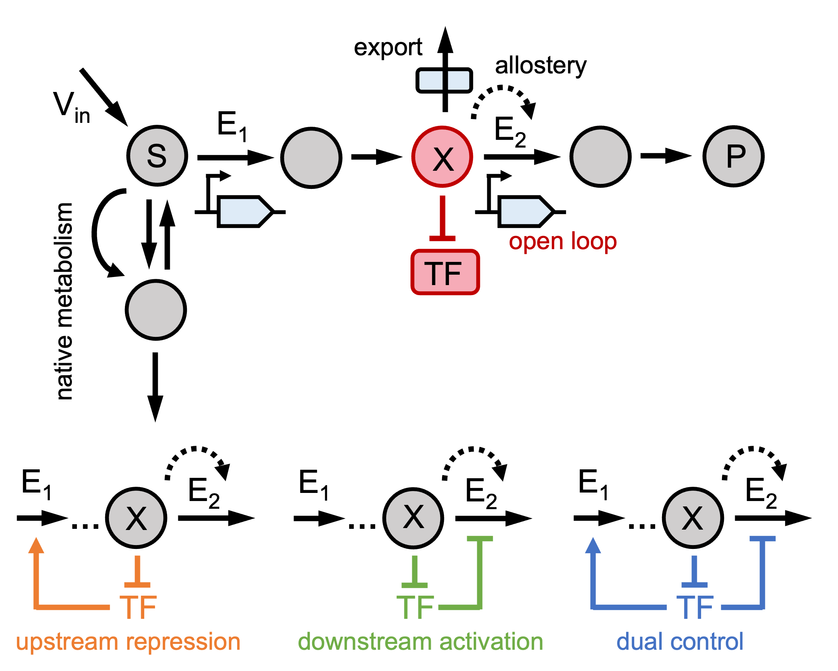
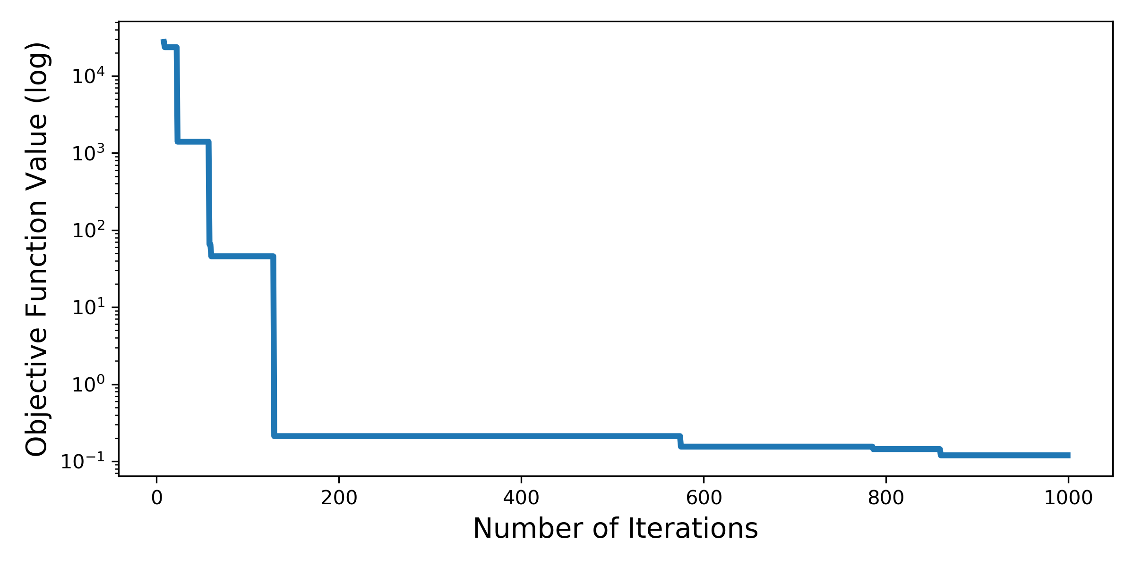
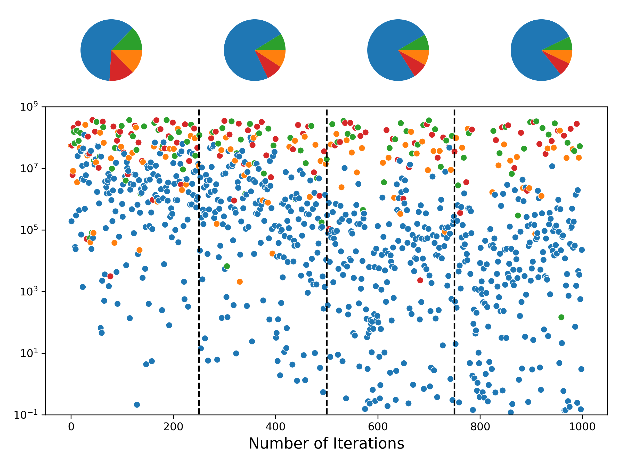

Slide 4
Kinetic parameter robustness
Influx concentration sweep

Slide 5
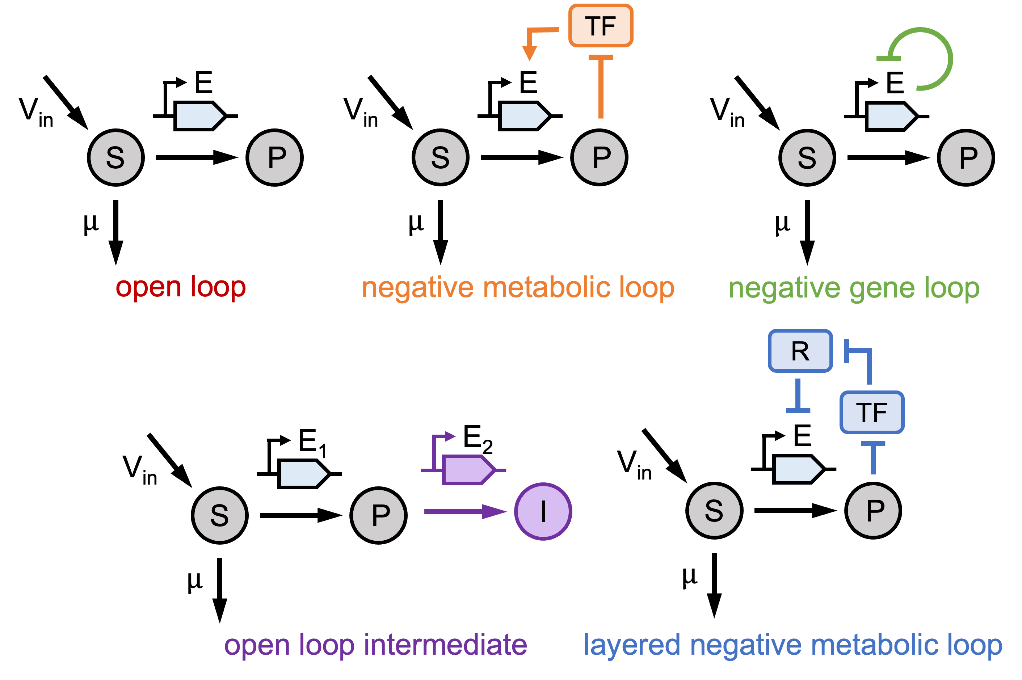
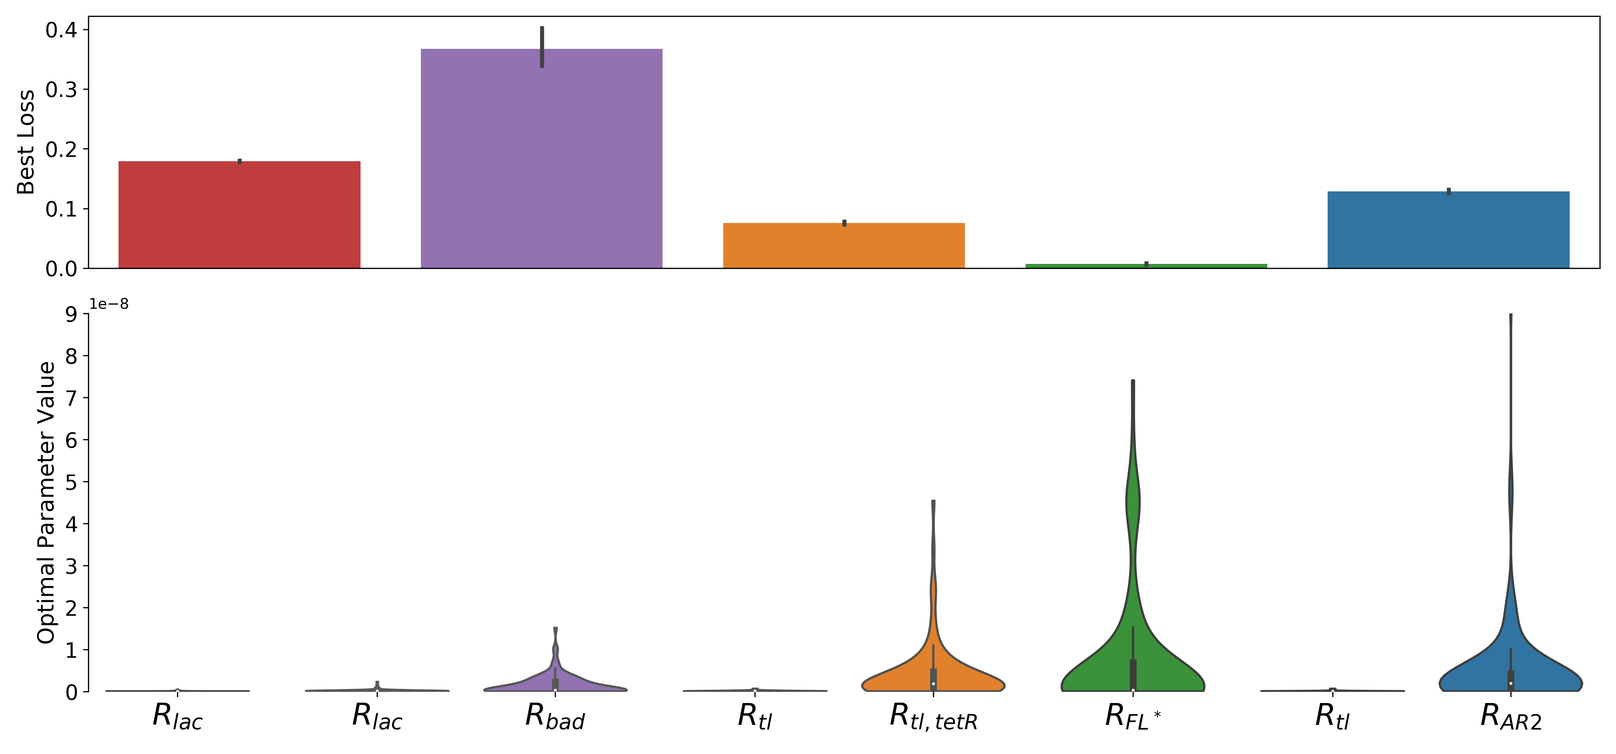
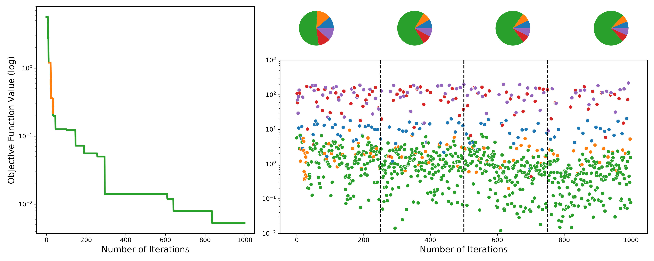
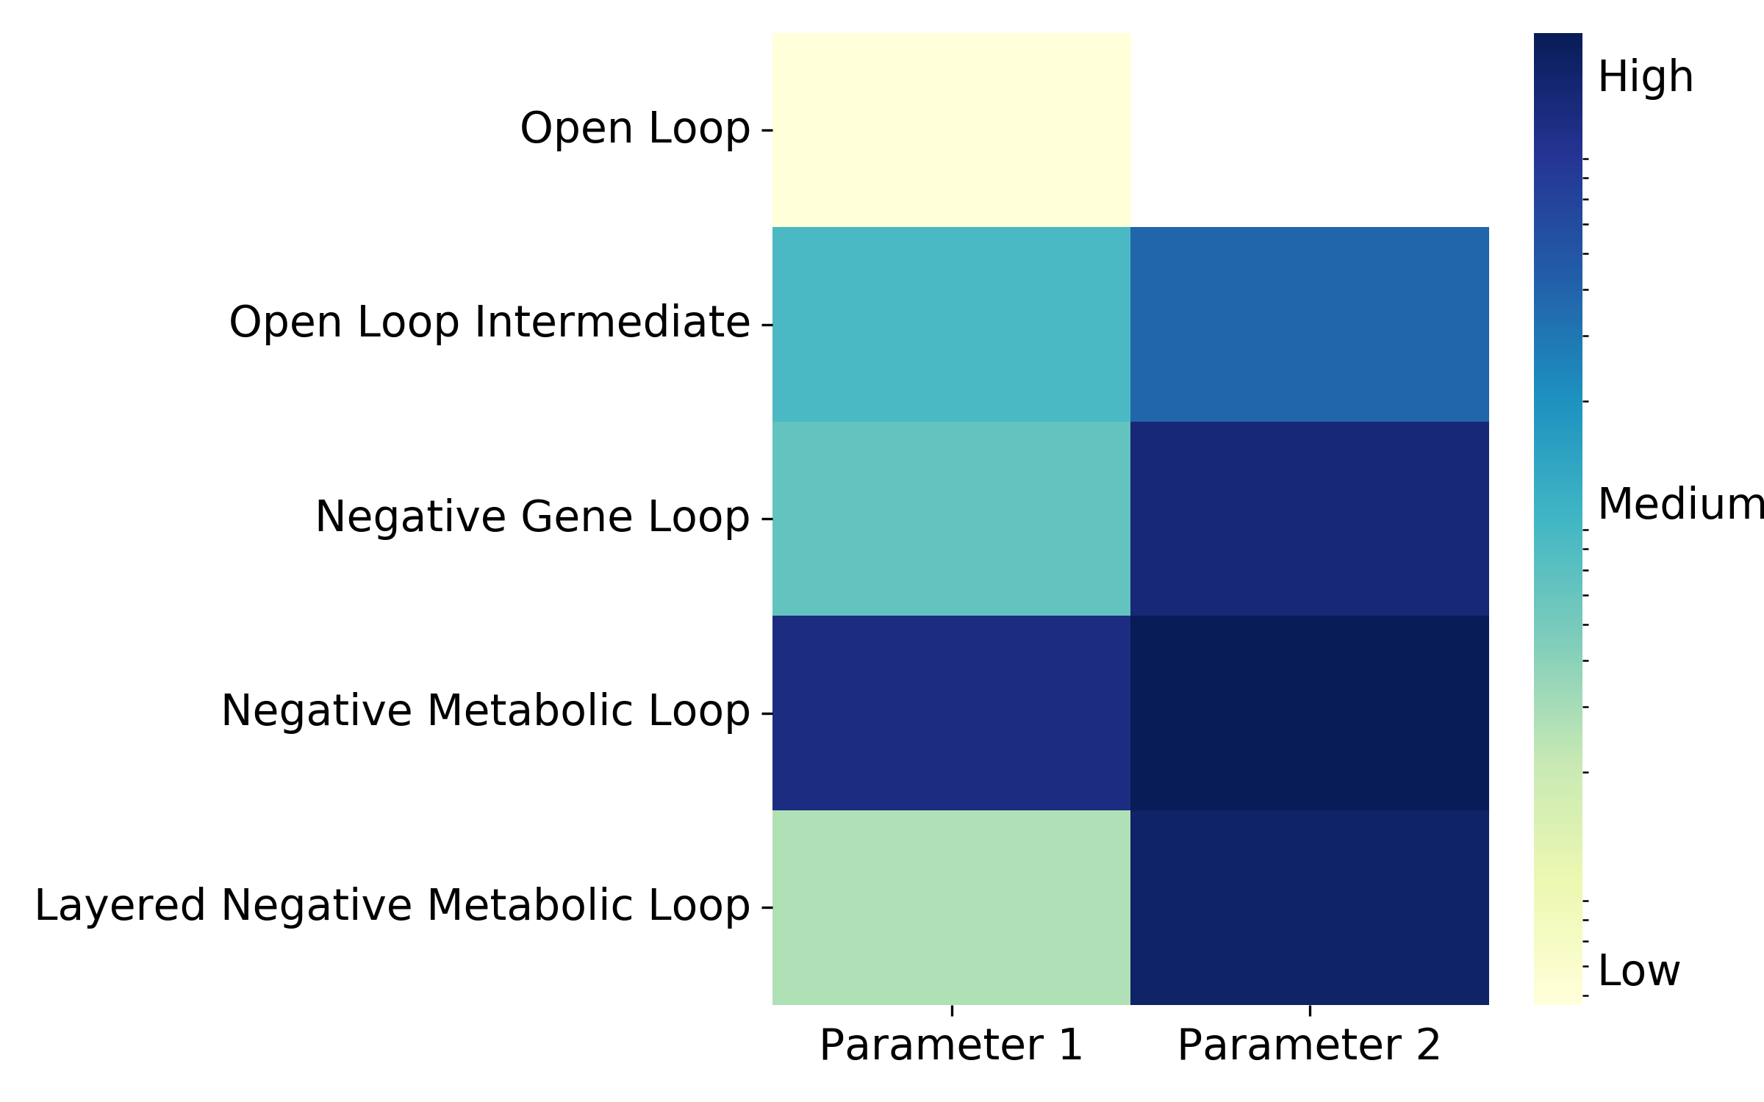
Notes:
Robustness score is invariant to mean. Instead, use coefficient of variation
Try violins/box plots for parameters
Bar plot with error bars

Slide 6
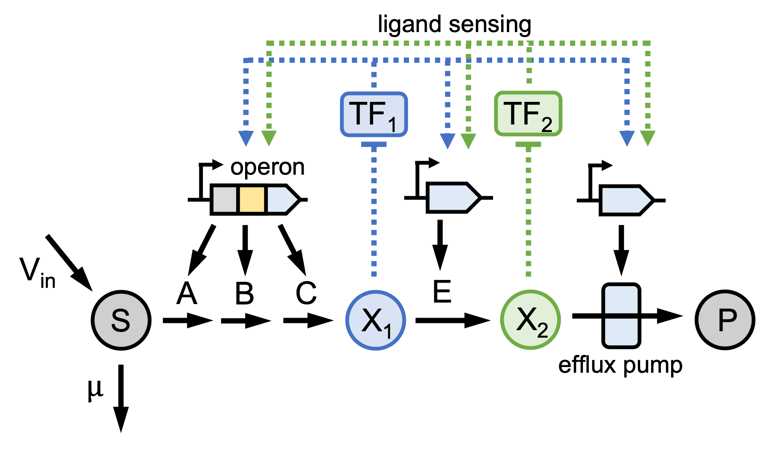
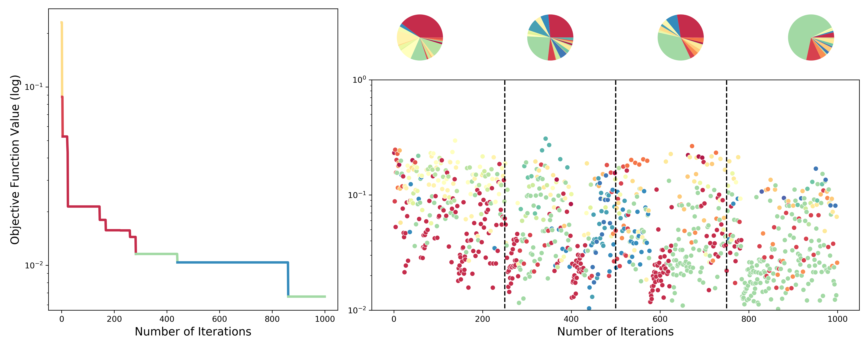
Toxicity Factor Robustness Results
Needs legend

Slide 7
Supplementary Figures

Slide 8
Raw Figures

Slide 9
V_{in}
E₁
E₂
X_{o}
X₁
P
E₀
TF
TF
TF
open
loop
upstream
repression
downstream
activation
dual control

Slide 10
export
allostery
V_{in}
E₁
E₂
S
X
P
open loop
TF
native metabolism
E₁
E₂
E₁
E₂
E₁
E₂
…
X
…
X
…
X
TF
TF
TF
upstream repression
downstream activation
dual control

Slide 11
TF
E
E
E
V_{in}
V_{in}
V_{in}
S
P
S
P
S
P
$$μ$$
$$μ$$
$$μ$$
open loop
negative metabolic loop
negative gene loop
R
TF
E₁
E₂
E
V_{in}
V_{in}
S
P
I
S
P
$$μ$$
$$μ$$
open loop intermediate
layered negative metabolic loop

Slide 12

ligand sensing
TF₁
TF₂
operon
V_{in}
A
B
C
E
S
X₁
X₂
P
$$μ$$
efflux pump

