Slide 1
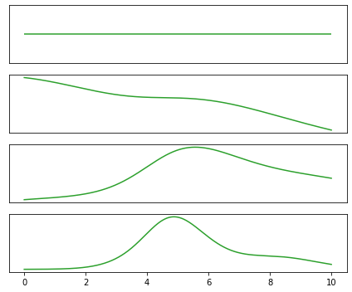
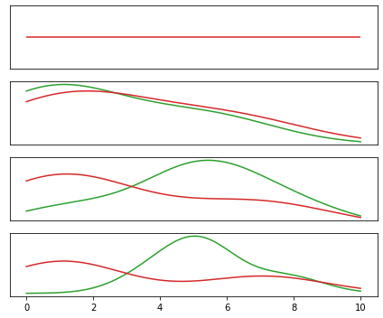
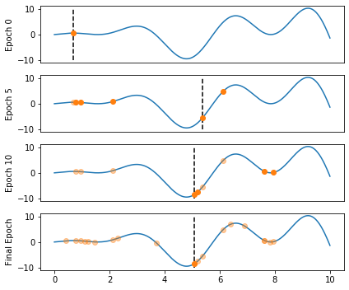
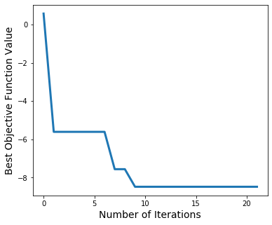
Figure 1 Panel B
Good/bad distributions – not sure if this is necessary
Value of objective function
Solve ODE and compute loss
Update knowledge about landscape
New parameter value guess
EI distribution – could plot on top of function example
Include information about tuning gamma threshold?
Explain TPE more?
Legend will go here?
Function -> landscape

Slide 2
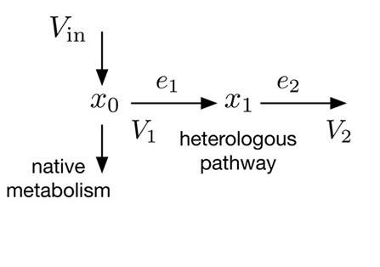
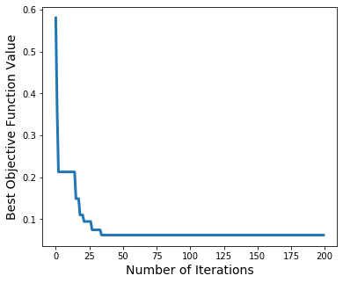
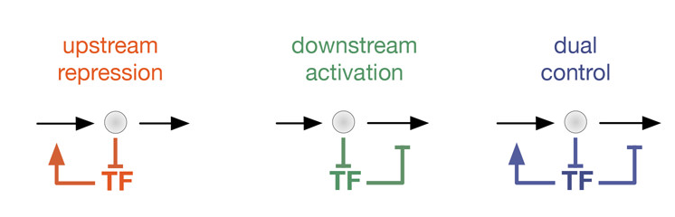
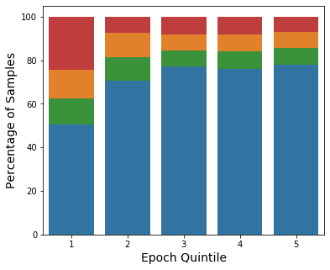
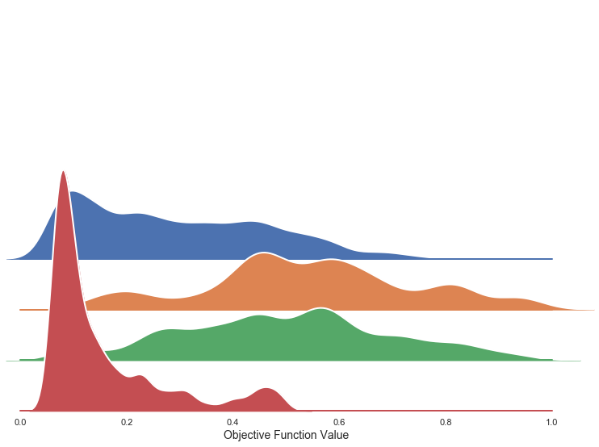
A
B
Do we want to color loss by architecture?
I think that point is covered in C, D.
B is just for “look the loss goes down”
no
control
C
D

