Slide 1
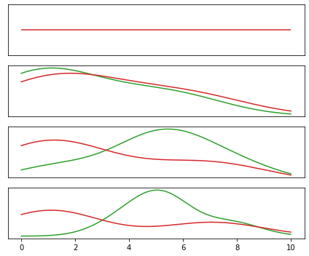
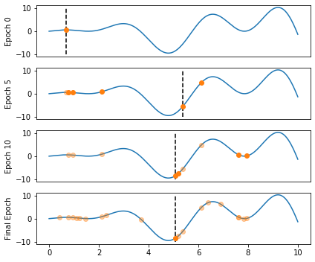
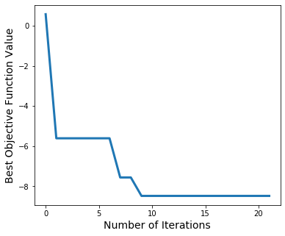
EI distributions – not sure if this is necessary
Value of objective function
Solve ODE and compute loss
Update knowledge about function
New parameter value guess
Legend will go here?

Slide 2
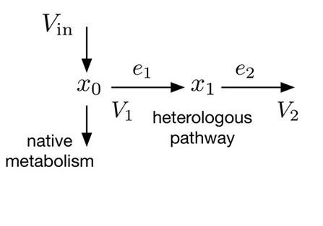
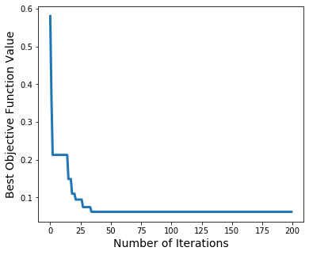
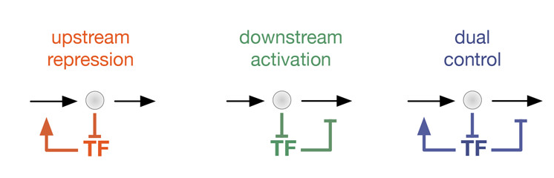
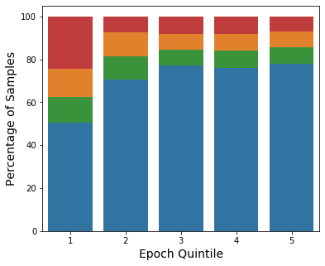
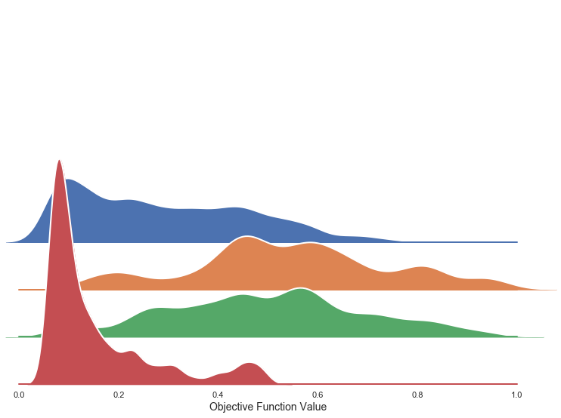
A
B
Do we want to color loss by architecture?
I think that point is covered in C, D.
B is just for “look the loss goes down”
no
control
C
D

