Slide 1


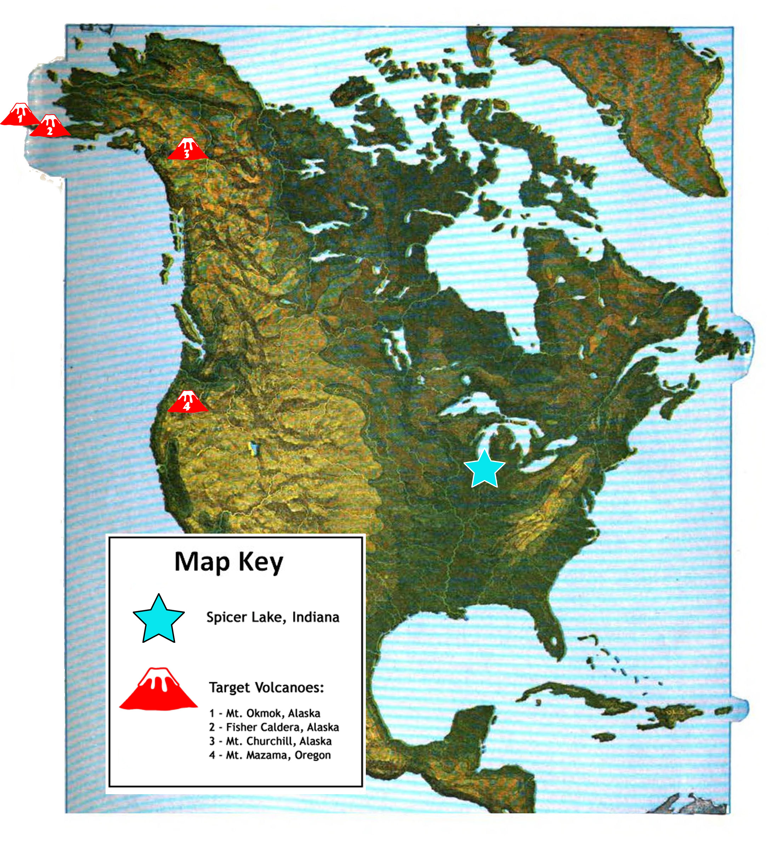
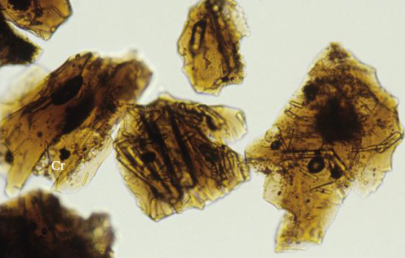
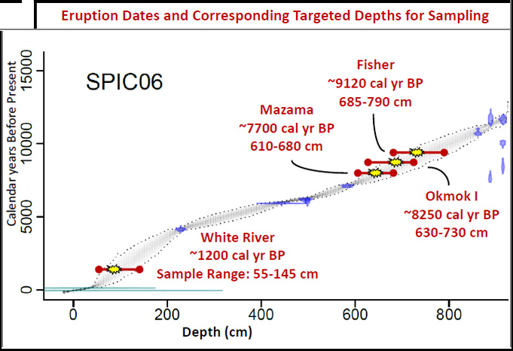



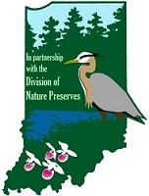
Cryptotephra - a radiocarbon dating alternative
Christopher J. Morgan¹, Samuel E. Muñoz, Yue Wang, John W. Williams
Department of Geography, University of Wisconsin-Madison
Introduction
Cryptotephra, or microtephra, are microscopic layers of volcanic ash invisible to the naked eye. Once discovered, they can be traced back to a volcano with a known eruption date.
Previous work in Canada and Europe has allowed for the verification and correction of age models developed by radiometric dating.
This relatively new tool is a versatile and cost effective way to understand depth ages and sedimentation rates due to each layer’s unique signature and ability to be correlated to other sites.
Project Methods
Based on previous research on sediment cores from Spicer Lake, we determined depths that likely correspond to eruption events. Sediment within these ranges are ignited to remove organics, treated with 1M HCl to remove carbonates, and sieved to remove particles <25 μm. Solutions of sodium polytungstate (SPT) are then used to float off and sink unwanted material. These remaining particles are then mounted and scanned under an optical microscope. Tephras appear transparent with a brown tinge under plane-polarized light, and under cross-polarized light appear a somewhat unique black, not transmitting light as a part of their isotropic properties².
Conclusion
Tephrochronology, the use of past volcanic events to understand the timing of geological events, provides high precision dates in sedimentary contexts. Previously the use of tephrochronology has been limited to areas proximal to volcanoes, but our research aims to extend this technique to the Great Lakes region by using a new approach capable of isolating small amounts of volcanic ash. Though only a single shard was discovered, this project will improve the existing age model for Spicer Lake, and provide a protocol for future cryptotephra work in this region.
2
Results
Using the age-depth model for Spicer Lake (Fig. 3), we developed target ranges for where to sample at depths of 50-150 cm and 550-850 cm. We hypothesized that four tephra layers would be identifiable in the target depths, although hours of microscope work resulted in just a single confirmed shard – found at a depth of 715-720 cm and presumed to be from Mt. Fisher. This will help improve our existing age-depth model for the lake, and hopefully lead to further exploration, as it is some of the first evidence of tephra in the Lower Great Lakes region.
1
References
¹corresponding author: cjmorgan3@wisc.edu
²Blockley et al., 2005. A new and less destructive laboratory procedure for the physical separation of distal glass tephra shards from sediments. Quaternary Science Reviews 24:1952-1960
³Lowe, D.J., 2011. Tephrochronology and its application: A review. Quaternary Geochronology 6:107-153
  Fig 2. The location of the lake sediment core used in this study (Spicer Lake, Indiana) in North America, and the locations of the four volcanoes whose eruptions were chosen as targets for detection.
40 µm
  Fig1. Yellowish-brown ash-size basaltic glass shards from mid-Holocene tephra erupted at Mt. Gambier, southeast South Australia³
3
  Fig 3. The age-depth model developed from radiocarbon dates from Spicer Lake. The red lines are the target depths based on eruption dates (yellow points). The discovered shard, along with further work, will be able to narrow the uncertainty of this model by shrinking the gray areas and provide further preliminary evidence of tephras in the Lower Great Lakes region.
Acknowledgements
This work was funded by the National Science Foundation (NSF) and the Wisconsin Alumni Research Foundation (WARF). I wish to thank the Spicer Lake Nature Preserve for lake access, and Lauren Davies, Britta Jensen, and Brigitta Rongstad for assistance with this project.
Research Question
Are there tephra layers present in a sediment core from Spicer Lake in northern Indiana?
Our target eruptions are from volcanoes in Oregon and Alaska, ranging between 1200-8250 calendar years before present.
Practical Applications
This work could lead to a better understanding of ash deposition’s impact on ecosystems, as well as improved volcanic hazard risk assessment.

