Slide 1
Harmony Graph Evaluation
Corey Nolet

Slide 2
Introduction
Harmony graph is a novel approach to analyzing songs
A social-network-like structure for representing songs as graphs
Allows visualization for analysis of songs
Provides a novel metric for summarizing the graph
Applications in music comparison algorithms like genre classification
Applications in corpus-based music generation

Slide 3
Markov Chain
A Markov chain is a random process that undergoes transitions from one state to another on a state space.
It possesses a property that is usually characterized as “memorylessness”, which is the probability distribution of the next state depends only on the current state and not on the sequence of events that preceded it.
A Markov chain is, most generally, a graph with states as veritces and probabilities as edges.
The edges determine the probabilities of a state transitioning to another state on the other side of the edge.

Slide 4
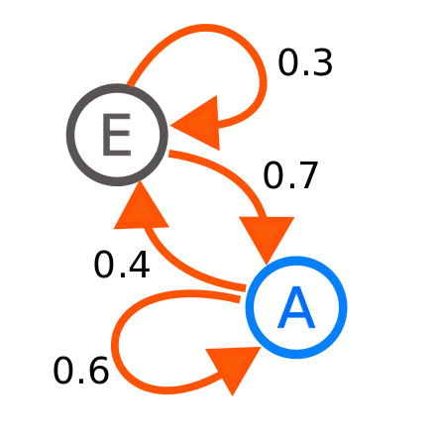
Markov Chain

Slide 5
A little music background
MIDI files are musical formats that contain events representing notes, pitches, & durations rather than audio.
Harmony refers to all notes being played simultaneously at any point in a piece of music.

Slide 6
Creating a Harmony Graph
Start by creating a “NULL” vertex which represents the beginning of a song
Each time a note changes in the piece of music, take all the notes being played simultaneously and create a vertex (if one doesn’t exist already).
Attach an edge between the previous set of notes and the current vertex (unless an edge already exists) and increment the weight of the edge by 1.
Once all harmonic components have been exhausted, attach the last vertex back to the NULL node.

Slide 7
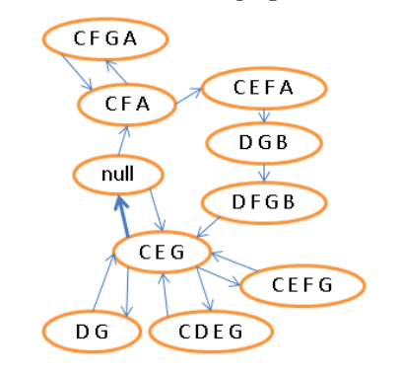
Creating a Harmony Graph

Slide 8
Creating a Harmony Graph
g = nx.DiGraph()
diction = set()
edges = set()
last_node = null_node
g.add_node(last_node)
for thisChord in o.recurse().getElementsByClass('Chord'):
pitchClasses = thisChord.orderedPitchClassesString
if pitchClasses not in diction:
g.add_node(pitchClasses)
diction.add(pitchClasses)
edgeKey = tuple([last_node, pitchClasses])
if edgeKey not in edges:
edges.add(edgeKey)
g.add_edge(last_node, pitchClasses, weight = 1)
else:
g.edge[last_node][pitchClasses]['weight'] = g.edge[last_node][pitchClasses]['weight']+1
last_node = pitchClasses
g.add_edge(last_node, null_node, weight = 1)
nx.write_graphml(g, "graphml/" + f + ".graphml”)

Slide 9
Metrics
Several metrics are proposed in the Harmony Graph paper for summarizing the graph
Degree distribution histogram allows us to see the general distribution of the degrees of the graph.
Clustering coefficient measures the degree to which nodes in a graph tend to cluster together.
Average path length is the average number of steps along the shortest paths for all possible pairs of network nodes.
Agglomeration is a novel measure created by the authors of the paper.

Slide 10
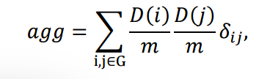
Agglomeration
A phenomenon that occurs when high-degree nodes link together, in contrast to the conditions for a large clustering coefficient, which is due to large number of triangles formed by clusters of links in the graph.
A value of 1 represents a complete graph
A value of 0 represents a completely isolated graph

Slide 11
Agglomeration
def agglomeration(g):
agglomeration_numerator = 0.0
total_degrees = 0.0
degrees = nx.degree(g)
for edge in g.edges():
agglomeration_numerator += degrees[edge[0]] * degrees[edge[1]]
for item in degrees:
total_degrees += degrees[item]
return agglomeration_numerator / pow(total_degrees, 2)

Slide 12
Music Generation
Two ways of generating music are presented
Random Walk
Link Prediction

Slide 13
Random Walk
By walking the graph randomly from any node, music can be produced.
Store the duration of the movement between two harmonies with the edges (along with the weights)
The random walker can also be able to play a changing rhythm along with the harmonic progression.
This approach is supposed to be able to produce similar styles of music to the corpus which is being walked.
The produced music will sound novel but familiar

Slide 14
Link Prediction
In random walk, if the degree of a node is 1, there is only 1 choice for the next node. It’s also very likely that the next node also has a degree of 1.
The longer the path of nodes with degrees of 1, the more the newly generated music sounds like the original.
Link prediction estimates the probability of connection for two unconnected nodes.
When a random walker departs one node, it chooses some other (possibly unconnected) node as extra candidates based on their link prediction probability.
Similarity measure for determining probability is the number of common notes divided by the total number of notes in each harmony. This is called Jacquard similarity.

Slide 15
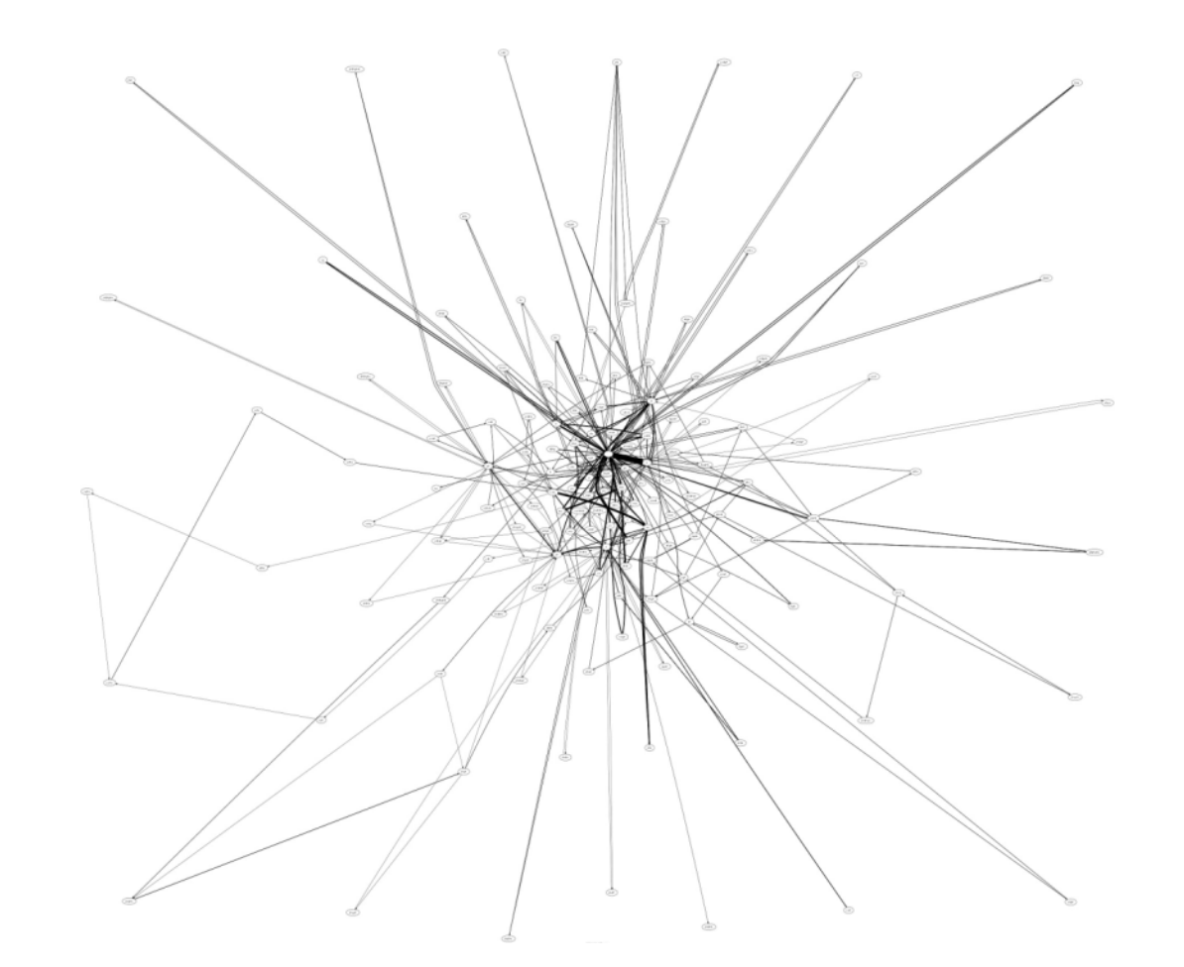
Visualizing The Graph
The harmony graph paper presents a graph which looks like the following.

Slide 16
Visualizing The Graph
Unfortunately, this is very hard to follow and doesn’t really mean much to anyone trying to analyze it!

Slide 17
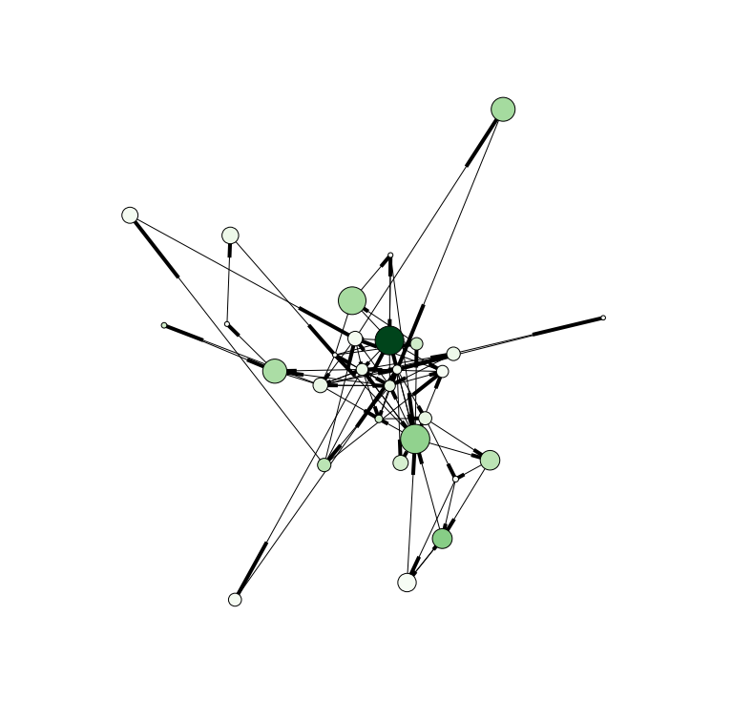
Visualizing The Graph
A better graph could look like this:

Slide 18
Visualizing The Graph
Size of vertices are drawn from eigenvector centrality

Slide 19
Visualizing The Graph
Color of vertices is based on betweenness centrality

Slide 20
Visualizing The Graph
Allows us to quickly separate graphs like this

Slide 21
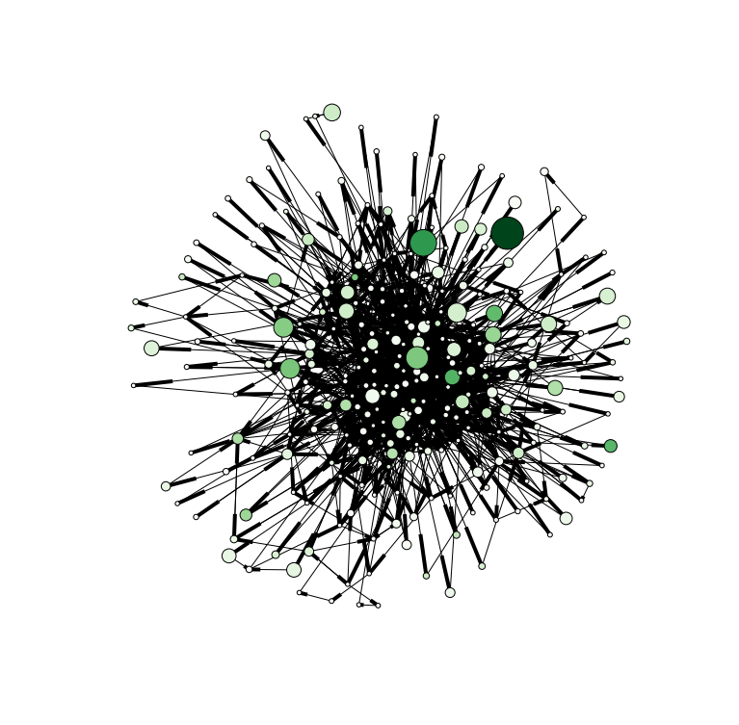
Visualizing the Graph
From graphs like this

Slide 22
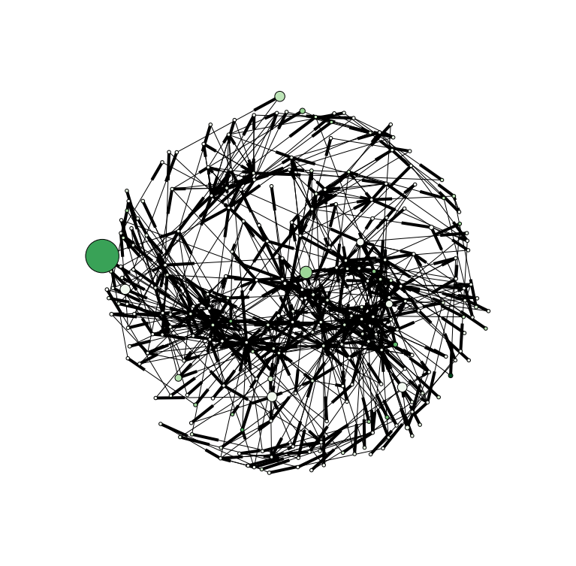
Visualizing the Graph
A spring layout was used for each image.

Slide 23
Visualizing the Graph
An algorithm called Fruchterman-Reingold force-directed

Slide 24
Let’s look at some data!
So now that we know the what the harmony graph is, how to construct it, what metrics to use when traversing it, and how to visualize it, let’s look at some resulting data.

Slide 25
Method
I found 89 MIDI files on the internet for several different genres spanning pop, rock, country, folk, jazz, classical, rap, and rhythm & blues.
A python script ran overnight analyzing each MIDI file, creating the resulting harmony graph, and outputting it as a graphml file.
All of the graphml files were then pulled parsed with another Python script, metrics created, and images drawn with the nodes & edges for visualization.

Slide 26
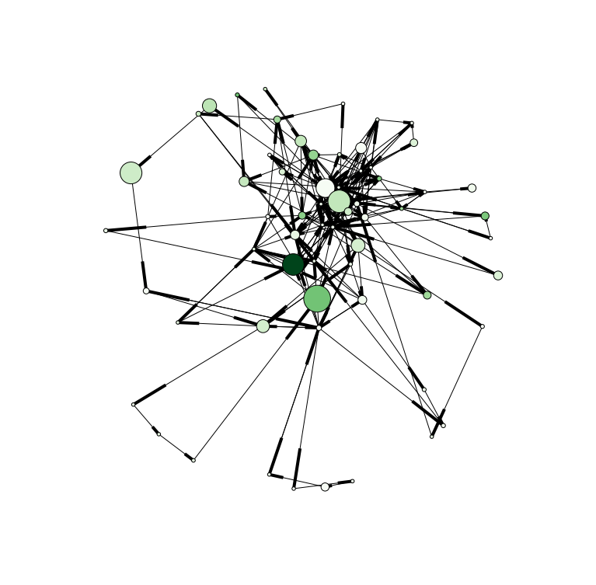
50 Cent – In Da Club

Slide 27
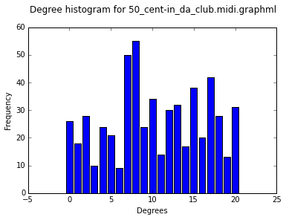
50 Cent – In Da Club
Clustering Coefficient: 0.0120648262587
Avg Path Length: 3.5752688172
Agglomeration: 0.207971807253
Number of nodes: 63
Number of edges: 282
Unique degrees: 21

Slide 28
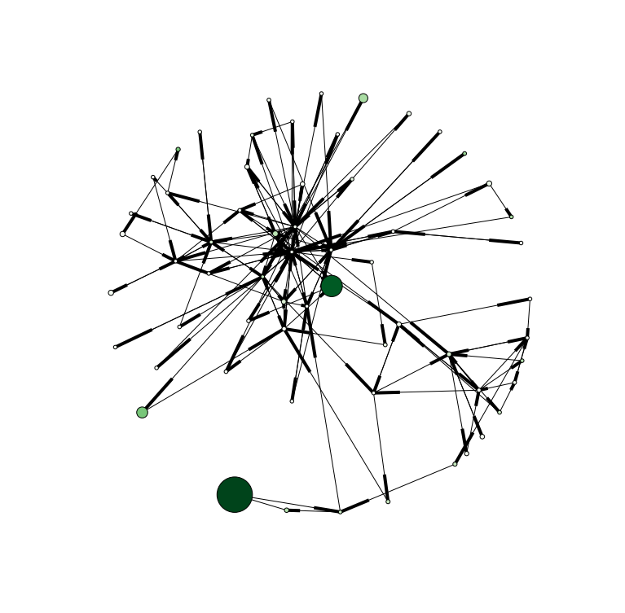
ACDC – Dirty Deeds

Slide 29
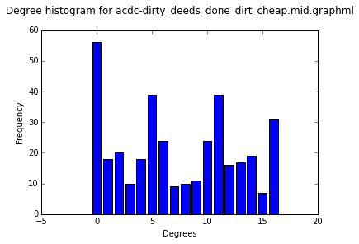
ACDC – Dirty Deeds
Clustering Coefficient: 0.00354762966973
Avg Path Length: 3.57131147541
Agglomeration: 0.227382147921
Number of nodes: 61
Number of edges: 184
Unique degrees: 17

Slide 30
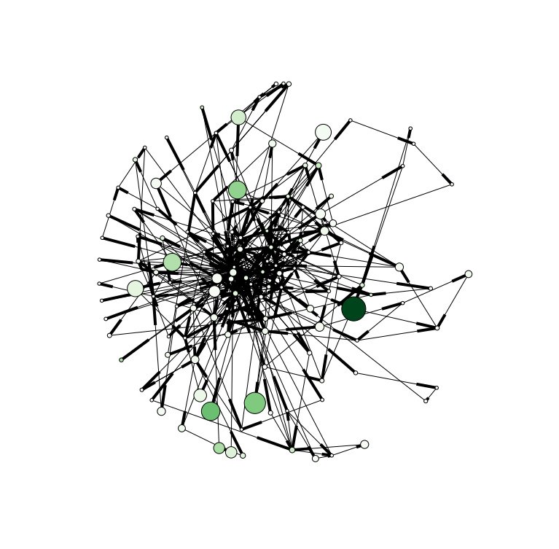
Ace of Base – All that she wants

Slide 31
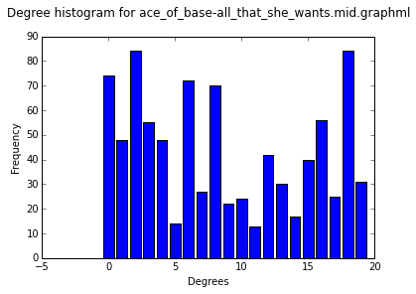
Ace of Base – All that she wants
Clustering Coefficient: 0.0155058346985
Avg Path Length: 3.76989359241
Agglomeration: 0.134799628865
Number of nodes: 132
Number of edges: 438
Unique degrees: 20

Slide 32
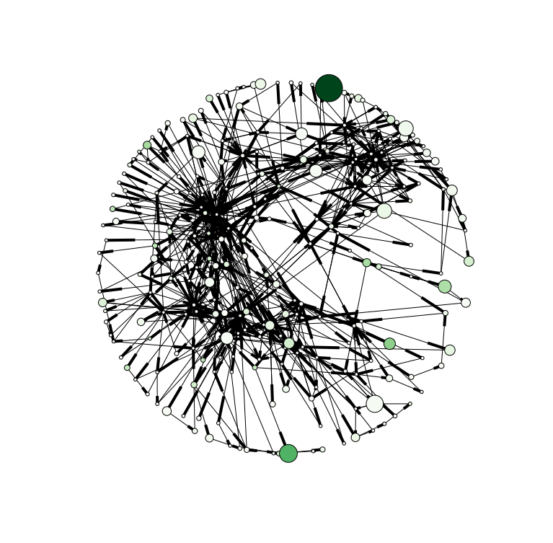
Adele – Rolling Deep

Slide 33
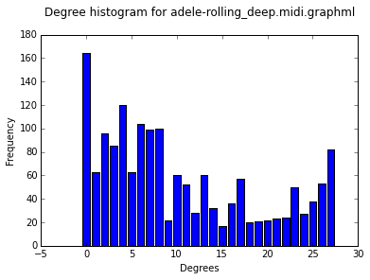
Adele – Rolling Deep
Clustering Coefficient: 0.0258326620925
Avg Path Length: 4.6290684624
Agglomeration: 0.0684676102133
Number of nodes: 243
Number of edges: 809
Unique degrees: 28

Slide 34
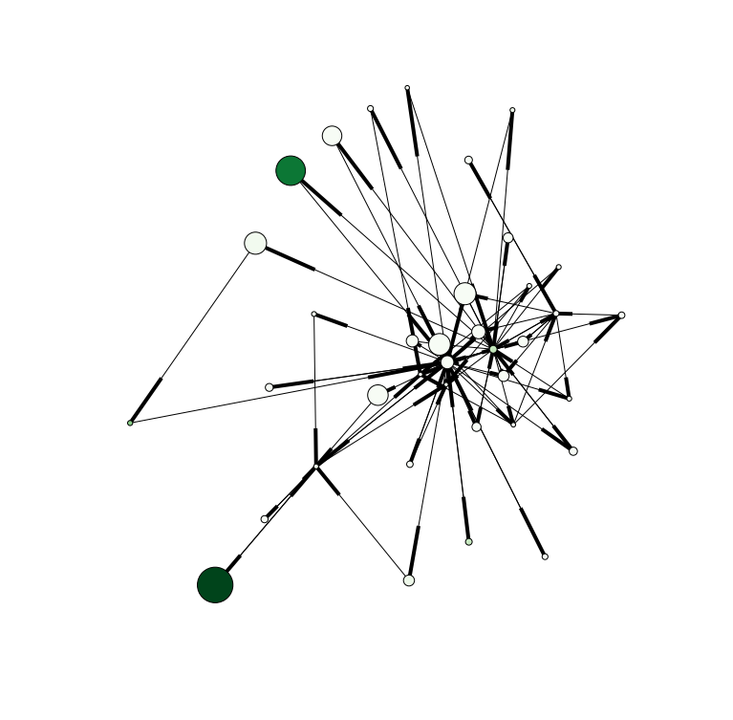
DMX – Ruff Ryders Anthem

Slide 35
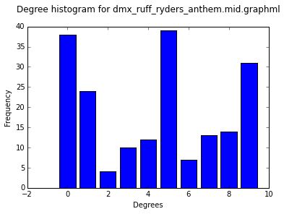
DMX – Ruff Ryders Anthem
Clustering Coefficient: 0.0637873147284
Avg Path Length: 2.61411411411
Agglomeration: 0.406087239583
Number of nodes: 37
Number of edges: 96
Unique degrees: 10

Slide 36
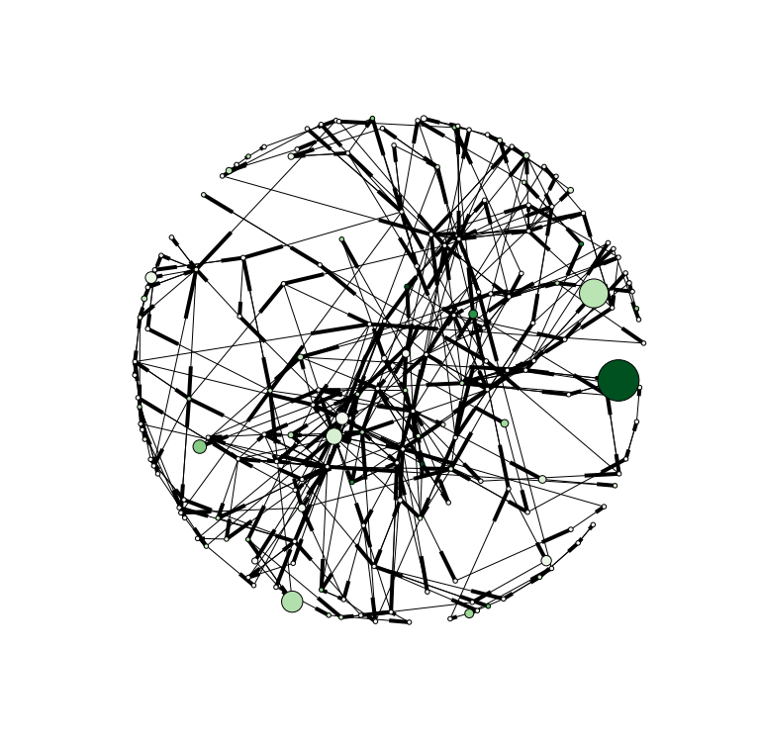
Cat Stevens – Wild World

Slide 37
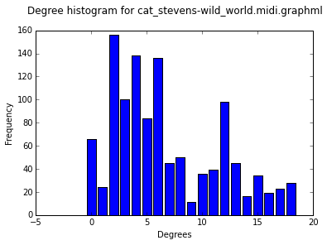
Cat Stevens – Wild World
Clustering Coefficient: 0.00791131184398
Avg Path Length: 6.03824911868
Agglomeration: 0.0368630795566
Number of nodes: 185
Number of edges: 574
Unique degrees: 19

Slide 38
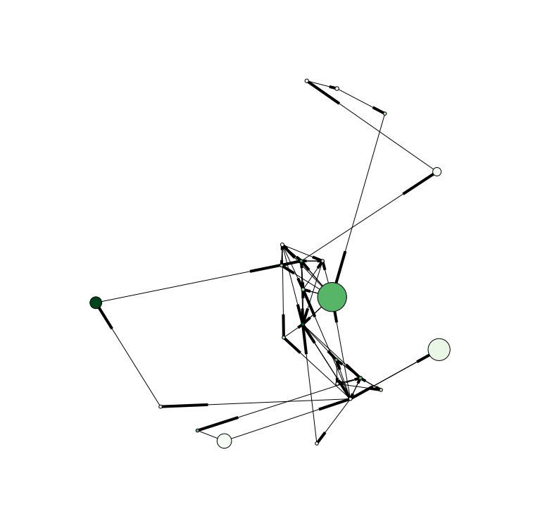
Bruce Springsteen – Born USA

Slide 39
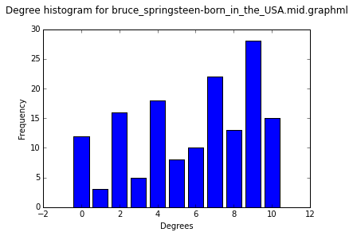
Bruce Springsteen – Born USA
Clustering Coefficient: 0.0322580249084
Avg Path Length: 3.29841897233
Agglomeration: 0.3092
Number of nodes: 23
Number of edges: 75
Unique degrees: 11

Slide 40
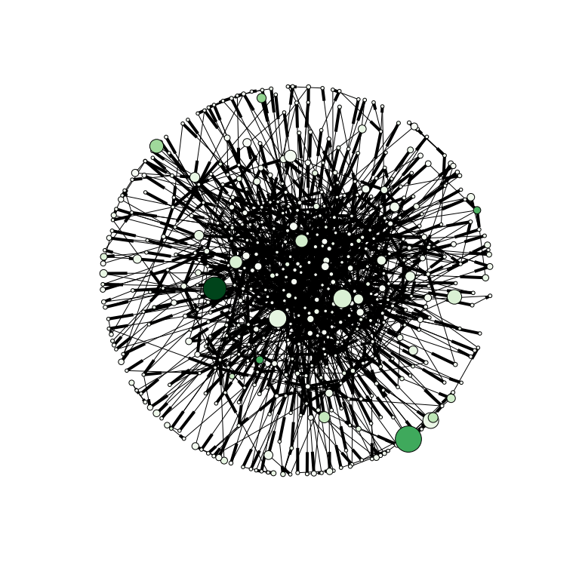
Errol Garner - Misty

Slide 41
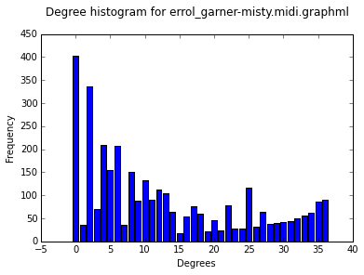
Errol Garner - Misty
Clustering Coefficient: 0.00908473818057
Avg Path Length: 4.62479572312
Agglomeration: 0.0558785040403
Number of nodes: 494
Number of edges: 1671
Unique degrees: 37

Slide 42
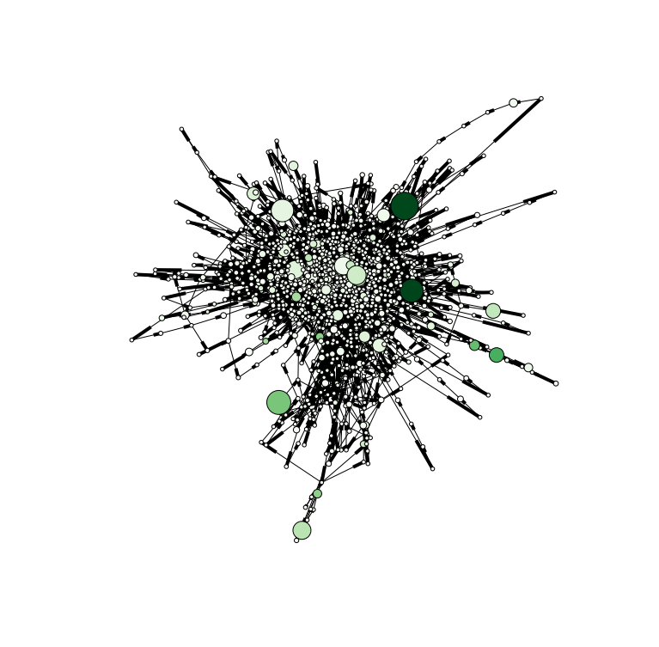
Miles Davis – Alone Together

Slide 43
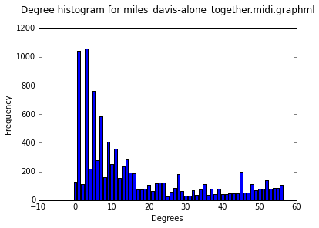
Miles Davis – Alone Together
Clustering Coefficient: 0.00816191426634
Avg Path Length: 5.64979873581
Agglomeration: 0.0319343444501
Number of nodes: 1378
Number of edges: 4781
Unique degrees: 57

Slide 44
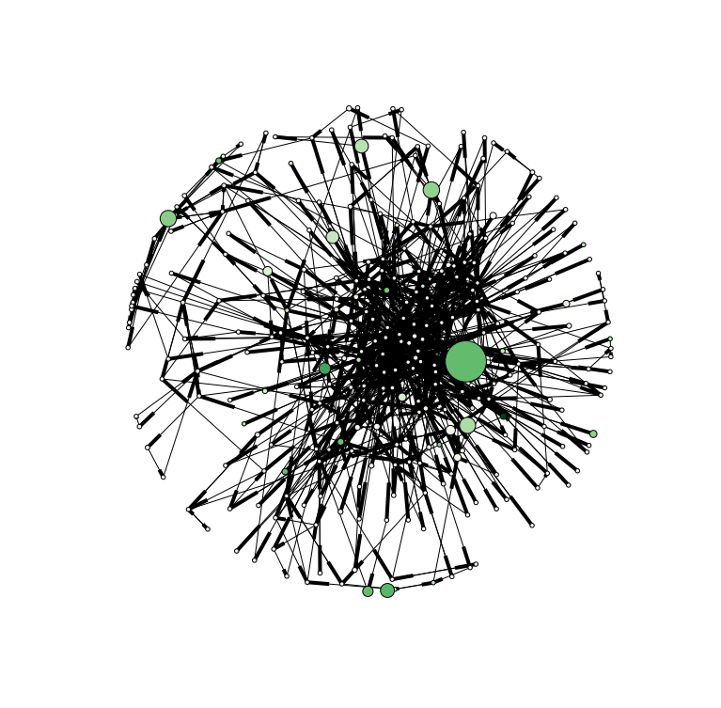
Mozart – Sym40 Mov1

Slide 45
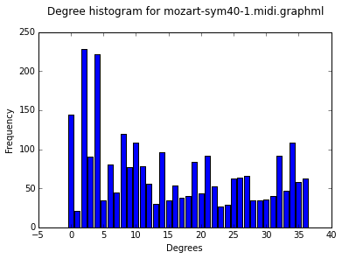
Mozart – Sym40 Mov1
Clustering Coefficient: 0.00186153221144
Avg Path Length: 4.26271726272
Agglomeration: 0.0898119768608
Number of nodes: 297
Number of edges: 1314
Unique degrees: 37

Slide 46
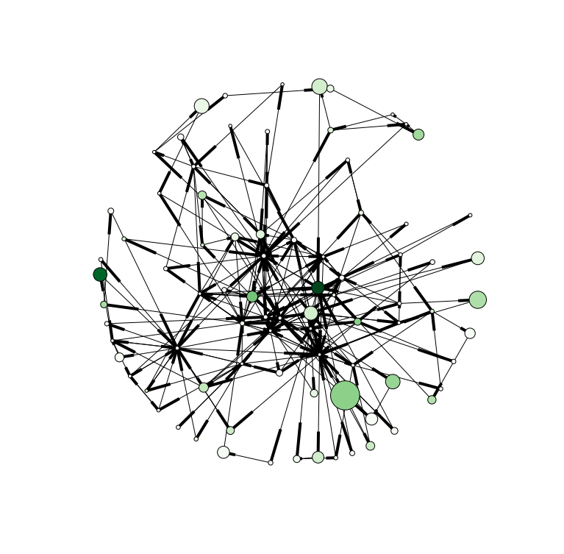
Muddy Waters – Honey Bee

Slide 47
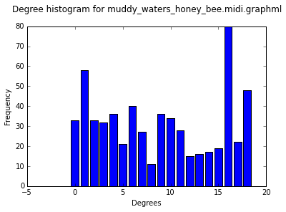
Muddy Waters – Honey Bee
Clustering Coefficient: 0.0290816066575
Avg Path Length: 3.5689902467
Agglomeration: 0.180050430786
Number of nodes: 84
Number of edges: 303
Unique degrees: 19

Slide 48
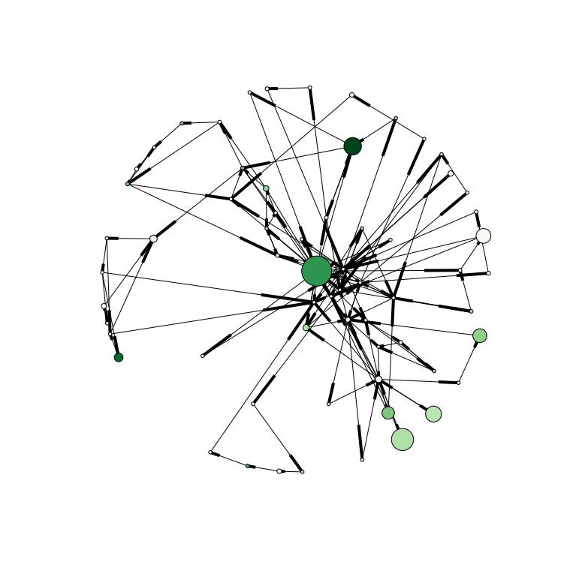
Johnny Cash – Cry Cry Cry

Slide 49
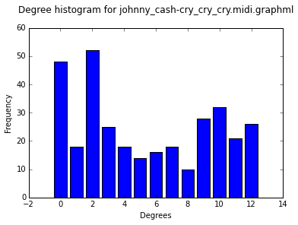
Johnny Cash – Cry Cry Cry
Clustering Coefficient: 0.0075031432452
Avg Path Length: 4.78224206349
Agglomeration: 0.135336294177
Number of nodes: 64
Number of edges: 163
Unique degrees: 13

Slide 50
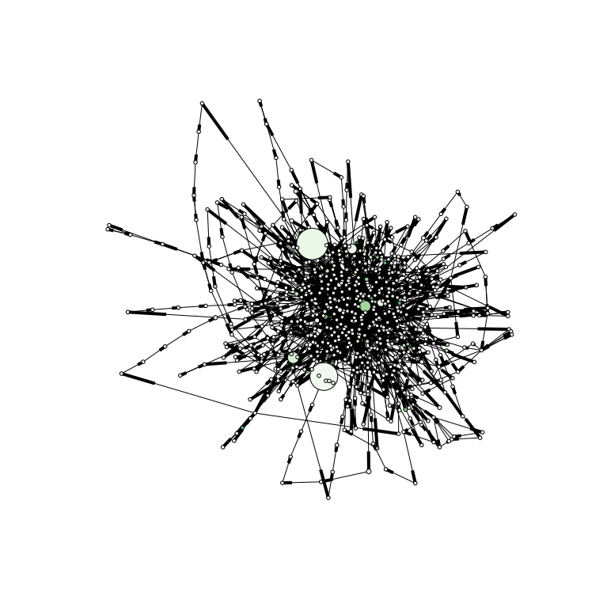
Al Jerrau – Since I Fell For You

Slide 51
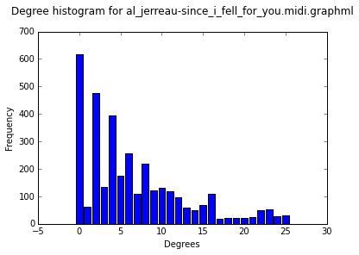
Al Jerrau – Since I Fell For You
Clustering Coefficient: 0.00627162762804
Avg Path Length: 7.62971268597
Agglomeration: 0.0126104631585
Number of nodes: 698
Number of edges: 1731
Unique degrees: 26

Slide 52
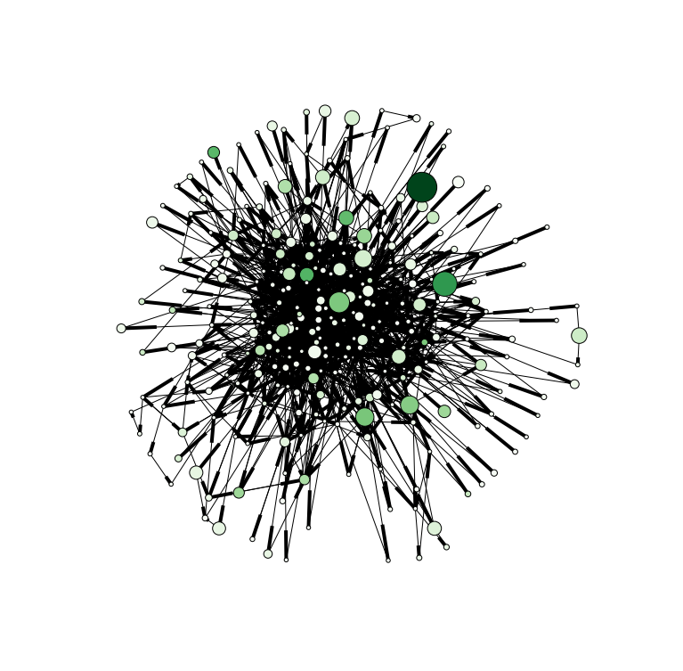
Bach – BWV292

Slide 53
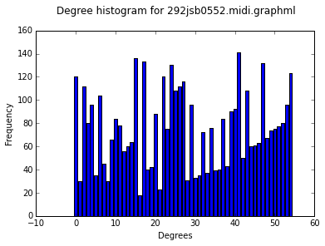
Bach – BWV292
Clustering Coefficient: 0.0229917122188
Avg Path Length: 3.15738553417
Agglomeration: 0.158601800931
Number of nodes: 275
Number of edges: 2088
Unique degrees: 55

Slide 54
Analysis – CC
As the author’s pointed out, the clustering coefficients don’t seem to be very useful when analyzing a harmony graph.
Most clustering coefficients were less than 0.01 and many of them were less than 0.001.
Enimem’s My Name Is had the highest clustering coefficient of 0.13. It’s important to note that this graph had only 29 nodes and 3x the number of edges so triangles among the nodes with respect to each other become more likely to occur. This also shows much repetition.

Slide 55
Analysis - Agglomeration
Right skewed degree distributions lower the agglomeration
Left skewed degree distributions raise the agglomeration
Distributions with very little skew tend to have an agglomeration between 1 and 3.

Slide 56
Analysis – Avg Path Length
High average path lengths are associated with many unique melodic movements.
From the results, avg path lengths less than 3 tend to be more simple songs with regards to variation of melody. For instance, DMX’s Ruff Ryder’s Anthem has an avg path length of 2.8.
An avg path length between 3-5 seem to be where most of the contemporary songs lie. This seems to include country, pop, rock, and folk music.
Many of the jazz and classical pieces have avg path lengths significiantly higher than 4.
Number of nodes should also be taken into account. For instance, Gwen Stefani’s Hollaback Girl only has 24 nodes and an Avg Path Length of 6 while Al Jerrau’s Since I fell for you has 698 nodes and an Avg Path Length of 7.6.

Slide 57
Analysis – Centraily
The visualizations use betweenness centrality and eigenvector centrality to scale the vertices
The number of large vs small vertices as well as dark vs light vertices can be compared for different songs.
Rock, rap and folk songs tend to have a couple large dark nodes that connect different clusters together. This seems to indicate a general verse/chorus formula.
Blues, jazz and classical songs tend to have a lot of small clusters (many darker and medium sized nodes) which seems indicative of more variation in the different movements of the pieces.

Slide 58
Analysis - # of nodes
Graphs with only a few nodes tend to be very repetitive in nature.
Many of the rap songs didn’t have many nodes. Rap songs also don’t tend to have things like complex instrument solos so most of the complexity in the nodes is going to be the main melody of the song. Sugar Hill Gang’s Rapper’s Delight has a very complex melody and thus has many more nodes than other rap songs.
Many of the blues, country, rock, pop and folk songs tended to have more nodes than rap songs even though the songs tend to be much less complex than jazz & classical. This is likely due to the inclusion of things like guitar solos as well as the singing rather than speaking.
Jazz, and classical tended to include many more nodes than the other genres.

Slide 59
Analysis - # of edges
It’s important to look at the number of edges with respect to the number of nodes.
Higher amount of melodic movement indicates nodes with less degrees.
Whereas contemporary styles and non-contemporary alike can all have complex melodies, jazz and classical tend to have less repetition when you take the melodies played over the backing harmonies. Because of this, those styles tend to have a higher ratio of edges to nodes than the more contemporary styles.
Still, the average ratio is between 3:1 and 4:1 for all the genres being analyzed. Some songs go as high as 5:1 and as low as 2:1.
Bach’s BWV292 had a 7.5:1 ratio!
Gwen Stefani’s Hollaback Girl has a ratio of only 1.7:1

