Slide 1
Harmony Graph Evaluation
Corey Nolet
Notes:
My name is Corey Nolet and I based my project around implementing and evaluating a whitepaper that proposed a novel method for building a graph to analyze of corpus of music based on content contained inside of MIDI files. The white paper proposed a graph called the Harmony Graph.

Slide 2
Introduction
Harmony graph is a novel approach to analyzing songs
A social-network-like structure for representing songs as graphs
Allows visualization for analysis of songs
Provides a novel metric for summarizing the graph
Applications in music comparison algorithms like genre classification
Applications in corpus-based music generation
Notes:
Harmony graph is a social network-like structure for representing songs as graph. By representing the songs as graphs, we can use common graph traversal, summarization, and visualization techniques in order to analyze the graphs. The Harmony Graph paper also proposed a novel metric for summarizing the graph. The whitepaper that proposed the harmony graph algorithm also presents applications in music comparison algorithms like genre classification for machine learning as well as corpus-based music generation.

Slide 3
Markov Chain
A Markov chain is a random process that undergoes transitions from one state to another on a state space.
It possesses a property that is usually characterized as “memorylessness”, which is the probability distribution of the next state depends only on the current state and not on the sequence of events that preceded it.
A Markov chain is, most generally, a directed graph with states as veritces and probabilities as weighted edges.
The edges determine the probabilities of a state transitioning to another state on the other side of the edge.
Notes:
Though the paper does not explicitly state it, the harmony graph is largely a markov chain. A markov chain is a random process that undergoes transitions from one state to another in a state space. It possesses a property that is usually characterized as “memorylessness”, which is the probability distribution of the next state depends only on the current state and not on the sequence of events that preceded.
To generalize this, let’s just say that a markov chain is a graph with states as vertices and probabilities as of a state transition as weighted edges.

Slide 4
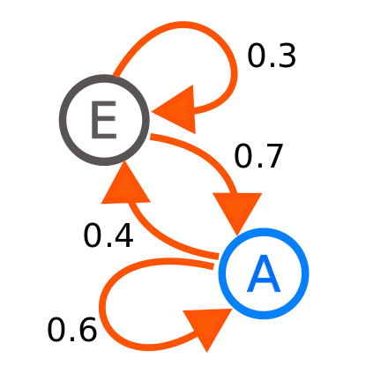
Markov Chain
Notes:
Here’s a small model of a markov chain taken from wikipedia. This has two states, A and E and associated probabilities of A transitioning to E or back to A and E transitioning to A or back to E.

Slide 5
A little music background
MIDI files are musical formats that contain events representing notes, pitches, & durations rather than audio.
Harmony refers to all notes being played simultaneously at any point in a piece of music.
Melody refers to notes being played in succession.
Notes:
Implementing a Harmony graph does not require an extreme amount of musical background but there are a couple important terms to know. First, I used MIDI files in my implementation. Really, any symbolic music format (music scores, musicXML format, etc.) will work for this but I chose to use MIDI files since they are freely available and easy to find on the internet. Also, there is a really good library made and maintained by some folks at MIT for processing MIDI files called Music21. Unlike audio, symbolic formats like MIDI files contain events for when notes begin, their durations, their pitches, and other more expressive information like pitch bends and modulations.
Harmony refers to all notes being played simultaneously by all instruments in a piece of music. Music21 has a nice function called “chordify” which will take all the instruments in a midi file and flatten them down into chords that can be iterated through.
Melody refers to notes being played in succession, one after another. A melody can be a strong sentence of notes played on top of a harmony as well, as we will get to later in the anaysis of the results.

Slide 6
Creating a Harmony Graph
Start by creating a “NULL” vertex which represents the beginning of a song
Each time a note changes in the piece of music, take all the notes being played simultaneously and create a vertex (if one doesn’t exist already).
Attach an edge between the previous set of notes and the current vertex (unless an edge already exists) and increment the weight of the edge by 1.
Once all harmonic components have been exhausted, attach the last vertex back to the NULL node.
Notes:
Creating a harmony graph starts by creating a null vertex to represent the beginning and end of a song. From the null vertex, the chords of the musical piece are iterated one after another. A new harmony occurs every time a note changes (either because a note ended or a new node was included). While iterating through all the harmonies of the song, vertices for unique harmonies are only created once. That means a harmony in a song, for instance, a Gmaj chord that occurs many times throughout a song will only be represented by a single vertex in the harmony graph. An edge is attached between two harmonies if, in the piece of music, one harmony was played directly after another. Each time an edge is created, any current edges connecting the same two harmonies are incremented by 1. Once there are no more harmonies to traverse, the last harmony in the song should connect back to the null vertex.

Slide 7
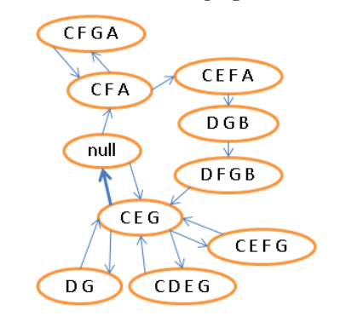
Creating a Harmony Graph
Notes:
This is a good visualization of what the resulting graph will look like after the harmonies have been turned into a harmony graph. Notice that the notes in the harmonies only occur once. That is, in the case of what we call “extended chords” that span over several octaves, we flatten those notes down so that each note only occurs once.

Slide 8
Creating a Harmony Graph
g = nx.DiGraph()
diction = set()
edges = set()
last_node = null_node
g.add_node(last_node)
for thisChord in o.recurse().getElementsByClass('Chord'):
pitchClasses = thisChord.orderedPitchClassesString
if pitchClasses not in diction:
g.add_node(pitchClasses)
diction.add(pitchClasses)
edgeKey = tuple([last_node, pitchClasses])
if edgeKey not in edges:
edges.add(edgeKey)
g.add_edge(last_node, pitchClasses, weight = 1)
else:
g.edge[last_node][pitchClasses]['weight'] = g.edge[last_node][pitchClasses]['weight']+1
last_node = pitchClasses
g.add_edge(last_node, null_node, weight = 1)
nx.write_graphml(g, "graphml/" + f + ".graphml”)
Notes:
Here’s the pseudo code for the creation of the harmony graph. Since I was already using python for the Music21 library, I decided to use a popular python graph library called NetworkX to represent the graph. So there is basically 3 parts to this pseudocode. The creation of the null node and the graph, the iteration through the chords of the song with the creation of the vertices and connection of the edges based on the chords, and finally the graph is written out to graphml.
The reason I wrote the graph out into graphml is because the chordify() function (which occurs directly before this pseodo-code) is a very expensive operation and takes quite awhile to run. In order to make this experiment easily repeatable, I needed a way to serialize the resulting harmony graph out to disk.

Slide 9
Metrics
Several metrics are proposed in the Harmony Graph paper for summarizing the graph
Degree distribution histogram allows us to see the general distribution of the degrees of the graph.
Clustering coefficient measures the degree to which nodes in a graph tend to cluster together.
Average path length is the average number of steps along the shortest paths for all possible pairs of network nodes.
Agglomeration is a novel measure created by the authors of the paper.
Notes:
The harmony graph paper presents several matrics that they found useful for analyzing a harmony graph. The degree distribution histogram is very useful and it allows us to quickly see the distribution of degrees within the graph. As we’ll see later, the shapes of the degree distributions can often give us insight into one of the other metrics.
The clustering coefficient is presented in the paper but is actually not used because another novel metric is proposed in its place. The clustering coefficient, as we’ve learned in this semester, measures the degree to which nodes in a graph tend to cluster together. I decided to use this metric in my own experiments mostly to validate the author’s claim that it is not very useful.
Average path length is the average number of steps along the shortest paths for all possible pairs of network nodes. The authors propose this metric and I found it quite useful when analyzing my own corpus.
Finally, agglomeration is the novel metric that was proposed by the authors to take the place of the clustering coefficient.

Slide 10
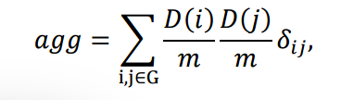
Agglomeration
A phenomenon that occurs when high-degree nodes link together, in contrast to the conditions for a large clustering coefficient, which is due to large number of triangles formed by clusters of links in the graph.
A value of 1 represents a complete graph
A value of 0 represents a completely isolated graph
Notes:
Agglomeration of a graph is a phenomenon that occurs when high-degree nodes link together. We care about this more than whether or not a large number of triangles happen to be formed by clusters of links in the graph and the reason why is because when representing music, we are going to need to summarize whether parts of a song had a large number of melodic (horizontal movement characterized by paths of only single degrees) or not.
Agglomeration has a value of 1 when all nodes are connected to every other node.
It has a value of 0 when there are no nodes connected. As we’ll see later, there is a correllation here to the degree distribution as well. Calculating the agglomeration is not extremely difficult and really just involved looping through all the edges and multiplying the degrees of each of the nodes on the edges and dividing by the number of total degrees squared.

Slide 11
Agglomeration
def agglomeration(g):
agglomeration_numerator = 0.0
total_degrees = 0.0
degrees = nx.degree(g)
for edge in g.edges():
agglomeration_numerator += degrees[edge[0]] * degrees[edge[1]]
for item in degrees:
total_degrees += degrees[item]
return agglomeration_numerator / pow(total_degrees, 2)
Notes:
Here’s the agglomeration function. Nothing too complicated.

Slide 12
Music Generation
Two ways of generating music are presented
Random Walk
Link Prediction
Notes:
Though I did not implement any of the music generation in my project, it’s worth mentioning because it’s in the harmony graph paper. There are two ways of generating music using the harmony graph. Random walk and link prediction.

Slide 13
Random Walk
By walking the graph randomly from any node, music can be produced.
Store the duration of the movement between two harmonies with the edges (along with the weights)
The random walker can also be able to play a changing rhythm along with the harmonic progression.
This approach is supposed to be able to produce similar styles of music to the corpus which is being walked.
The produced music will sound novel but familiar
Notes:
Random walk involves walking the graph randomly from any node. So we could start at the null node and just follow the edges and play the resulting chords. Another thing we can do is to store the duration of the movement between two harmonies along side the edge weights so that we can have some assemblance of rhythm as we’re walking the graph (the alternative would be to choose either a completely random duration or use the same duratino throughout the whole traversal and neither of these would sound very pleasant in the end).
The reason we want to walk the graph to generate music is to be able to produce a song that sounds novel but a similar style to the song in which the graph was created.

Slide 14
Link Prediction
In random walk, if the degree of a node is 1, there is only 1 choice for the next node. It’s also very likely that the next node also has a degree of 1.
The longer the path of nodes with degrees of 1, the more the newly generated music sounds like the original.
Link prediction estimates the probability of connection for two unconnected nodes.
When a random walker departs one node, it chooses some other (possibly unconnected) node as extra candidates based on their link prediction probability.
Similarity measure for determining probability is the number of common notes divided by the total number of notes in each harmony. This is called Jacquard similarity.
Notes:
Link prediction adds a little more complexity than the random walk. One problem with the random walk is that if the degree of a node is 1, there is only 1 choice for the next node. It’s also very likely that the next node also has a degree of 1. Because of this, the longer the past of nodes with degree of 1 (the more of a melody that has surfaced) the more the newly generated music is going to take on that melody in its entirety.
Link prediction estimates the probability of connection for two unconnected nodes. When a random walker departs one node, it chooses some other (possibly unconnected) node as extra candidates based on their link prediction probability.
Jacquard similarity is used for determining the probability that an edge would exist between two nodes. This is the number of common notes in two harmonies divided by the total number of notes between two hardmonies. This measure is also called the tanimoto coefficient.

Slide 15
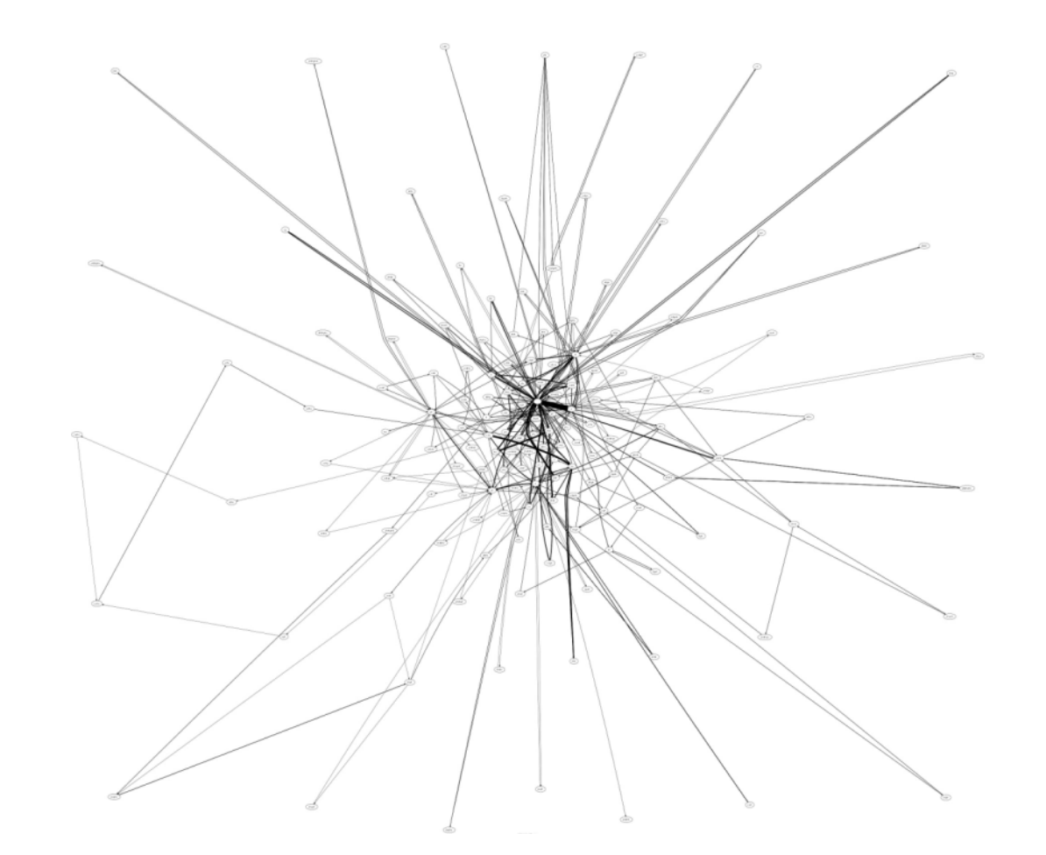
Visualizing The Graph
The harmony graph paper presents a graph which looks like the following.
Notes:
So before I get into the results of my MIDI corpus, I’ll finish off with how I implemented the visualization of the graph. The paper basically shows a graph which looks like this.

Slide 16
Visualizing The Graph
Unfortunately, this is very hard to follow and doesn’t really mean much to anyone trying to analyze it!
Notes:
The vertices are just about impossible to see individually. Though the overall layout is not quite as hard to visualize, it’s not that simple to see clustering and highly connected paths. The edge thickness is based on edge weights but other than the weight, it’s hard to summarize the actual shape.

Slide 17
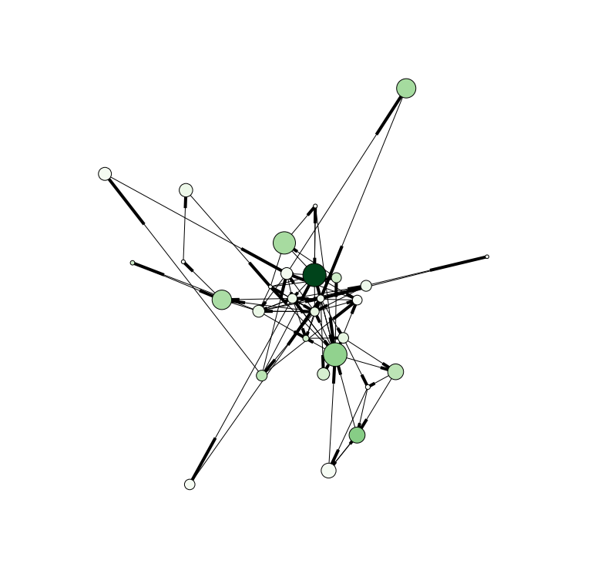
Visualizing The Graph
A better graph could look like this:
Notes:
This is what my implementation of a visualization for the harmony graph looks like. Notice in this graph the vertices have different sizes and colors.

Slide 18
Visualizing The Graph
Size of vertices are drawn from eigenvector centrality
Notes:
The sizes of the vertices are drawn from the eigenvector centrality. Eigenvector centrality is one method of computing the "centrality", or approximate importance, of each node in a graph. The assumption is that each node's centrality is the sum of the centrality values of the nodes that it is connected to.

Slide 19
Visualizing The Graph
Color of vertices is based on betweenness centrality
Notes:
The color of the vertices are drawn from the betweenness centrality. The darker the shade, the higher the betweenness centrality. Betweenness centrality is an indicator of a node's centrality in a network. It is equal to the number of shortest paths from all vertices to all others that pass through that node. Ultimately, it tries to show how likely a random walker would be to pass through that node if traversing randomly in a graph.

Slide 20
Visualizing The Graph
Allows us to quickly separate graphs like this

Slide 21
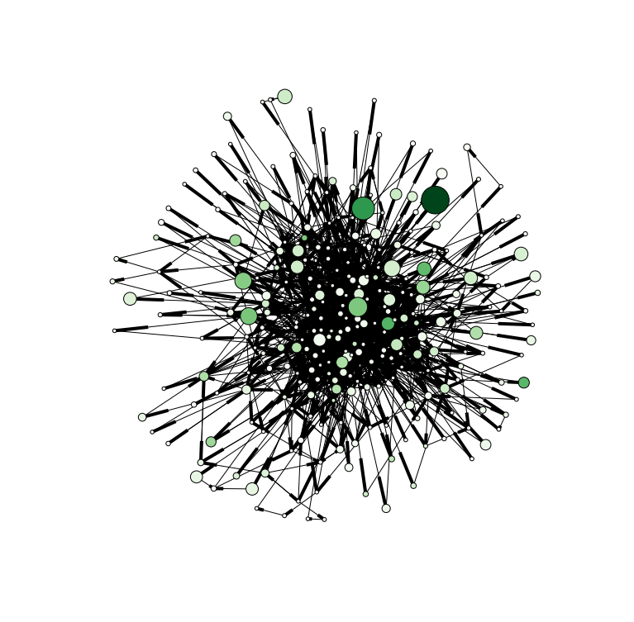
Visualizing the Graph
From graphs like this

Slide 22
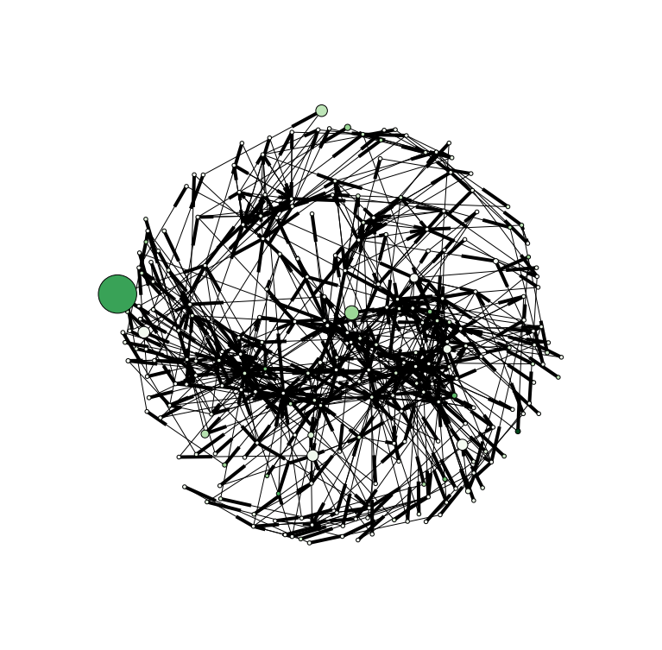
Visualizing the Graph
A spring force-directed layout was used for each image.
Notes:
A force directed layout is basically an iterative simulation of a physical where the edges act like springs. Forces are assigned to edges and vertices and their movement is simulated until they reach a steady state or equilibrium.

Slide 23
Visualizing the Graph
An algorithm called Fruchterman-Reingold force-directed
Notes:
The circular shape comes from a boundary applied to the graph.

Slide 24
Method
I found 86 MIDI files on the internet for several different genres spanning pop, rock, country, folk, jazz, classical, rap, and rhythm & blues.
A python script ran overnight analyzing each MIDI file, creating the resulting harmony graph, and outputting it as a graphml file.
All of the graphml files were then pulled parsed with another Python script, metrics created, and images drawn with the nodes & edges for visualization.
Notes:
86 midi files were included in the corpus for 8 different genres. To build the graphs out of the files, I had a python script run over night. Once the graphml files were persisted with the resulting harmony graphs, I able to run the metrics and build the resulting visualizaitons. I’ve included some of the more interesting results at the end of this slide deck but analyzing each one individually would be very time consuming and out of the scope of this project. Instead, I’m going to go through each of the metrics and share my analysis summarization based on the items in the corpus.

Slide 25
Analysis – CC
As the author’s pointed out, the clustering coefficients don’t seem to be very useful when analyzing a harmony graph.
Most clustering coefficients were less than 0.01 and many of them were less than 0.001.
Enimem’s My Name Is had the highest clustering coefficient of 0.13. It’s important to note that this graph had only 29 nodes and 3x the number of edges so triangles among the nodes with respect to each other become more likely to occur. This also shows much repetition.
Notes:
I’ll start with the clustering coefficient. As the authors pointed out, the clustering coefficients aren’t extremely useful when analyzing a harmony graph. Most of the clustering coefficients were very small, less than 0.01 and many of them were less than 0.001. Eminem’s song My Name Is had the highest clustering coefficient of 0.13. It’s important to note, however, that this graph had only 29 nodes and 3x the number of edges so triangles among the nodes with respect to each other become more likely to occur.

Slide 26
Analysis - Agglomeration
Right skewed degree distributions lower the agglomeration
Left skewed degree distributions raise the agglomeration
Distributions with very little skew tend to have an agglomeration between 1 and 3.
Many of the songs in the corpus are right skewed which means they have a fairly small agglomeration.
There are some songs with no skew like Ace of Base’s All That She Wants and Muddy Waters Honey Bee.
Very few of the songs tend to be left skewed but Bruce Springsteen’s Born In The USA is one.
Notes:
I noticed when analyzing the corpus that agglomeration was lower for data with right skewed degree distributions. Since the agglomeration is higher when higher degree nodes are connected, it makes sense that a left-skewed degree distribution (that is, many of the nodes have higher degrees) has a higher agglomeration. Distributions with very little skew tend to have an agglomeration between 1 and 3. A look at the corpus will show many songs right skewed (smaller number of high degree nodes). There are some songs with no skew as well (similar amount of smaller and higher degree nodes). Ace Of Base’s All that she wants and Muddy Waters Honey Bee are two such songs.
Very few songs tend to be left skewed. Bruce Springsteen’s Born in the USA is one such song, however.

Slide 27
Analysis – Avg Path Length
High average path lengths are associated with many unique subsequent melodic movements.
From the results, avg path lengths less than 3 tend to be more simple songs with regards to variation of melody. For instance, DMX’s Ruff Ryder’s Anthem has an avg path length of only 2.6.
An avg path length between 3 & 5 seem to be where most of the contemporary songs lie. This seems to include country, pop, rock, and folk music.
Many of the jazz and classical pieces have avg path lengths significiantly higher than 4.
Number of nodes should also be taken into account. For instance, Gwen Stefani’s Hollaback Girl only has 24 nodes and an Avg Path Length of 6 while Al Jerrau’s Since I fell for you has 698 nodes and an Avg Path Length of 7.6.
Notes:
High average path lengths are associated with many unique subsequent melodic movements. From the results, average path lengths less than 3 tend to be more simple songs with regards to variation of melody. For instance, DMX’s ruff ryder’s anthem has an average path length of only 2.6. An average path length between 3 and 5 seem to be where most of the contemporary songs lie. This seems to include country, pop, rock, and folk music.
Many of the jazz and classical pieces have average path lengths significantly higher than 4 which shows more complex and diverse melodic movements.
Number of nodes should also be taken into account if using avg path length to try to determine overall melodic content. For instance, Gwen Stefani’s Hollaback Girl only has 24 nodes and an avg path length of 6 while Al Jerrau’s Since I fell for you has 698 nodes an an average path length of 7.6.

Slide 28
Analysis – Centraily
The visualizations use betweenness centrality and eigenvector centrality to scale the vertices
The number of large vs small vertices as well as dark vs light vertices can be compared for different songs.
Rock, rap and folk songs tend to have a couple large dark nodes that connect different clusters together. This seems to indicate a general verse/chorus formula.
Blues, jazz and classical songs tend to have a lot of small clusters (many darker and medium sized nodes) which seems indicative of more variation in the different movements of the pieces.
Notes:
As mentioned earlier, the visualizations use betweenness centrality and eigenvector centrality to scale the vertices. The number of large vs small vertices as well as dark vs light vertices can be compared for different songs. Rock, rap, and folk songs tend to have only a couple large dark nodes that connect different clusters together while the other nodes tend to be smaller and lighter. I would liken this to indicating a general verse/chorus formula as is often used in these styles.
Blues, Jazz, and Classical songs tend to have a lot of small clusters (many darker and medium sized nodes) which seems indicative of more variation in the different movements of the pieces.

Slide 29
Analysis - # of nodes
Graphs with only a few nodes tend to be very repetitive in nature.
Many of the rap songs didn’t have many nodes. Rap songs also don’t tend to have things like complex instrument solos so most of the complexity in the nodes is going to be the main melody of the song. Sugar Hill Gang’s Rapper’s Delight has a very complex melody and thus has many more nodes than other rap songs.
Many of the blues, country, rock, pop and folk songs tended to have more nodes than rap songs even though the songs tend to be much less complex than jazz & classical. This is likely due to the inclusion of things like guitar solos as well as the singing rather than speaking.
Jazz and classical tended to include many more nodes than the other genres.
Notes:
Graphs with only a few nodes tend to be very repetitive in nature. Many of the rap songs didn’t have many nodes. Rap songs also don’t tend to have things like complex instrument solos so most of the complexity in the nodes is going to be main melody of the song. Sugar Hill Gang’s Rapper’s Delight has a very complex melody and thus has many more nodes than other rap songs.
Many of the blues, country, rock, pop, and folk songs tended to have more nodes than rap songs even though the songs tend to be much less complex than jazz & classical. This is likely due to the inclusion of things like guitar solos as well as the singing melodies rather than speaking.
Jazz and classical tended to include many more nodes than the other genres.

Slide 30
Analysis - # of edges
It’s important to look at the number of edges with respect to the number of nodes.
Higher amount of melodic movement indicates nodes with less degrees.
Whereas contemporary styles and non-contemporary alike can all have complex melodies, jazz and classical tend to have less repetition when you take the melodies played over the backing harmonies. Because of this, those styles tend to have a higher ratio of edges to nodes than the more contemporary styles.
Still, the average ratio is between 3:1 and 4:1 for all the genres being analyzed. Some songs go as high as 5:1 and as low as 2:1.
Bach’s BWV292 had a 7.5:1 ratio!
Gwen Stefani’s Hollaback Girl has a ratio of only 1.7:1
Notes:
It’s important to look at the number of edges with respect to the number of nodes. Just looking at the number of edges wouldn’t really say much for density of the graph.
Higher amount of melodic movement indicates more nodes with less degrees. Whereas contemporary styles and non-contemporary alike can all have complex melodies, jazz and classical tend to have less repetition when you take the melodies played over the backing harmonies. Because of this, those styles tend to have a higher ratio of edges to nodes than the more contemporary styles.
Still, the average ratio is between 3:1 and 4:1 for all genres being analyzed. Some songs go as high as 5:1 and as low as 2:1.
Bach’s BWV292 had a 7.5:1 ratio while Gwen Stefani’s Hollaback girl has a radio of only 1.7:1.
The rest of this slide deck contains the results of many of the songs which I found interesting when doing my analysis. I will not be going over then individually in this presentation but I invite you to download the slides and look through them. If you want to see the results of the entire corpus, You can also look at the HTML files called “harmony_graph.html” that I generated from the ipython notebook. I have all of this up on my github repository which is referenced in my discussion thread for the final project.
Thank you.

Slide 31
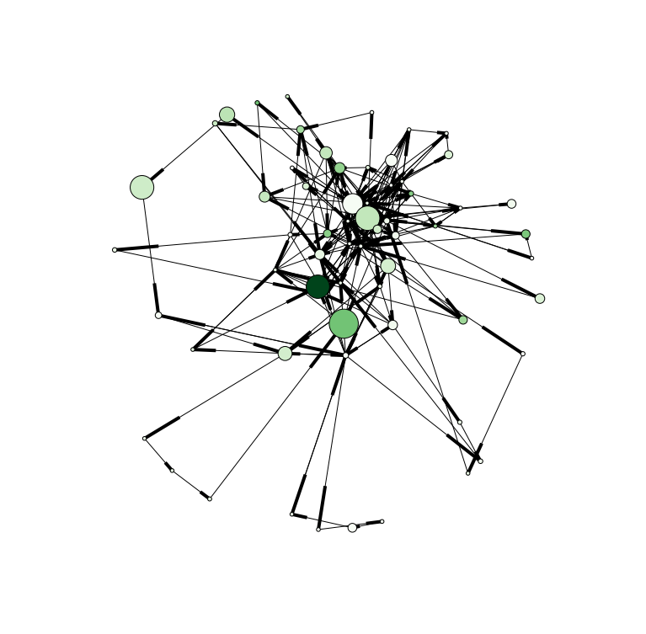
50 Cent – In Da Club

Slide 32
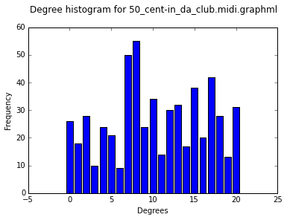
50 Cent – In Da Club
Clustering Coefficient: 0.0120648262587
Avg Path Length: 3.5752688172
Agglomeration: 0.207971807253
Number of nodes: 63
Number of edges: 282
Unique degrees: 21

Slide 33
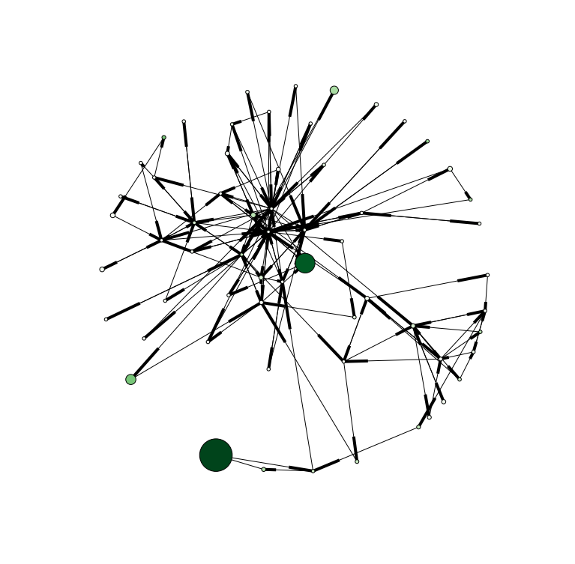
ACDC – Dirty Deeds

Slide 34
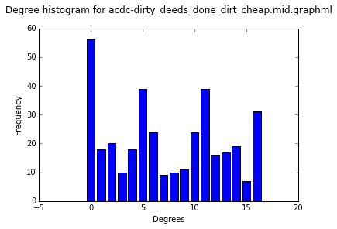
ACDC – Dirty Deeds
Clustering Coefficient: 0.00354762966973
Avg Path Length: 3.57131147541
Agglomeration: 0.227382147921
Number of nodes: 61
Number of edges: 184
Unique degrees: 17

Slide 35
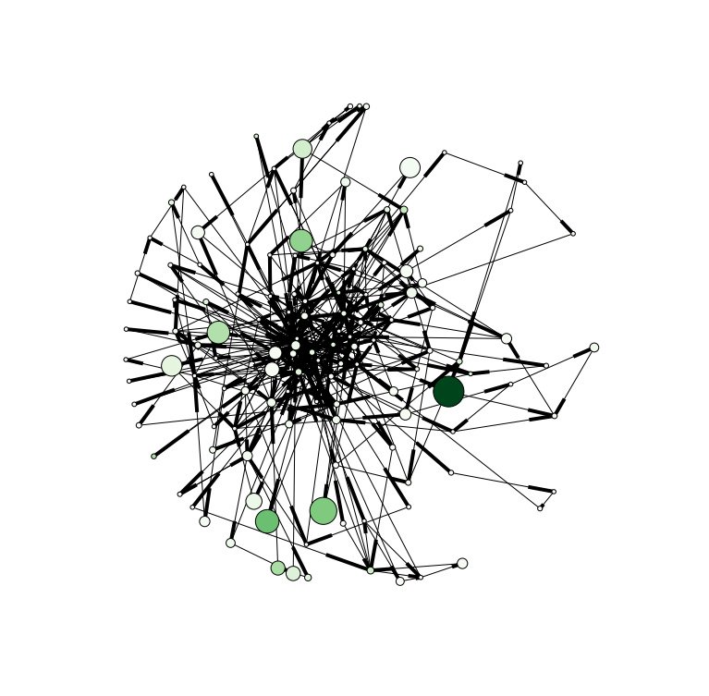
Ace of Base – All that she wants

Slide 36
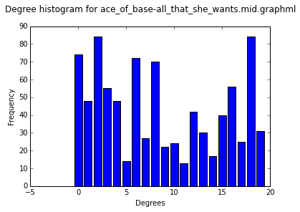
Ace of Base – All that she wants
Clustering Coefficient: 0.0155058346985
Avg Path Length: 3.76989359241
Agglomeration: 0.134799628865
Number of nodes: 132
Number of edges: 438
Unique degrees: 20

Slide 37
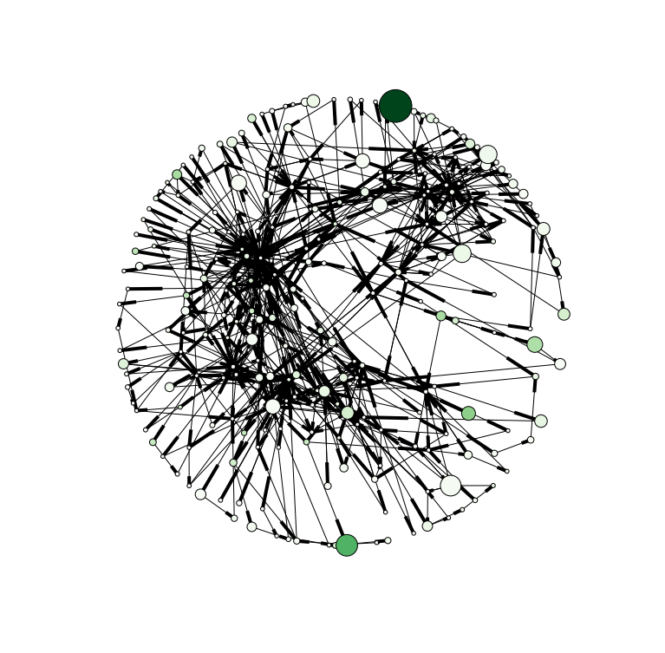
Adele – Rolling Deep

Slide 38
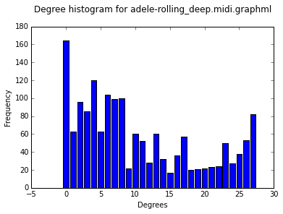
Adele – Rolling Deep
Clustering Coefficient: 0.0258326620925
Avg Path Length: 4.6290684624
Agglomeration: 0.0684676102133
Number of nodes: 243
Number of edges: 809
Unique degrees: 28

Slide 39
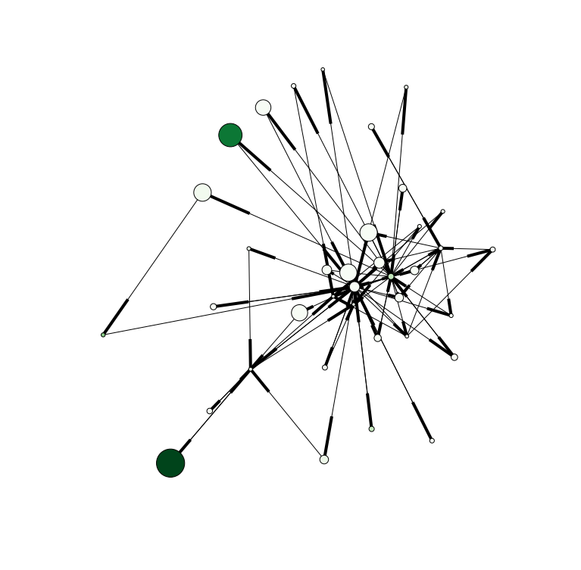
DMX – Ruff Ryders Anthem

Slide 40
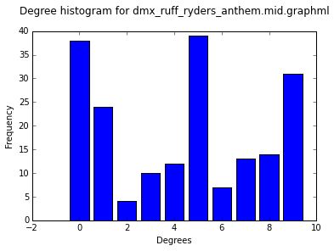
DMX – Ruff Ryders Anthem
Clustering Coefficient: 0.0637873147284
Avg Path Length: 2.61411411411
Agglomeration: 0.406087239583
Number of nodes: 37
Number of edges: 96
Unique degrees: 10

Slide 41
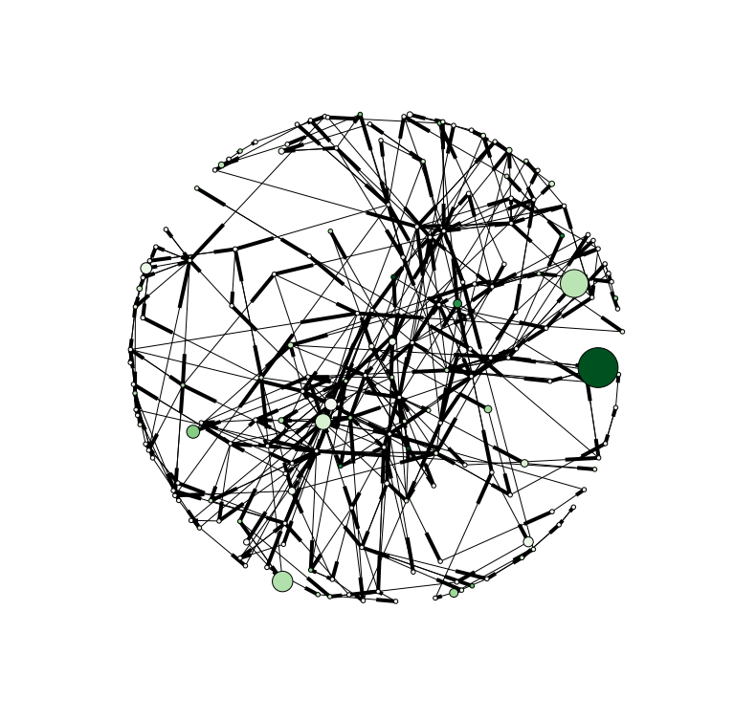
Cat Stevens – Wild World

Slide 42
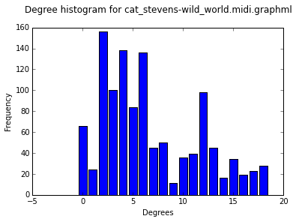
Cat Stevens – Wild World
Clustering Coefficient: 0.00791131184398
Avg Path Length: 6.03824911868
Agglomeration: 0.0368630795566
Number of nodes: 185
Number of edges: 574
Unique degrees: 19

Slide 43
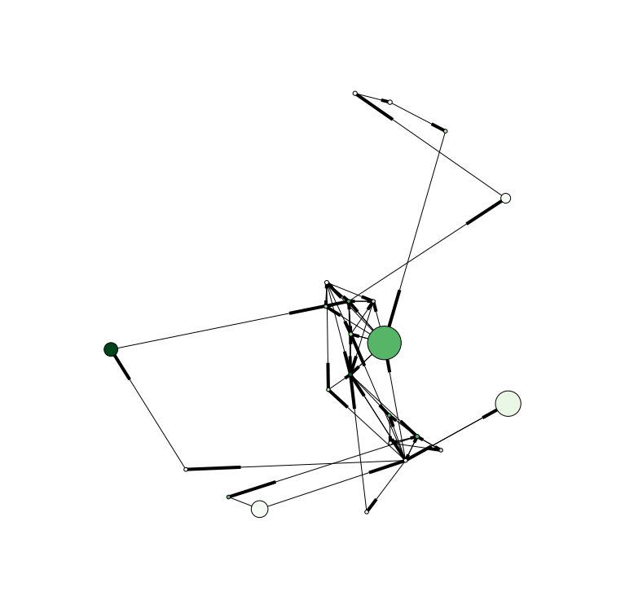
Bruce Springsteen – Born USA

Slide 44
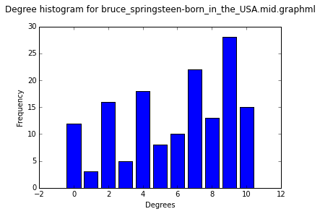
Bruce Springsteen – Born USA
Clustering Coefficient: 0.0322580249084
Avg Path Length: 3.29841897233
Agglomeration: 0.3092
Number of nodes: 23
Number of edges: 75
Unique degrees: 11

Slide 45
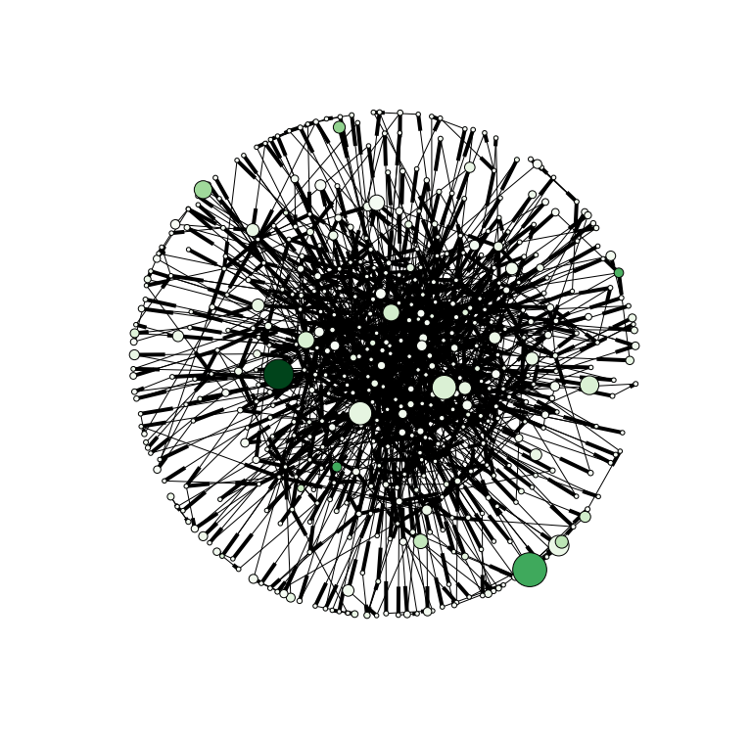
Errol Garner - Misty

Slide 46
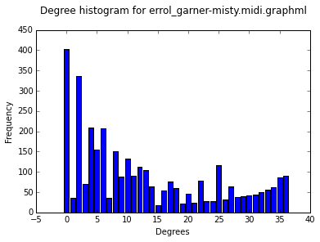
Errol Garner - Misty
Clustering Coefficient: 0.00908473818057
Avg Path Length: 4.62479572312
Agglomeration: 0.0558785040403
Number of nodes: 494
Number of edges: 1671
Unique degrees: 37

Slide 47
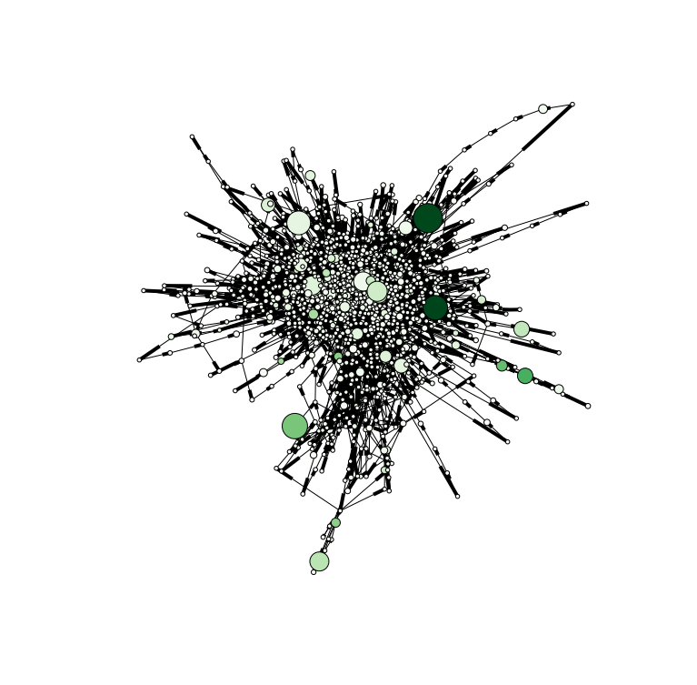
Miles Davis – Alone Together

Slide 48
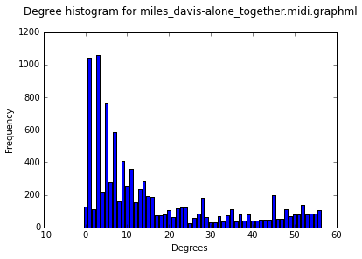
Miles Davis – Alone Together
Clustering Coefficient: 0.00816191426634
Avg Path Length: 5.64979873581
Agglomeration: 0.0319343444501
Number of nodes: 1378
Number of edges: 4781
Unique degrees: 57

Slide 49
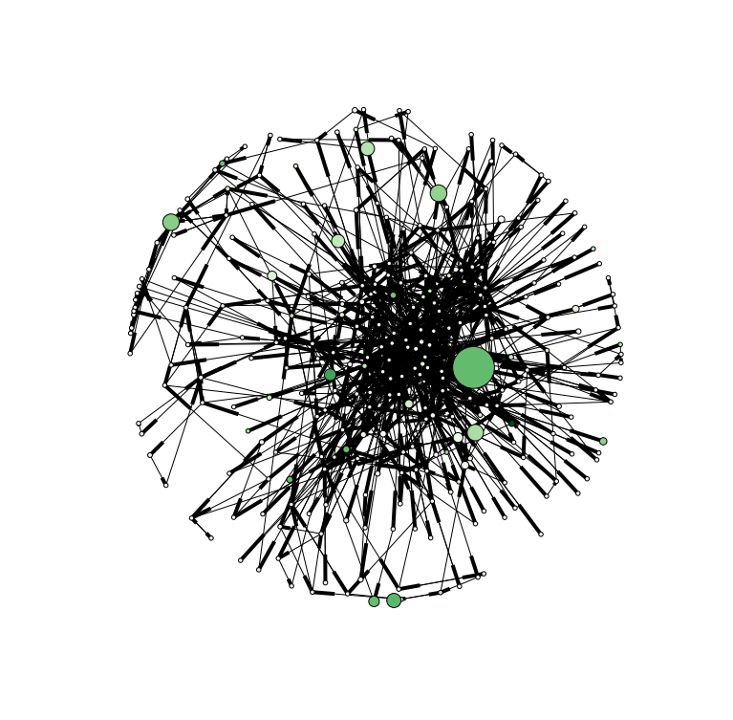
Mozart – Sym40 Mov1

Slide 50
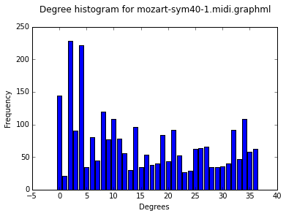
Mozart – Sym40 Mov1
Clustering Coefficient: 0.00186153221144
Avg Path Length: 4.26271726272
Agglomeration: 0.0898119768608
Number of nodes: 297
Number of edges: 1314
Unique degrees: 37

Slide 51
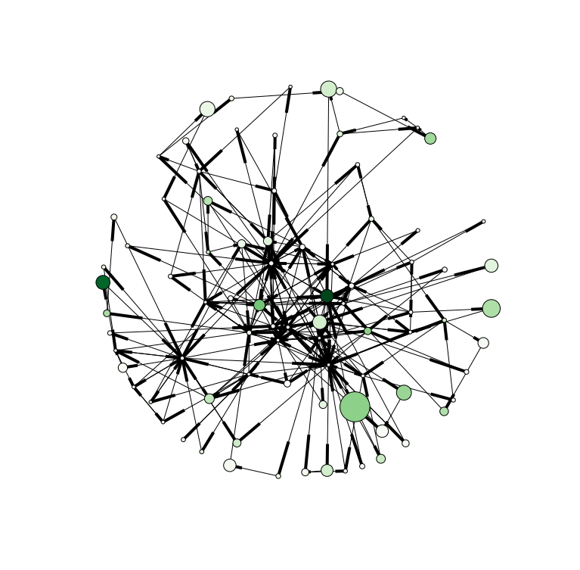
Muddy Waters – Honey Bee

Slide 52
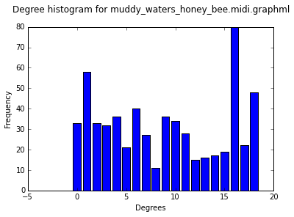
Muddy Waters – Honey Bee
Clustering Coefficient: 0.0290816066575
Avg Path Length: 3.5689902467
Agglomeration: 0.180050430786
Number of nodes: 84
Number of edges: 303
Unique degrees: 19

Slide 53
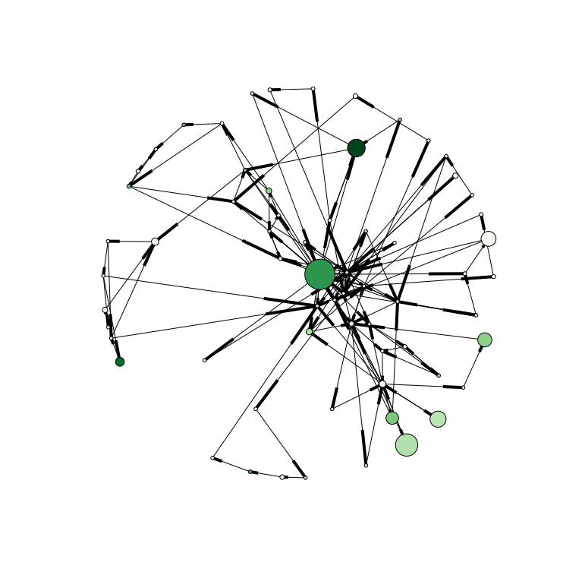
Johnny Cash – Cry Cry Cry

Slide 54
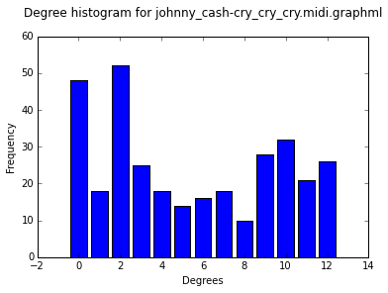
Johnny Cash – Cry Cry Cry
Clustering Coefficient: 0.0075031432452
Avg Path Length: 4.78224206349
Agglomeration: 0.135336294177
Number of nodes: 64
Number of edges: 163
Unique degrees: 13

Slide 55
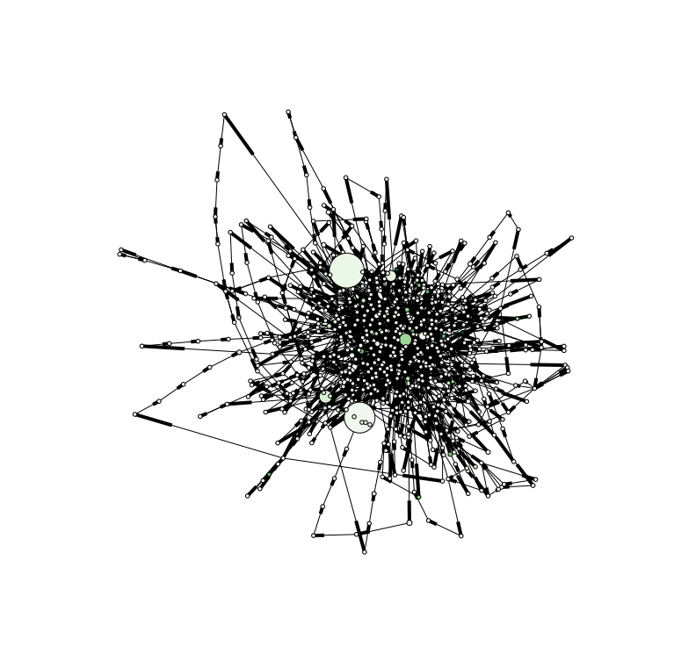
Al Jerrau – Since I Fell For You

Slide 56
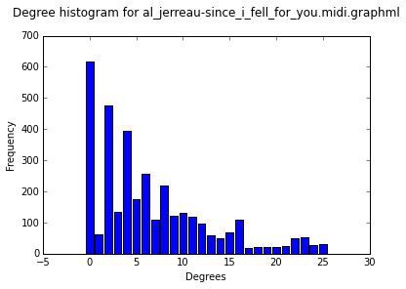
Al Jerrau – Since I Fell For You
Clustering Coefficient: 0.00627162762804
Avg Path Length: 7.62971268597
Agglomeration: 0.0126104631585
Number of nodes: 698
Number of edges: 1731
Unique degrees: 26

Slide 57
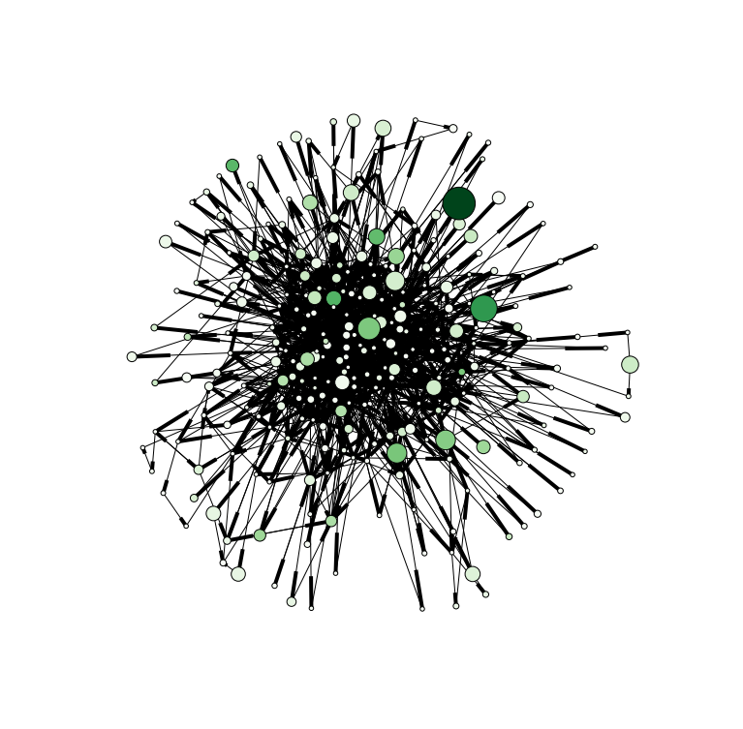
Bach – BWV292

Slide 58
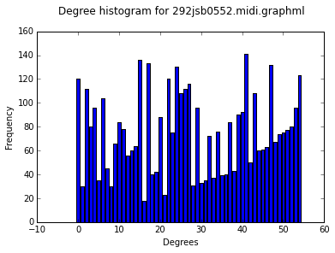
Bach – BWV292
Clustering Coefficient: 0.0229917122188
Avg Path Length: 3.15738553417
Agglomeration: 0.158601800931
Number of nodes: 275
Number of edges: 2088
Unique degrees: 55

