Slide 1

Spark Deep Dive
Corey Nolet
Tetra Concepts

Slide 2
Design Philosophies
Akka
  Remote actors model
  Designing for scalability
  Distributed / concurrent processing
  Across threads, processes, machines
Scala
  Functional / closure-based
  Lazy-evaluated
  Immutable
  Type inference
    Terse but safe
Notes:
I think a great place to start would be with the core design philosophies that the architecture was designed around.
First, we have Akka. This is a framework that, similar to many other distributed frameworks today, has you thinking about breaking your problems into their atomic particles first so that those particles can be designed on a single node and then scaled out as needed to run on clusters of machines. At its heart, it focuses on Actors who know how to intercept, process, and create new messages that are sent to other Actors. Actors are nothing more than objects which get serialized and deployed onto nodes and then start doing their magic, processing messages they choose to accept.
Then there's Scala which is the backbone that supports the expressive nature of the Akka framework. I could go on for hours about why Scala is such a useful framework for processing data but I'll opt for the basic bullet points since we're going to be strapped for time. Scala blends together functional and imperative programming in the JVM by using Java objects to define Closures, or first class functions that remember any variables available in the environment in which they were created. Similar to Java, Scala has a rich collections API. Unlike Java, however, Scala promotes immutability and uses shared structural state create new lightweight objects out of older objects when doing many operations that would normally require mutating state. Of course it does have mutable objects for those who need them, but it recommends sticking with immutability. When operations like add, remove, concatenate, etc.. are performed on many of the collections objects, they need not be copied- instead the inner
Similar to Java 8's streams API, and Guava's Iterables, Scala has

Slide 3
Hadoop-based
Integration with HDFS
Preserves data locality
Shuffles for all-to-all communications
Integrates natively with resource negotiators like YARN
Can use existing Hadoop input/output formats

Slide 4

Notes:
It turns out, this was no coincidence. This guy by the name of Matei Zaharia in 2008 wrote Hadoop's FairScheduler while working for Cloudera.
While getting his PhD at UC Berkeley, he created Apache Spark and Apache Mesos. Clearly this guy is no stranger to large-scale scheduling of computations on distributed systems.
He is one of the co-founders of Databricks and is currently their CTO while also an assistant professor of Computer Science @ MIT.
We love this guy- even though many of us don't know who he is.

Slide 5
New concepts for the community
Dependency graph instead of map/combine/reduce
  Can be narrow or wide depending on communication model
  Reprocessing partitions instead of restarting entire tasks
Dataset appears like a local collection but actions cause distributed computation
Memory can be used to cache data for reuse across different transformations & actions.

Slide 6
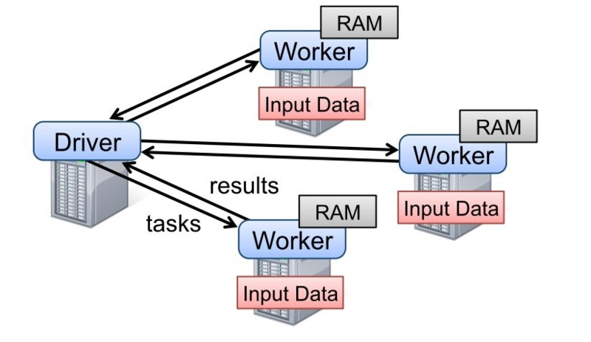

Slide 7
RDD
API Similar to Scala's collection's API
  Provides lazy functions like map(), flatMap(), reduce(), collect(), etc…
Transformation lineage is tracked
  Partitions can be rebuilt in the case of failure
Broken up into partitions that get scheduled on tasks

Slide 8
Jobs, Stages, Tasks
SparkContext can be a long-running object and we can submit many jobs to it.
Job: a sequence of transformations and actions on an RDD
Stage: a specific transformation or action on an RDD that gets scheduled on the executors.
Tasks: The actual closures executing on executors to process stages.

Slide 9
What are partitions?
Chunks of data that make up an RDD.
Distributed across the cluster and control parallelism of processing
Often start in a job from an input format
  Similar to input splits in MapReduce
Number can change throughout the stages that make up a job
  Default can be set using spark.default.parallelism

Slide 10
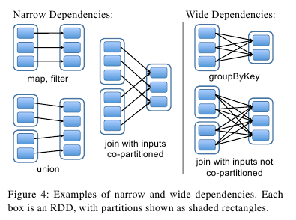
Partitions

Slide 11
Partition Locality
Can carry a set of “preferred locations” for which tasks should be scheduled.
  Like splits in MapReduce
Locality levels lowered when tasks become too busy
  Process, Node, Rack, Any, or No Pref
  Process is most preferred
  Set through
  spark.locality.wait.[process,node,rack]

Slide 12
Partition Sizes
Can be changed manually using rdd.coalesce()
Low overhead in deserializing tasks to process partitions
Unlike MapReduce, many small partitions are recommended over few large ones.
Generally 2-3 per core
Tasks can be small enough to run in 200ms and still be efficient.

Slide 13
Changing Partition Sizes
rdd.coalesce(
  numPartitions,
  shuffle?
)
rdd.repartition(
  numPartitions
)

Slide 14
Changing Partition Sizes
rdd.repartition(numParts)
actually calls
rdd.coalesce(numParts, true)

Slide 15
Coalesce (not shuffled)
Results in narrow dependency
For reducing number of partitions
  Drastic decrease (e.g. 1000→ 1) usually benefits more from shuffling
Final number of parts will never be greater than specified amount
  Could be less if the number of parent parts is less

Slide 16
Coalesce (not shuffled)
Groups final partitions so they map to the same number of parent partitions
When parents have locality information:
  Attempts to group parent partitions on their local nodes
When parents don't have locality information:
  Create groups by chunking parents that are close in the array of partitions

Slide 17
Coalesce (shuffled)
Results in wide dependency
Allows number of partitions to be increased at the expense of a shuffle.
Evens out distribution of data using a hash partitioner.

Slide 18
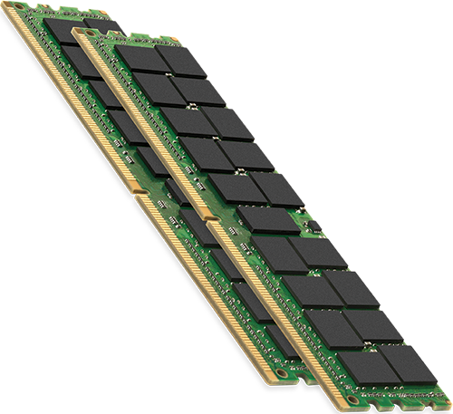
Memory in Spark

Slide 19
Executor Memory
Divided among cache and processing
  60% used for cached objects
    spark.storage.memoryFraction=60
    spark.storage.safetyFraction=90
  20% used for shuffles
    spark.shuffle.memoryFraction=20
    spark.shuffle.safetyFraction=80
  What's left over is for task execution
Usable memory is defined as follows:
    (max memory allocated to JVM – overhead memory used in the JVM) * memoryFraction * safetyFraction.

Slide 20
Executor Memory
High JVM overhead can significantly reduce amount of memory available for caching, shuffles, and task execution.
    Default amount allocated for YARN executors used to be 7%. Raised to 10% in 1.3
    Dependent on choices of data structures and overhead of classes used.
    spark.yarn.executor.memoryOverhead

Slide 21
RDD Caching
Useful when multiple downstream transformations depend on a single upstream RDD
val rdd1 = inputRdd.map(..)..saveAsTextFile(..)
val rdd2 = inputRdd.map(..)..saveAsTextFile(..)
Done through rdd.persist()
LRU eviction of memory cached RDDs when memory is full (automatic cleanup)
Can be manually evicted using rdd.unpersist()

Slide 22
RDD Caching
Deserialized / Raw
  Generally faster
    No cost of serializing data
  Larger data sets put pressure on the garbage collector
Serialized
  Can take up to 2x - 4x less memory
  Can be slower processing than raw while garbage collector is running efficiently

Slide 23
Storage Levels
MEMORY_ONLY
MEMORY_AND_DISK
MEMORY_ONLY_SER
MEMORY_AND_DISK_SER
DISK_ONLY
MEMORY_ONLY_SER_2
MEMORY_AND_DISK_SER_2
MEMORY_ONLY_2
MEMORY_AND_DISK_2
OFF_HEAP

Slide 24
Tachyon
Uses a Ramdisk, or in-memory file system, to expose HDFS API.
Asynchronously writes to HDFS
Allows off-heap caching to put less pressure on garbage collector
Data can be shared by multiple executors
  Cached data is not lost when an executor dies
Still experimental as of Spark 1.4.0

Slide 25
Project Tungsten
Designs for three major optimizations to Spark
One of them provides off-heap memory management to lower object overheads and bypass garbage collection.
Another provides cache-aware data structures that can minimize memory lookups
https://databricks.com/blog/2015/04/28/project-tungsten-bringing-spark-closer-to-bare-metal.html

Slide 26
Shared Memory
Broadcast variables
  Read-only memory cached on each executor and shared across tasks
  Can be used like distributed cache in MapReduce to share large lookup tables across tasks
Accumulators
  Can be used like counters in MapReduce
  Can also perform any generic associative algorithm.

Slide 27
Broadcast & Accumulators
// Using broadcast variable
val valueToWrap = “fubar”
val broadcastVal = sc.broadcast(valueToWrap)
…
rdd.filter(_ == broadcastVal.value)
// Using accumulators
val accumulator = sc.accumulator(0)
rdd.map(it => {
accumulator += 1
    it
})

Slide 28

Serialization in Spark
Two different types
  Closures
  Data

Slide 29
Closures
Scala can be a little confusing
  Functions vs Methods
  Objects vs Classes
Closure is just an anonymous implementation of the FunctionX class in Scala
Closure will always contain a reference to its outer object
  Any objects used inside the closure will be serialized

Slide 30
Functions vs. Methods
class MyClass {
    // compiles down to Java method
  def myMethod(): Unit {}
}
class MyClass {
    // compiles to impl of FunctionX trait
val myFuction: () => Unit = () => {}
}
Methods can also be coerced into functions, allowing them to pass around like functions.

Slide 31
Objects vs. Classes
object MyObject {
    // compiles to static member of MyObject
    val myVal: Boolean = true
    // compiles to Java static method
  def myMethod(): Unit {}
}
class MyClass {
    // compiles to instance value
    val myVal: Boolean = true
    // compiles to method on MyClass
def myMethod(): Unit {}
}

Slide 32
Closure Serialization
The primary way code makes it from the driver to executors
  No more extends Mapper/Reducer
  Closures can be shipped at runtime
Currently only supports Java serialization
Closure cleaner attempts to prune unused references of the object graph
  Can still use unnecessary memory if not careful

Slide 33
Closure Cleaner
class MyProcessor {
  def process(rdd: RDD[String]) {
      rdd.filter(_ == “good”)
      ...
  }
}
The filter() closure's reference to outer class MyProcessor gets pruned by the ClosureCleaner because it is not used.

Slide 34
Closure Cleaner
class MyProcessor(
  filterWord: String
) {
  def process(rdd: RDD[String]) {
      rdd.filter(_ == filterWord)
      ...
  }
}
Whole class gets serialized but doesn't extend Serializable. Execution will fail.

Slide 35
Closure Cleaner
object MyProcessor{
  val filterWord = ...
  def process(
    rdd: RDD[String]
  ) {
      rdd.filter(_ == filterWord)
      ...
  }
}
process() compiles to a Java static method so only filter()'s closure gets serialized.

Slide 36
Closure Cleaner
class MyProcessor(
  filterWord: String
) {
  def process(rdd: RDD[String]) {
      val filterWord2 = filterWord
      rdd.filter(_ == filterWord2)
      ...
  }
}
The filter() closure serializes because filterWord2 has separated the value from the instance of MyProcessor

Slide 37
Data Serialization
Kryo & Java both supported
  Kryo is faster and more compact than Java
  spark.serializer = org.apache.spark.serializer.KryoSerializer
  Kryo requires object serializers to be registered
    Native Scala classes are supported
  Serialization errors will not be noticed until the data leaves the JVM
  Used in in memory and on disk

Slide 38
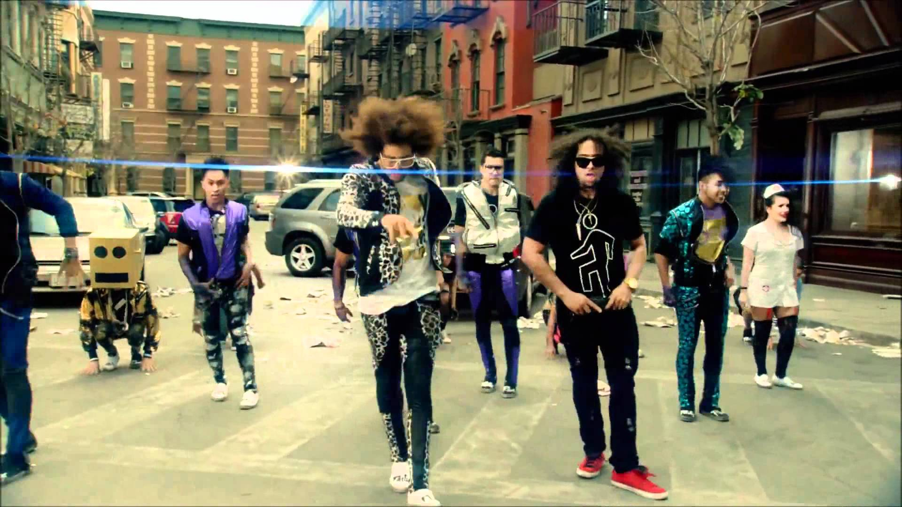
Shuffling in Spark

Slide 39
Shuffling
Required for all-to-all communications
  reduceByKey(), aggregateByKey(), sortByKey(), etc…
Always a bottleneck
  Network & Disk IO
  Serialization
  Compression
Receiving lots of attention.

Slide 40
Spark vs MapReduce
Reduce phase does not overlap with the Map phase like MapReduce
  Spark reducer's pull shuffle data from mappers
  MapReduce does push in a concurrent copy stage
Map and Reduce tasks all run on same executor JVMs
  MapReduce uses different JVMs for these tasks

Slide 41
First there was a hash-based shuffle...
Originally required M * R number of intermediate files (that is, # of mappers & # of reducers)
Concurrently opened files are C * R (# of cores * # of reducers)
Enabling shuffle spilling created even more temporary files.
Many random writes/reads caused CPU time spent in reduces to mainly wait on disk I/O

Slide 42
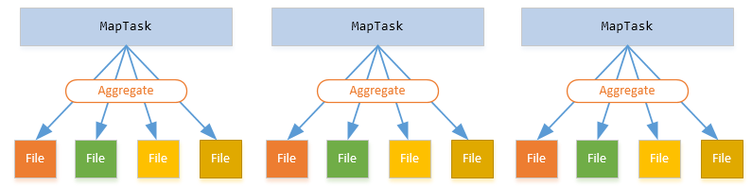
Original hash-based shuffle

Slide 43
Then they consolidated files...
Introduced an extra merge phase
  All map tasks running on the same core write to the same set of files in tandem
File consolidation reduces number of files to C * R
Each reducer fetches a smaller number of files
Still bad for high numbers of reducers
Concurrently opened files are still C * R
spark.shuffle.consolidateFiles=true

Slide 44
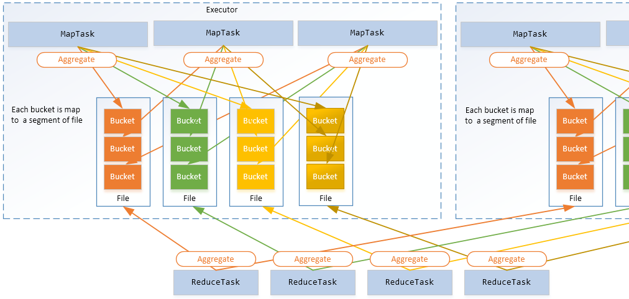
Consolidated files

Slide 45
And along came sort-based Shuffle
Records sorted in memory by partition ID and merged into a single file for each core along with an index file
  If map-side combine, buckets sorted by key & partition and run through combiner
  Otherwise, just sorted only by partition
Ranges of buckets in each file served to reducers upon request
Each segment is merged together on the reducer
Records deserialized and passed through all-to-all function (e.g. aggregateByKey(), reduceByKey()) to complete the stage
  In the case of sortByKey() and other ordered functions, the partitions are sorted before being run through the all-to-all function.
When <= 200 reducers and no sort or aggregation is needed hash-based is used instead
  spark.shuffle.sort.bypassMergeThreshold

Slide 46
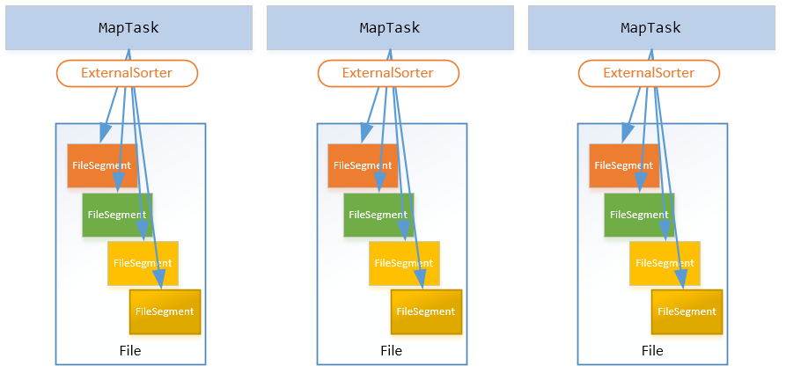
And along came a sort-based Shuffle

Slide 47
Shuffle Evolution
Shuffle write consolidation in 0.9
Pluggable shuffle managers in Spark 1.0
  Hash-based (pre-1.2)
  Sort-based (introduced in 1.1, default in 1.2+)
NettyTransferService introduced in 1.2 for transferring shuffle “blocks”
External shuffle service introduced in 1.2
In 1.5+, Community is working on tiered merge strategy.

Slide 48
Shuffle Durability
Failure of an executor will lose shuffle files unless Aux Shuffle Service is configured on the YARN NodeManager.
SparkConf:
spark.yarn.shuffle.service = true
yarn-site.xml add spark_shuffle to:
yarn.nodemanager.aux-services
yarn-site.xml add:
yarn.nodemanager.aux-services.spark_shuffle.class = org.apache.spark.network.yarn.YarnShuffleService

Slide 49
Perhaps we could establish some best practices
Consider the parallelism at each stage of your jobs based on your data and number of cores.
Executor memory should be fine-tuned for expected cache and shuffle sizes.
Minimize footprint of closures
  Use broadcasts for large values
Use Kryo to serialize data
Know your communication patterns (one-to-all, all-to-all, etc..) and optimize accordingly
Use aux-shuffle service

Slide 50
Shuffle Optimization
A couple properties that affect shuffle performance
  spark.akka.threads
  spark.reducer.maxMbInFlight
By default, shuffles will use only 20% of the memory allocated to executor
  Increase spark.shuffle.memoryFraction at expense of spark.storage.memoryFraction

Slide 51
Questions?
corey@tetraconcepts.com

