Slide 1
CosmosAIGraph
Americas Cosmos DB Global Black Belt (GBB) Team, Microsoft
Public GitHub Repository: aka.ms/caig
Video: https://www.youtube.com/watch?v=0alvRmEgIpQ

Slide 2
Background
Growth and demand for AI and Generative-AI accelerated in 2023
Specifically Azure OpenAI, Chat-GPT, and Vector Search
Rise in “Graph, AI-Driven Graph, and AI-Driven Knowledge Graph” workloads
These are the target workloads for CosmosAIGraph. Operational in nature, not analytic
The AltGraph solution, created in 2022:
Is a proven design that uses the Cosmos DB NoSQL API to solve “graph workloads”
https://devblogs.microsoft.com/cosmosdb/altgraph-graph-workloads-with-azure-cosmos-db-for-nosql/
However, it is lacking in some ways:
No Query Language, No Schema/Ontology, uses a Single Graph Replica
These are solved by the CosmosAIGraph solution
These factors led to the creation of the CosmosAIGraph solution
Concurrent MSR GraphRAG Whitepaper
https://www.microsoft.com/en-us/research/blog/graphrag-unlocking-llm-discovery-on-narrative-private-data/

Slide 3
What is CosmosAIGraph?
It’s an open-source reusable design and set of reference implementations
It is not a Microsoft, Azure, or Cosmos DB product
It is built on the following:
Cosmos DB Mongo vCore or NoSQL PaaS service. Supports Vector Search
Azure OpenAI PaaS service
RDF Technology – triples, OWL ontologies (schemas), SPARQL queries
In-memory graph – inspired by LinkedIn, for faster performance and lower costs
Python 3 – rdflib, FastAPI, Pydantic, pymongo, Semantic Kernel
Deployed to Azure Container Apps (ACA) with Bicep. Or AKS. Microservice design
It supports Generative AI for dynamic application and AI logic
RDF is a standard industry solution for Knowledge Graphs
Offers a simplified architecture with just one DB: Cosmos DB
CosmosAIGraph introduces and implements the concept of Omni RAG
Why Omni RAG? Because vector search doesn’t always return the best results

Slide 4
RDF Technology
Resource Description Framework (RDF)
A set of W3C standards. Mature, ~ 20 years old
Typically used for Knowledge Graphs
Web Ontology Language (OWL)
An XML syntax to define the Classes and ObjectProperites of your graph
Think of these as the Entities and Relationships, or your graph schema
Triples
A tuple of ( subject, predicate, and object )
For example: ( Cosmos DB → has_api → vCore )
An RDF graph consists of many of these simple triples, plus an ontology
Conceptually simple
SPARQL 1.1 – query language. Similar to SQL. Simpler than Gremlin & Cypher
rdflib – A python library that implements a mutable in-memory RDF graph

Slide 5
CosmosAIGraph – Graph Design and Development Steps
Design and load your Cosmos DB account
Use typical NoSQL design patterns, JSON documents
No special “triples” documents are required, unlike AltGraph
Define your Graph Schema
It’s an XML syntax. Define Classes, attributes w/datatypes, and relationships
Load the in-memory RDF database from Cosmos DB
Read only the necessary attributes of the Cosmos DB documents
The in-memory graph is mutable, but is static in the reference applications
Alternatively, in a dev environment, load the graph fro a “triples file” (i.e. – *.nt)
The graph is strictly an in-memory concept; it doesn’t exist on disk
Query the in-memory RDF database with SPARQL
It’s very fast because it’s in-memory
It’s low cost, because no vectorization is involved
The SPARQL can optionally be generated with GenAI & Azure OpenAI. This is a great learning tool

Slide 6
Vector Search – Development Steps
“Vectorize” your data
Use the Azure OpenAI SDK with your Azure OpenAI PaaS service
Pass in a text value, receive back an “embedding” – an array of 1536 floats
The embedding captures the semantic meaning of the text
An embedding looks verbose, but it is a very efficient data structure
Use the text-embedding-ada-002 model within Azure OpenAI
Store that vector, along with document context, in your Cosmos DB vCore database
https://learn.microsoft.com/en-us/azure/ai-services/openai/tutorials/embeddings
Vector Search
Implement a vector index
https://learn.microsoft.com/en-us/azure/cosmos-db/mongodb/vcore/vector-search
https://learn.microsoft.com/en-us/azure/cosmos-db/nosql/vector-search
Pass in a vector (i.e. – embedding) as the argument to a search in the database
Receive n-number of documents which match the given vector. Semantic similarity
Can return more relevant results vs traditional search engines
Filtered vector search is currently in preview

Slide 7
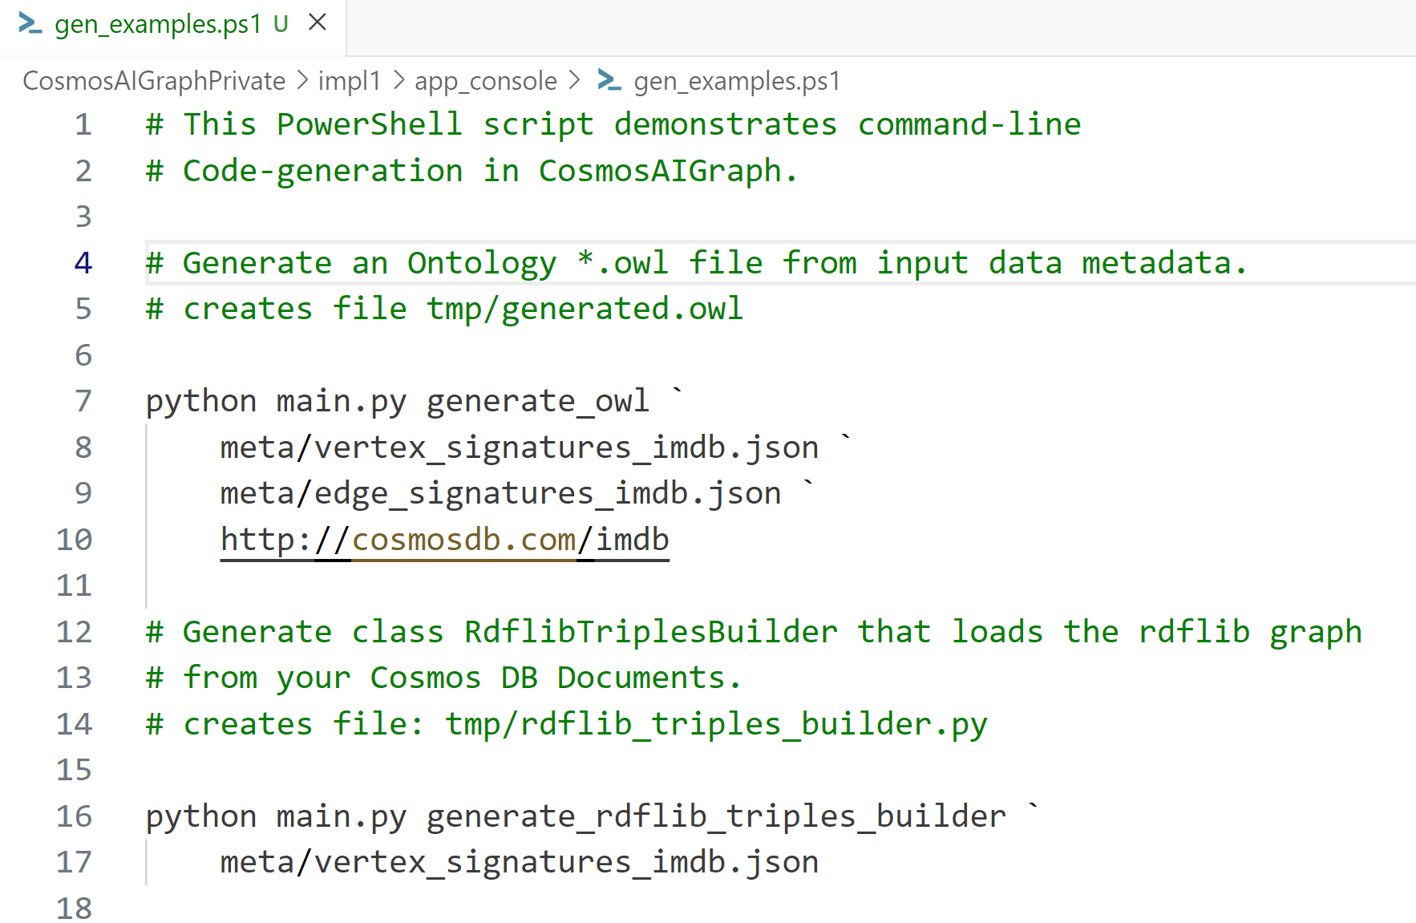
CosmosAIGraph – Code Generation

Slide 8
CosmosAIGraph – Generative AI Use-Cases
Infer the “RAG Strategy” from User natural-language
Implements “LUIS-like” utterances, entities, and intents with OpenAI and a prompt
See class StrategyBuilder#determine
Generate SPARQL Queries from User natural-language
Uses the OWL ontology as a system prompt
See AIService#generate_sparql_from_user_prompt
Generate Python code to wrangle your input data into Cosmos DB Documents
Infer input schemas from CSV headers, JSON structure
Targets the defined OWL ontology
This is currently a work-in-progress
You may have additional use-cases for your CosmosAIGraph application
A note on Generative AI Skills:
See the O’Reilly Media “AI-Assisted Programming” book, 2024
CEO: “Now when I consider hiring a developer, I want to know how they leverage AI.”.
“Satya Nadella” …. “they are becoming standard issue for any developer…”.

Slide 9
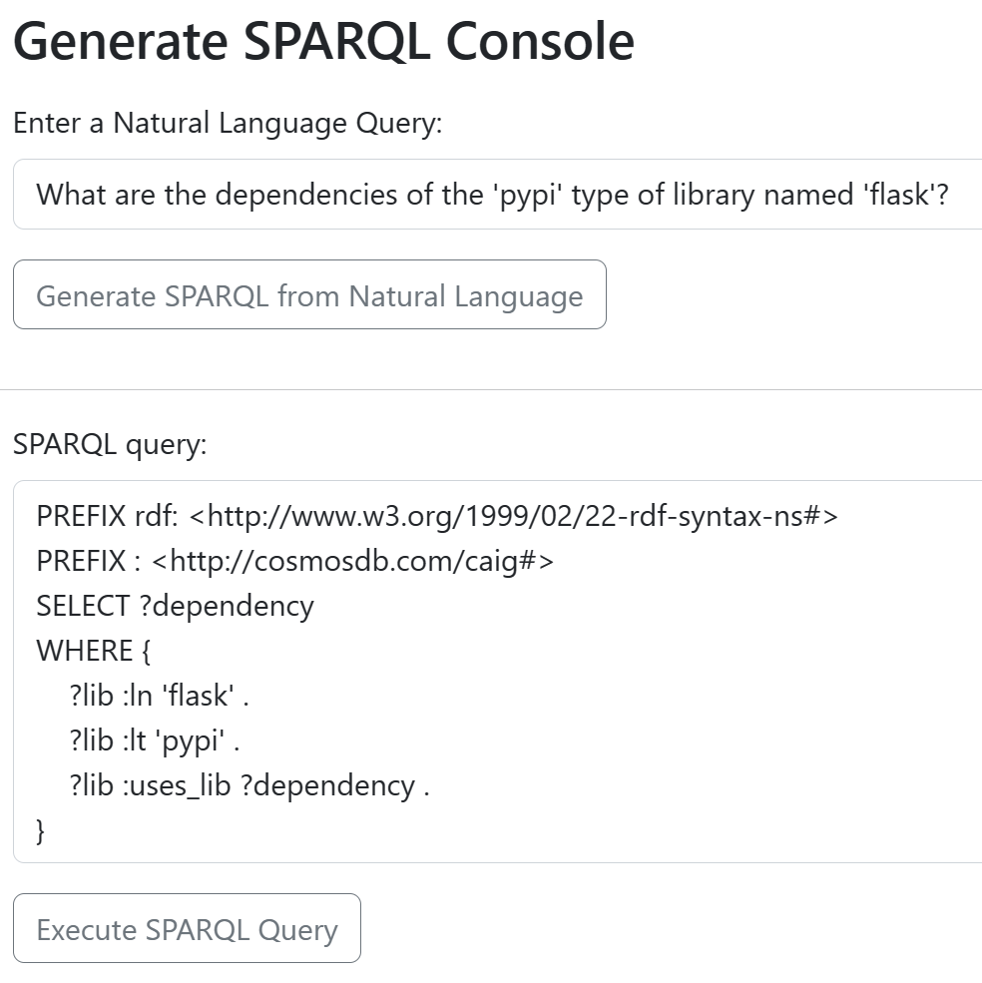
Generative AI in CosmosAIGraph – Web App Example
Uses Azure OpenAI, gpt-4, and the “RAG” pattern
The OWL ontology is the “System Prompt”
The Natural Language is the “User Prompt”
The result is a working SPARQL query

Slide 10
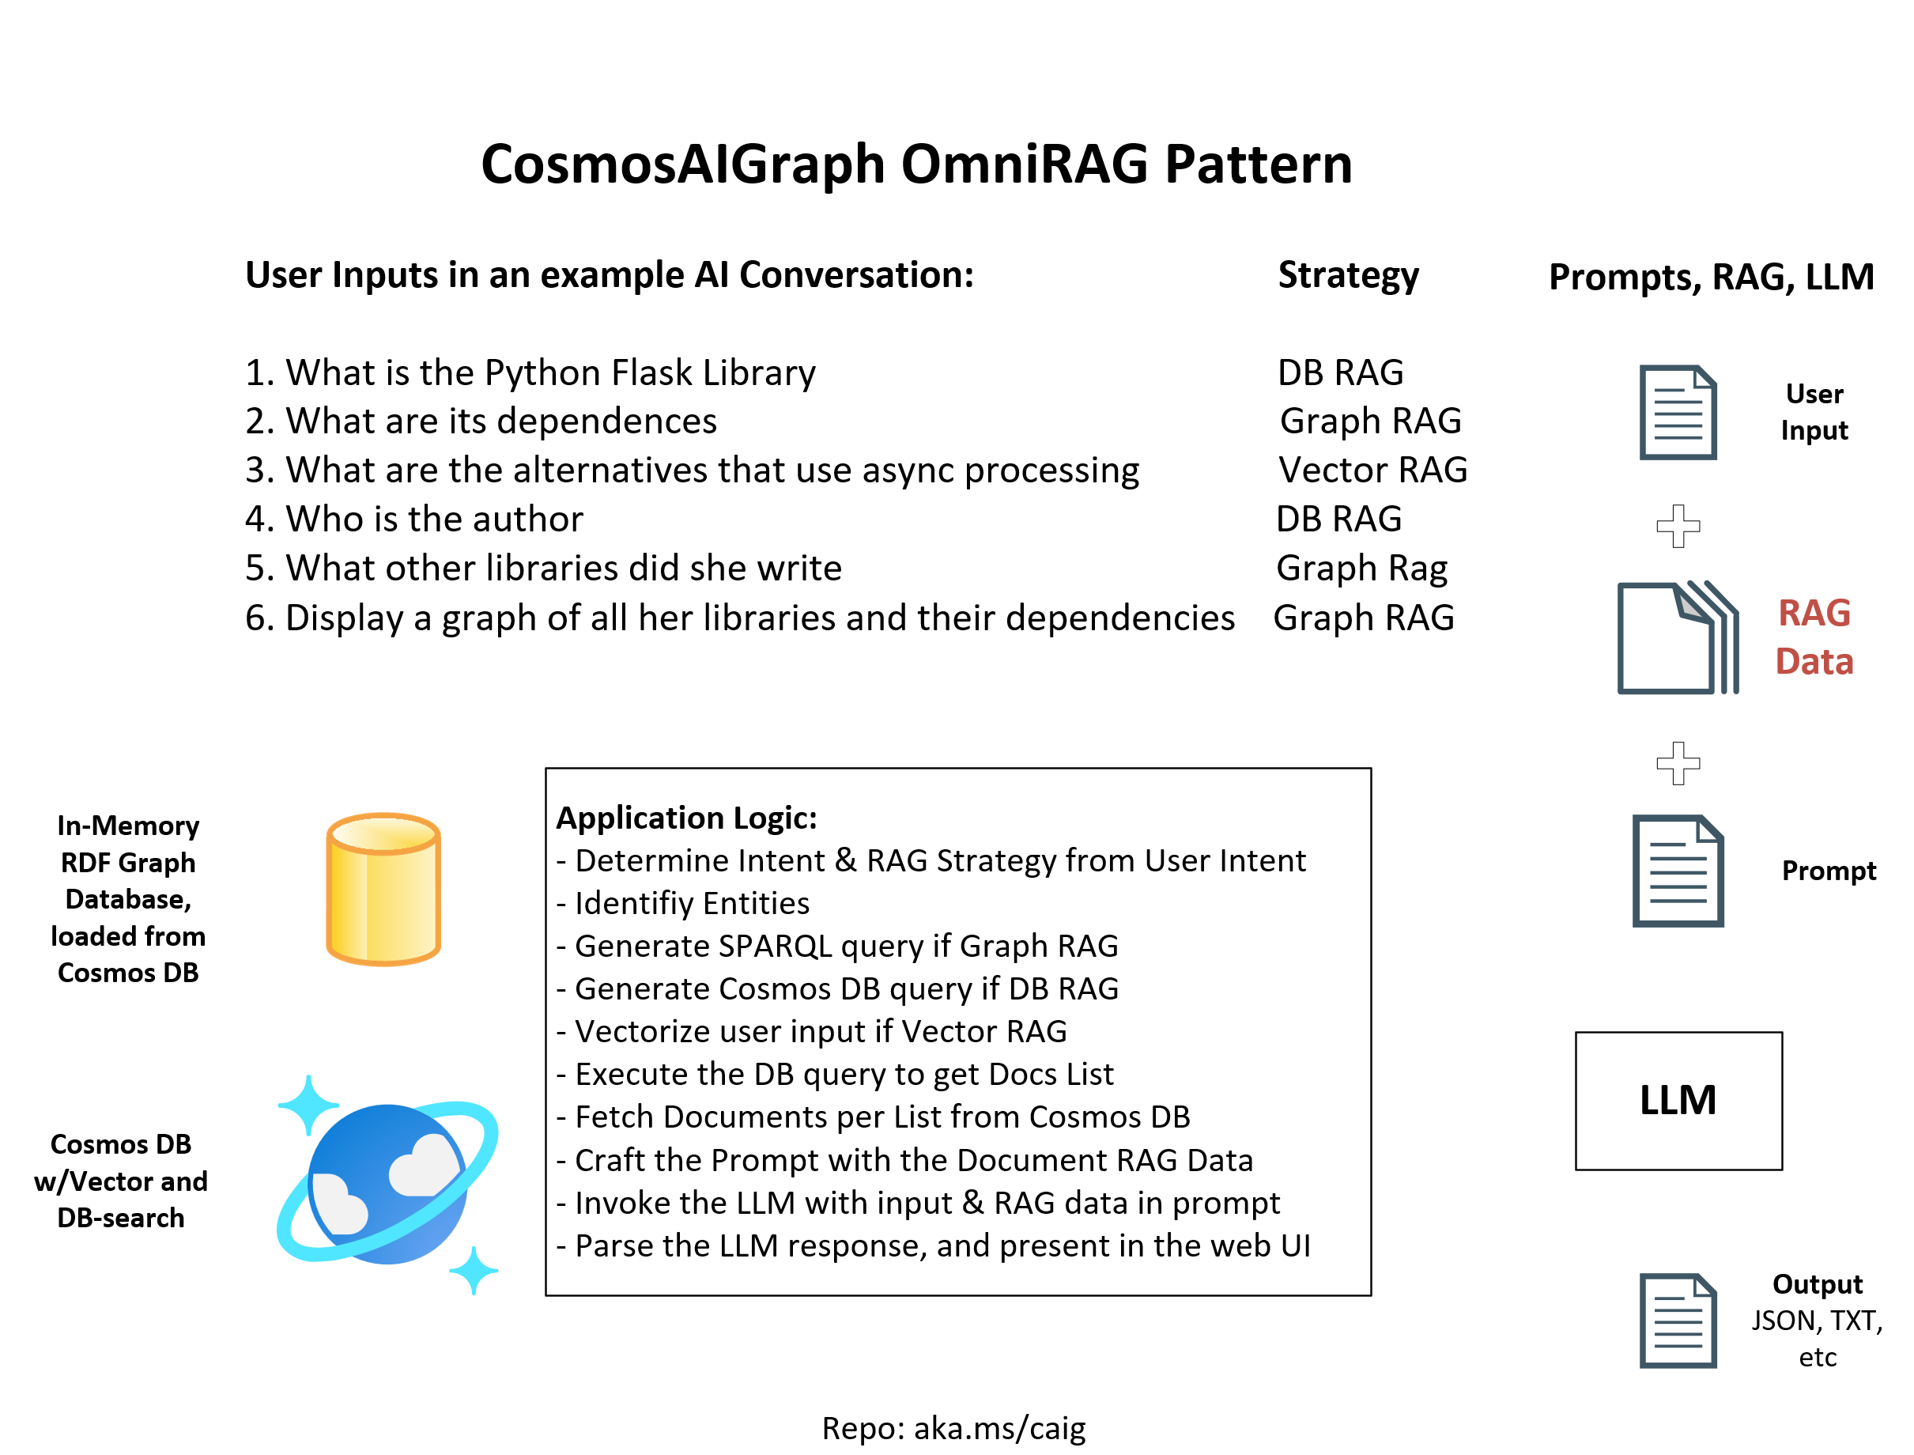

Slide 11
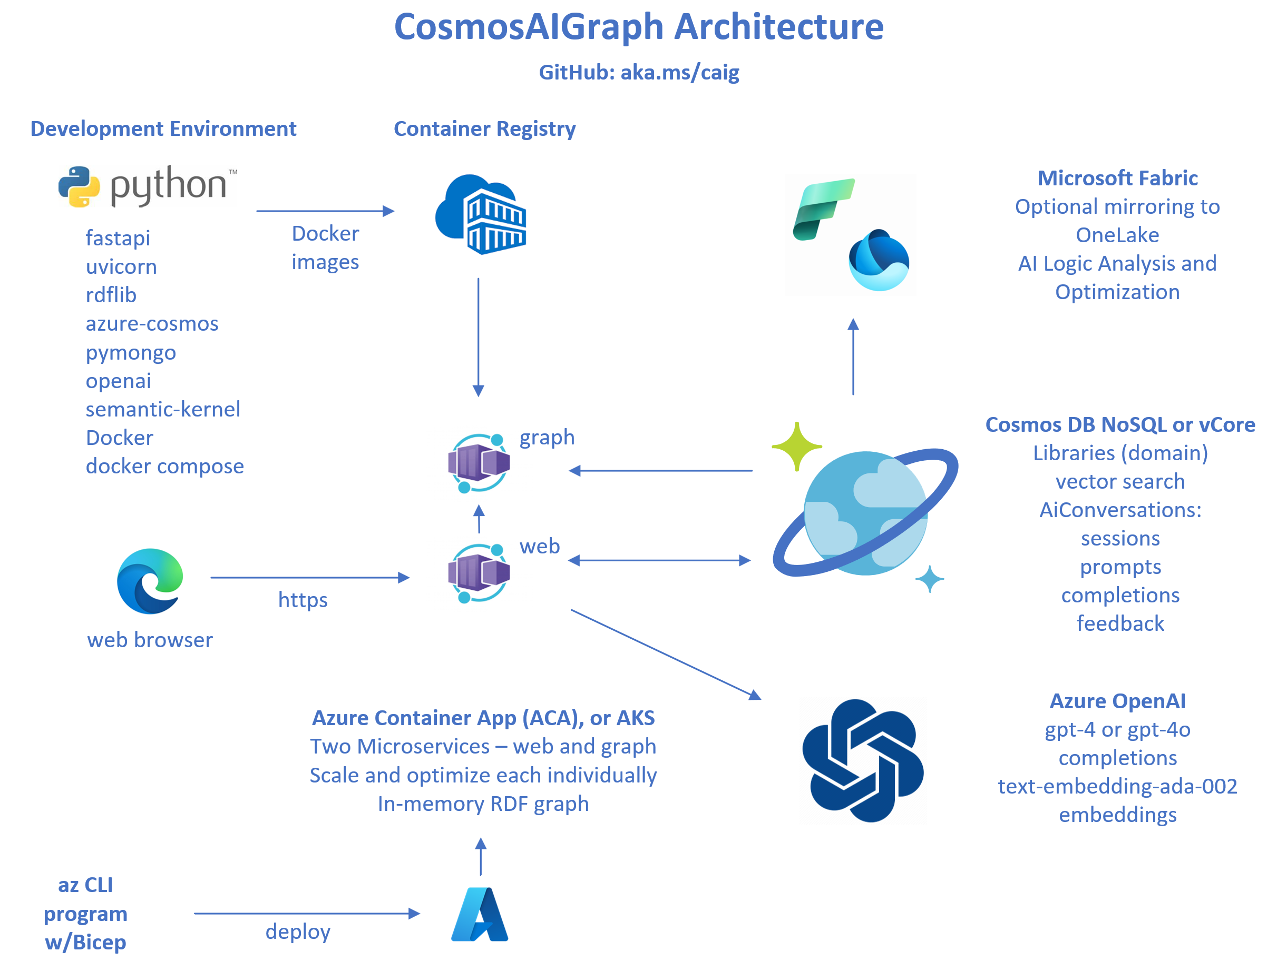

Slide 12
Web Application UI Screen Shots

Slide 13
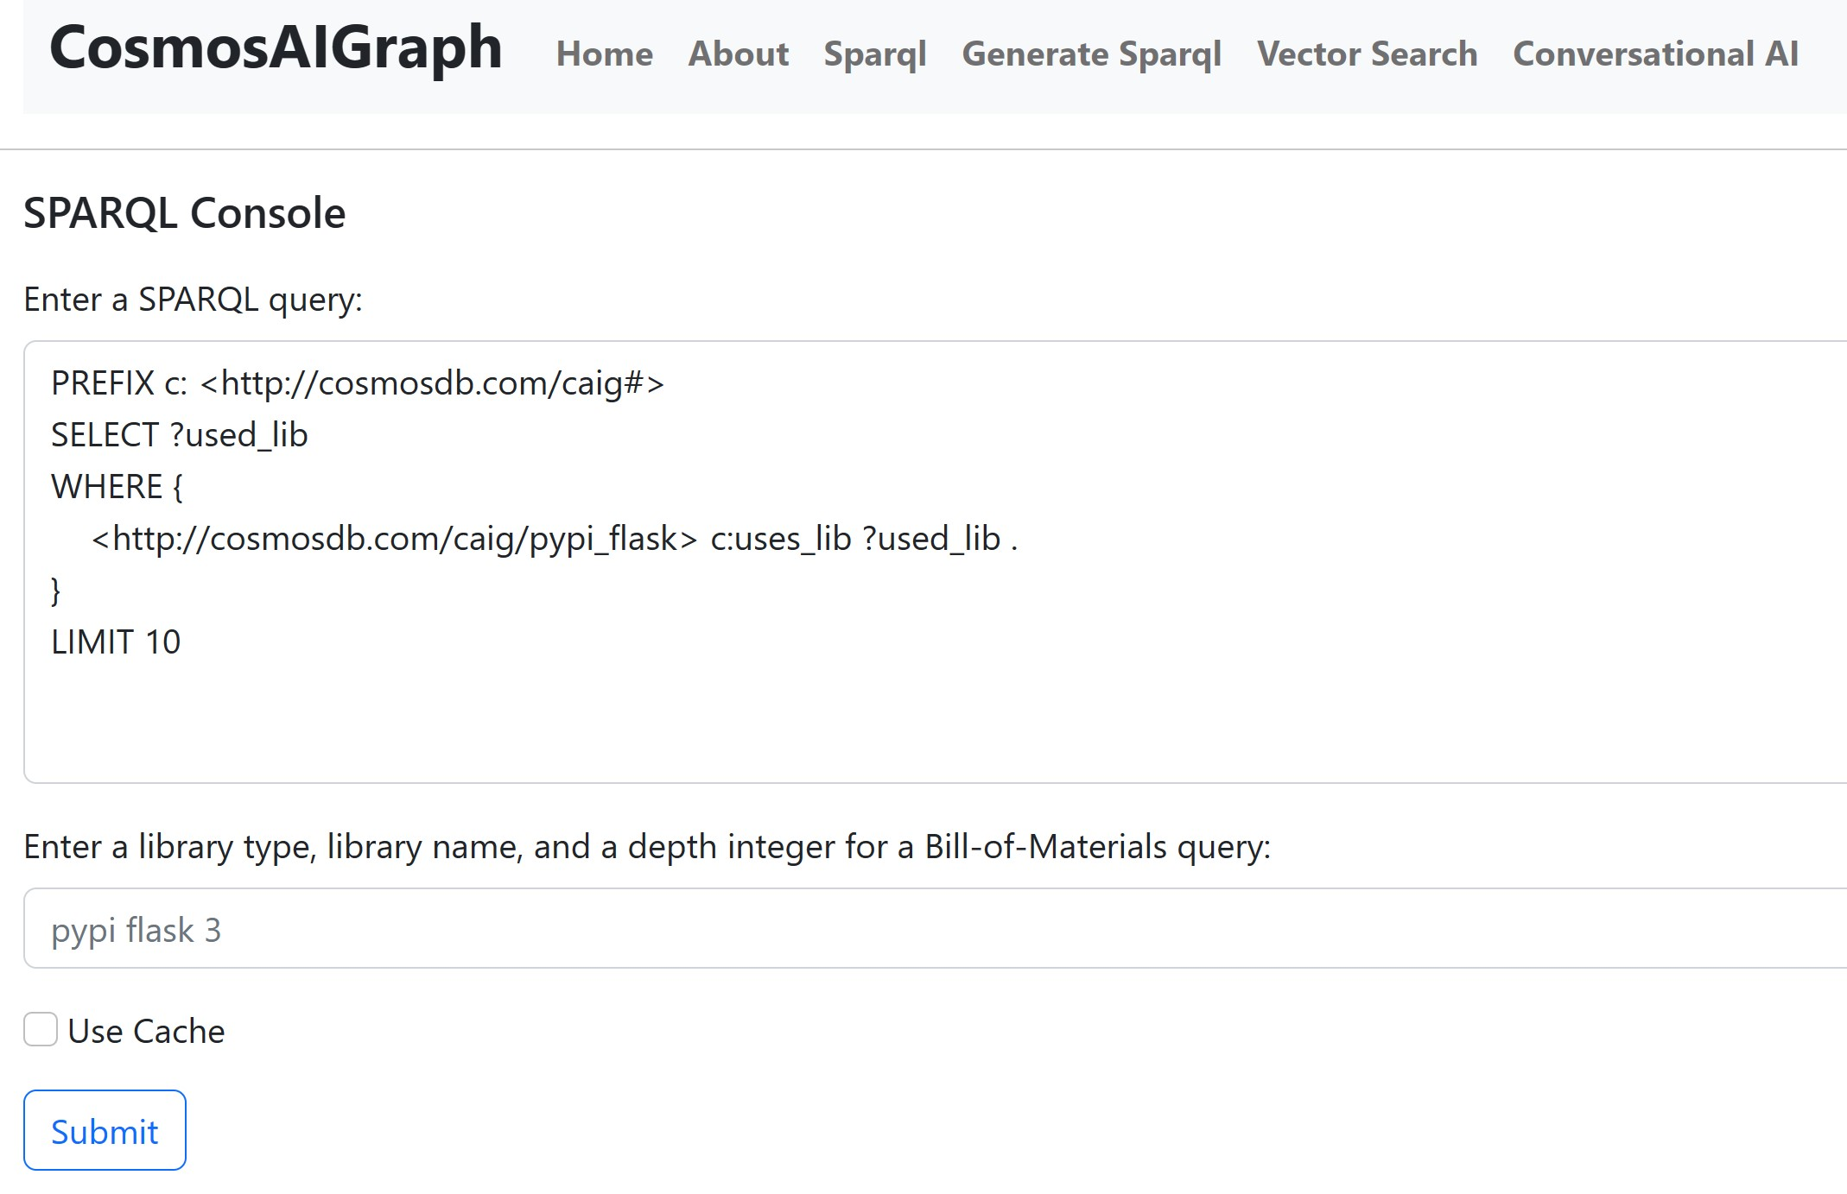
The SPARQL Console Page introduces and demonstrates queries vs the in-memory RDF graph

Slide 14
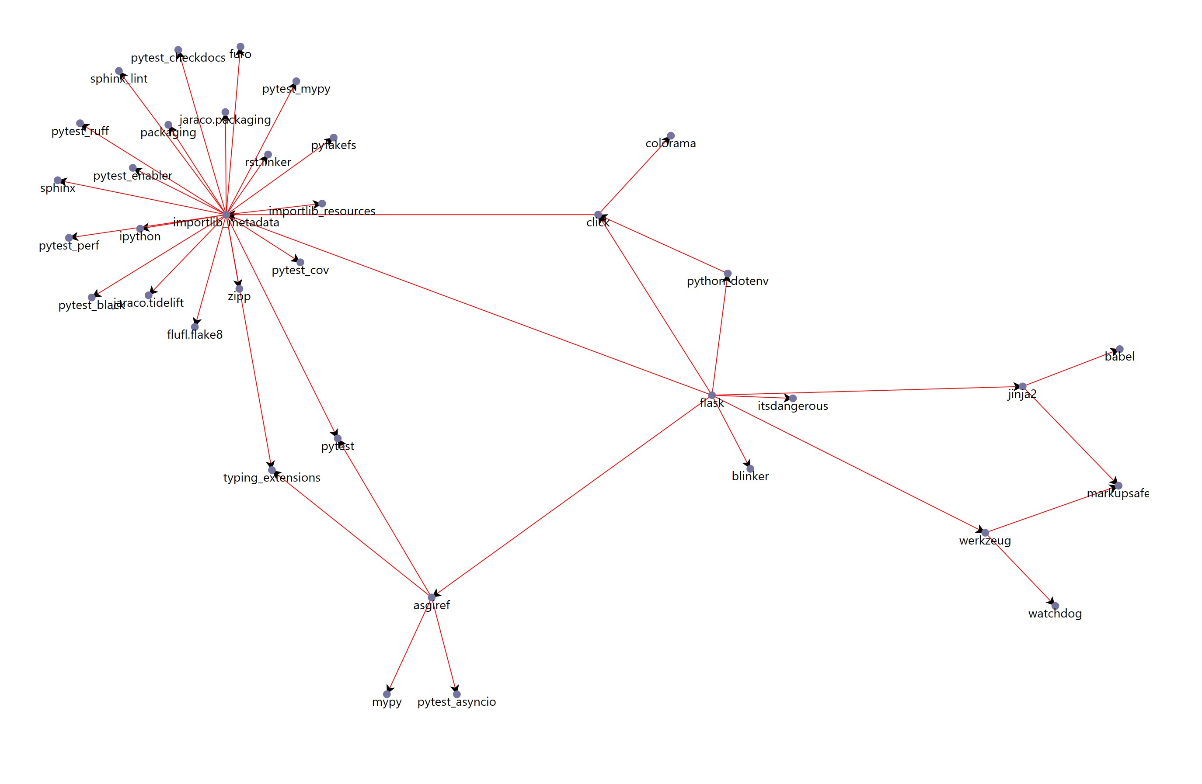
Graph Visualizations with the D3.js JavaScript library in the SPARQL Console page

Slide 15
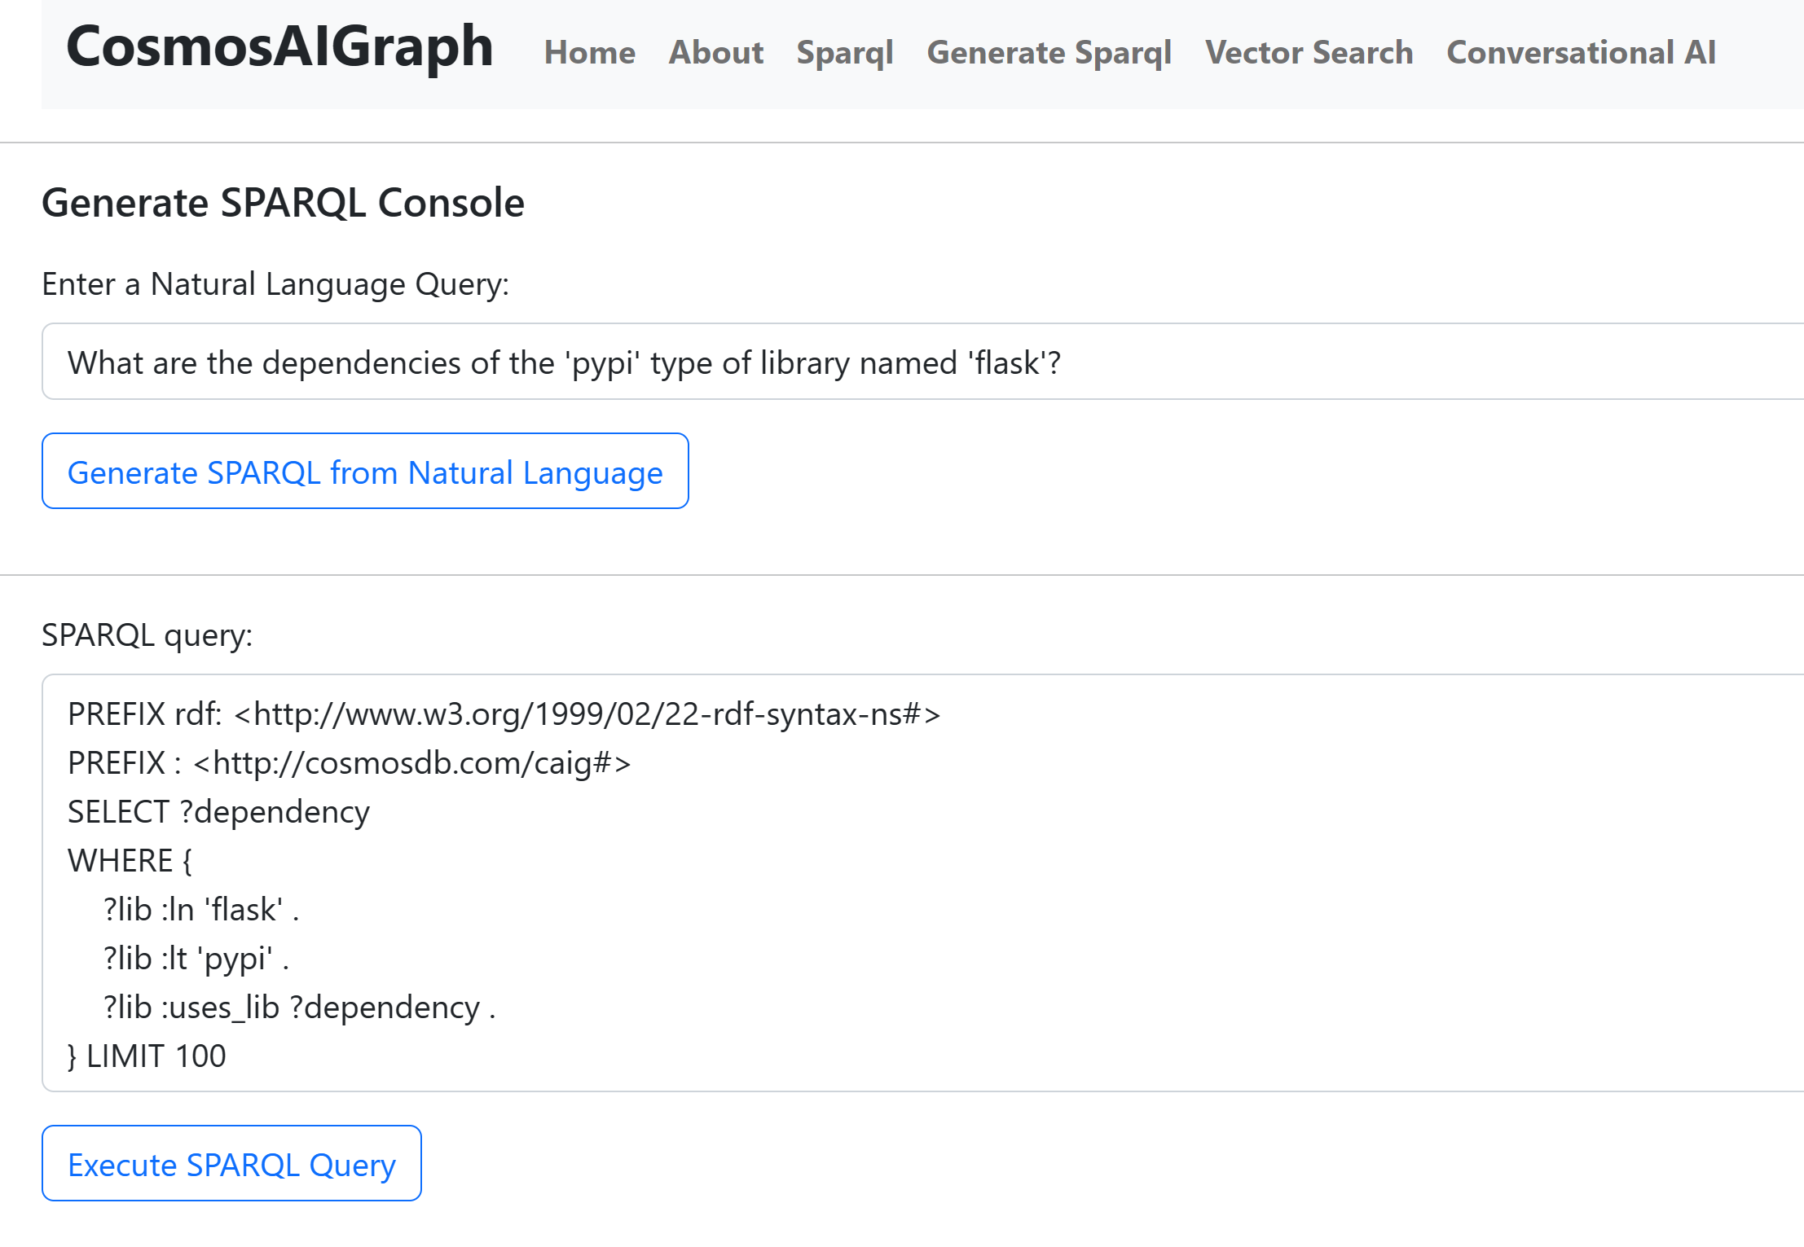
Generate SPARQL Console demonstrates the power of generative AI

Slide 16
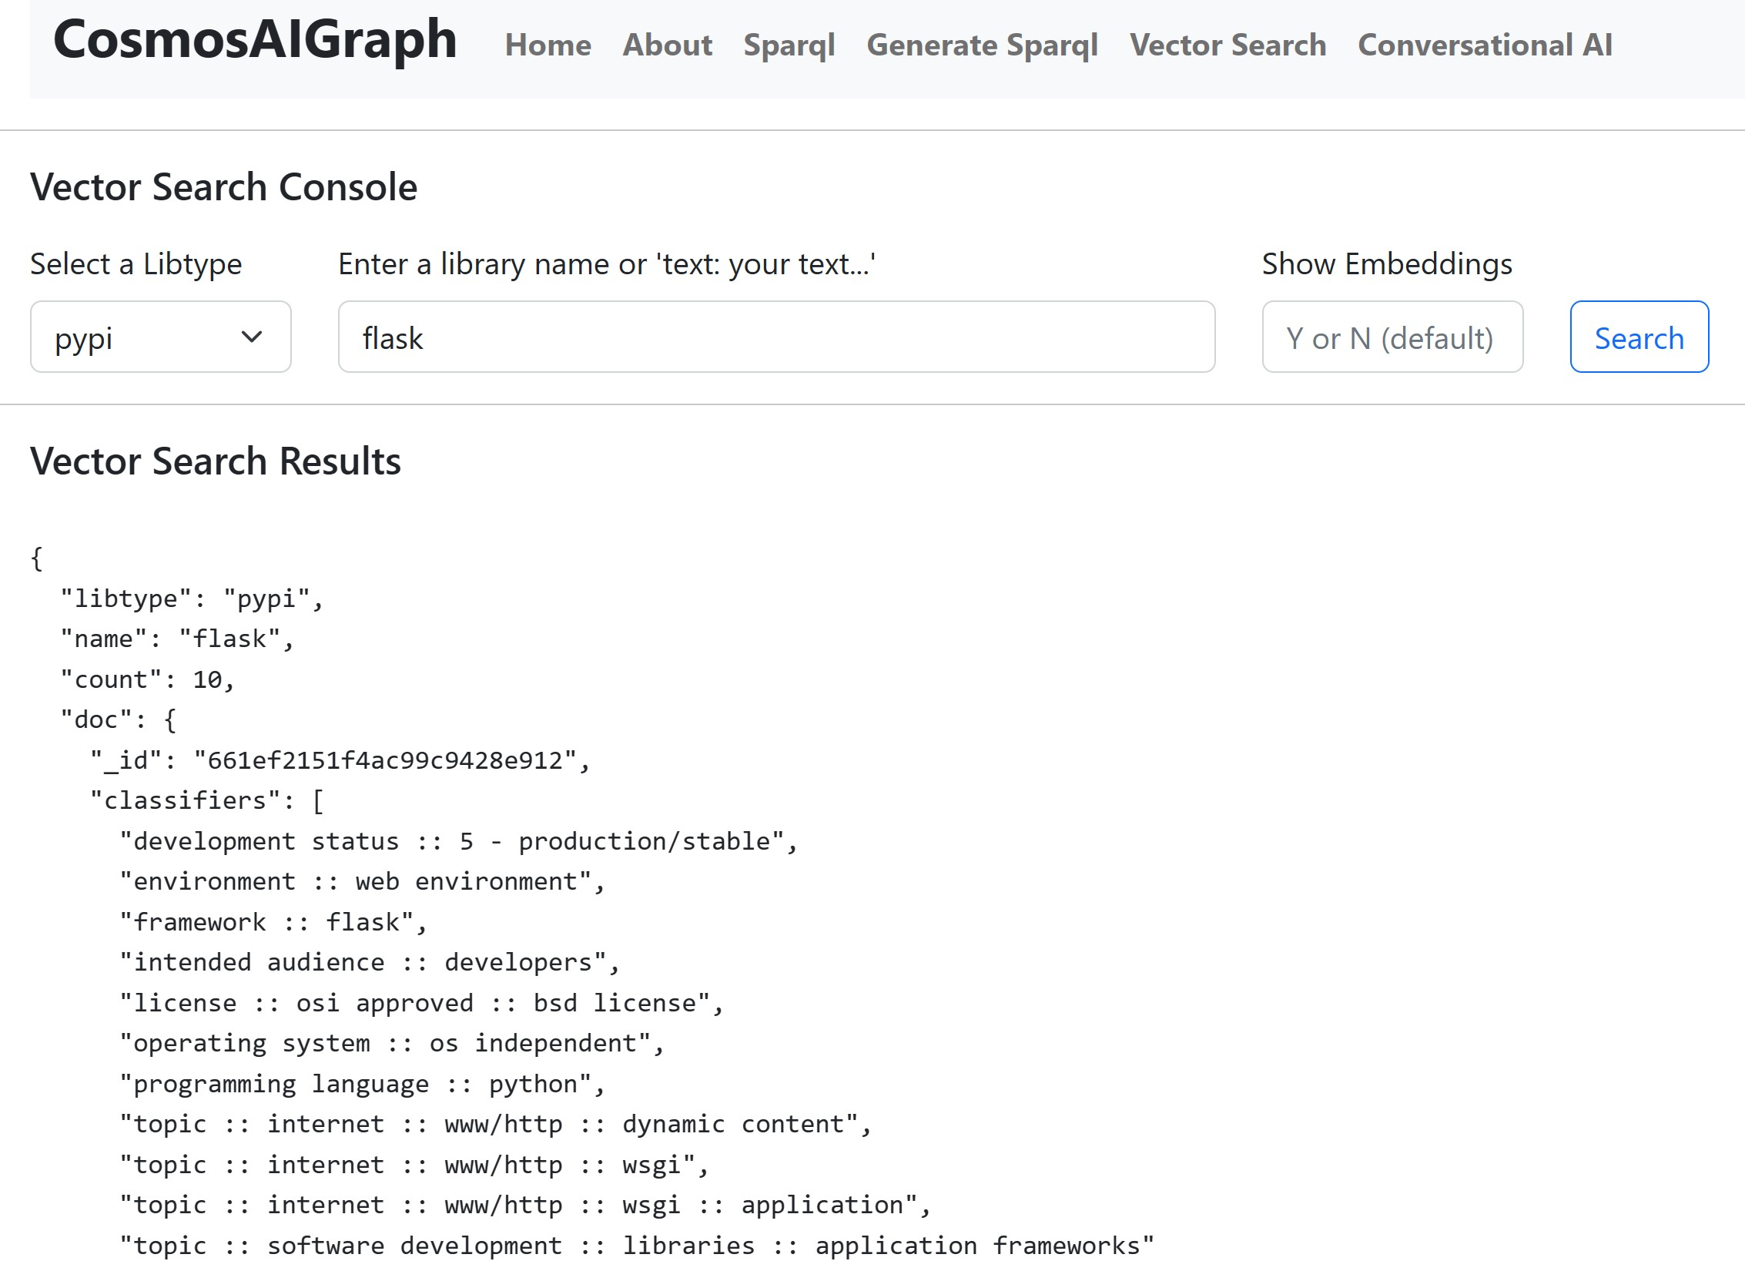
Vector Search Page demonstration page, executes vector search vs Cosmos DB vCore

Slide 17
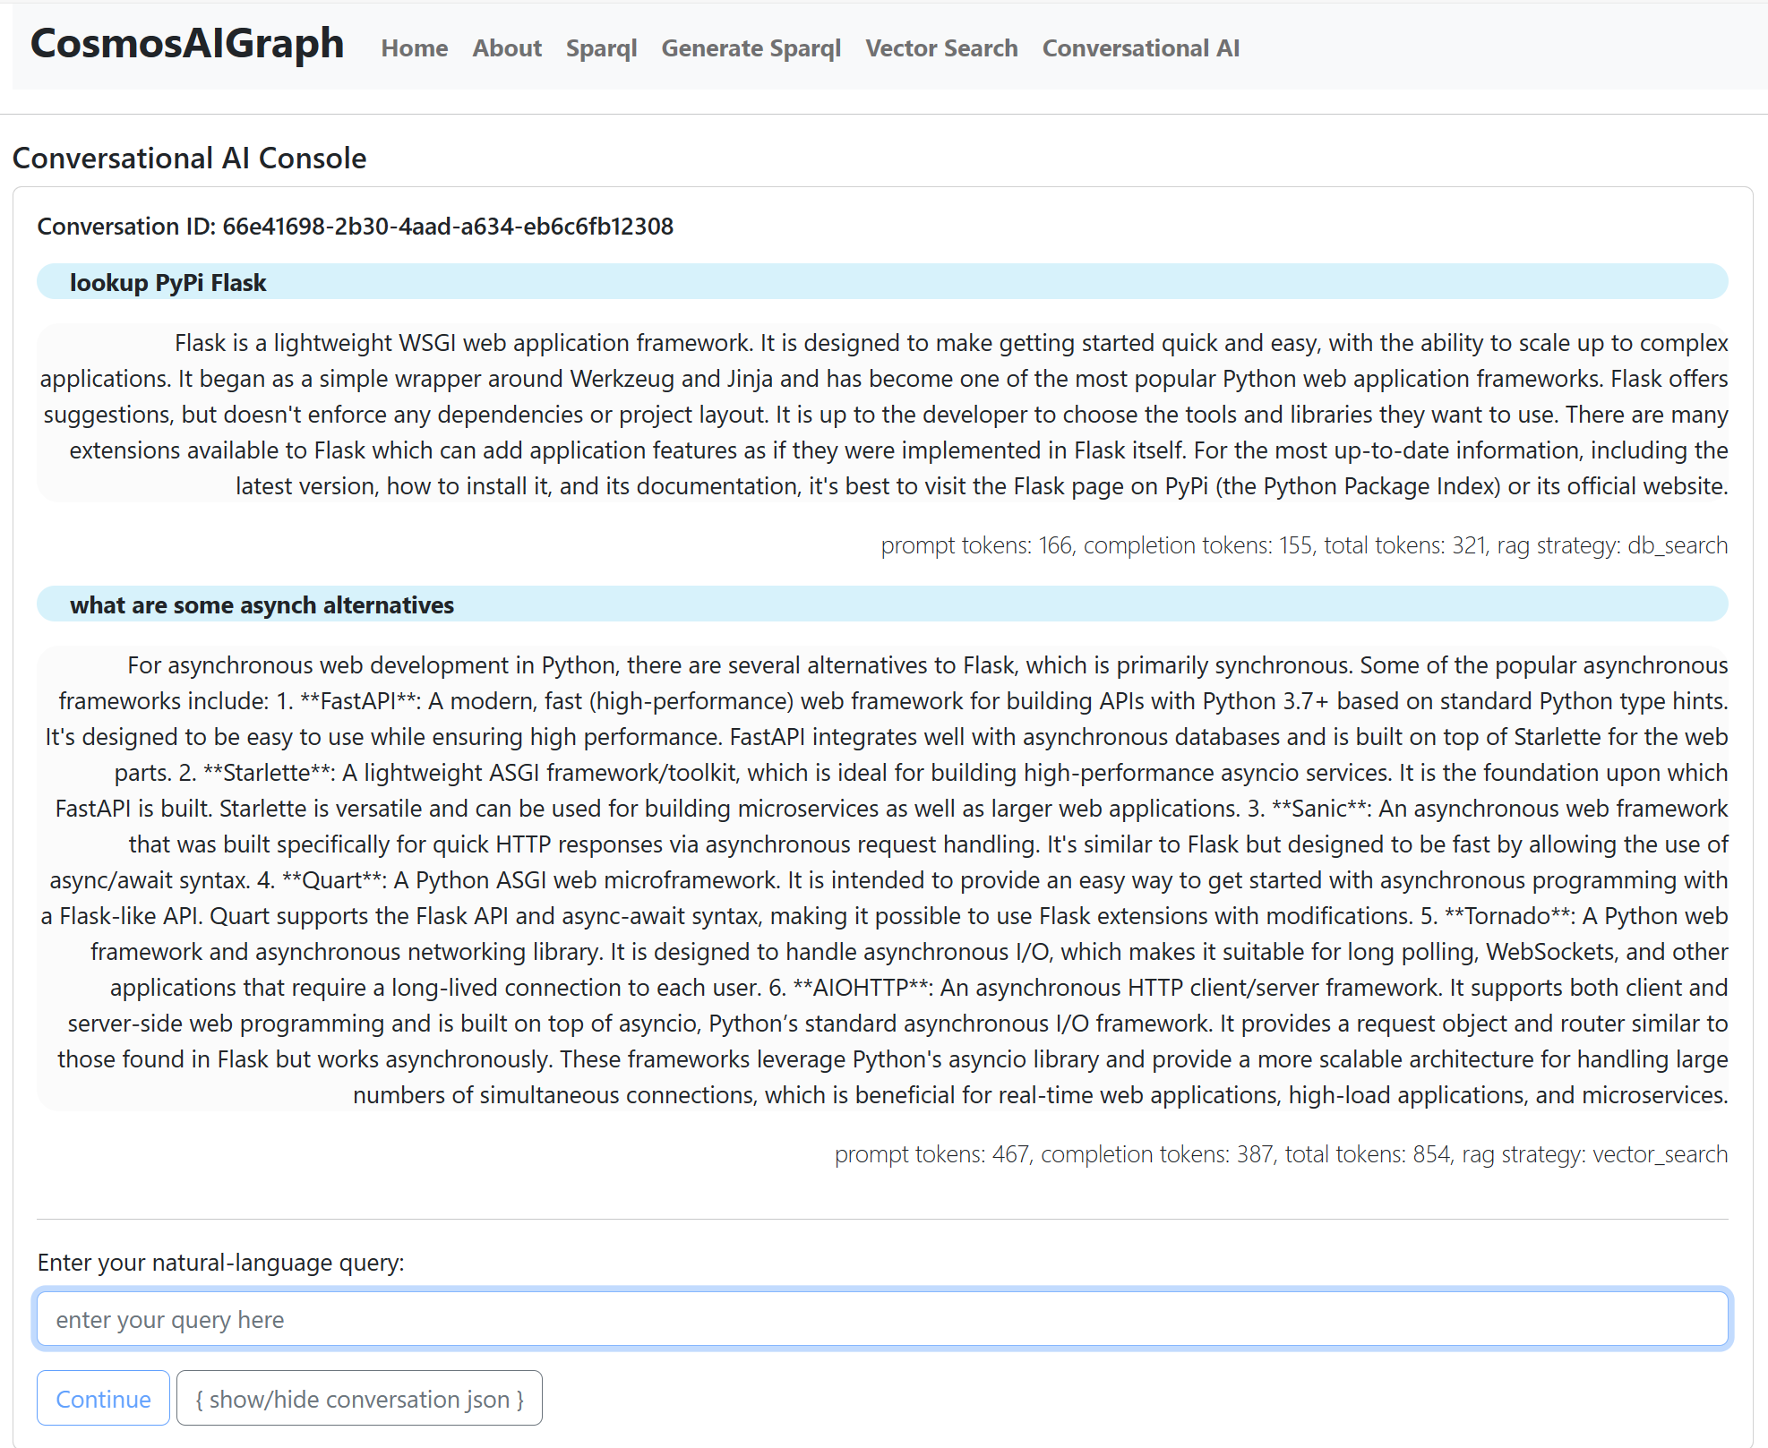
Conversational AI Page demonstrates Hybrid RAG approach and conversation history

Slide 18
CosmosAIGraph - Summary
CosmosAIGraph provides a cost-effective performant solution for:
Graph Workloads (with little or no AI)
AI-Driven Graph Workloads
AI-Driven Knowledge Graph Workloads
AI Chat Applications
Supports Generative AI
Uses the accurate and cost-effective Omni RAG Pattern
Open-Standards Based – RDF, OWL Ontologies, SPARQL queries, Python
Robust and Replicated Deployments with Docker Containers and Azure Container Apps
Reference applications and documentation assist and guide users in adoption
Public GitHub Reposiory: aka.ms/caig

Slide 19
Thank you! Questions?

