Slide 1

Notes:
A new approach to application automation focusing on the application first and enables any application you build, deploy, and manage to behave consistently in any environment — from traditional data-centers to containerized microservices.

Slide 2

Christian Johannsen
Professional Entertainer
Chef, Inc.
@cjohannsen81
Notes:
This is your intro slide
Tell the crowd something about yourself, why you’re here, etc. You are the face of Chef that is about to tell them things about a new Chef product. Let them know why they should trust and listen to you
Sample script: I'm super excited to talk to you about habitat, a new open source project from Chef. How many developers in the room? DevOps? This talk applicable to both. This project will bring benefit to your org, either side. Imagine an app developer working on bleeding edge tech, working with the latest cloud tools (such as heroku, etc). Now imagine the other side, and sysadmin working with legacy software in an enterprise environment. This new tool from Chef will immediately help both of these people, and even allow them to work together.

Slide 3
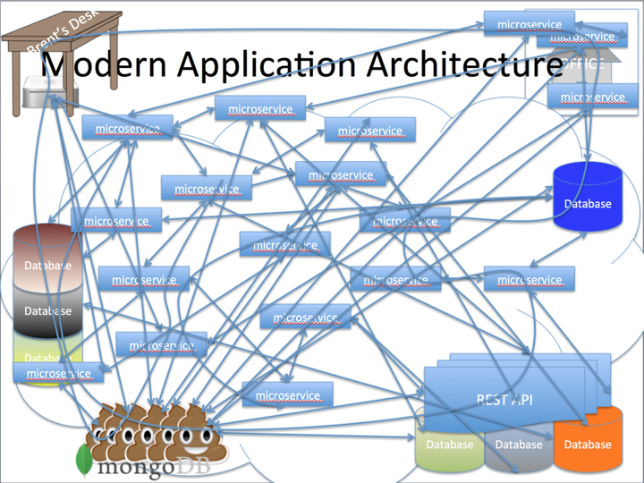
Brent’s Desk
database cluster
Notes:
Sample script: “I think what unites all of us is the complexity of the systems we are creating and managing. Web innovators have changed the way we work with in the cloud. This complexity is reflected in the way we have been operating: in an infrastructure-first approach. We start with hardware, add an OS, add some application-level infrastructure, (such as a JVM or docker), add libraries and packages, and then add our application on top. Especially in the enterprise, where the role of operations is to create the platform, and the role of developers is to deploy to the platform. The developer has to figure out how to run their code on the system, rather than the system being designed around the application.

Slide 4
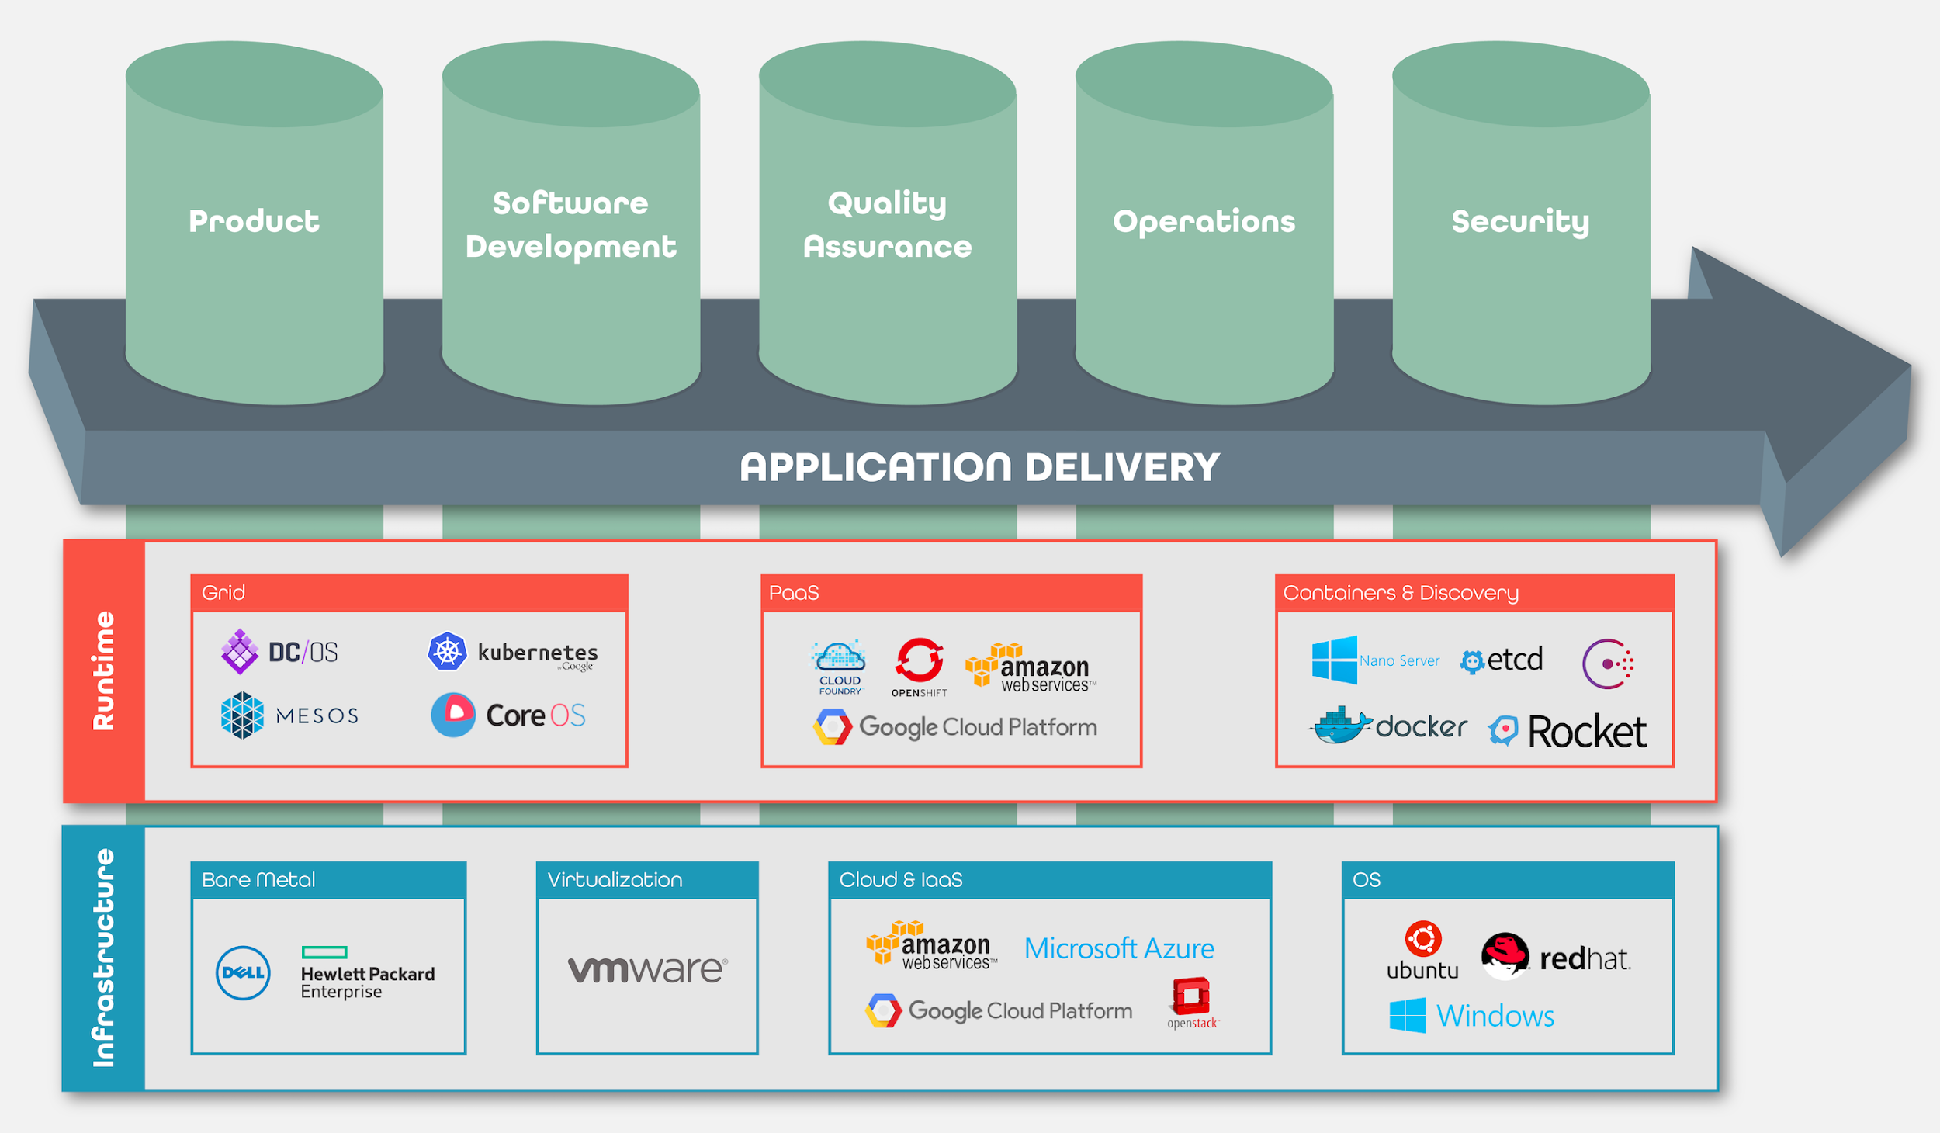
Infrastructure First Development
Notes:
Sample script: Most approaches, including containers, start with an infrastructure-first approach. The operating system and platform choices matter up-front and they are tightly bound to decisions made in your application code. A bunch of independent tools to bring your app to life. Those choices are different based upon your platform. But you’re still committed to using the toolset for that platform and developing the way that platform wants you to code. Tools like Chef are still great for infrastructure -- automating things in a repeatable way. This is great for modeling solutions that work reliably for that complexity, but not for reducing it.

Slide 5

„Containers don’t automate your applications.“
Production
Security
Code Quality
Container Hosting
Peer Discovery
Config Changes
Supervision
Monitoring
Rolling Deployment
Networking
Internal Registry
Workload Placement
The Container Learning Cliff
Development
Notes:
Sample script: But wait, I thought containers were going to solve this? Every other talk at DevOps Days has Docker all over it. Containers don’t automate your applications. Containers create a lightweight environment for devs to develop in but you still have to configure, manage, and update your containers at runtime. While Docker eases the pain of getting started with Development, the complexity of running it on infrastructure is all introduced on the backend of the cycle. You want to defer choices about your infrastructure until they matter, not defer the pain until you’re about to run in production.

Slide 6
Habitat’s technology
Build
Describes how to build the software
Explicit about dependencies
Includes what is configurable about the application
Deploy
Built in service discovery
Self-organizes into topologies
Handles inter-service discovery through binding
Has no single point of failure
Manage
Encrypted, authenticated run-time configuration
Automatic, safe, atomic software updates
Dynamic topology updates

Slide 7



Examples of application pain in the real world
Patch management
Continuous deployment
Cloud migration of legacy applications

Slide 8
Habitat’s Approach
Applications: portable & responsible for their own automation
Small OS serves the application
Make application components aware of each other over a network
Continuous deployment without traditional “ARA”
The solution should be the same:
For new and legacy applications.
No matter the runtime environment
Notes:
Make the OS as small as possible. Its role is to serve the application.
Applications should, individually, be fully responsible for all their dependencies, isolated from others.
Application components should be aware of each other across a network, without a central supervisor/orchestrator.
There should be a clear way to do deployment with real-life semantics, without the need for a central orchestrator/traditional “ARA”.
The solution should be the same for new and legacy applications.
The solution should be the same no matter what the runtime environment (bare-metal, VM, IaaS, PaaS/grid, container…)

Slide 9
Habitat
Application automation that enables modern application teams to build, deploy, and manage any application in any environment - from traditional data-centers to containerized microservices.
Notes:
Automation that travels with the application. So, what you build, manage, and deploy will behave in any runtime. The application is the unit of automation.
Habitat is a full-featured runtime with deployment coordination and service discovery capabilities built in. Any application – legacy + greenfield – can be contained within a habitat package.
The unit of deployment is the app and its automation
Everything an app needs, for life, is in the package
Straightforward way to describe how an app behaves
Outward-facing API presents standard interface
As an autonomous actor, app makes progress toward its desired state
Exposes standard interfaces for interacting with others
An atomic, immutable build artifact
Automation travels with the app artifact
That allows the app to run directly on bare metal Operating Systems, in Virtualization, in Containers, or on PaaS without change
Gain same deployment and management characteristics of modern applications even with legacy apps. Same workflow, same interface
Most ppl hate legacy software not because it doesn’t work but because managing it sucks.

Slide 10
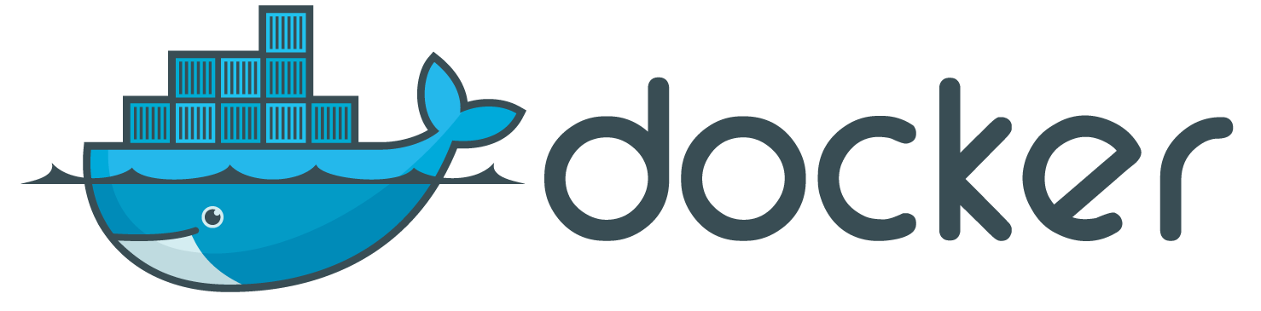




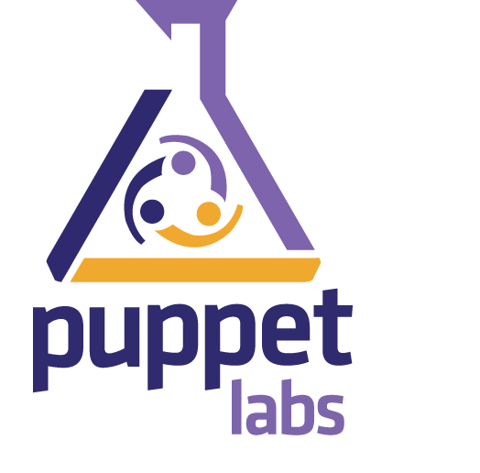
Doesn’t X do that?
> Focuses on the container as the unit of automation; apps are opaque.
> Focuses on the grid as the unit of automation; apps must be specialized
> Building tools around applications; pushing in the old direction
> Focused on integrated SDKs; “Cloud Native” rewrites
> Operating System centric; application automation becomes complex

Slide 11
Habitat
Habitat is a full-featured runtime with deployment coordination and service discovery capabilities built in. Habitat is comprised of:
A packaging format
A supervisor
The format defines Habitat packages, which are isolated, immutable, and auditable.
The term auditable means that the package can keep track of what happened to it, who did it, where it happened, how it happened, and when.
By isolated, we mean that each package contains everything it needs to run. There are no outside dependencies.
By immutable we mean that a particular version of the package never changes. If something does change—including available versions of dependencies—you create a new Habitat package, which has its own unique identifier.
Notes:
Habitat Details
Habitat is a full-featured runtime with deployment coordination and service discovery capabilities built in. Habitat is comprised of:
A packaging format
A supervisor

Slide 12





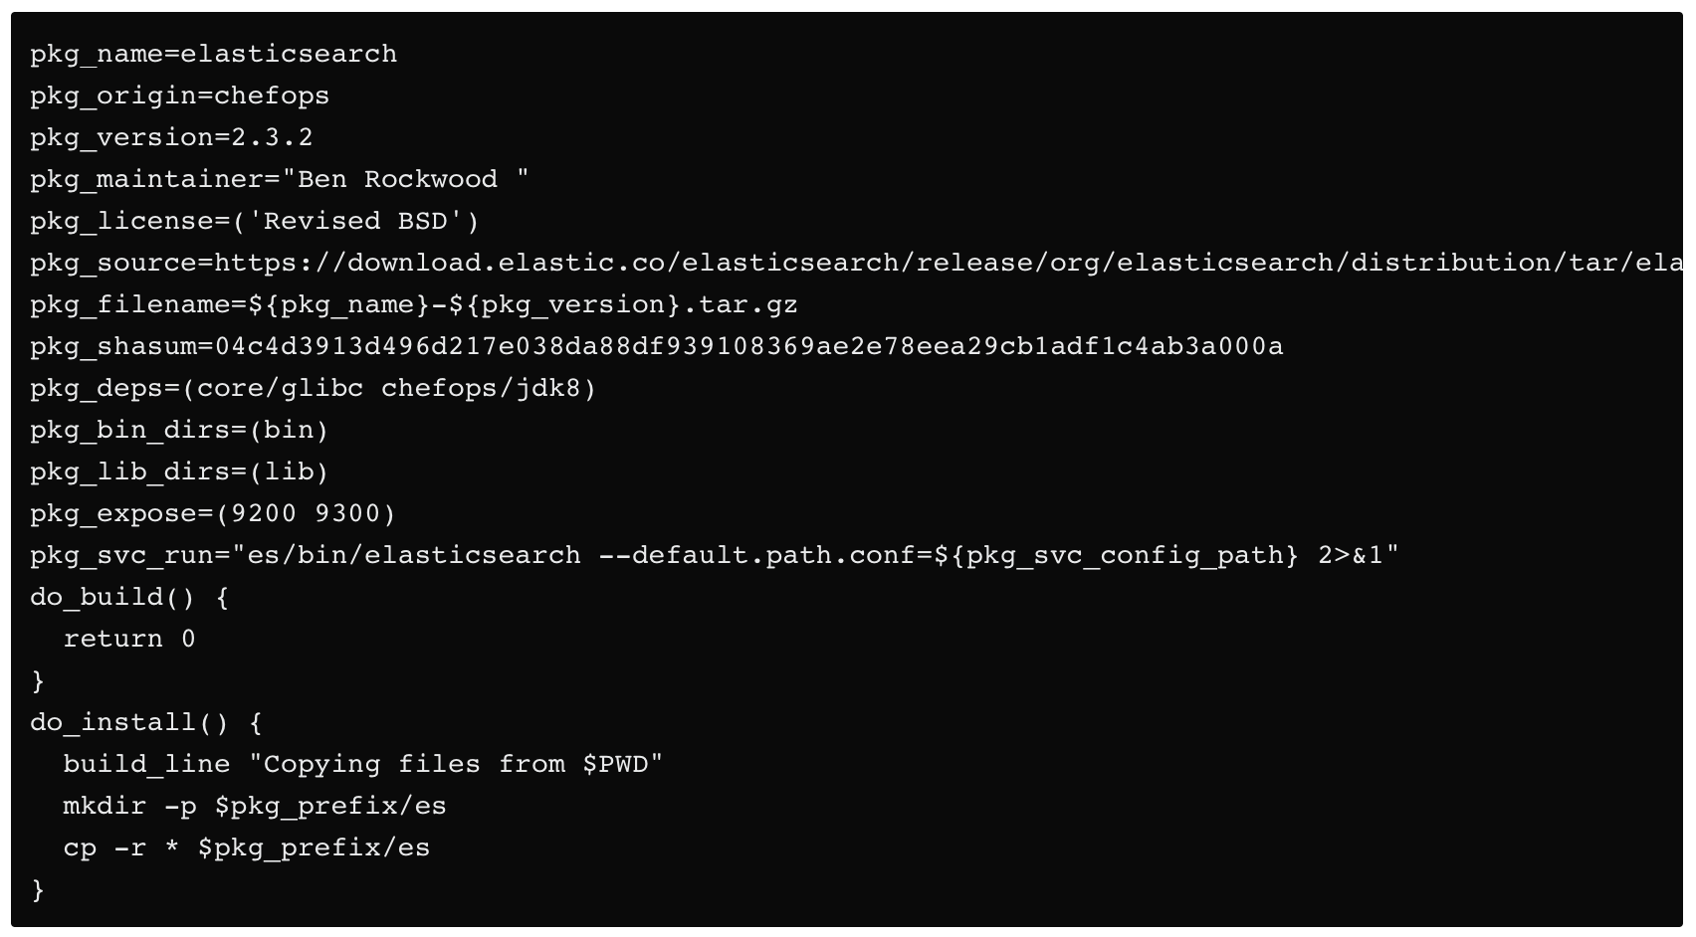
How we do it
Package Format
Bare Metal
Containers
Plan
Artifact
Depot
AMI
VM
To build a package, Habitat uses a build description, called a plan, which describes the application, its dependencies, and configuration options.
The Habitat build service takes all these components and wraps them into a single, encrypted or signed artifact, which can be configured dynamically when the service starts.

Slide 13

How we do it
Supervisor
Leader
Service
Service
Depot
Artifact
Service
Service
Initializer
Stand Alone
Ring
The Habitat supervisor knows how to take the packages and run them. It's aware of the package's peer relationships, its upgrade strategy and security policies.
The supervisor is a process manager that has two primary responsibilities. First, it starts and monitors the child app service defined in the package. Second, it receives and acts upon configuration changes from other supervisors to which it is connected. A service will be reconfigured through hooks if its configuration has changed.
Notes:
Habitat Details
Habitat is a full-featured runtime with deployment coordination and service discovery capabilities built in. Habitat is comprised of:
A packaging format
A supervisor

Slide 14

How we do it
Load Balancer
Security
Service
Service
Secret Payloads
Service
Service
Service
Service
Pub Key
Service
Service
Symmetric Encryption
Security is important because once distributed pieces of an application begin communicating with each other you also need trust relationships. You need to have security that's built into the system, not only for policy changes but for ongoing compliance.
https://www.habitat.sh/docs/concepts-keys/

Slide 15
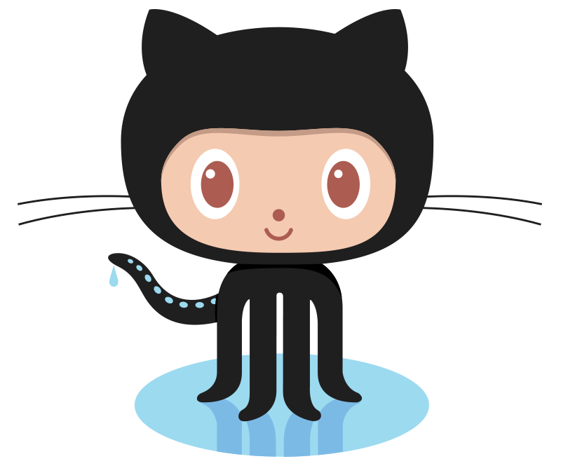

How we do it
Build Service
Plan
Build
Service
Artifact
Depot
In addition, the Habitat ecosystem includes a build service that retrieves the source code for a package from a depot and creates the packages.
There is a cloud-based, public-facing depot maintained by Chef. It is also possible to have a private depot.

Slide 16



What the modern application team gets out of it:
Developers, System Administrators, CIOs; Enterprise and Tech Innovators
Simplification
Runs the same way in any environment
Management travels with the application; no drift
Autonomous and self-organizing
Legacy and Greenfield
Acceleration
Lets the enterprise modernize without re-writing the world
Faster to build, easier to deploy, safer to manage
Easiest way to deploy containers and microservices in production
Empowerment
Developers can focus on building great applications
Systems Administrators can focus on how those applications should behave
Gives both a language they can share, with clear boundaries
Confidential & subject to NDA. Patents Pending.

Slide 17


















Chef: An integrated end-to-end software supply chain
Assessment
Local Dev
Collaborative Dev
Production
Targets/Workloads
Apps
Visibility
Test
Provision
...
Search
Model
Chef server
Audit
Build
Chef Workflow
Discover
Test
Chef Supermarket
Runtime environments
Compliance
Chef DK
Repo
...
Chef Client (infrastructure centric)
Infrastructure
Deploy
Habitat (modern app centric)
...
Confidential & subject to NDA. Patents Pending.

Slide 18
How to start
Habitat Website: https://www.habitat.sh/
Habitat Video: https://www.habitat.sh/about/announcement/
Download Habitat: https://www.habitat.sh/docs/get-habitat
Package repo: https://app.habitat.sh/#/pkgs/core
Demo to play with: https://www.habitat.sh/try/

