Slide 1
eVitals Facility Administrators for Licensed Healthcare Facilities, Midwiferies, Funeral Homes, and Medical Examiner/Coroner Offices Please mute your audio and disable your camera Presenter: Chante
Welcome To The Training Session:

Slide 2
Registered for this Training?
You must be registered for this course in order to receive credit for attendance
If you are registered for this training but not logged in and viewing from your registration, you will not get credit for the course.
Please log into TRAIN PA and join the meeting to
receive credit for the course and be able to
download your training certificate.

Slide 3
Meeting Logistics
This training will take approximately 1 hour
If you get disconnected – please join the meeting again
Please allow the presenters of the class to admit any attendees waiting in the lobby
All trainees – please mute yourself and turn off your camera; if you have a question, please type it into the chat function of the meeting
We will have a Q&A session at the end of the course

Slide 4
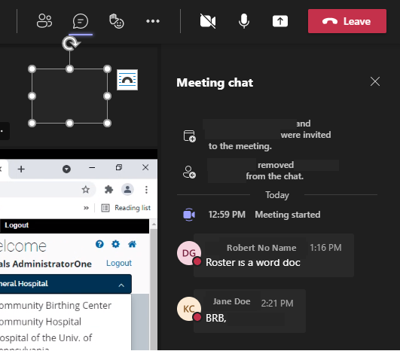
How To Pose Questions
To pose a question during the training use the chat function in your Microsoft Teams Meeting Window(yellow circle)

Slide 5
Resources
These are available in the TRAIN PA course under the Resources Tab
You can print or save these files for your reference:
eVitals Facility Administrator Training Manual
This PowerPoint slide presentation
eVitals Browser Plug-In Instructions
Register for a Keystone ID and Request Access to eVitals Instructions
FAQs for Facility Administrators
Notes:
Need to change screen shot

Slide 6
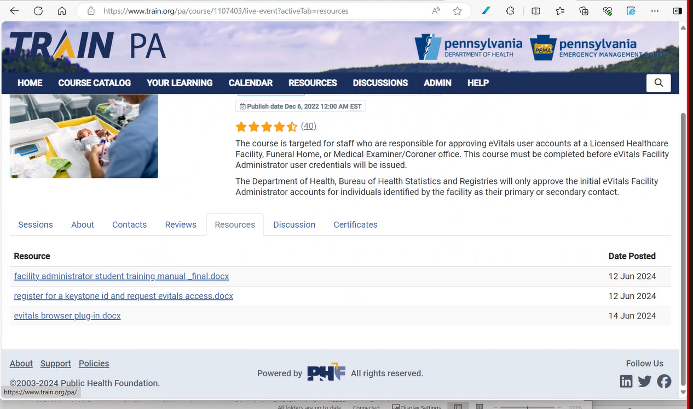
Resources
Notes:
Need to change screen shot

Slide 7
Dynamsoft Installation
In order to upload documentary evidence, All Death Reporting users are required to install a browser plug-in.
Please work with your IT Department on installing the plug-in on your device. DOH cannot offer any technical advice on this software. The software is required to use eVitals.
Cross-browser support on Windows, macOS, Linux and mobile.
Allows you to directly scan from within Chrome, Firefox, Edge, and other mainstream browsers.
Rare Cause deaths, maternal deaths, and amendments all have a documentation requirement.
There is no cost associated with this installation.
https://www.train.org/a/course/1107403/documents/38461/content/
Notes:
Need to change screen shot

Slide 8
What is A Facility Administrator
A Facility Administrator has special responsibilities for managing users at a facility.
There is one Facility Administrator per facility.
Must be the primary or secondary contact reported to the Department of Health by an official of that facility.
The Department of Health will activate the Facility Administrator account upon completion of this course.
No other users at the facility can be enrolled at the facility until the facility administrator has been activated.

Slide 9
What is A Deputy Facility Administrator
A Deputy Facility Administrator has the same responsibilities and permissions as the Facility Administrator.
The Facility Administrator will activate the Deputy Facility Administrator account upon completion of this course.
Up to 3 Deputy Facility Administrators may be established for a facility

Slide 10
Your Responsibilities (User Profile Requests)
Facility Administrators and Deputy Facility Administrators are responsible for:
Approving or rejecting user profile requests for your facility which includes:
Verifying the requesting user is responsible for reporting births or deaths at your facility for data entry and/or certification
Verifying the requesting user has completed all mandatory eVitals training
Deactivating users, including administrators, who are about to retire or leave the facility.
Replacing Deactivated users with new users and ensuring new user(s) complete the required training courses as applicable.
If the replacement Deputy or Facility Administrator has already completed the eVitals Facility Administrator course, there is no need to complete the course again, just provide a copy of your certificate.
If you are leaving the facility, be sure to submit a new contact form indicating your replacement as Facility Administrator.

Slide 11
Your Responsibilities (user verification)
Ensuring that the requesting individual has completed the required training through Train PA
For eVitals access
PA-BHSR: eVitals (Stakeholders) Reporting a Live Birth in Pennsylvania (Hospital/Birthing Center or Midwifery) Mandatory Course
Death reporting courses for users are encouraged but not required

Slide 12
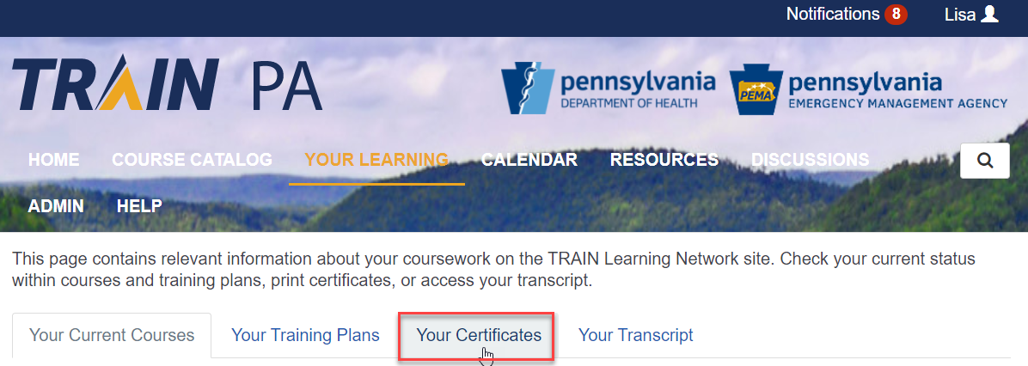
Your Responsibilities (user certificates)
The user should be able to provide you with a copy of the certification of completion which can be found in Train PA under Your Learning.
DOH will be auditing the users that have taken the mandated courses.

Slide 13
Your Responsibilities (other)
Facility Administrators and Deputy Facility Administrators are responsible for :
Managing the user profiles once they are approved
Approving or rejecting abandon birth or death registrations requests (if they have the combined role of Birth Assistant Admin or Death Assistant Admin)

Slide 14
Business Partner User Registration
No user accounts will be migrated from DAVE to eVitals
All users must go through the registration process. Requests for access will be approved or rejected by the Facility Administrator/Deputy Facility Administrator.

Slide 15
Business Partner User Registration
Each user (including Facility and Deputy Account managers) will:
Request a Keystone ID (IDM) (assignment of B- account)
Request eVitals access using the Keystone ID (IDM)
Full instructions can be found under steps 3 and 4 of the eVitals sign-up page at the following link:
https://www.health.pa.gov/topics/Reporting-Registries/eVitals/Pages/Sign-Up.aspx as well as in the Resources tab of this TRAIN PA course

Slide 16
Business Partner User Registration
The eVitals production site is not yet ready for user registration
We will email you when you are able to register for eVitals
You CAN'T register for eVitals yet.

Slide 17
Conclusion: Reminder – Upcoming Trainings
Birth Reporting Users:
If you have not already registered and taken the course, we recommend that you register through TRAIN PA for
Training Part 2: PA-BHSR: eVitals Specialized Birth Registrations, Birth Amendments, and System Reports
It will instruct users on how to submit amendments, register special birth cases, and run data reports on your facility’s birth cases
Death Reporting Users:
Course information for death reporting will be posted to TRAIN PA in end of July 2024.

Slide 18
Demonstration of eVitals
Now a demonstration of the
Facility Administrator Functions!

Slide 19
Conclusion: Roll-Call
Type your FIRST NAME and LAST INITIAL in the chat so we can credit you with taking the course.
Birth reporting questions should be posed to the RA-DHEBRS@pa.gov email
Death reporting questions should be posed to RA-DHEDRS@pa.gov email
Check out our website https://www.health.pa.gov/topics/Reporting-Registries/eVitals for any announcements
Please leave a review on TRAIN PA.
Thank you for taking the class and WELCOME to eVitals.

Slide 20
Thank you!

