Slide 1

Food & Fitness tracker -fft
Christopher Jordan B00554456
COM667

Slide 2
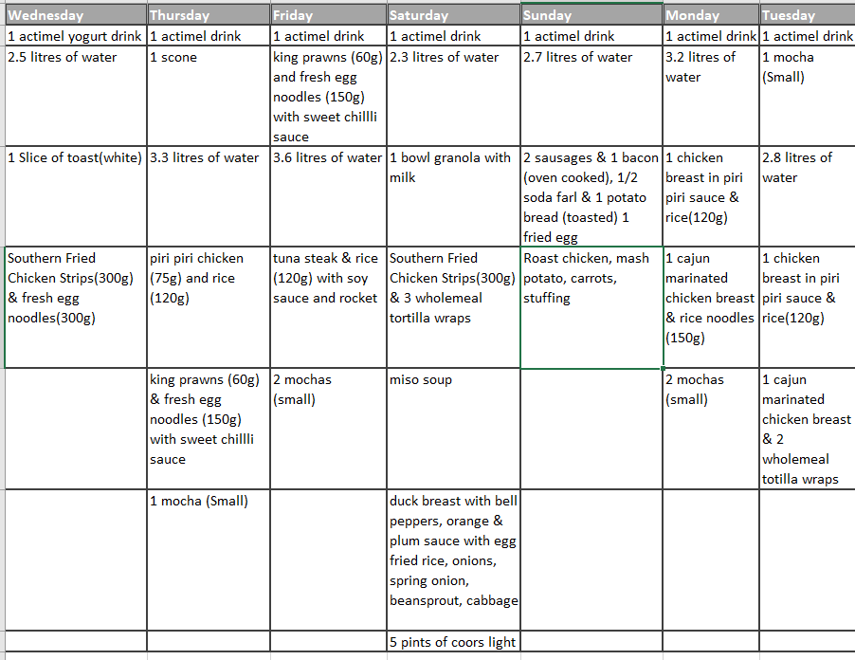
Problem statement
To help me keep a record of what I am eating and what exercises I am doing on daily basis, I employ the use of several mobile applications, as I have not been able to find an app which will do the same job as all three apps.
Currently used apps
Nike run Club
Apple Health
MyFitnessPal
MapMyRun

Slide 3
Solution & Aim
Project Solution
Project Aim
I desire to create an application that will keep track of a user’s daily eating and fitness habits.
The initial features for the proposed solution will allow the user to enter their daily diet and any exercises they have completed.
As well as being able to track the current route a user is taking for an exercise that they are currently completing.
A breakdown of the users’ daily diet and fitness habits will also be provided to the user.
My project aim is to create a cross-platform application that will allow the user to track their daily diet and exercise activities and provide a breakdown of the information in an easily interpreted graphical representation.

Slide 4


Requirements gathering Why is it Used?
Allows for stakeholders to develop a full understanding of what it will deliver that is critical to its success.
It is important that this stage of a project is not overlooked, so that further down the line it is not realised that the customers’ needs have not been adequately met due to the customers requirements not being fully understood.

Slide 5

Focus Group
Focus Groups are used to help provide a large variety of possible requirements, by getting a group of people together to discuss the problem and think of possible solutions and desirable functionality.
This technique is useful in that it allows people to bounce ideas of each other and therefore creating broader range of ideas.

Slide 6

Observations
Observations is another useful technique for requirement gathering.
Observations work by a person observing the environment that the solution will used in or by observing solutions that are already on the market.
Apps Observed
Nike Run Club
Apple health
MyFitnessPal
MapMyRun

Slide 7
Functional Requirements
Number | Functional Requirement
FR-01 | The application shall work on both iOS and Android platforms
FR-02 | A new user shall be asked to set up an account
FR-03 | The app shall remember a user after first-time set up
FR-04 | The user shall be able to navigate the app via a Navigation menu pane
FR-05 | The app shall allow a user to be able to search for meals.
FR-06 | A user shall be able to log a meal for breakfast
FR-07 | A user shall be able to log a meal for lunch
FR-08 | A user shall be able to log a meal for dinner
FR-09 | A user shall be able to log a snack
FR-10 | A user shall be able to view all the food they have logged in the last 7 days
FR-11 | A user shall be able to view a calorie break down for all the food they have eaten for the current day.
FR-12 | The app shall allow the user to start a run
FR-13 | The app shall allow the user to pause a run
FR-14 | The app shall allow the user to continue a run
FR-15 | The app shall allow the user to end a run
FR-16 | The app shall record the time ran by a user
FR-17 | The app shall record the distance covered during a run
FR-18 | The app shall record the calories burned during a run
FR-19 | Upon a run ending the app shall show the route a user ran on a map
FR-20 | Upon a run ending the app shall show the distance a user ran
FR-21 | Upon a run ending the app shall show the calories burned by a user
FR-22 | Upon a run ending the app shall show the average pace of the user
FR-23 | The app shall show statistics on all the runs a user has completed
FR-24 | The app shall display the total distance walked/ran in a day
FR-25 | The app shall show the average distance walked/ran since the user started using the app
FR-26 | A user will be required to enter their date of birth upon initial set up
FR-27 | The app shall ask the user to select a gender upon initial set up
FR-28 | The app shall ask the user to enter their weight upon initial set up
FR-29 | The app shall be able to randomly suggest a meal for breakfast
FR-30 | The app shall be able to randomly suggest a meal for lunch
FR-31 | The app shall be able to randomly suggest a meal for dinner
FR-32 | The app shall display the recipe upon selecting a meal
FR-33 | The app shall be provide a nutritional breakdown of any meals/snacks it suggests

Slide 8
Non-functional requirements
Number | Non-Functional Requirement
NFR-01 | The app shall have a consistent theme throughout the application
NFR-02 | The app shall be simple to understand and use
NFR-03 | The app shall work on devices of different screen sizes
NFR-04 | The app shall not crash
NFR-05 | The app shall be capable of running in the background
NFR-06 | The app shall react appropriately to changes orientation
NFR-07 | The app shall be easy to navigate
NFR-08 | The app shall conform to best practice and design principles for the chosen platforms

Slide 9

Requirement prioritisation strategy
A requirement prioritisation strategy is used to determine which requirements should be implemented first and which ones can be delayed until later in the projects development lifecycle.
For this project the MOSCOW technique was employed. Requirements are assigned to the following categories:
Must Do
Should Do
Could Do
Won’t Do
Notes:
Number
Functional Requirement
MosCOW
FR-01
The application shall work on both iOS and Android platforms
Must
FR-02
A new user shall be asked to set up an account
Must
FR-03
The app shall remember a user after first-time set up
Must
FR-04
The user shall be able to navigate the app via a Navigation menu pane
Must
FR-05
The app shall allow a user to be able to search for meals.
Should
FR-06
A user shall be able to log a meal for breakfast
Must
FR-07
A user shall be able to log a meal for lunch
Must
FR-08
A user shall be able to log a meal for dinner
Must
FR-09
A user shall be able to log a snack
Should
FR-10
A user shall be able to view all the food they have logged in the last 7 days
Should
FR-11
A user shall be able to view a calorie break down for all the food they have eaten for the current day.
Must
FR-12
The app shall allow the user to start a run
Must
FR-13
The app shall allow the user to pause a run
Should
FR-14
The app shall allow the user to continue a run
Should
FR-15
The app shall allow the user to end a run
Must
FR-16
The app shall record the time ran by a user
Must
FR-17
The app shall record the distance covered during a run
Must
FR-18
The app shall record the calories burned during a run
Should
FR-19
Upon a run ending the app shall show the route a user ran on a map
Should
FR-20
Upon a run ending the app shall show the distance a user ran
Should
FR-21
Upon a run ending the app shall show the calories burned by a user
Should
FR-22
Upon a run ending the app shall show the average pace of the user
Should
FR-23
The app shall show statistics on all the runs a user has completed
Should
FR-24
The app shall display the total distance walked/ran in a day
Must
FR-25
The app shall show the average distance walked/ran since the user started using the app
Should
FR-26
A user will be required to enter their date of birth upon initial set up
Must
FR-27
The app shall ask the user to select a gender upon initial set up
Must
FR-28
The app shall ask the user to enter their weight upon initial set up
Must
FR-29
The app shall be able to randomly suggest a meal for breakfast
Could
FR-30
The app shall be able to randomly suggest a meal for lunch
Could
FR-31
The app shall be able to randomly suggest a meal for dinner
Could
FR-32
The app shall display the recipe upon selecting a meal
Could
FR-33
The app shall be provide a nutritional breakdown of any meals/snacks it suggests
Could
NFR-01
The app shall have a consistent theme throughout the application
Must
NFR-02
The app shall be simple to understand and use
Must
NFR-03
The app shall work on devices of different screen sizes
Must
NFR-04
The app shall not crash
Must
NFR-05
The app shall be capable of running in the background
Must
NFR-06
The app shall react appropriately to changes orientation
Must
NFR-07
The app shall be easy to navigate
Must
NFR-08
The app shall conform to best practice and design principles for the chosen platforms
Must

Slide 10
Risk analysis
No. | RISK | IMPACT | RESOLUTION
1 | Developer illness | Reduced productivity. Project falls behind schedule. | Task buffers and trying to work ahead of schedule.
2. | Lack of productivity | Project will fall behind schedule | Creation and following of a project plan will help ensure productivity.
3 | Compromising on Design | Finished software may not follow the same theme and be complex to user. May lead to further coding being needed in later stages. | Designs for all screens will produced before any development commences. 2 weeks has been dedicated to this.
4 | Data Loss | Project may need to be restarted or falls behind schedule due to having redo work. | Multiple copies of all work carried out will be kept. i.e. Cloud, USB, hard drive
5 | Unidentified resources | Time wasted getting the unidentified resources. Fall behind schedule | All required resources will be identified early in the projects planning stage.
6 | Unavailable resources | Resources may be identified which you may need to pay for or are unable to access. Workarounds could compromise project quality. Project falls behind schedule | All resources will gathered in advance and checked that
7 | Unforeseen Circumstances | Both technical and personal issues which may result in work not being completed to schedule. Or having to change project direction. | Buffers are included in the project plan to account for unforeseen circumstances.
8 | Requirement Creep | Constant updating/adding of requirements will result in work not being accounted for in the project plan | Requirements will be finalised and can only be changed should a review carried to determine the feasibility and impact on the projects planned completion date.
For any project to achieve a successful it is important that all project risks are identified early and managed appropriately to avoid time slippage, increased costs, corruption or even the total loss of the project.
A risk can be thought as anything that may be a potential problem that may occur during the software development life cycle.

Slide 11
Risk Mitigation Strategy Probability-Impact Matrices
Before Control
Post Controls

Slide 12
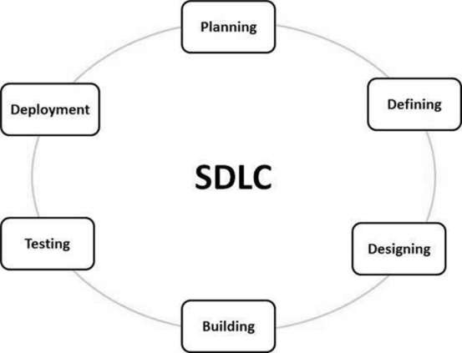
Software Development lifecycle
A SDLC is a framework which defines the tasks to be performed at each stage of the software development process.
(Wisdomjobs.com, 2018)
Notes:
Wisdomjobs.com, 2018. SDLC OVERVIEW SOFTWARE DEVELOPMENT LIFECYCLE (SDLC). [Online] Available at: https://www.wisdomjobs.com/e-university/software-development-lifecycle-sdlc-tutorial-1513/sdlc-overview-25976.html [Accessed 01 November 2018].

Slide 13
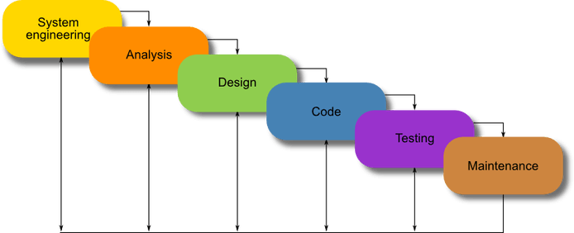
Chosen Methodology
Modified Waterfall Model
This model allows a developer to go back to an earlier task and update it if they release that something needs to be changed instead of going back starting all over again from the start
(Powell-Morse, 2016)
Notes:
Powell-Morse, A., 2016. Waterfall Model: What Is It and When Should You Use It?. [Online] Available at: https://airbrake.io/blog/sdlc/waterfall-model [Accessed 01 November 2018].

Slide 14
Modified Waterfall model
Advantages
Disadvantages
Adapts to shifting teams
Forces a structured organisation
Allows for early design changes
Suited for milestone development
Adaptive to Design Constraints
Lack of user/client feedback mid-process
Delayed Testing Period

Slide 15
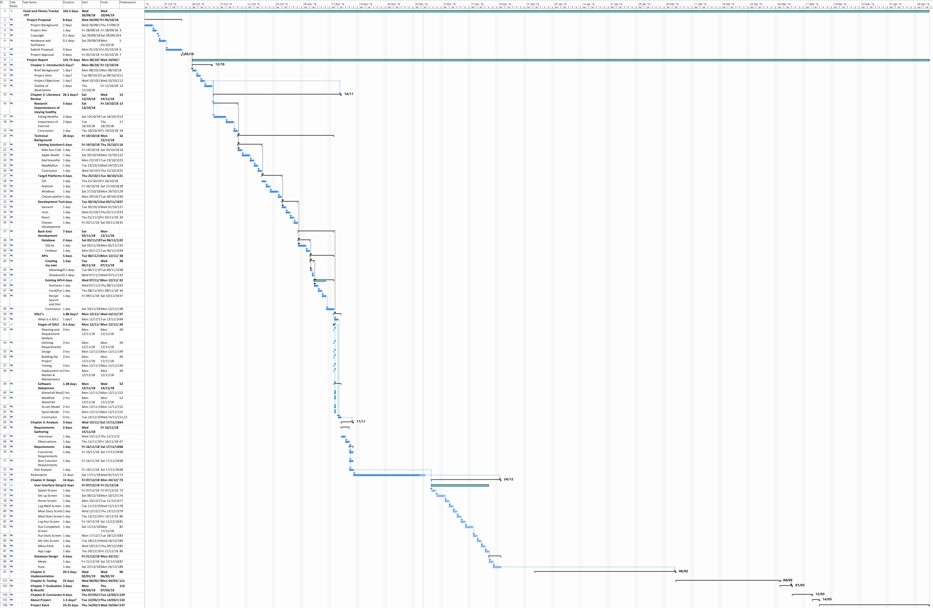

Slide 16
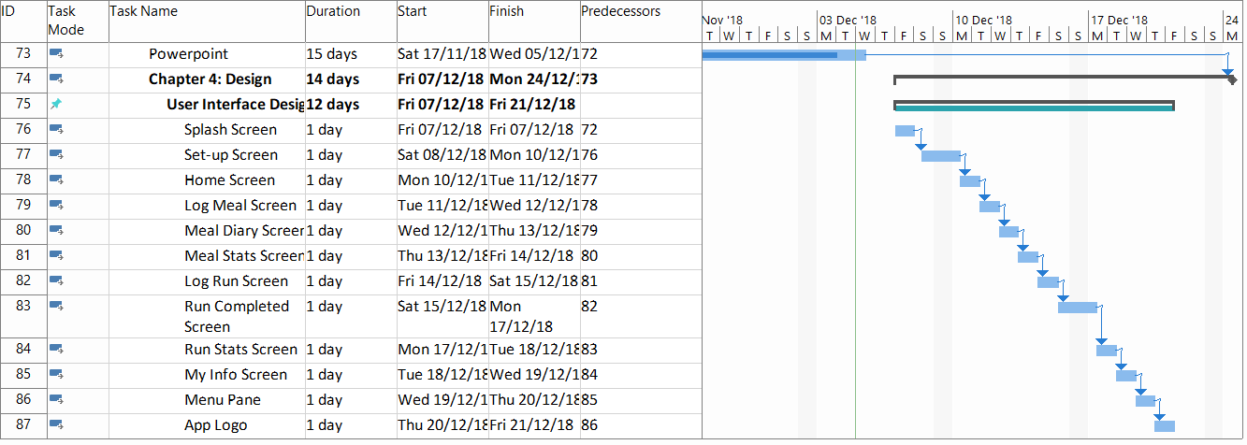
Where I am now

Slide 17
Implementation Strategy
Intend to follow my Gantt chart as my plan for which worked should be carried out.
The Gantt chart will be updated as work is carried out. It will wbe updated to show tasks as 25%, 50%, 75% and 100% completed.

Slide 18


Software Platform
Original Choice
C#
Visual Studio plug-in
Difficult for complex applications
New Choice
Ionic 3 (latest version, ionic 4 in beta testing)
HTML, Javascript, and CSS
Produces Native looking apps
Also uses Angular.js
Is an HTML5 framework which works with the help of Cordova or PhoneGap.

Slide 19
Other Technical Resources
Ionic Account
SQLITE – database (used as the database only needs to be accessed by the user)
Adobe Experience Design (XD) – UI design
RapidAPi – API Hub (intending to use the Nutrionix api)
Katalon Studio – Testing (automated API, mobile testing)
Git/Github Desktop
Node.js

Slide 20

Work Completed to Date
Literature Review - completed
Technical Information – changes required due to switch to Ionic from Xamarin
Methodolgy chosen and implemented
Requirements gathering – completed
Requirement Prioritisation - completed
Risk Analysis – completed

Slide 21
Next Objective? – UI/UX Design
Shneiderman’s 8 Golden Principles
Strive for consistency.
Enable frequent users to use shortcuts.
Offer informative feedback.
Design dialog to yield closure.
Offer simple error handling.
Permit easy reversal of actions.
Support internal locus of control.
Reduce short-term memory load.
Will use Adobe Experience Design (XD)

Slide 22
Prototypes

Slide 23
Any questions?

