Slide 1
Airline Travel Safety
DSC640 Data Visualization
Executive Briefing
Christine J Orosco

Slide 2
Airline Safety
Purpose:
To illustrate that Airline travel is a safe means of transportation
Outline:
Airline and Vehicular mileage comparisons
Airline and Vehicular passenger and driver comparisons
Less fatalities than vehicular travel

Slide 3
Airline and Vehicular Travel Comparisons
Domestic Airline Miles Flown
Avg of 584K per year
51% increase from 2000 - 2019
Vehicular Miles Driven
Avg of 4.86M per year
18% increase from 2000 - 2019
Domestic Airline Passengers
Avg of 150.2M per year
19% increase from 2003 - 2015
Licensed Drivers
Avg of 210M per year
17% increase from 2000 - 2019

Slide 4
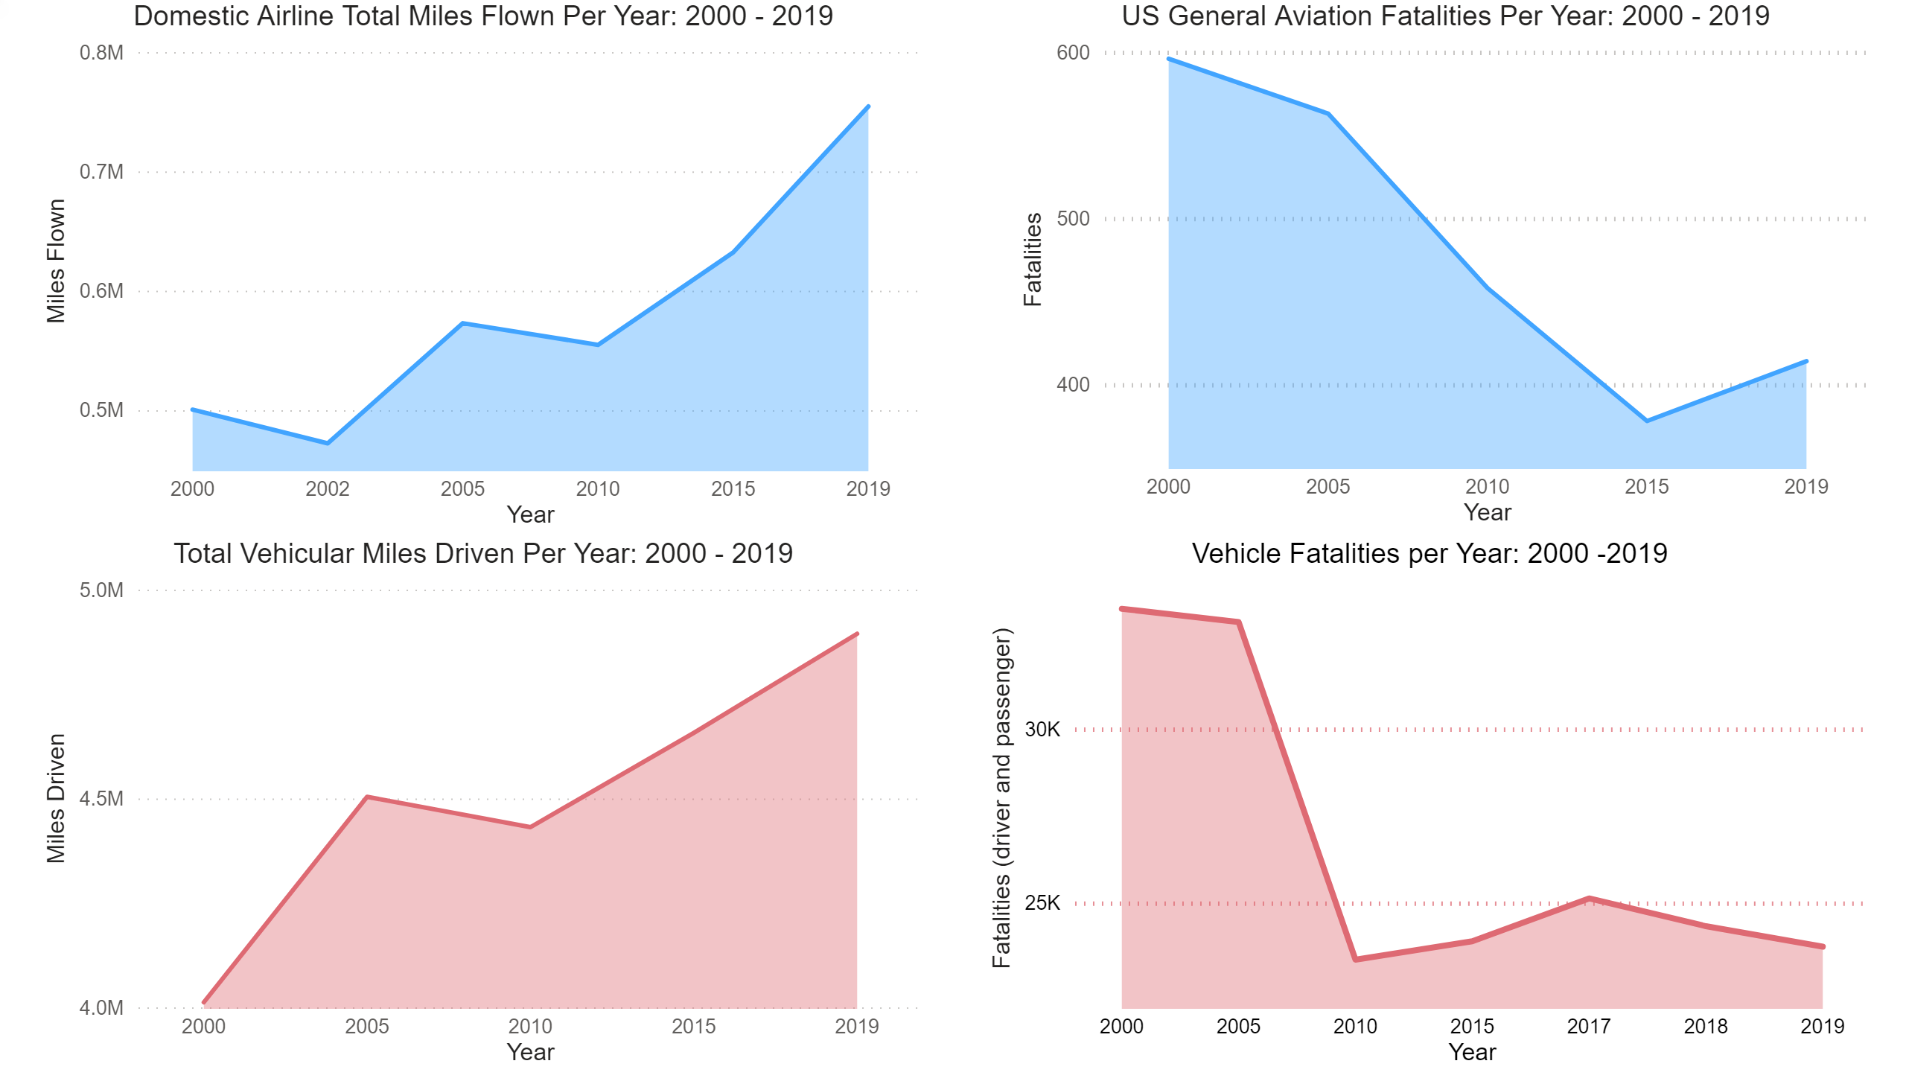
Airline and Vehicular Miles

Slide 5
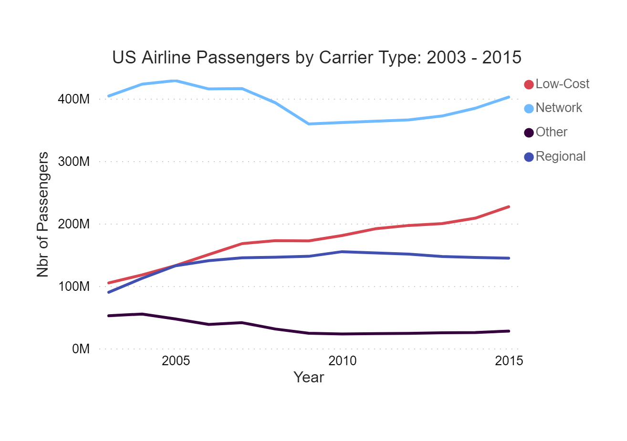
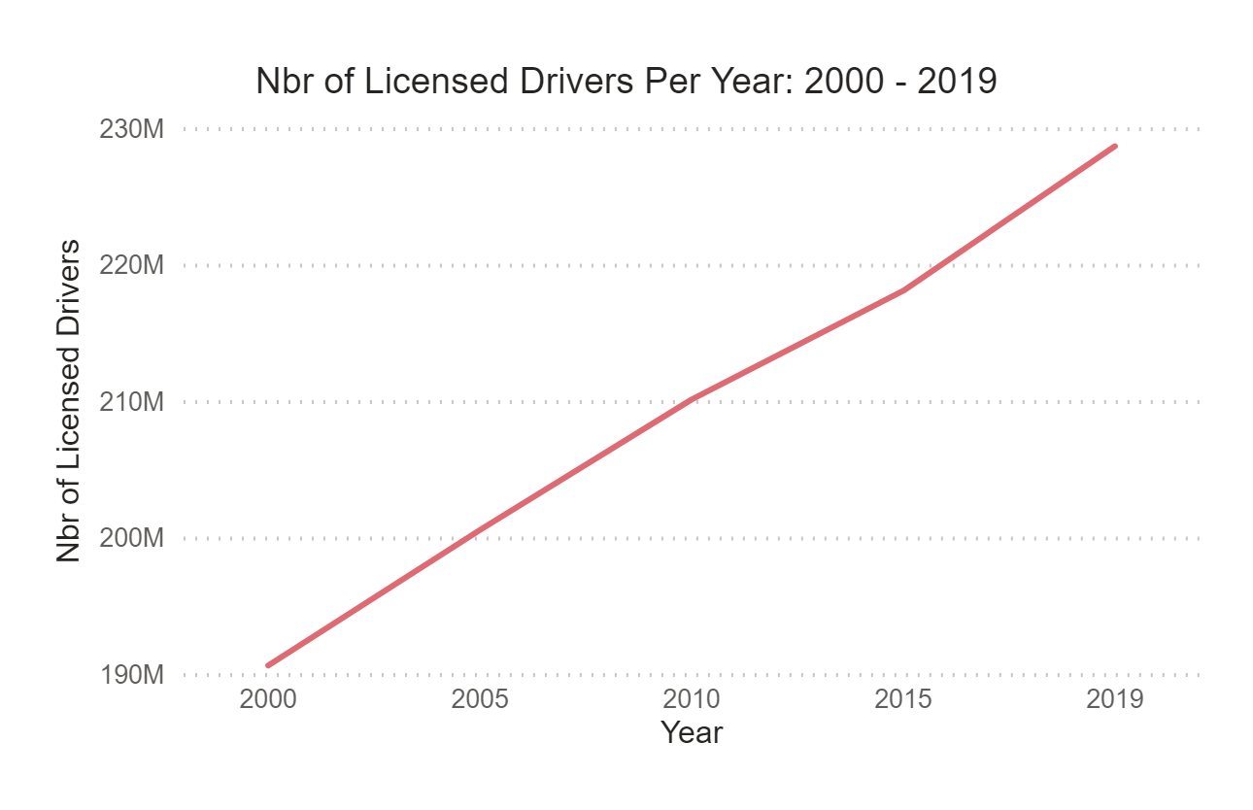
Airline Pax and Vehicular Drivers

Slide 6
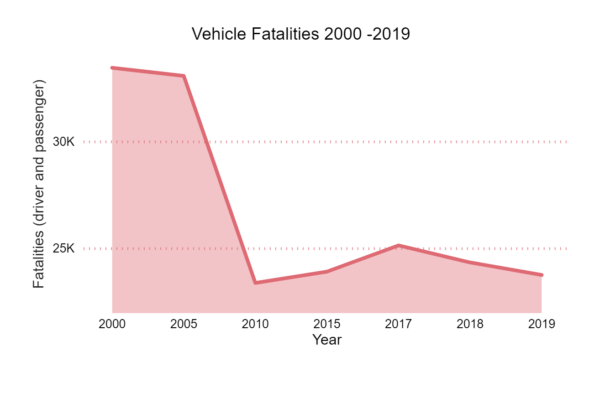
Fatality Metrics

Slide 7
Conclusions
Airline Travel no more dangerous than vehicular travel
Total of 10 Domestic airline fatal accidents from 2000 - 2014
Total of 523K vehicular fatal accident for same time period.
Airline travel hours significantly less than vehicles
Average person spends 1 hour driving per day
Leads to more exposure for chance of accident
Notes:
*

