Slide 1
Linux Host CloudProxy
CloudProxy application
fileServer
fileClient
BidServer/BidClient/BidJudge
AuthClient, AuthServer
Tao (for app), Policy Public Key
KeyNegoServer
Key management
Policy Private Key
tcService.exe
Tao (for Hv)
Policy Public Key
tciodd.ko
Tao (for OS)
Policy Public Key
Linux
Disks
NIC

Slide 2
KVM CloudProxy
Guest Partition
tCloudProxy application
Tao (for app), Policy Public Key
tcKvmService.exe
tcKvmGuestOsService.exe
Tao (for OS), Policy Public Key
Tao (for Hv)
Policy Public Key
ktciodd.ko
Tao (for OS), Policy Public Key
Hypercall
kvmtciodd.ko
Tao (for OS)
Policy Public Key
KVM Hypercall handler
Linux
KVM
Disks
NIC

Slide 3
Hypervisor CloudProxy
Control Partition
(MCP)
Guest Partition
I/O Service Partition
Tao (for OS)
Links to service partitions
Policy Public Key
Tao (for Hv)
Device Tables
Partition auth policy
Policy Public Key
Hypercall link
Policy Public Key
MCP Measurement
Partition ID’s
Inter-partition communications permissions
VMM
VMM Functions
Maintain MCP
Follow MCP directives
Local permission check for inter-partition I/O
Isolation, hypercall fielding, startup/teardown
MCP Functions
Startup policy
Device assignment policy
Services map
Tao for hypervisor
Disks
NIC

Slide 4
VMM
Boots and isolates
Measures and starts MCP
Sends policy dependent service requests to MCP
Sends Tao requests to MCP
Implements device assignment determined by MCP
Notes:
Change “trapdoor” and “keyword”. Redo this slide to add in SSE and PEKS

Slide 5
MCP
Implements Tao
Determines which partitions to start (like I/O partition and authorized guests)
Owns devices until assigned to partitions
Maintains map of services to partitions
Disk and network IO
Other device driver partitions
Communicates (through I/O partition) with infrastructure and reports usage, etc.
Performs authentication and authorization determinations for VMM
Machine health
Determines resource assignment for partitions
Initiates all partition startup (except for self)
Notes:
Change “trapdoor” and “keyword”. Redo this slide to add in SSE and PEKS

Slide 6
Other partitions
I/O
Performs I/O for shared devices
Guest
Implements Tao for OS
May “own” devices
Exports common I/O services (e.g.-Disk, network) to an I/O partition using virtual device driver
Notes:
Change “trapdoor” and “keyword”. Redo this slide to add in SSE and PEKS

Slide 7
Trusted Computing Service and
service device driver
fileClient.exe
Protected app
tcService.exe
Service requests
Start trusted app
Seal
Unseal
Quote
Get policy key
Policy Key
OS Public Key
tcService hash
tcDD (device driver)
OS
read, write
read, write

Slide 8
Building a secure distributed application
Currently
With CloudProxy
Write the programs implementing the application correctly
Deploy the program safely (no changes)
Configure the operating environment correctly
Ensure other programs can’t (or don’t) interfere with safe program execution
Generate and deploy keys safely
Protect keys during use and storage
Ensure data is not visible to adversaries and cannot be changed in transmission or storage
Add new program elements during operation
Ensure trust infrastructure is reliable
Manually audit to provide confidence this all happened during operations
Write the programs implementing the application correctly
Properties
Fail safe remotely verifiable operation
Simple programming model
Support multiple layers of familiar software stack (Application, OS, Hypervisor, Hardware)

Slide 9
The “secret sauce”
Host system provides:
Isolation for measurement-based principals
Hosted programs
Services for measurement-based principals
Restricted use of cryptographic keys to encrypt and decrypt secrets for a measurement-based principal
Key management for the principals
Policy enforcement anchor (authentication and authorization)

Slide 10
Measurement-based Principals
Measurement based principal is an executing hosted program together with its environment
The binary
The parameters and other initial data
The host system and its ancestors
The host system is also a measurement-based principal
Measurement-based principals have public-private key-pairs that “speak for” (authenticate) them
Root host system is hardware

Slide 11
Key management
How do measurement-based principals get their keys?
Generate public-private key pair when first started on host system
Host system “attests” to public key
Signs attestation (certificate) with hosted system measurement and public key
Attestation transmitted to “authority” who signs public key with hosted system measurement
Certificate chain from hardware to hosted system is evidence for key
Private keys protected by host system
… Only this principal has access to the corresponding private key when isolated. Certificate chain is proof of key validity.

Slide 12
Policy anchor
Policy public key is part of measured principal
Roots policy enforcement for activity
All valid assertions chain to this key
Key can’t be modified without changing principal
Instant PKI
Important for scalability

Slide 13
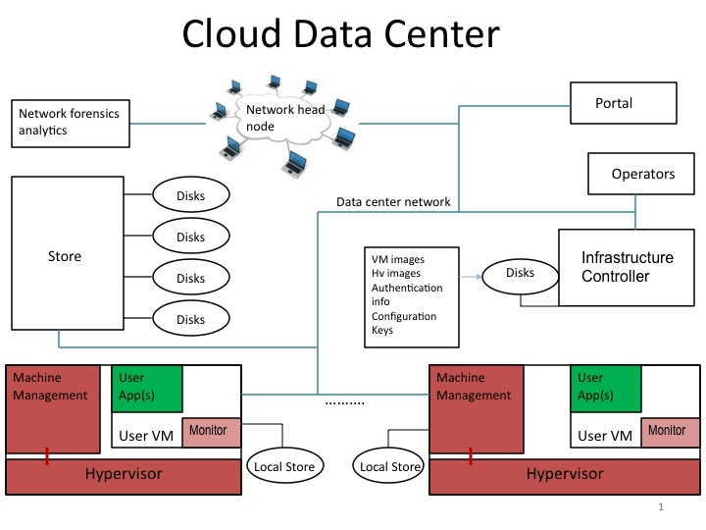
Cloud setting: protection model
Threats
Co-tenants, insiders,
Eavesdroppers, technicians
Key disclosure
Correct operation, configuration, …
CA’s
Large software services written by others (to guarantee confidentiality or integrity)

Slide 14
CloudProxy Tao Library
Primitives
Start measured isolated hosted program
Seal/unseal secrets to program identity
Generate, manage, certify keys via attestation keys (initialization)
Authenticate programs
Policy based authentication and authorization
Program based root
XML claims, access guard
Cryptographic authentication (signatures)
End-point protected communications
Encrypted, authenticated, integrity protected channels and storage
Authenticates additional principals “spoken for” by channel
Distributed recovery
Update keys, programs,…

