Slide 1
The CloudProxy Tao for Trusted Computing
John L. Manferdelli
Intel Science and Technology Center for Secure Computing
UC, Berkeley
Joint work with Tom Roeder (Google) and Fred Schneider (Cornell)

Slide 2
Building a secure distributed application
Currently
With CloudProxy
Write the programs implementing the application correctly
Deploy the program safely (no changes)
Configure the operating environment correctly
Ensure other programs can’t (or don’t) interfere with safe program execution
Generate and deploy keys safely
Protect keys during use and storage
Ensure data is not visible to adversaries and cannot be changed in transmission or storage
Add new program elements during operation
Ensure trust infrastructure is reliable
Manually audit to provide confidence this all happened during operations
Write the programs implementing the application correctly
Properties
Fail safe remotely verifiable operation
Simple programming model
Support multiple layers of familiar software stack (Application, OS, Hypervisor, Hardware)

Slide 3
The “secret sauce”
Host system provides:
Isolation for measurement-based principals
Hosted programs
Services for measurement-based principals
Restricted use of cryptographic keys to encrypt and decrypt secrets for a measurement-based principal
Key management for the principals
Policy enforcement anchor (authentication and authorization)

Slide 4
Measurement-based Principals
Measurement based principal is an executing hosted program together with its environment
The binary
The parameters and other initial data
The host system and its ancestors
The host system is also a measurement-based principal
Measurement-based principals have public-private key-pairs that “speak for” (authenticate) them
Root host system is hardware

Slide 5
Key management
How do measurement-based principals get their keys?
Generate public-private key pair when first started on host system
Host system “attests” to public key
Signs attestation (certificate) with hosted system measurement and public key
Attestation transmitted to “authority” who signs public key with hosted system measurement
Certificate chain from hardware to hosted system is evidence for key
Private keys protected by host system
… Only this principal has access to the corresponding private key when isolated. Certificate chain is proof of key validity.

Slide 6
Policy anchor
Policy public key is part of measured principal
Roots policy enforcement for activity
All valid assertions chain to this key
Key can’t be modified without changing principal
Instant PKI
Important for scalability

Slide 7
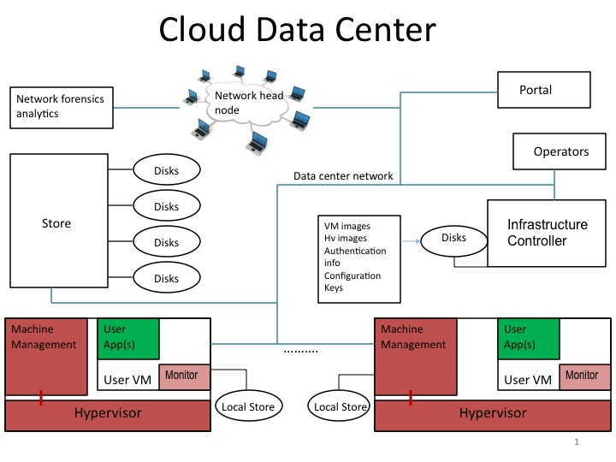
Cloud setting: protection model
Adversaries: Co-tenants, insiders (but not “inside” developer), eavesdroppers, technicians
Protect: Key disclosure, integrity violation, data (maybe code)
Ensure: Correct operation, configuration (affecting confidentiality and integrity)
Avoid: Large software services written by others, CAs

Slide 8
The Tao Library
Primitives
Start measured isolated hosted program
Seal/unseal secrets to program identity
Generate, manage, certify keys via attestation keys (initialization)
Authenticate programs
Policy based authentication and authorization
Program based root
XML claims, access guard
Cryptographic authentication (signatures)
End-point protected communications
Encrypted, authenticated, integrity protected channels and storage
Authenticates additional principals “spoken for” by channel
Distributed recovery
Update keys, programs,…

Slide 9
Linux Host CloudProxy
Key/platform
Certification
(mainly init)
CloudProxy application
fileServer
fileClient
BidServer/Client, BidJudge
AuthClient, AuthServer
Tao (for app), Policy Public Key
KeyNegoServer
Key management
Policy Private Key
tcService.exe
Tao (for Hv)
Policy Public Key
Linux and small trusted file system (initramfs) measured and protected by Tao (authenticated boot)
Runs designated applications only
Apps and libraries in measured file system
Host services
by hardware for OS
Host services
by OS for applications
tpm0
tciodd.ko
Tao (for OS)
Policy Public Key
Linux
Disks
NIC

Slide 10
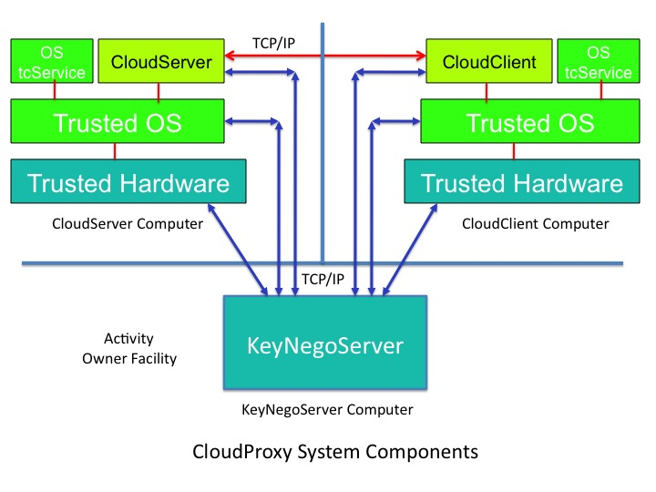
Initialization
Policy Public Key
keyNegoServer
CloudClient
My Keys
End state
CloudClient has private key that only it can access, while isolated and Policy principal signed certificate for the public key.
Policy principal signed certificate can be used to
Establish SSL channel
Authenticate program and isolation regime
Valid
Hashes
HW vendor
certs
Revocation

Slide 11
Operation
CloudServer
Policy Public Key
Policy Public Key
CloudClient
End state
Programs have access to unsealed private keys and symmetric keys (to encrypt/integrity protect files, etc)
Program can use it’s private key to authenticate identity and isolation regime
Program can do authentication and authorization rooted in policy key
Trusted programs have authenticated, encrypted integrity protected channel to communicate.
My Keys
My Files
(encrypted)
Properties
All trust rooted in “Policy Key”
All private keys sealed to code identity
Policy key is part of identity

Slide 12
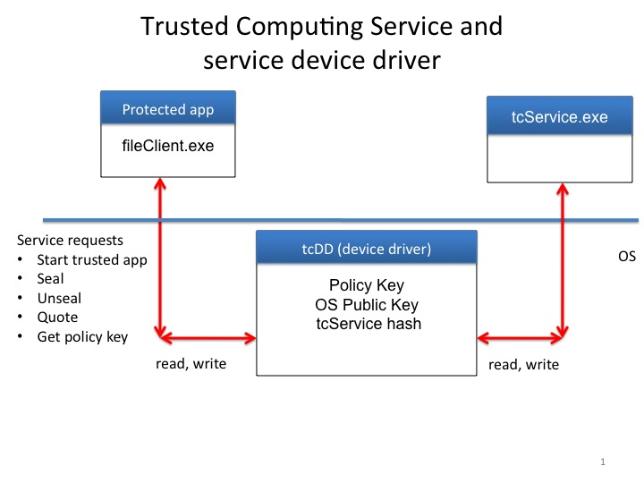
The Trusted OS
Simplified Linux
OS support for Tao services
tcService
Kernel changes
encrypted swap
application identity
tied to Tao services
Initramfs
Encapsulated initial
file system
Measured at boot
Contains apps
Configuration
Module loading restrictions
Don’t mount file systems as trusted
Isolation: One trusted app per OS

Slide 13
Trusted Computing Service and
service device driver
fileClient.exe
Protected app
tcService.exe
Service requests
Start trusted app
Seal
Unseal
Attest (Quote)
Get policy key
Policy Key
OS Public Key
tcService hash
tcDD (device driver)
OS
read, write
read, write

Slide 14
What’s next
TCP/IP
OS tcService
CloudServer
CloudClient
OS tcService
Trusted OS
Trusted OS
Hv tcService
Hv tcService
Trusted Hypervisor
Trusted Hypervisor
Trusted Hardware
Trusted Hardware
Hypervisor hosted CloudProxy components

Slide 15
KVM Hypervisor
CloudProxy application
Tao (for app), Policy Public Key
Guest Partition
ncp.exe
Data Center
Fabric control
Node Control
Program
tcKvmGuestOsService.exe
Tao (for OS),
Policy Public Key
tcKvmService.exe
Host services by guest OS for applications
Tao (for Hv)
Policy Public Key
Host services by host OS for Guest OS
Host services
for host
programs
tciodd0
Tao (for OS)
ktciodd0
Host interface
Host services
by hardware for
Host OS
Hypercall
tpm0
kvmtciodd0
Tao (for OS)
Policy Public Key
KVM Hypercall handler
Linux
KVM
Disks
NIC

Slide 16
Node control program (partition)
Communicates with data center control to receive data center policy
Which VMs run when.
Health monitoring
Authenticates and verifies authorization to be enforced by host Linux (or VMM)
Small and simple like ideal hypervisor
Claims based access control
Policy key
Protected by Tao

Slide 17
Hypervisor CloudProxy
Node Control Partition
(NCP)
Guest Partition
I/O Service
Partition
Data Center
Fabric control
Tao (for OS)
Links to service partitions
Policy Public Key
Tao (for Hv)
Device Tables
Partition auth policy
Policy Public Key
Hypercall link
Partition ID’s,
Node policy
Policy Public Key
NCP Measurement
VMM
Host services by hardware for VMM
tpm0
VMM Functions
Maintain MCP
Follow MCP directives
Local permission check for inter-partition I/O
Isolation, hypercall fielding, startup/teardown
MCP Functions
Startup policy
Device assignment policy
Services map
Tao for hypervisor
Disks
NIC

Slide 18
Things to do
Node control program
Minimize Linux footprint
Security review
Small type I hypervisor
Partition infrastructure
I/O for “assigned” devices
Scale application
Google infrastructure
Changes to key management infrastructure (?)
New hardware support

Slide 19
Did you say clients?
CloudService
Policy Public Key
Policy Public Key
MyClient
(Chrome?)
Policy Public Key
MyPhone
Policy Public Key
CloudService
Policy Public Key
DigitalMe
(Glasses)
Policy Public Key
HomeService
Policy Public Key

