Slide 1
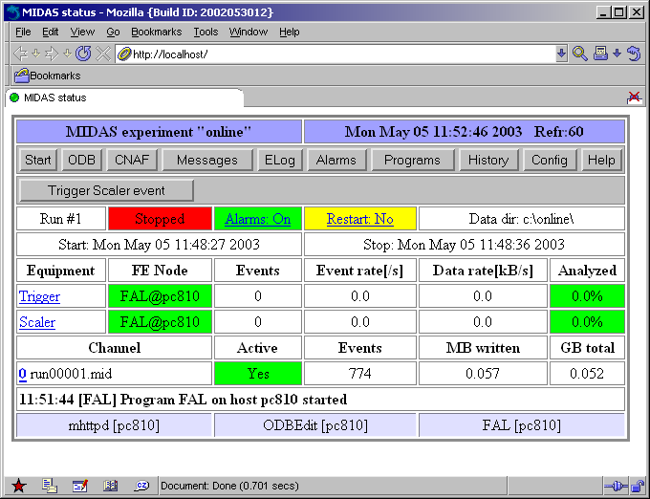
MIDAS Short Course
Stefan Ritt (Paul Scherrer Institute, Switzerland)
Pierre André Amaudruz (TRIUMF, Canada)

Slide 2
Agenda
Part I
Part II
(demo)
Introduction
Internal structure
  Remote Procedure Calls
  Buffer Manager
  Online Database
Applications
  Data Logger
  Frontend Framework
  Analyzer Framework
  Run control
  Tools
Example Experiments
Installation
Implementation of FE code
Implementation of analyzer
System configuration
Running data taking
Monitoring

Slide 3
Why MIDAS?
Fulfill needs of certain experiments (~thousand channels, ~MB data rate)
Incorporated slow control system
Integrated data analysis (histogramming)
Operating system independent
Hardware independent
Quick installation
Easy application programming

Slide 4
What is MIDAS?
DAQ Framework
  Event transport
  Central configuration
  Frontend and analyzer framework
  You have to write “user code”
C library + applications
Contains logging, slow control, alarm system, electronic logbook: Maximum Integrated Data Acquisition System
Suitable for small tests/experiments to medium size experiments, not (?) for HEP experiments
Not to be confused with ESO-Midas, Midas/UK, Auto service… Let’s call it “MIDAS/PSI”

Slide 5
What is MIDAS?
~100.000 lines of C code
Optimized for event-based DAQ, typically nuclear and particle physics
Contains driver library for CAMAC, VME, FASTBUS
MIDAS is free and under GPL
Two “main” developers (S. Ritt and P. Amaudruz)
Support by PSI and TRIUMF
http://midas.psi.ch
Stefan.ritt@psi.ch
http://midas.triumf.ca
amaudruz@triumf.ca

Slide 6
Small (test) system
PC ($1000)
CAMAC interface
(HYTEC $3000)
1MB/sec
Linux / Windows
ROOT / PAW

Slide 7
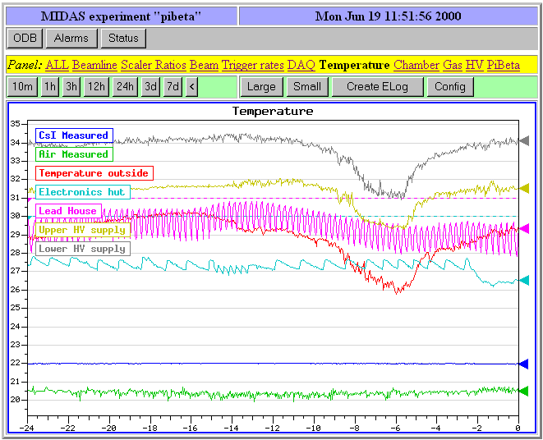
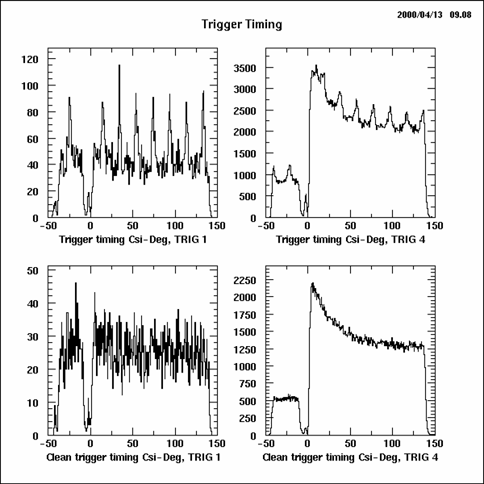

Medium size experiment
Monitoring
Gigabit-Ethernet ~tens of MB/sec
CAMAC
VME CPU
Beam line
On-line
Analysis
Slow control
12345
VME CPU
12345
Fastbus
Control
Logging
HV
DLT

Slide 8
History
1990
1992
1994
1996
1998
2000
2002
HIX-System
Oct. ’93 MIDAS start
Implementation
πβ Experiment
TRIUMF
CHAOS
Real-Time ‘97
PSI
ISAC
MIDAS becomes standard DAQ
at PSI and TRIUMF
TWIST
μ → e γ

Slide 9
The MIDAS library

Slide 10
Platform independence
Operating system
independent calls
Buffer Manager
Online Database
bm_open_buffer()
bm_send_event()
...
db_find_key()
db_set_value()
...
93%
System call layer
ss_open_shared_memeory()
conditional compiling
7%
Windows NT
VMS
UNIX
ppl$create_
shared_memeoy()
OpenFileMapping()
shmget()

Slide 11
MIDAS RPCs
Computer A
program
subroutine
call
subroutine
program
continues

Slide 12
MIDAS RPCs
Computer A
Computer B
program
subroutine
call
subroutine
stub
dispatcher
subroutine
receive
result
send result
program
continues

Slide 13
MIDAS RPCs
No IDL, stubs are produced “by hand”
Computer A
Computer B
main()
{
…
sub1(a, &b);
…
}
sub1(int a, int *b)
{
*b = 2*a;
}
TCP/IP
sockets
rpc_dispatch(id,…)
{
if (id==ID_SUB1)
sub1(a,b);
}
sub1(int a, int *b)
{
rpc_call(ID_SUB1,a,b);
}

Slide 14
Why not standard RPCs?
Availability (VxWorks, RT-Linux, …)
Performance
  RPC layer is speed optimized
  Data representation is negotiated
  Some functions like send_event can bypass part of the standard RPC-layer for buffered and asynchronous RPC
  -> 11MB/sec over 100MBit Ethernet
Dynamic extensions at run-time
Asynchronous notification (-> callbacks)
No IDL compiler necessary, simple syntax

Slide 15
Buffer Manager
Variable event size / different events
Multiple producers/consumers
Selective consumer requests
Blocking/nonblocking requests
Robust: hanging client cannot crash system
High performance: many MB/sec throughput
Data
Producer
events
resume/sleep
Buffer
(FIFO)
Data
Consumer 2
Data
Consumer 1

Slide 16
Event Structure
short int event_id
short int trg_mask
16-byte header
User data area unspecified
MIDAS bank system
YBOS bank system
Subevent system
Default max. event size 512k
16
Bytes
unsigned int serial_number
unsigned int time_stamp
unsigned int data_size
8
Bytes
unsigned int data_size
subevent
unsigned int flags
subevent
8
Bytes
bank_name[4]
type
size
subevent
data
subevent
subevent
8
Bytes
bank_name[4]
subevent
type
size
data
subevent
subevent

Slide 17
Event Requests
Data
Producer
Cache
Consumer 1
Consumer 1
event id, trigger mask
event id, trigger mask
...
FIFO
Buffer
Consumer 2
Consumer 2
event id, trigger mask
...

Slide 18
Remote Access
Computer B
Computer A
Midas Server
Process
spawn on
connect
Local Data
Producer
Remote Data
Producer
send_event()
send_event()
subprocess
Buffer
(FIFO)
send_event()
IPC
IPC
Local Data
Consumer

