Slide 1
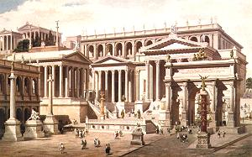
ROME
Collaboration Meeting in Pisa
Presented by Matthias Schneebeli

Slide 2
Index
Introduction to the ROME Environment
  Requirements on the Framework
  Objects inside ROME Projects
  Structure of Analysis with ROME
  ROMEBuilder
  Installation
Sample of a ROME generated framework

Slide 3
Introduction to ROME

Slide 4
Framework Requirements
Universal
  The framework should be usable by as many experiments as possible.
Modular
  Possibility to exchange calculation modules without changing the program.
Object oriented
  Program should deal with objects, not with single values.
Easy to use
  The user should write as less and as simple code as possible.

Slide 5
Universality
ROME is clearly separated into
an experiment independent part of the framework
  Works for all event based experiments
  e.g. Event loop, IO.
an experiment dependent part of the framework
  Summarized in a framework definition file.
  e.g. Data structure, program structure
the calculation code
  Has to be written by the experimenter

Slide 6
Modularity
ROME is based on Tasks and Folders.
Tasks are independent calculation modules.
The interface to the tasks are folders.
Tasks can be combined or exchanged arbitrarily, as long as the interface matches.
E.g. one can execute different calibration tasks without re-linking.
A1
B1
A2
B2
A3
A4
Possible even during runtime

Slide 7

ROME Objects
Folders
Data objects in memory
Tasks
Calculation objects
Trees
Data objects saved to disc
Histograms
Graphical data objects
Steering Parameters
Framework steering
Midas Banks
Midas raw data objects
ROME Objects :
Only 6 different objects.
Only access methods are visible to the user
Access methods have same naming conventions

Slide 8
Interconnections
Disk
(Input)
Read (any Format)
Histograms
Histograms
Histograms
Read
Fill
Tasks
Tasks
Tasks
Folders
Histograms
Histograms
Histograms
Fill
Fill
Histograms
Flag
Histograms
Histograms
Fill
Trees
Trees
Trees
Disk
(Output)
Write (ROOT)

Slide 9
Easy to use
User can summarize the experiment dependent part of the framework in a XML file.
The XML file is then translated by the romebuilder into c++ code.
The user adds only calculation code to predefined event methods of the tasks.
Calculation code is ‘c-code’.

Slide 10
The ROME Environment
Experiment independent ‘ROME’-Classes
  Base classes for the generated, experiment dependent classes.
ROMEBuilder
  Builds all experiment dependent classes out of simple XML Files.
  XML files describe Tasks, Folders, Trees, Histos, Steering Parameters and Midas Banks.
  Links the generated project.
  Documents the generated project.
  Like the MAKE command in ODBEdit
Project
ROME classes
ROME classes
ROME Environment
Exp. classes
ROMEBuilder
ROME classes
ROME classes
ROME classes
Executable
Documentation
XML File

Slide 11
XML Project Definition File
<ROMEFrameworkDefinition>
  <Folders>
    Folder definitions…
  </Folders>
  <Tasks>
    Task definitions…
  </Tasks>
  <Trees>
    Tree definitions…
  </Trees>
  <GeneralSteeringParameters>
    Steering Parameters definitions…
  </GeneralSteeringParameters>
  <MidasBanks>
    Midas Bank definitions…
  </MidasBanks>
</ROMEFrameworkDefinition >
Folder Classes
Task Classes
Analyzer Class

Slide 12
Folders
XML File
<Folder>
  <FolderName>Folder Name</FolderName>
  <ArraySize>Array Size</ArraySize>
  <DataBaseAccess>yes/no</DataBaseAccess>
  <Field>
    <FieldName>Field Name 1<FieldName>
    <FieldType>Field Type 1<FieldType>
  </Field>
  <Field>
    <FieldName>Field Name 2<FieldName>
    <FieldType>Field Type 2<FieldType>
  </Field>
</Folder>
Code
Single Folders
[Field Type 1] Get[Folder Name]()->Get[Field Name 1]();
void Get[Folder Name]()->Set[Field Name 1]([Field Type 1] value);
Folder Arrays
[Field Type 1] Get[Folder Name]At(int index)->Get[Field Name 1]();
void Get[Folder Name]At(int index)->Set[Field Name 1]([Field Type 1] value);

Slide 13
Tasks
XML File
<Task>
  <TaskName>Task Name<TaskName>
  <Histogram>
    <HistName>Histo Name 1<HistName>
    <…>
  </Histogram>
  <SteeringParameters>
    <…>
  </SteeringParameters>
</Task>
Code
void [Experiment Shortcut]T[Task Name]::Init() { }
void [Experiment Shortcut]T[Task Name]::BeginOfRun() { }
void [Experiment Shortcut]T[Task Name]::Event() { }
void [Experiment Shortcut]T[Task Name]::EndOfRun() { }
void [Experiment Shortcut]T[Task Name]::Terminate() { }
Fill[Histo Name 1](double value,double weight)
Draw[Histo Name 1]()
Get[Histo Name 1]Handle()
Fill[Histo Name 1]At(int index,double value,double weight)
Draw[Histo Name 1]At(int index)
Get[Histo Name 1]HandleAt(int index)
Single Histograms
Histogram Arrays

Slide 14
Installation
Installation of ROOT
Installation of LIBXML2 (only Linux)
Installation of MIDAS (only online, Linux)
CVS checkout of ROME
Define environment variable ROMESYS
Define environment variable ‘Path’
Windows
C:\> set ROMESYS=C:/ROME
C:\> set Path=%Path%;%ROMESYS%/bin
C:\> cvs checkout ROME
C:\ROME> nmake –f Makefile.win
C:\MyExp> ROMEBuilder.exe myExp.xml –v [–o Output Path]
C:\MyExp> progname
Linux
[~]$ setenv ROMESYS ~/ROME
[~]$ setenv PATH $ROMESYS/bin:$PATH
[~]$ cvs checkout ROME
[~/ROME]$ make
[../MyExp]$ romebuilder myExp.xml [-o Output Path]
[~/MyExp]$ progname

Slide 15
Configuration File
XML File
<RunNumbers>1001,1002-1004</RunNumbers>
<Modes>
  <AnalyzingMode>offline</AnalyzingMode>
  <InputDataFormat>midas</InputDataFormat>
</Modes>
<Tasks>
  <Task>
    <TaskName>Task 1</TaskName>
    <Active>yes/no</Active>
  </Task>
</Tasks>
<Trees>
  <Tree>
    <TreeName>Tree1</TreeName>
    <Read>yes/no</Read>
    <Write>yes/no</Write>
  </Tree>
</Trees>
<GeneralSteeringParameters>
  <SteeringParameterField>
    <SPName>Value</SPName>
    <SPValue>123</SPValue>
  </SteeringParameterField>
</GeneralSteeringParameters>

Slide 16
Summary
ROME is a framework generator.
Only 6 different objects with up to 6 access methods.
All classes are generated, only event methods have to be written.
No knowledge about object oriented programming is needed.
Folders and Tasks support a very clear program structure.
Modularity : tasks can be exchanged even at runtime.

Slide 17
Sample Experiment

Slide 18
Sample Overview
2 Folders
  PMTData
  Calib (Data base)
2 Tasks
  ReadMidas
  ADCCalib
1 Midas Bank
  ADC0

Slide 19
XML Definition File I
sample.xml
<Folder>
  <FolderName>PMTData</FolderName>
  <ArraySize>228</ArraySize>
  <Field>
    <FieldsName>ADC</FieldName>
    <FieldsType>Float_t</FieldType>
  </Field>
</Folder>
<Folder>
  <FolderName>PMTCalib</FolderName>
  <ArraySize>228</ArraySize>
  <DataBaseAccess>true</DataBaseAccess>
  <Field>
    <FieldsName>ADCPedestal</FieldName>
    <FieldsType>Float_t</FieldType>
    <DataBasePath>/RunCatalog(id=#)/LPCalib[0,227]/pedestal</DataBasePath>
  </Field>
</Folder>

Slide 20
XML Definition File II
sample.xml
<Tasks>
  <Task>
    <TaskName>ReadMidas</TaskName>
  </Task>
  <Task>
    <Histogram>ADCCalib</Histogram>
    <HistName>ADCHisto</HistName>
    <HistType>TH1F</HistType>
    <HistArraySize>228</HistArraySize>
    <HistXNbins>500</HistXNbins>
    <HistXmin>0</HistXmin>
    <HistXmax>500</HistXmax>
  </Task>
</Tasks>
<MidasBanks>
  <Bank>
    <BankName>ADC0</BankName>
    <BankType>unsigned short</BankType>
  </Bank>
</MidasBanks>

Slide 21
Read Midas Task
XYZTReadMidas.cpp
void XYZTReadMidas::Event()
{
for (int i=0;i<228;i++) {
Float_t adcValue = gAnalyzer->GetADC0BankAt(i);
gAnalyzer->GetPMTDataAt(i)->SetADC(adcValue);
}
}

Slide 22
ADC Calibration Task
XYZTADCCalib.cpp
void XYZTADCCalib::Event()
{
for (int i=0;i<228;i++) {
float pmtData = gAnalyzer->GetPMTDataAt(i)->GetADC();
float pedestal = gAnalyzer->GetCalibAt(i)->GetADCPedestal();
FillADCHistoAt(i,pmtData - pedestal);
}
}
void XYZTADCCalib::EndOfRun()
{
for (int i=0;i<228;i++) {
DrawADCHistoAt(i);
}
}

Slide 23
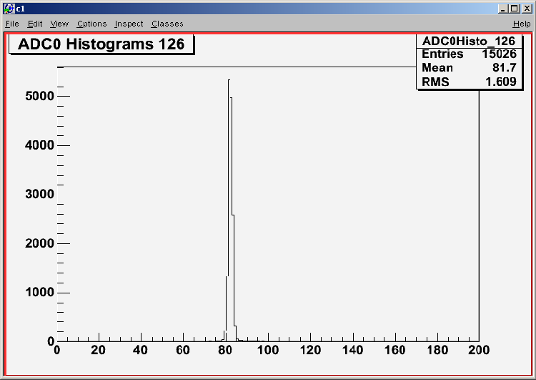
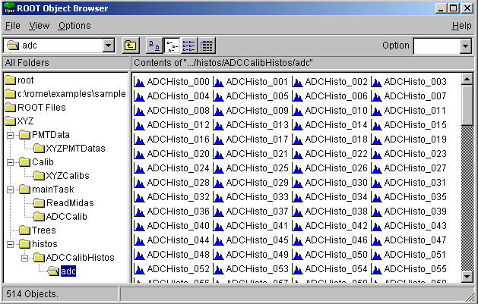
Run Program
Windows
C:\Sample> ROMEBuilder.exe sample.xml
link messages
C:\Sample> XYZ
q : Terminates the program
e : Ends the program
s : Stops the program
r : Restarts the program
c : Continuous Analysis
o : Step by step Analysis
g : Run until event #
i : Root interpreter
root [0] TBrowser t
root [1] cout << gAnalyzer->GetPMTData()->GetADC()

Slide 24
Comparison of AliROOT and ROME

Slide 25
ROME vs. AliROOT
Question
AliROOT
ROME
Usable for MEG ? | Used by the ALICE collaboration. (Maybe also others) | Used for the LP. Midas Analyzer used for PiBeta.
Needed modifications ? | Classes have to be modified to match the data structure. Calculation code has to be rewritten. | Classes holding data structure have to be generated. Calculation code has to be written.
Requirements on the user ? | Good knowledge of C++ and object oriented programming. | Knowledge of C, no knowledge about OO-programming needed.

Slide 26
Modifications
Features
AliROOT
ROME
Control Classes | Little modifications. | No changes.
Detector Classes (Geometry, clustering, reconstruction, …) | Have to be completely rewritten. Classes can only be used as templates. | Data structure will be generated. Calculations have to be written.
Virtual Monte Carlo | Little changes. | Can be added easily (ROOT feature).
Monitor | Needs modifications. | LP monitor. ROME’s online monitor can be used offline!
Data base | Needs modifications. | No changes.
Info about AliROOT form Federico Carminati (AliROOT Offline Project Leader)

Slide 27
Differences between ROME and AliROOT
AliROOT
ROME
Objects are classes containing calculations and data. | Objects are composite items. Calculations and data are strictly separated.
Tasks have a clearly defined interface
The interfaces are automatically documented by the romebuilder
A1
B1
A’
A
B
A2
B2
C
D
A3
A4
Possible even during runtime
Has to be relinked

Slide 28
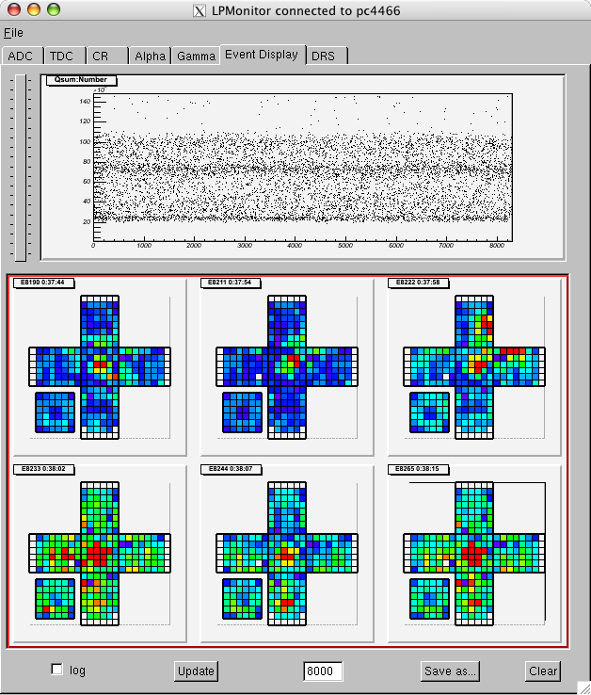
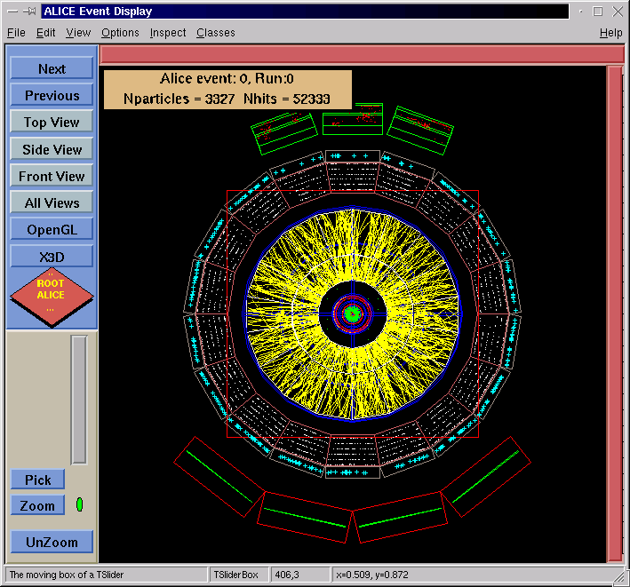
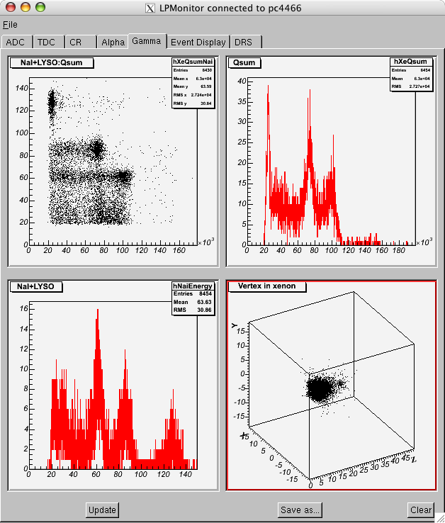
Monitors
AliROOT
LPMonitor

Slide 29
Summary
Both frameworks need about the same amount of work to adopt for MEG.
The only question is, which framework is better suited for the MEG collaboration?
  Little experienced programmers can use ROME.
  ROME is easier to use.
  ROME generates a framework.

