Slide 1
Talk

Slide 2
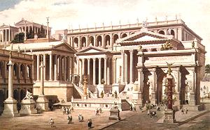
ROME
a universally applicable analysis framework generator
CHEP 2006
Written by Matthias Schneebeli, Ryu Sawada, Stefan Ritt
Presented by Matthias Schneebeli

Slide 3
Index
Generating frameworks
  Why generating a Framework
  How to generate a Framework
Introduction to ROME
  Features

Slide 4
Generating Frameworks

Slide 5
Writing an Analysis Software
Different approaches for writing an analysis software for an experiment
Writing an analysis software specifically for the experiment
Limited use, only usable for 1 experiment
No help from other collaborations
Writing an analysis software for all HEP experiments
Impossible
Generating an analysis framework
Adding experiment specific analysis code by hand
Presented in this talk

Slide 6

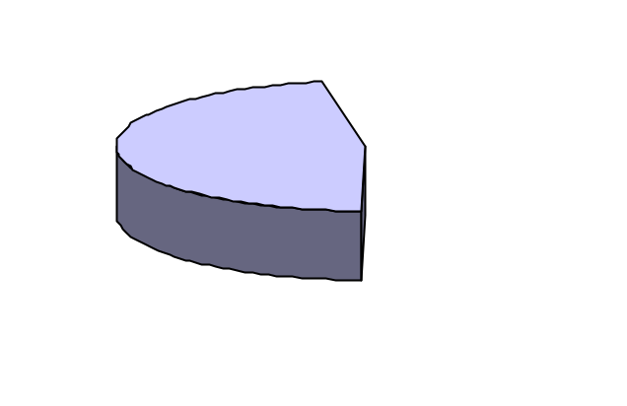
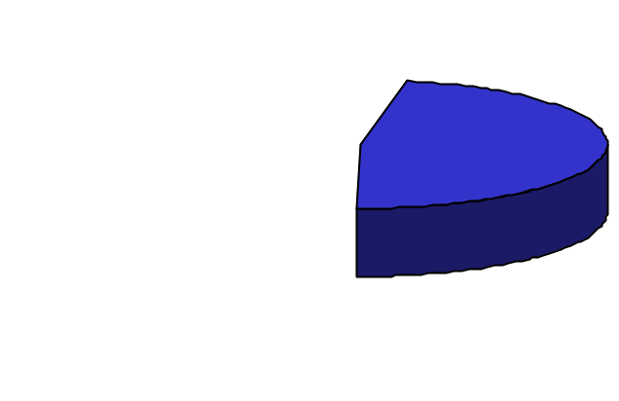
Composition of an Analysis Tool
Totally experiment independent code
Event Loop
Support functions
Code part of the distribution
Code generated by a translation program
Analysis Code
Experiment dependent code which can not be summarized
Physical Calculations
Framework
Experiment dependent code which can be summarized in a experiment description
  Data structure
  Task structure
  Database access, DAQ access
Code implemented by the experimenter

Slide 7
Generating an Analysis Framework
Experiment Summarization
Data Structure
Task Structure
Database Connection
DAQ Interface
...
Translation
Program
Add Analysis Code
ROME classes
ROME classes
ROME classes
ROME classes
ROME classes
ROME classes
General Framework
Objects
Task
Objects
Data Storage
Objects
Database
DAQ System

Slide 8
Benefit of a generated Framework
Clear separation between Framework and Analysis Code
Consistent Program Structure
Less Handwritten Code
Improvements are shared to other users
Reduction of man power

Slide 9
Introduction to ROME

Slide 10
Implementation in ROME
XML file for experiment description
Experiment independent ROME classes (mostly base classes for the generated classes)
Makefile generated and executed by the ROMEBuilder
Framework documentation generated by the ROMEBuilder
Project
ROME classes
ROME classes
ROME Distribution
Exp. classes
ROMEBuilder
ROME classes
ROME classes
ROME classes
Executable
Documentation
Summarization
XML File
Add analyisis
code

Slide 11

ROME Features
For all event based data analysis
Fully object oriented
Based on Root
Online and Offline
XML is used for experiment descriptions
Experiment documentation created
Automatical makefile generation and linking performed
MySQL database access
Access to 2 online DAQs integrated (Midas,Orca)
Socket connection to third party software (ROOT sockets)
GUI extension generated by the ROMEBuilder

Slide 12
Conclusion
It’s possible to generate analysis frameworks
ROME is such a framework generator
http://midas.psi.ch/rome/
Currently used at
  PSI (Switzerland)
  Los Alamos National Laboratory (USA)
  Triumf (Canada)
Try it out

Slide 13
Back Up
Slides

Slide 14
Composition of an Analysis Tool
Totally experiment independent code
Event Loop
Support functions
Code part of the distribution
Experiment dependent code which can be summarized in a description file
Data structure
Task structure
Database access, DAQ access
Code generated by a translation program
Experiment dependent code which can not be summarized
Analysis Code (Physics)
Code implemented by the user

Slide 15
Framework Requirements
Object oriented
  Program should deal with objects, not with single values.
Modular
  Possibility to easy exchange calculation modules.
Universal
  The framework should be usable by as many experiments as possible.
Easy to use
  The user should write as less and as simple code as possible.

Slide 16
ROME Objects
Folders
Data objects in memory
Tasks
Calculation objects
Trees
Data objects saved to disc
Histograms
Graphical data objects
Steering Parameters
Framework steering
Midas Banks
Midas raw data objects
ROME Objects :
Only 6 different objects.
Access methods have same naming conventions

Slide 17
Interconnections
Disk
(Input)
Read (any Format)
Histograms
Histograms
Histograms
Read
Fill
Tasks
Tasks
Tasks
Folders
Histograms
Histograms
Histograms
Fill
Fill
Histograms
Flag
Histograms
Histograms
Fill
Trees
Trees
Trees
Disk
(Output)
Write (ROOT)

Slide 18
From Banks to Folders
Readout values of a sub-detectors
Sub-detector with all
it’s readout values
ADC Bank
Value 1
Value 2
...
SCLR Bank
Value 1
Value 2
...
TDC Bank
Value 1
Value 2
...
PMT Folder
ADC
TDC
X
X
X
x
PMT Folder
ADC
TDC
X
X
X
x
PMT Folder
ADC
TDC
HV demand
HV measured
HV current
Scaler
DMND Bank
Value 1
Value 2
...
CRNT Bank
Value 1
Value 2
...
MSRD Bank
Value 1
Value 2
...

Slide 19
Proposed Analysis Structure
Banks
ROME folder
Task
Task
ROME folder
Task
ADC
ADC
charge
charge
charge
charge
counts
Pedestal subtraction
Counts -> Charge
counts
High
level
analysis
counts
Mapping
ADC/TDC
-> counter
Hit
charge
time
HV
scaler
counts
Hit
charge
time
HV
scaler
Hit
charge
time
HV
scaler
TDC
Decoding
(chn./crate/…
-> number)
Offset correction
TDC
time
time
time
time
header
chn./value
chn./value
Optional
analysis of
decoded data
Raw
data
Decoded
data
Object
data
*.root
*.root
*.root

Slide 20
Modularity
ROME is based on Tasks and Folders.
Tasks are independent calculation modules.
The interface to the tasks are folders.
Tasks can be combined or exchanged arbitrarily, as long as the interface matches.
E.g. one can execute different calibration tasks without re-linking.
A1
B1
A2
B2
A3
A4
Possible even during runtime

Slide 21
Universality
ROME is clearly separated into
an experiment independent part of the framework
  e.g. Event loop, IO, Database access.
  Works for all event based experiments
an experiment dependent part of the framework
  e.g. Data structure, program structure
  Summarized in a framework definition file.
  Translated into c++ code by the ROMEBuilder.
the calculation code
  Has to be filled in by the experimenter
Part of ROME
Generated by ROMEBuilder
Written by the user

Slide 22
The framework generation
ROMEBuilder
  Translation program.
  Reads in a XML framework definition file and translates this information into c++ code.
  Links the generated project.
  Documents the generated project.
  Like the MAKE command in ODBEdit
Project
ROME classes
ROME classes
ROME Environment
Exp. classes
ROMEBuilder
ROME classes
ROME classes
ROME classes
Executable
Documentation
Summarization
XML File
Add calculation
code

Slide 23
Introduction to XML
XML File
<Garage>
<Car>
<Type>Ferrari</Type>
<Color>Red</Color>
</Car>
<Car>
<Type>Fiat</Type>
<Color>Blue</Color>
</Car>
<Bicycle>
<Type>Bianchi</Type>
<Color>White</Color>
</Bicycle>
</Garage>
Extensible Markup Language (XML)
Standardized ascii format
Tree structure
Syntax is similar to html
XSD File
<xs:complexType name="VehicleDesc">
<xs:sequence>
<xs:element name="Type" type="xs:string"/>
<xs:element name="Color" type="xs:string"/>
</xs:sequence>
</xs:complexType>
<xs:element name="Garage">
<xs:complexType>
<xs:sequence>
<xs:element name="Car" type="VehicleDesc" maxOccurs="unbounded"/>
<xs:element name="Bicycle" type="VehicleDesc" maxOccurs="unbounded"/>
</xs:sequence>
</xs:complexType>
</xs:element>

Slide 24
XML Project Definition File
<ROMEFrameworkDefinition>
  <Folders>
    Folder definitions…
  </Folders>
  <Tasks>
    Task definitions…
  </Tasks>
  <Trees>
    Tree definitions…
  </Trees>
  <GeneralSteeringParameters>
    Steering Parameters definitions…
  </GeneralSteeringParameters>
  <MidasBanks>
    Midas Bank definitions…
  </MidasBanks>
</ROMEFrameworkDefinition >
Folder Classes
Task Classes
Analyzer Class

Slide 25
Folders
XML File
<Folder>
  <FolderName>Folder Name</FolderName>
  <Field>
    <FieldName>Field Name 1<FieldName>
    <FieldType>Field Type 1<FieldType>
  </Field>
  <Field>
    <FieldName>Field Name 2<FieldName>
    <FieldType>Field Type 2<FieldType>
  </Field>
</Folder>
Code
[Field Type 1] Get[Folder Name]()->Get[Field Name 1]();
void Get[Folder Name]()->Set[Field Name 1]([Field Type 1] value);

Slide 26
Tasks
XML File
<Task>
  <TaskName>Task Name<TaskName>
  <…>…<…>
</Task>
Code
void [Experiment Shortcut]T[Task Name]::Init() { }
void [Experiment Shortcut]T[Task Name]::BeginOfRun() { }
void [Experiment Shortcut]T[Task Name]::Event() { }
void [Experiment Shortcut]T[Task Name]::EndOfRun() { }
void [Experiment Shortcut]T[Task Name]::Terminate() { }

Slide 27
Easy to use
User can summarize the experiment dependent part of the framework in a XML file.
The XML file is then translated by the romebuilder into c++ code.
The user adds only calculation code to predefined event methods of the tasks.
Calculation code is ‘c-code’.

Slide 28
Benefit of a generated Framework
Consistent Program Structure
  All classes look the same
  Better readability
Less Handwritten Code
  Code of a class is written once (in the builder) and reproduced many times
Easier Maintenance
  Modification are done once (in the builder) and then available in the whole framework

Slide 29
Configuration File
XML File
<RunNumbers>1001,1002-1004</RunNumbers>
<Modes>
  <AnalyzingMode>offline</AnalyzingMode>
  <InputDataFormat>midas</InputDataFormat>
</Modes>
<Tasks>
  <Task>
    <TaskName>Task 1</TaskName>
    <Active>yes/no</Active>
  </Task>
</Tasks>
<GeneralSteeringParameters>
  <SteeringParameterField>
    <SPName>Value</SPName>
    <SPValue>123</SPValue>
  </SteeringParameterField>
</GeneralSteeringParameters>
<…>

Slide 30
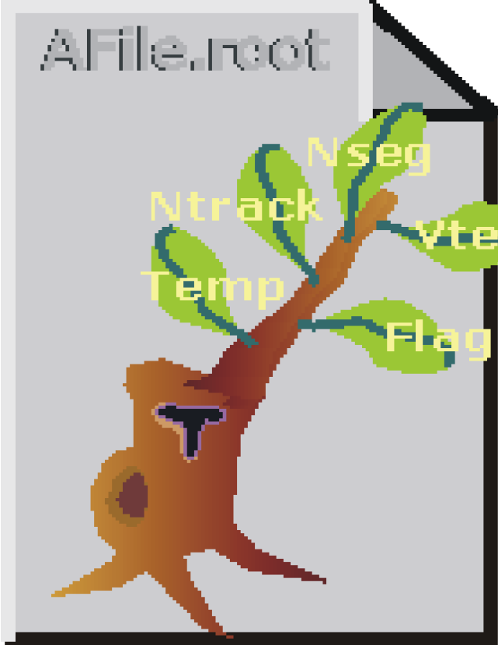
Program structure
Start
read configuration file
<Configuration>
<MainConfiguration>
<Run25</Runs>
<Evers></Events>
read database
BOR
read raw data
fill tree
Event
write tree
EOR
End of Analysis
Start ROOT
interactive session

Slide 31
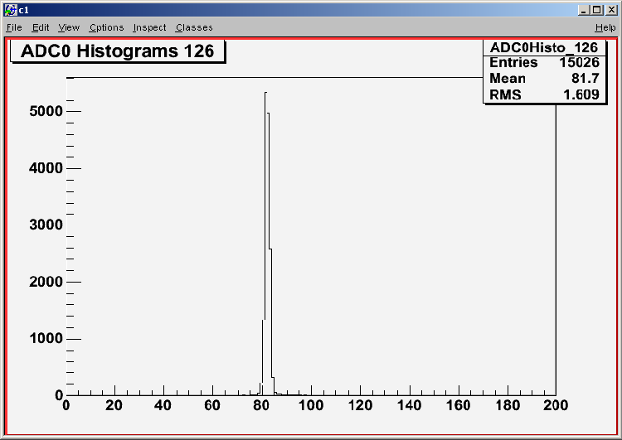
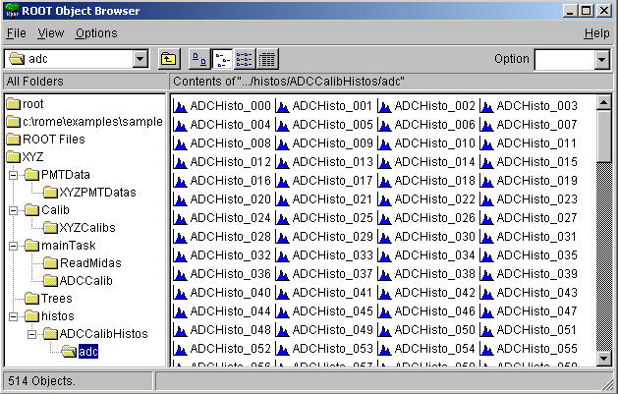
Run Program
Windows
C:\Sample> ROMEBuilder.exe sample.xml
link messages
C:\Sample> XYZ
q : Terminates the program
e : Ends the program
s : Stops the program
r : Restarts the program
c : Continuous Analysis
o : Step by step Analysis
g : Run until event #
i : Root interpreter
root [0] TBrowser t
root [1] cout << gAnalyzer->GetPMTData()->GetADC()

Slide 32
Monitoring Tools

Slide 33
Monitoring ROME Objects
ROME can distribute objects over a socket interface.
Any third party application can access and even modify ROME objects.
The distribution of the objects goes over the network.
Used for monitoring/displaying ROME objects
Users can display online histograms. E.g. at home.

Slide 34
ARGUS
Written by Ryu Sawada
Experiment independent GUI framework
Helps to write an full experiment dependent event display
Provides connection to
  ROME
  Midas Analyzer
  SQL Database, Midas ODB

Slide 35
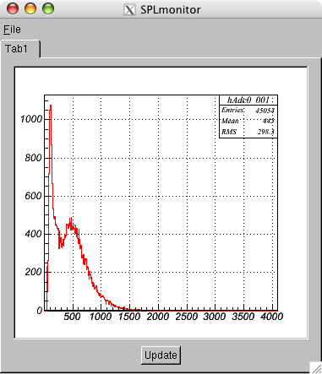
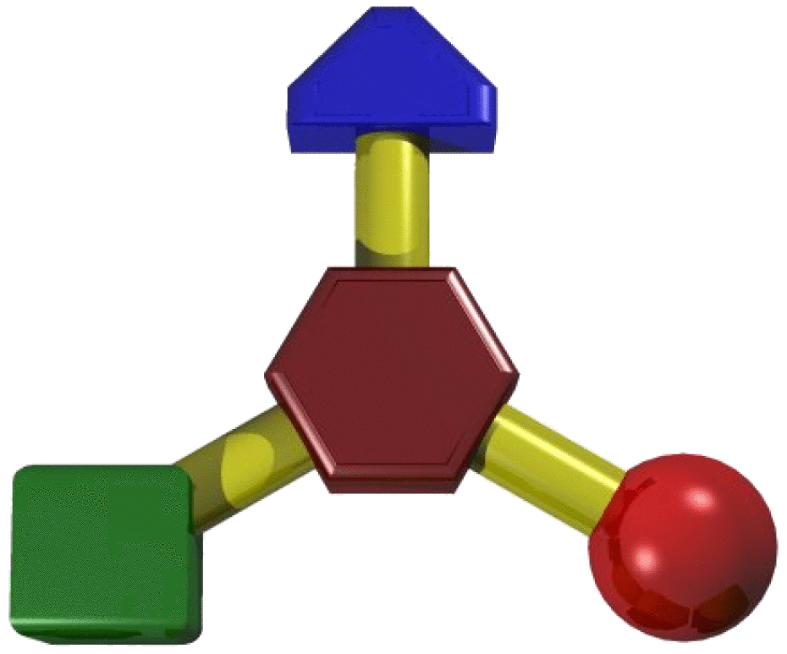


Socket Connections
MIDAS
Analyzer
Network
ROME
Database
Argus

Slide 36
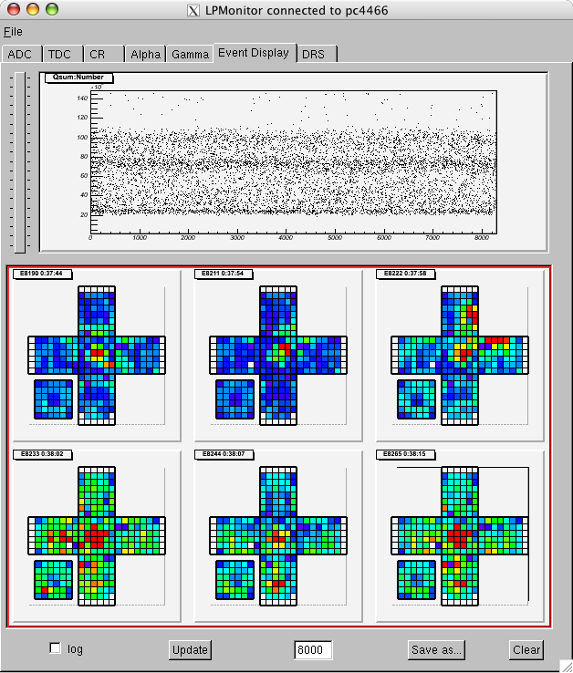
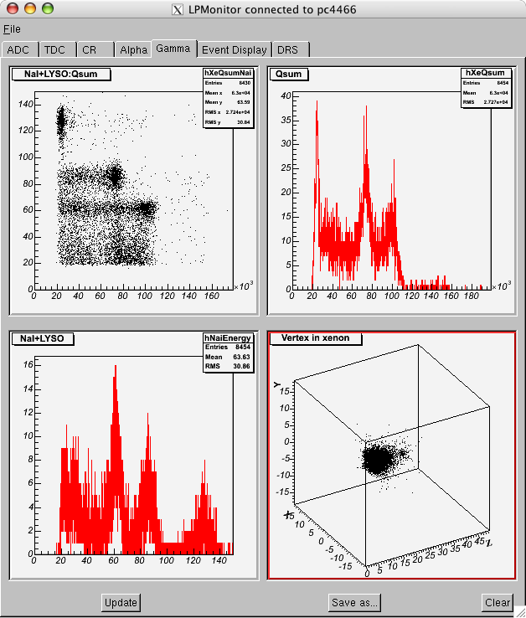
ARGUS Samples

Slide 37
ROODY
Written at the Triumf, Vancouver
Histogram Display
Final application (unlike ARGUS) but only for histograms
Provides connection to
  ROME
  Midas Analyzer

Slide 38
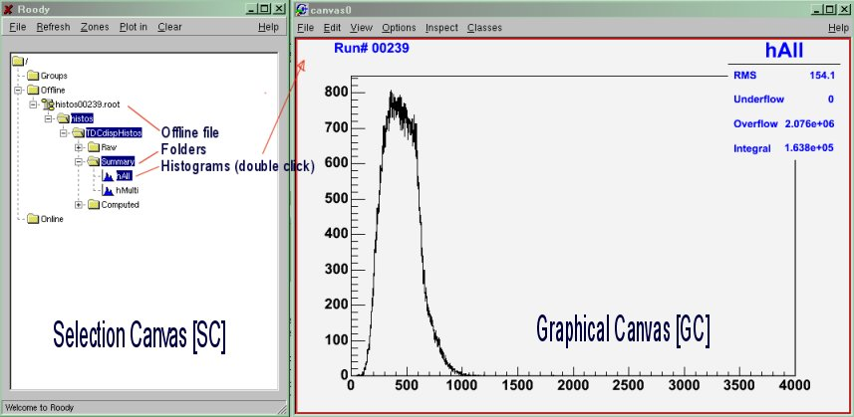
ROODY Samples

Slide 39
Summary
ROME is a framework generator.
Only 6 different objects with up to 6 access methods.
All classes are generated, only event methods have to be written.
No knowledge about object oriented programming is needed.
Folders and Tasks support a very clear program structure.
Modularity : tasks can be easily exchanged even at runtime.
Socket connection to third party applications

Slide 40
Sample

Slide 41
Sample Experiment

Slide 42
Sample Overview
2 Folders
  PMTData
  Calib (Data base)
2 Tasks
  ReadMidas
  ADCCalib
1 Midas Bank
  ADC0

Slide 43
XML Definition File I
sample.xml
<Folder>
  <FolderName>PMTData</FolderName>
  <ArraySize>228</ArraySize>
  <Field>
    <FieldsName>ADC</FieldName>
    <FieldsType>Float_t</FieldType>
  </Field>
</Folder>
<Folder>
  <FolderName>PMTCalib</FolderName>
  <ArraySize>228</ArraySize>
  <DataBaseAccess>true</DataBaseAccess>
  <Field>
    <FieldsName>ADCPedestal</FieldName>
    <FieldsType>Float_t</FieldType>
    <DataBasePath>/RunCatalog(id=#)/LPCalib[0,227]/pedestal</DataBasePath>
  </Field>
</Folder>

Slide 44
XML Definition File II
sample.xml
<Tasks>
  <Task>
    <TaskName>ReadMidas</TaskName>
  </Task>
  <Task>
    <Histogram>ADCCalib</Histogram>
    <HistName>ADCHisto</HistName>
    <HistType>TH1F</HistType>
    <HistArraySize>228</HistArraySize>
    <HistXNbins>500</HistXNbins>
    <HistXmin>0</HistXmin>
    <HistXmax>500</HistXmax>
  </Task>
</Tasks>
<MidasBanks>
  <Bank>
    <BankName>ADC0</BankName>
    <BankType>unsigned short</BankType>
  </Bank>
</MidasBanks>

Slide 45
Read Midas Task
XYZTReadMidas.cpp
void XYZTReadMidas::Event()
{
for (int i=0;i<228;i++) {
Float_t adcValue = gAnalyzer->GetADC0BankAt(i);
gAnalyzer->GetPMTDataAt(i)->SetADC(adcValue);
}
}

Slide 46
ADC Calibration Task
XYZTADCCalib.cpp
void XYZTADCCalib::Event()
{
for (int i=0;i<228;i++) {
float pmtData = gAnalyzer->GetPMTDataAt(i)->GetADC();
float pedestal = gAnalyzer->GetCalibAt(i)->GetADCPedestal();
FillADCHistoAt(i,pmtData - pedestal);
}
}
void XYZTADCCalib::EndOfRun()
{
for (int i=0;i<228;i++) {
DrawADCHistoAt(i);
}
}

Slide 47
Run Program
Windows
C:\Sample> ROMEBuilder.exe sample.xml
link messages
C:\Sample> XYZ
q : Terminates the program
e : Ends the program
s : Stops the program
r : Restarts the program
c : Continuous Analysis
o : Step by step Analysis
g : Run until event #
i : Root interpreter
root [0] TBrowser t
root [1] cout << gAnalyzer->GetPMTData()->GetADC()

Slide 48
Additional Slides

Slide 49
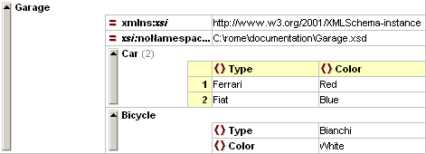
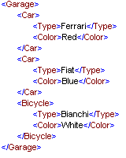
XML Editors
XMLSpy
  Table Format
  Commercial Software (50 Euro)
  Only for Windows
EditiX
  Nice Tree Format
  Commercial Software (30 Euro)
  Windows, Linux, Mac
ROME works with any Editor

Slide 50
Installation
Installation of ROOT
Installation of MIDAS (only online, Linux)
CVS checkout of ROME
Define environment variable ROMESYS
Define environment variable ‘Path’
Windows
C:\> set ROMESYS=C:/ROME
C:\> set Path=%Path%;%ROMESYS%/bin
C:\> cvs checkout ROME
C:\ROME> nmake –f Makefile.win
C:\MyExp> ROMEBuilder.exe myExp.xml –v [–o Output Path]
C:\MyExp> progname
Linux
[~]$ setenv ROMESYS ~/ROME
[~]$ setenv PATH $ROMESYS/bin:$PATH
[~]$ cvs checkout ROME
[~/ROME]$ make
[../MyExp]$ romebuilder myExp.xml [-o Output Path]
[~/MyExp]$ progname

Slide 51
Advantages of Proposed Analysis Structure
High level analysis accesses data in objects
  no knowledge of cable mapping or ADC/TDC decoding necessary
ADC/TDC decoding is decoupled from mapping and high level analysis
  If ADC/TDC module is changed, only decoding task needs to be changed
  If counter is reconnected to different ADC/TDC,
  only mapping task needs to be changed
Data can be stored/retrieved between different tasks in ROOT format
  Analyze raw data
  Analyze decoded data
  Analyze object data

Slide 52
ROME vs. Midas Analyzer
Midas Analyzer
ROME
Banks -> Arrays or structures | Folders -> Objects (Classes)
odbedit> make -> experim.h containing data structure | romebuilder -> classes containing data structure and access methods
Midas required for online and offline | Midas not needed for offline
Calibration and configuration data in ODB | Calibration and configuration data in mySQL, XML, ...
User code added to BOR,EVENT,EOR functions | User code added to BeginOfRun, Event, EndOfRun functions
Input format : midas | Input format : midas, root
Output format : midas, root | Output format : root

Slide 53
Features
Tool for Event based Data Analysis
Fully Object Oriented
Root based
Full connection to the Midas Environment
Online and Offline
Based on Tasks and Folders for an easy Data and Program Structure
Experiment independent Base Classes
Experiment dependent Classes are generated out of simple XML-Files
The Users write only experiment specific code (physics)
Administrative code is implemented in the generated code
Self Documenting Code
Self Linking Project

Slide 54
Classes in the Generated Project
The generated classes are :
Task classes
  Implement 5 user methods : Init(), BeginOfRun(), Event(), EndOfRun(), Terminate().
Folder classes
  Define how the data is stored.
Analyzer class
  Main class. The Analyzer provides all user-methods.
IO class
  The IO handles all input and output.
IO
Trees
Data base
Analyzer
Folders
Steering
ROME classes
ROME classes
Tasks
fAnalyzer
Folders
ROMEEventLoop

Slide 55
Trees
XML File
<Experiment Shortcut>
  <Trees>
    <Tree Name=“Tree Name” Title=“Title”>
      <Branch Name=“Branch Name” Folder=“Folder”/>
    </Tree>
  </Trees>
</Experiment Shortcut>

Slide 56
General Steering Parameters
XML File
<Experiment Shortcut>
  <GeneralSteeringParameters>
  <Field 1 Type=“Type 1” Init=“Init 1” Comment=“Comment 1”/>
    <SubClass>
      <Field 2 Type=“Type 2” Init=“Init 2” Comment=“Comment 2”/>
    </SubClass>
  </GeneralSteeringParameters>
</Experiment Shortcut>
Code
[Type 1] GetGSP()->Get[Field 1]()
[Type 2] GetGSP()->Get[SubClass]()->Get[Field 2]()
XML File
<SubTask Name=“Task Name”>
  <SteeringParameters>
  <…/>
  </SteeringParameters>
</SubTask>

Slide 57
Midas Banks
XML File
<Experiment Shortcut>
  <MidasBanks>
  <Bank 1 Type=“Type 1”/>
    <Bank 2 Type=“struct” StructName=“Structure Name”>
      <Field 2 Type=“Type 2” PackedSize=“PackSize 2”/>
    </Bank 2>
  </MidasBanks>
</Experiment Shortcut>
Code
[Type 1] Get[Bank 1]BankAt(int index)
Int Get[Bank 1]BankEntries()
[Structure Name]* Get[Bank 2]BankAt(int index)
Int Get[Bank 2]BankEntries()
e.g. : [Type 2] Get[Bank 2]BankAt(int index)->[Field 2]
Simple Banks
Structured Banks

Slide 58
Comparing to Midas
In the Online Data Base :
ASUM
  Sum
  Average
In the XML-File :
<SubFolder FolderName=“ASUM">
  <Fields>
    <Sum/>
    <Average/>
  </Fields>
</SubFolder>
Midas Library is not used for offline analysis

Slide 59
Generated Code
XML File
<SubFolder FolderName=“Folder Name“>
<Fields>
<Field Name 1 Type=“Field Type 1” Init=“Init Value 1” Comment=“Comment 1”/>
</Fields>
</SubFolder>
Code
class [Experiment Shortcut][Folder Name] : public TObject
{
protected:
[Field Type 1] f[Field Name 1]; // [Comment 1]
public:
[Experiment Shortcut][Folder Name]([Field Type 1] value1=[Init Value 1] )
{ f[Field Name 1] = value1; };
[Field Type 1] Get[Field Name 1]() { return f[Field Name 1]; };
void Set[Field Name 1]([Field Type 1] value1) { f[Field Name 1] = value1; };
ClassDef([Experiment Shortcut][Folder Name],[Version Number])
};

Slide 60
Data base
SQL Data base
  see Ryu’s presentation
XML data base
  If no network connection available

Slide 61
Read and Write Data
Input Data
  Root files
  Midas files
  Online buffer
  Data base
Output Data
  Root files
  Database
Read and filled to the Folder by the Framework
Read by the Framework. Data accessed via Midas Bank access methods.
Read and filled to the Folder by the Framework
Written by the Framework, can be flagged
Written with : fAnalyzer->Write[Folder]DataBase(this);

Slide 62
Summary
Structure of the framework is defined in XML-files
All code is generated, except the physical calculations
The framework provides access functions for the user
SQL Data base
XML Configuration file

Slide 63
Class Structure
main
Analyzer
gAnalyzer
Config
Folders
EventLoop
DAQ-Systems
Tasks
DB-Classes

Slide 64
Short introduction to ROOT

Slide 65
What’s ROOT ?
ROOT is an object oriented HEP analysis framework
It provides class libraries for
  handling and analyzing large amount of data
  data visualization
  Monte Carlo, parallel processing, …
Notes:
Regular grammar (C++) on command line
Single language
We have one single language C++ instead of a scripting and restricted language KUIP. The macros can be interpreted or dynamically executed via the compiler
Object Oriented
The main point is that from the interpreter one can call functions from the user classes if these classes have been run through rootcint. Because a full object dictionary is available we can do all kinds of things with the objects; All what is called reflection or introspection with Java is available in ROOT. This is an extremely important addition on top of C++. The dictionary is the heart of the system. It is with the dictionary that we can do automatic schema evolution for example or have the automatic context menus.
Interactive User Interface
PAW had also an interactive interface (command line and also a mouse interface). The ROOT interface and the GUI is more advanced than PAW. This interface is user oriented. Picking is automatic in the pad.
Well Documented code. HTML class descriptions for every class.
The Root code is better documented than the PAW code. Html documentation for the source is generated automatically and available from the Web. User classes can also be documented automatically via the THtml class.
Object I/O including Schema Evolution
I/O in ROOT cannot be compared with PAW I/O. PAW I/O was limited to simple histograms or ntuples. ROOT can be used as the main I/O engine for user classes including automatic schema evolution.
Root supports network classes (TCP/IP sockets, remote I/O via rootd)

Slide 66
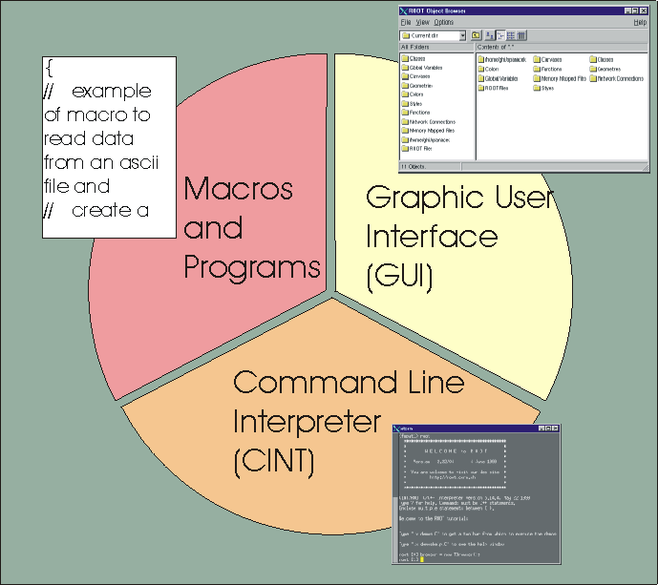
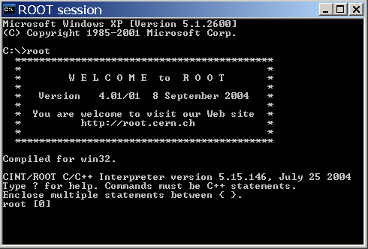
Three User Interfaces
int main()
{
TH1F *h;
h = new TH1F(“h“);
h->Fill(1);
h->Draw();
TBrowser t;
}
GUI
windows, buttons, menus
Root Command line
CINT (C++ interpreter)
Macros, applications, libraries (C++ compiler and interpreter)

Slide 67
ROOT vs. PAW
Regular grammar (C++) on command line
Single language (compiled and interpreted)
Object Oriented (use your class in the interpreter)
Advanced Interactive User Interface
Object I/O including Schema Evolution
3-d interfaces with OpenGL and X3D.
Well Documented code. HTML class descriptions for every class.
Notes:
Regular grammar (C++) on command line
Single language
We have one single language C++ instead of a scripting and restricted language KUIP. The macros can be interpreted or dynamically executed via the compiler
Object Oriented
The main point is that from the interpreter one can call functions from the user classes if these classes have been run through rootcint. Because a full object dictionary is available we can do all kinds of things with the objects; All what is called reflection or introspection with Java is available in ROOT. This is an extremely important addition on top of C++. The dictionary is the heart of the system. It is with the dictionary that we can do automatic schema evolution for example or have the automatic context menus.
Interactive User Interface
PAW had also an interactive interface (command line and also a mouse interface). The ROOT interface and the GUI is more advanced than PAW. This interface is user oriented. Picking is automatic in the pad.
Well Documented code. HTML class descriptions for every class.
The Root code is better documented than the PAW code. Html documentation for the source is generated automatically and available from the Web. User classes can also be documented automatically via the THtml class.
Object I/O including Schema Evolution
I/O in ROOT cannot be compared with PAW I/O. PAW I/O was limited to simple histograms or ntuples. ROOT can be used as the main I/O engine for user classes including automatic schema evolution.
Root supports network classes (TCP/IP sockets, remote I/O via rootd)

Slide 68
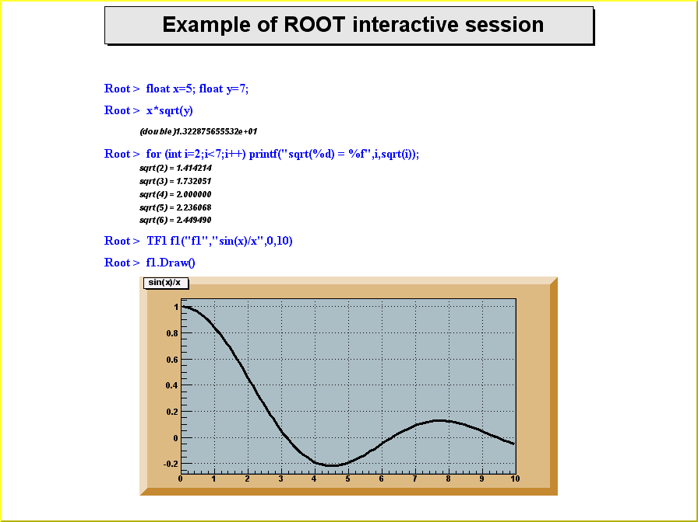
Example of a ROOT interactive session
Root > float x=5, y=7;
Root > x*sqrt(y)
(double)1.322875655532e+01
Root > TF1 fl(“fl”,”sin(x)/x”,0,10)
Root > fl.Draw()

Slide 69
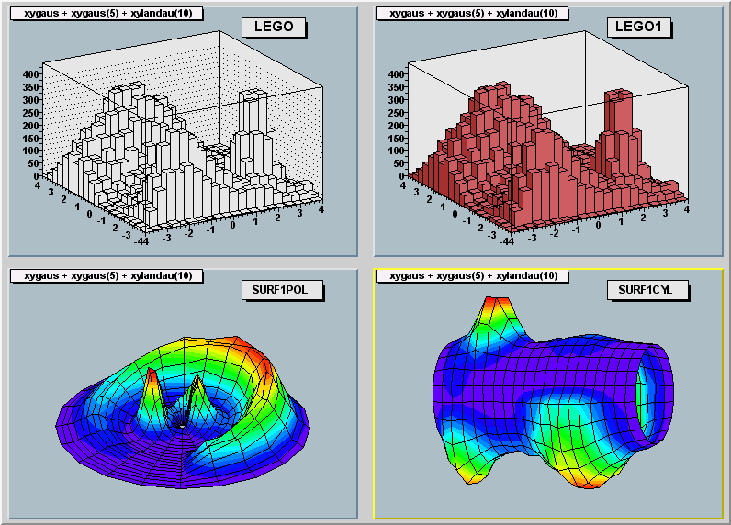
Histogram Views
All these plots can be rotated with the mouse

Slide 70
Data acquisition/analysis

Slide 71
DAQ Setup
VME
Run control
Trigger
Front-end
CAMAC
Event buffer
WWW
Histogram
display
Tape
Logger
Analyzer
Office computers
Back-end computer
ROME
Argus, Roody

