Slide 1
Talk

Slide 2
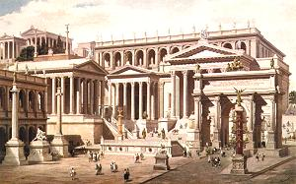
ROME
Root based Object oriented Midas Extension
Presented by Matthias Schneebeli

Slide 3
Index
Introduction to the ROME Environment
  Requirements to a Framework
  Objects inside ROME Projects
  Structure of Analysis with ROME
  ROMEBuilder
  Installation
Sample of a ROME generated framework

Slide 4
Introduction to ROME

Slide 5
Framework Requirements
Universal
  The framework should be usable by as many experiments as possible.
Modular
  Possibility to exchange calculation modules without changing the program.
Object oriented
  Program should deal with objects, not with single values.
Easy to use
  The user should write as less and as simple code as possible (only physics).

Slide 6
Universality
ROME is clearly separated into
an experiment independent part of the framework
  Works for all event based experiments
  e.g. Event loop, IO, base classes.
an experiment dependent part of the framework
  Summarized in a framework definition file.
  e.g. Data structure, program structure
the calculation code
  Has to be written by the experimenter

Slide 7
Modularity
ROME is based on Tasks and Folders.
Tasks are root objects, which are executed by the framework.
The interface to the tasks are folders.
Tasks can be combined or exchanged arbitrarily, as long as the interface matches.
For example: One can execute different calibration tasks without changing the framework

Slide 8
Object Oriented
ROME is based on Objects.
Values, which belong together, are stored in the same object
Objects reflect real objects, like a sub-detector (e.g. a PMT)
Objects are easier to use
Objects support the modularity

Slide 9
From Banks to Objects
Readout values of a sub-detectors
Sub-detector with all
it’s readout values
ADC Bank
Value 1
Value 2
...
SCLR Bank
Value 1
Value 2
...
TDC Bank
Value 1
Value 2
...
PMT Folder
ADC
TDC
X
X
X
x
PMT Folder
ADC
TDC
X
X
X
x
PMT Folder
ADC
TDC
HV demand
HV measured
HV current
Scaler
DMND Bank
Value 1
Value 2
...
CRNT Bank
Value 1
Value 2
...
MSRD Bank
Value 1
Value 2
...

Slide 10

ROME Objects
Folders
Objects, where data is stored in
Stores the data of one detector (or sub detector) component
Hierarchically arranged
Data inside of Folders is structured
Tasks
Tasks are objects, which provides actions
They make calculations
Store and read data in folders
Fill trees and histograms
Hierarchically arranged.
Trees
Data Objects (contains folder content)
Used to write data on files
Midas Banks
Objects containing midas raw data
Histograms
Graphical Data Objects : only written
ROME Objects are :
Complex items.
User only needs access methods
Access methods have same naming
Steering Parameters
Framework steering
Task steering

Slide 11
Interconnections
Disk
(Input)
Read (any Format)
Histograms
Histograms
Histograms
Read
Fill
Tasks
Tasks
Tasks
Folders
Histograms
Histograms
Histograms
Fill
Fill
Histograms
Flag
Histograms
Histograms
Fill
Trees
Trees
Trees
Disk
(Output)
Write (ROOT)

Slide 12
Proposed Analysis Structure
Banks
ROME folder
Task
Task
ROME folder
Task
ADC
ADC
charge
charge
charge
charge
counts
Pedestal subtraction
Counts -> Charge
counts
High
level
analysis
counts
Mapping
ADC/TDC
-> counter
Hit
charge
time
HV
scaler
counts
Hit
charge
time
HV
scaler
Hit
charge
time
HV
scaler
TDC
Decoding
(chn./crate/…
-> number)
Offset correction
TDC
time
time
time
time
header
chn./value
chn./value
Optional
analysis of
decoded data
Raw
data
Decoded
data
Object
data
*.root
*.root
*.root

Slide 13
Advantages of Proposed Analysis Structure
High level analysis accesses data in objects
  no knowledge of cable mapping or ADC/TDC decoding necessary
ADC/TDC decoding is decoupled from mapping and high level analysis
  If ADC/TDC module is changed, only decoding task needs to be changed
  If counter is reconnected to different ADC/TDC,
  only mapping task needs to be changed
Data can be stored/retrieved between different tasks in ROOT format
  Analyze raw data
  Analyze decoded data
  Analyze object data

Slide 14
Easy to use
Experiment dependent part of the framework can be summarized in a XML file.
The XML file is then translated by the romebuilder into c++ code.
The user adds only physical calculation to predefined event methods of the tasks.
Calculation code is c-code.

Slide 15
The ROME Environment
Experiment independent ‘ROME’-Classes
  Base classes for the generated, experiment dependent classes.
ROMEBuilder
  Builds all experiment dependent classes out of simple XML Files.
  XML files describe Tasks, Folders, Trees, Histos, Steering Parameters and Midas Banks.
  Links the generated project.
  Documents the generated project.
  Like the MAKE command in ODBEdit
Project
ROME classes
ROME classes
ROME Environment
Exp. classes
ROMEBuilder
ROME classes
ROME classes
ROME classes
Executable
Documentation
XML File

Slide 16
XML Project Definition File
<ROMEFrameworkDefinition>
  <Folders>
    Folder definitions…
  </Folders>
  <Tasks>
    Task definitions…
  </Tasks>
  <Trees>
    Tree definitions…
  </Trees>
  <GeneralSteeringParameters>
    Steering Parameters definitions…
  </GeneralSteeringParameters>
  <MidasBanks>
    Midas Bank definitions…
  </MidasBanks>
</ROMEFrameworkDefinition >
Folder Classes
Task Classes
Analyzer Class

Slide 17
Folders
XML File
<Folder>
  <FolderName>Folder Name</FolderName>
  <ArraySize>Array Size</ArraySize>
  <DataBaseAccess>yes/no</DataBaseAccess>
  <Field>
    <FieldName>Field Name 1<FieldName>
    <FieldType>Field Type 1<FieldType>
  </Field>
  <Field>
    <FieldName>Field Name 2<FieldName>
    <FieldType>Field Type 2<FieldType>
  </Field>
</Folder>
Code
Object Arrays
[Field Type 1] Get[Folder Name]At(int index)->Get[Field Name 1]();
void Get[Folder Name]At(int index)->Set[Field Name 1]([Field Type 1] value);
Single Objects
[Field Type 1] Get[Folder Name]Object()->Get[Field Name 1]();
void Get[Folder Name]Object()->Set[Field Name 1]([Field Type 1] value);

Slide 18
Tasks
XML File
<Task>
  <TaskName>Task Name<TaskName>
  <Histogram>
    <HistName>Histo Name 1<HistName>
    <…>
  </Histogram>
  <SteeringParameters>
    <…>
  </SteeringParameters>
</Task>
Code
void [Experiment Shortcut]T[Task Name]::Init() { }
void [Experiment Shortcut]T[Task Name]::BeginOfRun() { }
void [Experiment Shortcut]T[Task Name]::Event() { }
void [Experiment Shortcut]T[Task Name]::EndOfRun() { }
void [Experiment Shortcut]T[Task Name]::Terminate() { }
Fill[Histo Name 1](double value,double weight)
Draw[Histo Name 1]()
Get[Histo Name 1]Handle()
Fill[Histo Name 1]At(int index,double value,double weight)
Draw[Histo Name 1]At(int index)
Get[Histo Name 1]HandleAt(int index)
Single Histograms
Histogram Arrays

Slide 19
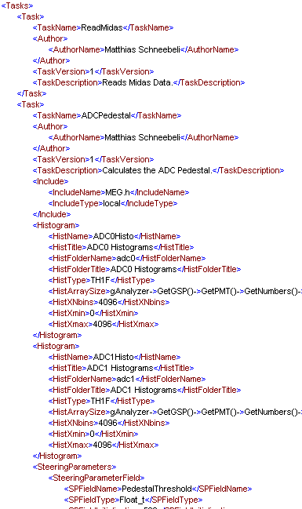
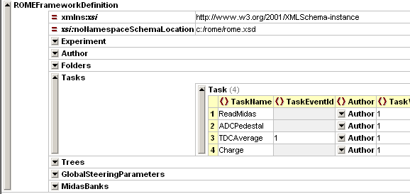
XML Editors
XMLSpy
  Table Format
  Commercial Software (50 Euro)
  Only for Windows
EditiX
  Nice Tree Format
  Commercial Software (30 Euro)
  Windows, Linux, Mac
ROME works with any Editor

Slide 20
Benefit of a generated Framework
Consistent Program Structure
  All classes look the same
  Better readability
Less Handwritten Code
  Code of a class is written once (in the builder) and reproduced many times
Easier Maintenance
  Modification are done once (in the builder) and then available in the whole framework

Slide 21
Installation
Installation of ROOT
Installation of LIBXML2 (only Linux)
Installation of MIDAS (only online, Linux)
CVS checkout of ROME
Define environment variable ROMESYS
Define environment variable ‘Path’
Windows
C:\> set ROMESYS=C:/ROME
C:\> set Path=%Path%;%ROMESYS%/bin
C:\> cvs checkout ROME
C:\ROME> nmake –f Makefile.win
C:\MyExp> ROMEBuilder.exe myExp.xml –v [–o Output Path]
C:\MyExp> progname
Linux
[~]$ setenv ROMESYS ~/ROME
[~]$ setenv PATH $ROMESYS/bin:$PATH
[~]$ cvs checkout ROME
[~/ROME]$ make
[../MyExp]$ romebuilder myExp.xml –v [-o Output Path]
[~/MyExp]$ progname

Slide 22
Configuration File
XML File
<RunNumbers>1001,1002-1004</RunNumbers>
<Modes>
  <AnalyzingMode>offline</AnalyzingMode>
  <InputDataFormat>midas</InputDataFormat>
</Modes>
<Tasks>
  <Task>
    <TaskName>Task 1</TaskName>
    <Active>yes/no</Active>
  </Task>
</Tasks>
<Trees>
  <Tree>
    <TreeName>Tree1</TreeName>
    <Read>yes/no</Read>
    <Write>yes/no</Write>
  </Tree>
</Trees>
<GeneralSteeringParameters>
  <SteeringParameterField>
    <SPName>Value</SPName>
    <SPValue>123</SPValue>
  </SteeringParameterField>
</GeneralSteeringParameters>

Slide 23
ROME vs. Midas Analyzer
Midas Analyzer
ROME
Banks -> Arrays or structures | Folders -> Objects (Classes)
odbedit> make -> experim.h containing data structure | romebuilder -> classes containing data structure and access methods
Midas required for online and offline | Midas not needed for offline
Calibration and configuration data in ODB | Calibration and configuration data in mySQL, XML, ...
User code added to BOR,EVENT,EOR functions | User code added to BeginOfRun, Event, EndOfRun functions
Input format : midas | Input format : midas, root
Output format : midas, root | Output format : root

Slide 24
Sample Experiment

Slide 25
Sample Overview
3 Folders
  PMTData
  Calib (Data base)
  PMTInfo (Data base)
2 Tasks
  ReadMidas
  ADCCalib
1 Midas Bank
  ADC0

Slide 26
XML Configuration File I
sample.xml
<XYZ>
  <Folder>
    <SubFolder FolderName="PMTData" Array="257">
      <Fields>
        <ADC Type="Float_t" Initialisation="0" Comment="// ADC Data"/>
      </Fields>
    </SubFolder>
    <SubFolder FolderName="Calib" Array="257" DataBase="yes">
      <Fields>
        <ADCPedestal Type="Float_t" Initialisation="0" DataBasePath=“/Calib/Ped”/>
      </Fields>
    </SubFolder>
    <SubFolder FolderName="PMTInfo" Array="257" DataBase="yes">
      <Fields>
        <PMID Type="Int_t" Initialisation="0" DataBasePath=“/Info/PMID”/>
        <ADCID Type="Int_t" Initialisation="0" DataBasePath=“/Info/ADCID”/>
      </Fields>
    </SubFolder>
  </Folder>

Slide 27
XML Configuration File II
sample.xml
  <Task>
    <SubTask Name="ReadMidas“/>
    <SubTask Name="ADCCalib">
      <Histos>
        <ADCHisto Type="TH1F" ArraySize="257" FolderName="adc" Title="ADC" NumberOfBinsX=“500" XMin="0" XMax=“500"/>
      </Histos>
    </SubTask>
  </Task>
  <MidasBanks>
    <ADC0 Type="unsigned short“/>
  </MidasBanks>
</XYZ>

Slide 28
Read Midas Task
XYZTReadMidas.cpp
void XYZTReadMidas::Event()
{
for (int i=0;i<257;i++) {
int iadc = fAnalyzer->GetPMTInfoAt(i)->GetADCID();
Float_t adcValue = fAnalyzer->GetADC0BankAt(iadc);
fAnalyzer->GetPMTDataAt(i)->SetADC(adcValue);
}
}

Slide 29
ADC Calibration Task
XYZTADCCalib.cpp
void XYZTADCCalib::Event()
{
for (int i=0;i<257;i++) {
float pmtData = fAnalyzer->GetPMTDataAt(i)->GetADC();
float pedestal = fAnalyzer->GetCalibAt(i)->GetADCPedestal();
FillADCHistoAt(i,pmtData - pedestal);
}
}
void XYZTADCCalib::EndOfRun()
{
for (int i=0;i<257;i++) {
DrawADCHistoAt(i);
}
}

Slide 30
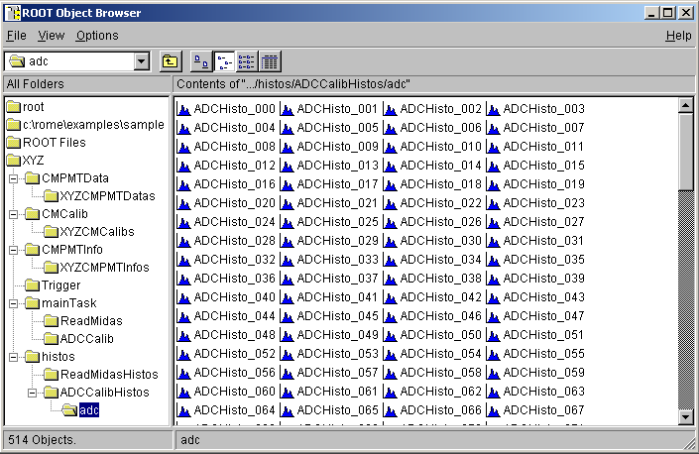
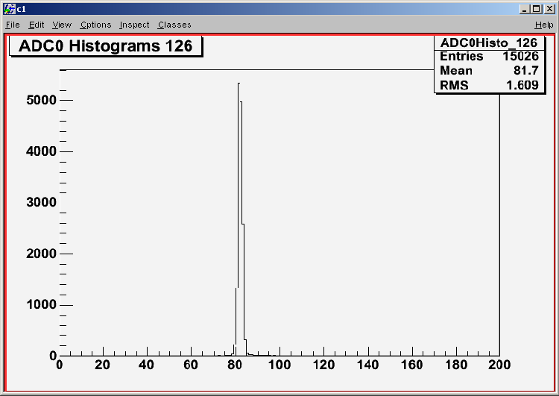
Run Program
Windows
C:\Sample> ROMEBuilder.exe sample.xml –v
link messages
C:\Sample> XYZ
12005 events processed
Task 'ReadMidas' : run time = 00:00:00
Task 'ADCCalib' : run time = 00:00:02

Slide 31
ROME vs. AliROOT

Slide 32
Differences between ROME and AliROOT
AliROOT
ROME
Objects are classes containing calculations and data. | Objects are complex items. Calculations and data are strictly separated.
A1
B1
A’
A
B
A2
B2
C
D
A3
A2’

Slide 33
Differences between ROME and AliROOT
AliROOT
ROME
Classes have to be modified to match the data structure. | Classes holding data structure are generated. (Folders)
Calculation code has to be rewritten. | Calculation code has to be added.
Good knowledge of C++ | Knowledge of C
Used by the ALICE collaboration. (others?) | Used for the LP. Midas Analyzer used for PiBeta.

Slide 34
Modifications
Features
AliROOT
ROME
Control Classes | Little to medium modifications. | None
Detector Classes (Geometry, clustering, reconstruction, …) | Have to be rewritten completely. Classes can only be used as templates. | Data structure will be generated. Calculations have to be written.
Virtual Monte Carlo | Little changes (ROOT feature) | Can be added easily (ROOT feature)
Monitor | Needs modifications | LP monitor. ROME’s online monitor can be used offline!

Slide 35
Comments form the ALICE Collaboration
From a mail of Federico Carminati (Offline Project Leader) :
“AliRoot was not meant to be a ‘framework’ for experiments”
Out of 51 modules:
ElectroMagnetic calorimeter code. To be discarded
AliRoot main program, probably to be modified
Methods for the production of raw data. To be modified
Analysis classes, to be modified, possibly lightly
Online monitoring code. May be interesting, to be modified
Main steering classes, needs modification
Display Code. Has to be modified
Interface with the FLUKA MC. Can be reused
Event generator interfaces. To be modified

Slide 36
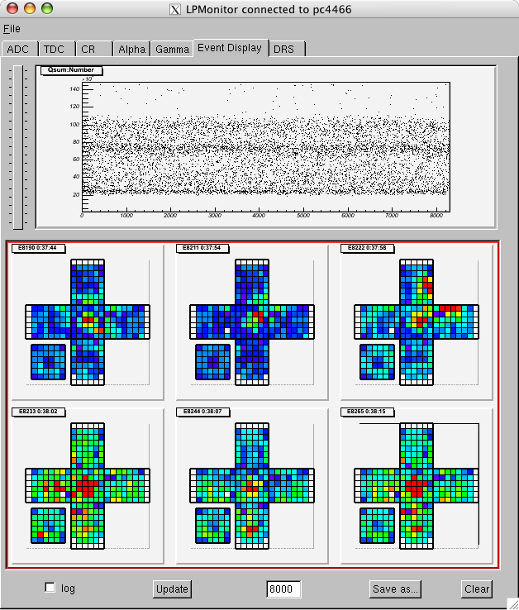
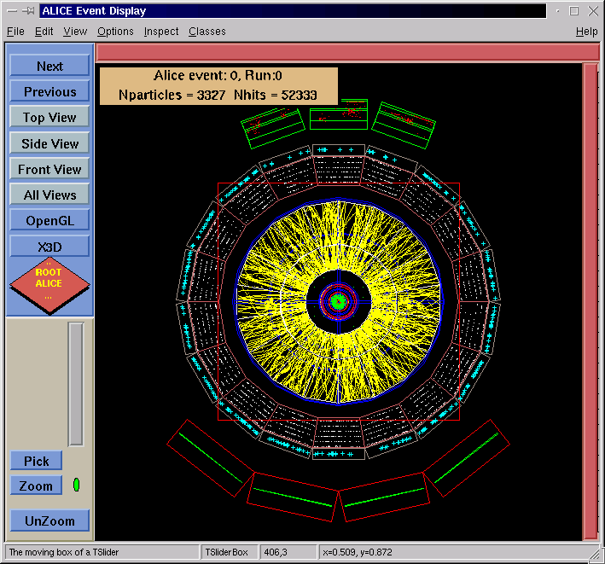
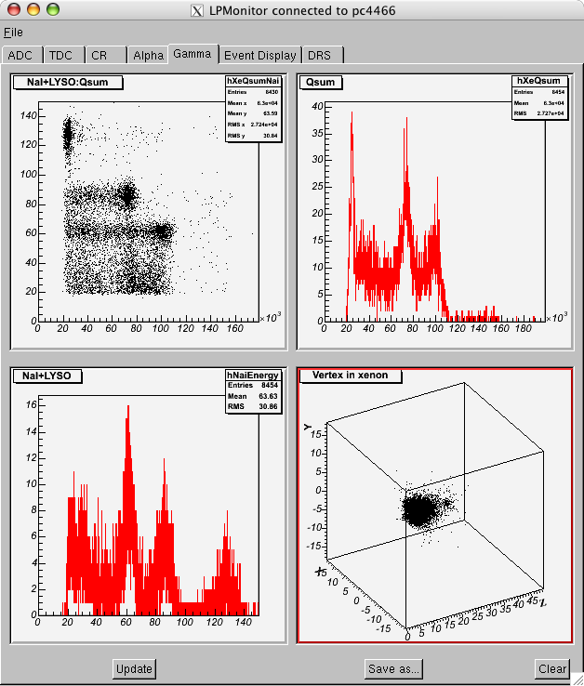
Monitors
AliROOT
LPMonitor

Slide 37
Additional Slides

Slide 38
Features
Tool for Event based Data Analysis
Fully Object Oriented
Root based
Full connection to the Midas Environment
Online and Offline
Based on Tasks and Folders for an easy Data and Program Structure
Experiment independent Base Classes
Experiment dependent Classes are generated out of simple XML-Files
The Users write only experiment specific code (physics)
Administrative code is implemented in the generated code
Self Documenting Code
Self Linking Project

Slide 39
Classes in the Generated Project
The generated classes are :
Task classes
  Implement 5 user methods : Init(), BeginOfRun(), Event(), EndOfRun(), Terminate().
Folder classes
  Define how the data is stored.
Analyzer class
  Main class. The Analyzer provides all user-methods.
IO class
  The IO handles all input and output.
IO
Trees
Data base
Analyzer
Folders
Steering
ROME classes
ROME classes
Tasks
fAnalyzer
Folders
ROMEEventLoop

Slide 40
Trees
XML File
<Experiment Shortcut>
  <Trees>
    <Tree Name=“Tree Name” Title=“Title”>
      <Branch Name=“Branch Name” Folder=“Folder”/>
    </Tree>
  </Trees>
</Experiment Shortcut>

Slide 41
General Steering Parameters
XML File
<Experiment Shortcut>
  <GeneralSteeringParameters>
  <Field 1 Type=“Type 1” Init=“Init 1” Comment=“Comment 1”/>
    <SubClass>
      <Field 2 Type=“Type 2” Init=“Init 2” Comment=“Comment 2”/>
    </SubClass>
  </GeneralSteeringParameters>
</Experiment Shortcut>
Code
[Type 1] GetGSP()->Get[Field 1]()
[Type 2] GetGSP()->Get[SubClass]()->Get[Field 2]()
XML File
<SubTask Name=“Task Name”>
  <SteeringParameters>
  <…/>
  </SteeringParameters>
</SubTask>

Slide 42
Midas Banks
XML File
<Experiment Shortcut>
  <MidasBanks>
  <Bank 1 Type=“Type 1”/>
    <Bank 2 Type=“struct” StructName=“Structure Name”>
      <Field 2 Type=“Type 2” PackedSize=“PackSize 2”/>
    </Bank 2>
  </MidasBanks>
</Experiment Shortcut>
Code
[Type 1] Get[Bank 1]BankAt(int index)
Int Get[Bank 1]BankEntries()
[Structure Name]* Get[Bank 2]BankAt(int index)
Int Get[Bank 2]BankEntries()
e.g. : [Type 2] Get[Bank 2]BankAt(int index)->[Field 2]
Simple Banks
Structured Banks

Slide 43
Comparing to Midas
In the Online Data Base :
ASUM
  Sum
  Average
In the XML-File :
<SubFolder FolderName=“ASUM">
  <Fields>
    <Sum/>
    <Average/>
  </Fields>
</SubFolder>
Midas Library is not used for offline analysis

Slide 44
Generated Code
XML File
<SubFolder FolderName=“Folder Name“>
<Fields>
<Field Name 1 Type=“Field Type 1” Init=“Init Value 1” Comment=“Comment 1”/>
</Fields>
</SubFolder>
Code
class [Experiment Shortcut][Folder Name] : public TObject
{
protected:
[Field Type 1] f[Field Name 1]; // [Comment 1]
public:
[Experiment Shortcut][Folder Name]([Field Type 1] value1=[Init Value 1] )
{ f[Field Name 1] = value1; };
[Field Type 1] Get[Field Name 1]() { return f[Field Name 1]; };
void Set[Field Name 1]([Field Type 1] value1) { f[Field Name 1] = value1; };
ClassDef([Experiment Shortcut][Folder Name],[Version Number])
};

Slide 45
Data base
SQL Data base
  see Ryu’s presentation
XML data base
  If no network connection available

Slide 46
Read and Write Data
Input Data
  Root files
  Midas files
  Online buffer
  Data base
Output Data
  Root files
  Database
Read and filled to the Folder by the Framework
Read by the Framework. Data accessed via Midas Bank access methods.
Read and filled to the Folder by the Framework
Written by the Framework, can be flagged
Written with : fAnalyzer->Write[Folder]DataBase(this);

Slide 47
Summary
Structure of the framework is defined in XML-files
All code is generated, except the physical calculations
The framework provides access functions for the user
SQL Data base
XML Configuration file

