Slide 1

Applying VaR Backtesting to Apple Inc. Stock Data
Cameron Porteous
ACTSC445

Slide 2

Apple Inc.
American multinational technology company
Designs, develops, and sells consumer electronics and software
Founded in 1976
Traded on NASDAQ as AAPL
Revenue in 2017: US$229.234 billion

Slide 3
Working Data
Adjusted Close values for the period of 01/05/2017 – 30/04/2018 were downloaded from Yahoo Finance, denoted S_{i}
Negative log returns were calculated as:
ΔX_{i} = ln (S_{i}/S_{i+1})
mean(ΔX) = -0.0005404151 = û
sd(ΔX) = 0.01361868 = ŝ
Thus we can model X ~ N(û, ŝ²)

Slide 4
VaR_{0.95} Estimation
Assuming negative log return is normally distributed, we estimate:
VaR_{0.95} = μ + σΦ⁻¹(0.95)
= 0.02186033

Slide 5
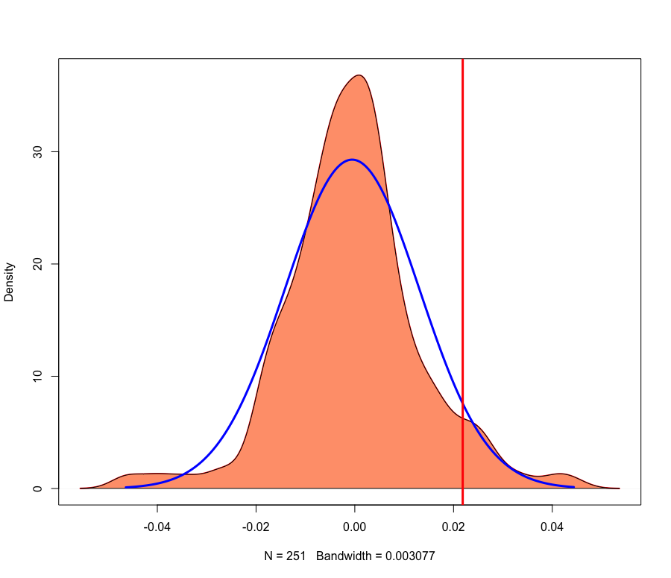
Kernel Density vs. Normal with VaR_{0.95} Estimate

Slide 6
VaR Backtesting - Binomial
We have T = 251, R = 15, c = 0.95
We use the test statistic TS ≈ N(0,1)
ts = (R-cT) / sqrt(Tc(1-c))
= 0.709549
p-value = Pr(|Z| > |ts|), Z ~ N(0,1)
= 2(1 – Φ(ts))
= 0.4779838
p-value > 0.05, so our VaR_{0.95} estimate cannot be rejected at 5% significance.

Slide 7
VaR Backtesting - POF Test
Define H₀: true failure rate is c = 0.95
We have ĉ = R/T = 0.05976096
We use the test statistic LR ~ χ²(1)
lr = - 2ln[ (c^{R}(1-c)^{T-R}) / (ĉ^{R}(1-ĉ)^{T-R}) ]
= 0.4751457
p-value = Pr(W > lr) , W ~ χ²(1)
= 0.4906294
p-value > 0.05, so we cannot reject H₀. Thus our VaR_{0.95} estimate cannot be rejected at 5% significance.

Slide 8
VaR Backtesting - Conditionality
We have n₀₀ = 223, n₀₁ = 12, n₁₀ = 12, n₁₁ = 3
π₀ = 0.05106383, π₁ = 0.2, π = 0.05976096
Using the formula on Slide 25 of Ch. 5, we obtain the following test statistic:
lr_{ind} = 3.70312
p-value = Pr(W > lr_{ind}), W ~ χ²(1)
= 0.05431081
p-value > 0.05, so we cannot reject our VaR_{0.95} estimate at 5% significance. However, due to how close the p-value is to 0.05, it is very possible that our assumption of normality was incorrect. It would be prudent to conduct further analysis (use goodness of fit tests for model, increase sample size, etc.).

Slide 9
Conclusion
Based on our 3 backtesting methods, our estimate of VaR_{0.95} = 0.02186033 is suitable.
This means that the 95% value at risk for daily stock loss (in terms of return rate) can be estimated as:
exp(-VaR_{0.95}) - 1 = -2.162312%

