Slide 1

Applying Extreme Value Theory to
Amazon.com Inc. Stock Data
Cameron Portous
ACTSC 445

Slide 2

Amazon.com Inc.
American electronic commerce and cloud computing company
Largest Internet retailer in the world by revenue and market capitalization
Founded in 1994
Traded on NASDAQ as AMZN
Revenue in 2017: US$177.6 billion

Slide 3
Working Data
Adjusted Close values for the period of 01/05/2009 – 28/09/2018 were downloaded from Yahoo Finance, denoted S_{i}
Negative log returns were calculated as:
ΔX_{i} = ln (S_{i}/S_{i+1})

Slide 4
Block Maximum Based Method
With n = 22, we obtain the following n-block sequence histogram for {M_{n,1}, M_{n,2}, … }

Slide 5
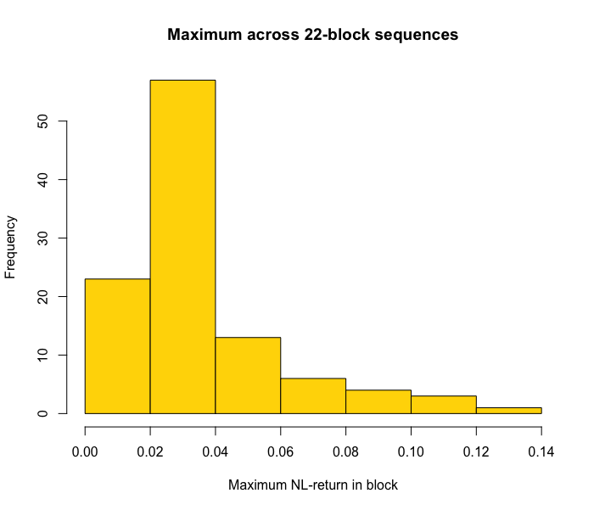

Slide 6
Fitting to GED
Fitting the block maxima to the Generalized Extreme Distribution, we obtain:
μ = 0.02442646
θ = 0.01123048
ξ = 0.3604652

Slide 7
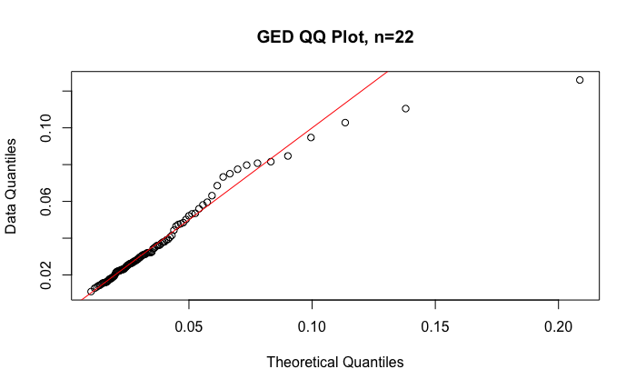
Goodness of Fit Analysis - GED

Slide 8
We conclude that the GED goodness of fit is quite strong for n = 22

Slide 9
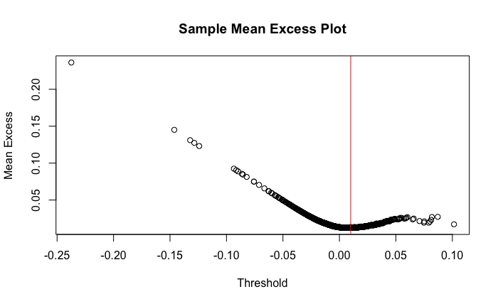
Threshold Exceedance Based Method

Slide 10
Fitting the GPD
Thus we choose u = 0.01
Fitting the Generalized Pareto Distribution with u = 0.01, we obtain:
ξ = 0.1057814
θ = 0.01161951

Slide 11
GPD VaR_{0.99}(X) and CVaR_{0.99}(X)
We estimate F(u) as:
(#observations >= 0.01) / total observations
= 0.2151899
We then use the formulas from the slides to obtain estimates for VaR and CVaR under GPD:
We estimate VaR_{0.99}(X) to be 0.05212839
We estimate CVaR_{0.99}(X) to be 0.070106

Slide 12
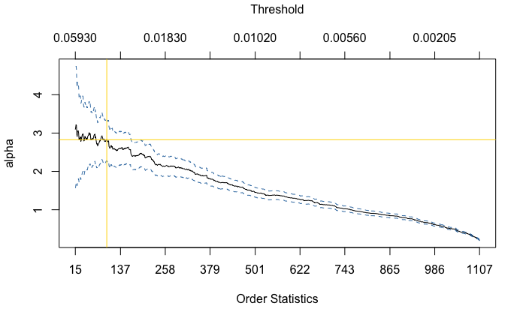
Hill’s Method
We obtain the following Hill Plot for X:

Slide 13
Developing Hill Estimator
Based on the Hill Plot, we choose k = 190
Using the formula from the slides, we obtain a Hill Estimator of 2.826003

Slide 14
VaR_{0.99}(X) and CVaR_{0.99}(X) Under Hill
Again, using the formula from the slides, VaR_{0.99}(X) can be estimated to be 0.05012537
Using CVaR = E(X|X >= VaR), CVaR_{0.99}(X) can be estimated to be 0.07380687

Slide 15
