Slide 1
SI 618: Large-scale distributed computation 2
Fall 2021
Instructor: Ceren Budak
Some slides courtesy of Kevyn Collins-Thompson and Yuhang Wang

Slide 2
Data Gathering and Processing Projects
Proposals due next Wednesday, right before class.
Proposal Guidelines (100 points):
(20 points) Summarize and motivate your proposed project.
(20 points) Choose and describe (at least) two different datasets.
(20 points) Describe how you might manipulate and join the two datasets.
(30 points) Describe at least three tasks you will perform to gain insights from the datasets (you can use mrjob, spark or sparksql) --- you haven’t learned sparksql yet so you can propose mrjob or spark for now.
(10 points) Describe at least one visualization you might create that highlights insights you hope to gain
You can propose an alternative project structure with prior approval (you need to contact me for this)

Slide 3
This week
Hadoop Framework
Cavium
Spark

Slide 4

Hadoop Framework
A software framework for distributed computing
Take 100 'commodity' machines that don't share memory or disk storage
Turn commodity machines into a cluster
Redundant and Reliable
Powerful and Scalable
Cost-effective
Java-based APIs to Hadoop services
But calling these directly is tedious and error-prone so people use programming languages like spark to perform Hadoop jobs
Notes:
Commodity does not mean consumer-class, but just not specialized enterprise machines

Slide 5
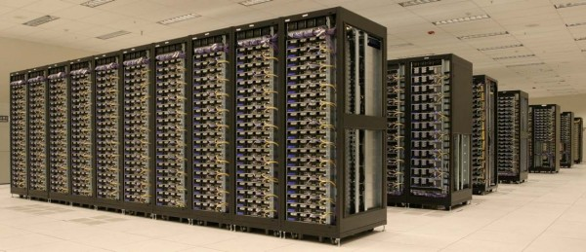
Hadoop Framework
Major components
MapReduce (algorithm)
A programming model for large-scale data processing
Hadoop Distributed File System (data storage)
Stores and aggregates data on cluster machines
Hardware Architecture
Networked machines
Cluster of machines running Hadoop at Yahoo! (Source: Yahoo!) via
http://www.michael-noll.com/tutorials/running-hadoop-on-ubuntu-linux-multi-node-cluster/

Slide 6
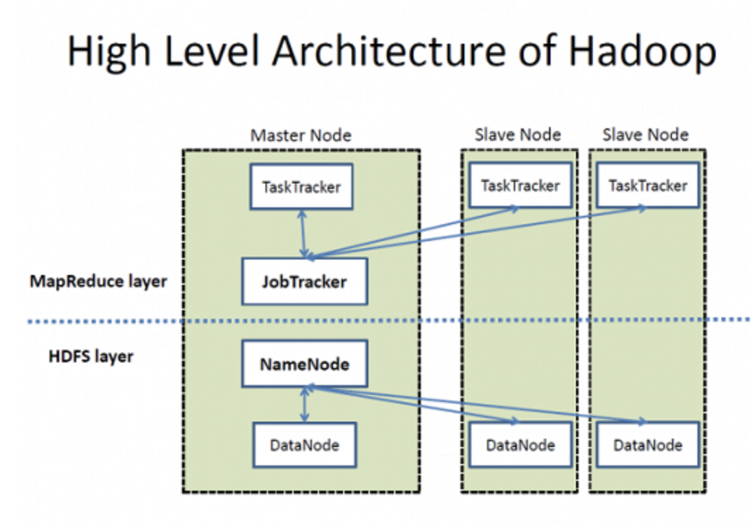
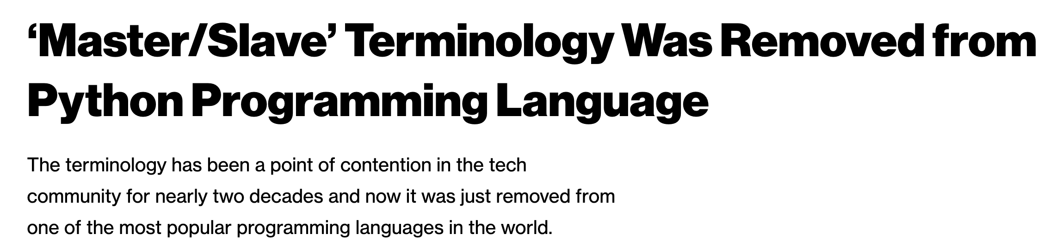
High Level Overview
Warning: The high level summary I will show right now includes unacceptable language. Sadly, this is the current state in computer science
It is important for us to acknowledge the current state and highlight the fact that such terminology being considered acceptable is perhaps a function of the diversity of the teams that found it acceptable
There are efforts to change things, though.
Coordinator Node
Worker Nodes
I will focus on the HDFS aspect. For more on YARN (Job scheduling):
https://hadoop.apache.org/docs/current/hadoop-yarn/hadoop-yarn-site/YARN.html

Slide 7
Hadoop Distributed File System (HDFS)
Also need a mechanism to support the process at the data level.
HDFS is designed to be…
Scalable in storage and I/O bandwidth
Highly fault-tolerant (check periodically)
Optimized for commodity machines
Typical Settings:
Save a file into blocks (128MB)
Replicate 3 times
Notes:
http://www.youtube.com/watch?v=1_ly9dZnmWc

Slide 8
Hadoop Distributed File System (HDFS)
Name node keeps track of where these chunks are. Name node also has a simple webpage that lists some basic details.
Single point of availability failure (which is why systems generally replicate and have two name nodes)
Client
Name Node
Data Node
Data Node
Data Node
Responsible for actual read and write
Notes:
Secondary name node is not a demon. It pull the metadata from master name node and save it as a file image, then feed back to the master node fro persistence.

Slide 9
Hadoop MapReduce
In large configurations, there might be multiple racks with multiple nodes.
Name node is rack-aware (what if an entire rack goes down? We need to be resilient to this case)
Job Tracker
Name Node
Name Node2
1
1
1
1
What happens if rack 1 goes offline?

Slide 10
Hadoop MapReduce
In large configurations, there might be multiple racks with multiple nodes.
Name node is rack-aware (what if an entire rack goes down? We need to be resilient to this case)
Job Tracker
Name Node
Name Node2
1
1
1
1
What happens if rack 1 goes offline?

Slide 11
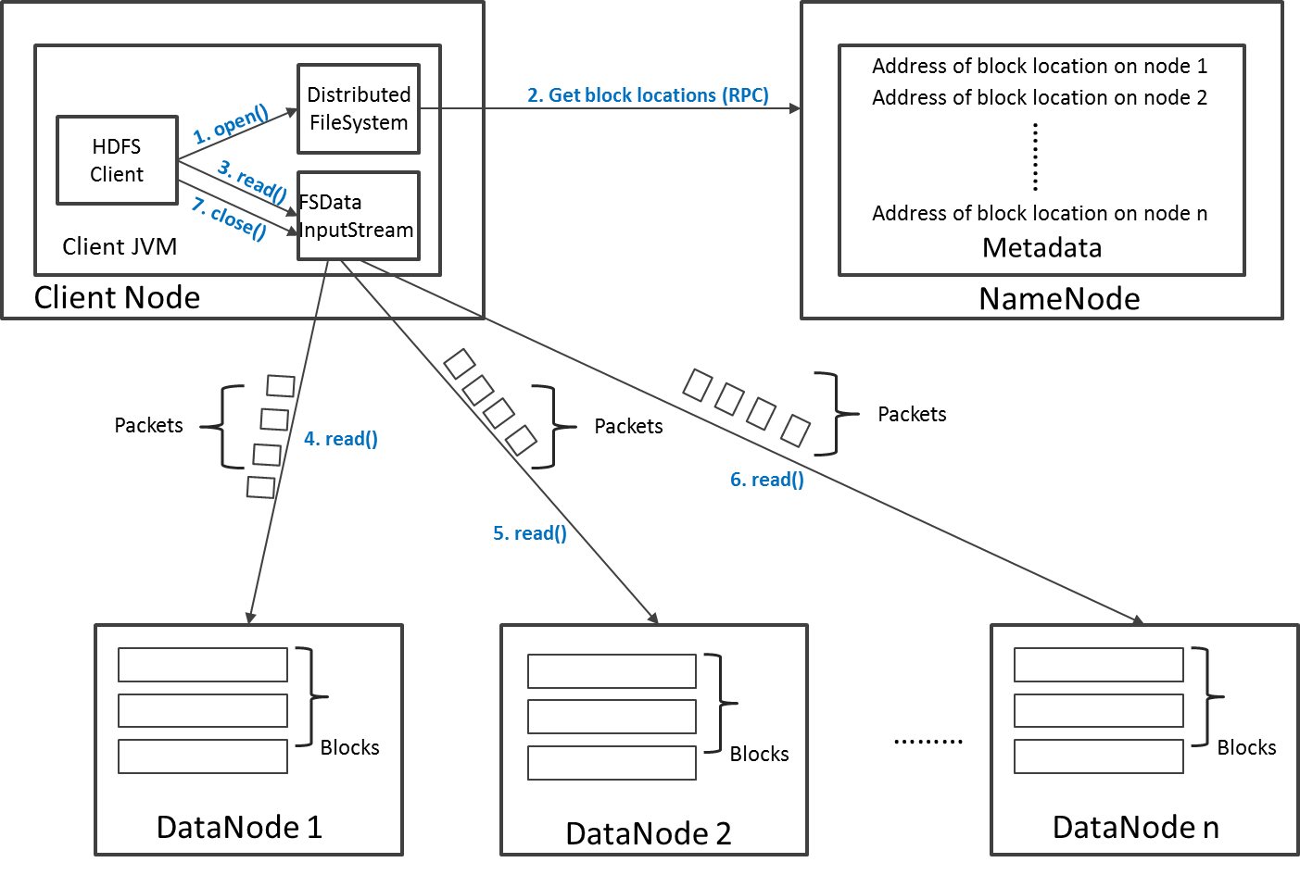
Read Operation in HDFS
Say that the client is looking for a block that is replicated on three datanodes. Namenode gives a sorted listed of datanodes to contact. Client will contact the second datanode only if it does not receive a response from the first
Why does the client go to the name node only to get the list and communicate with the data nodes directly? We don’t want name node to be a single point of failure

Slide 12
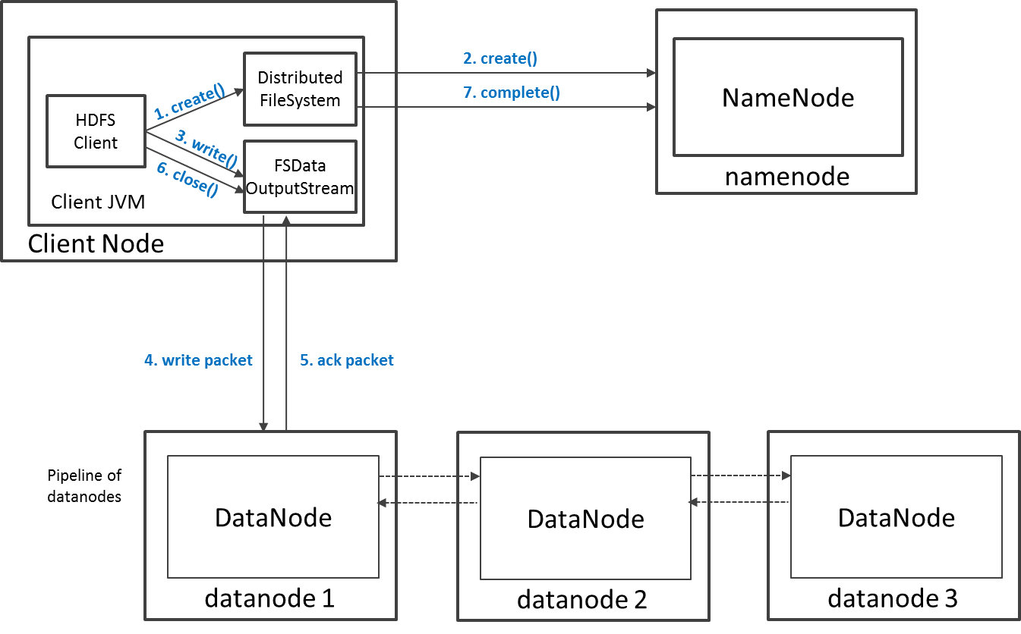
Write Operation in HDFS
Say your replication is 3, two of those are generally saved on two different datanodes on the same rack? Why?

Slide 13
So far
Hadoop: open-source framework for reliable, scalable, distributed computing.
MapReduce (algorithm)
A programming model for large-scale data processing
Hadoop Distributed File System (data storage)
Stores and aggregates data on cluster machines
Hardware Architecture
Networked machines
Yet, we did everything locally. Now we go to the cluster!

Slide 14
Cavium
The Cavium Thunder X Hadoop cluster is a next-generation Hadoop cluster available to researchers at the University of Michigan.
It holds 3PB of storage for researchers to approach and analyze data science problems.
The cluster consists of 40 servers each containing 96 ARMv8 cores and 512GB of RAM per server.
The cluster provides 1PB of total disk space, 40GbE inter-node networking, and Hadoop 2.7.2 with Spark 2 and Hive 2.
ARC-TS provides various other computing solutions. Check out: https://arc-ts.umich.edu/systems-services/ for more info.
We will use the Cavium Hadoop cluster in this class. For the user guide, please check: https://arc-ts.umich.edu/cavium/user-guide/

Slide 15
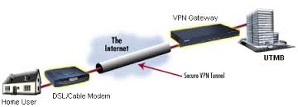

Working off-campus: Step 1: Use VPN (Virtual Private Network)
VPN: uses encryption and tunneling to establish secure private connections over third-party networks
See http://www.itcom.itd.umich.edu/vpn/ for details on how to install VPN software for UM.

Slide 16
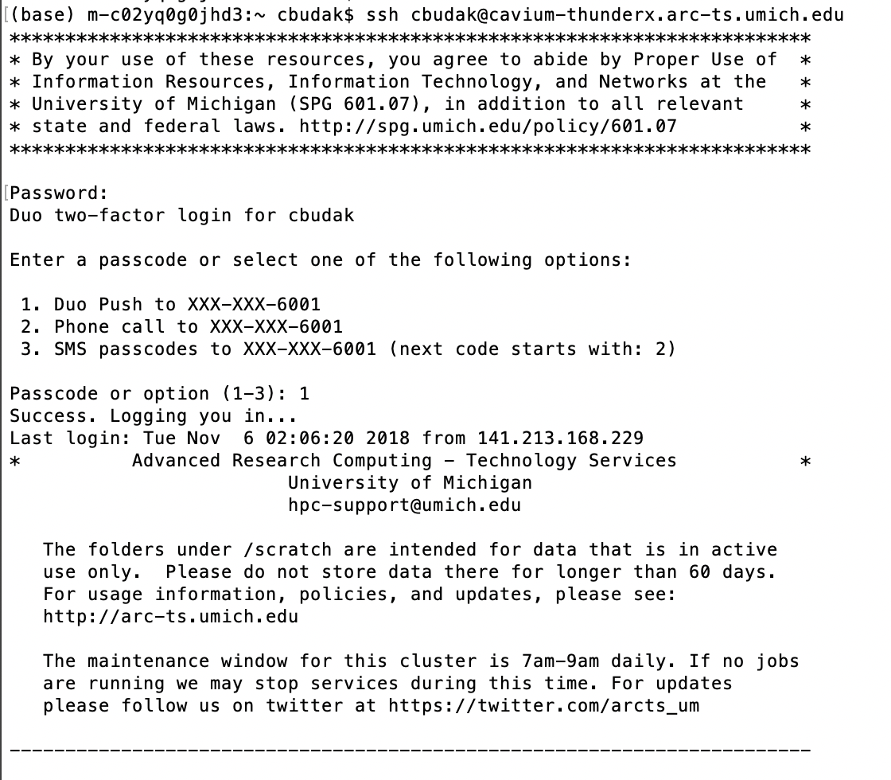
Step 2: Logging in to remote server
You can also use software such as Putty (on Windows machines).

Slide 17
Working on a remote server: copying files between your laptop and the remote account
Option 1: Use scp
Copy from local to server:
scp localfile uniqname@cavium-thunderx.arc-ts.umich.edu:remotefile (copy a file)
scp -r localdir uniqname@cavium-thunderx.arc-ts.umich.edu:remotedir (copy an entire directory)
Copy from server to local
scp uniqname@cavium-thunderx.arc-ts.umich.edu:remotefile localfile
Option 2: Use CyberDuck (on Mac) or WinSCP (on Windows)

Slide 18
Unix command line refresher
ls : list contents of a directory
pwd : print working directory
Paths
/home/<youruniqname>
Special directory names:
. Current directory
.. Parent directory
cd <directory> : change directory
cat <filename> : dump contents of a file
rm <filename> : remove a file

Slide 19
Hadoop file system follows the Unix command line conventions
hadoop fs –ls
hadoop fs –ls <directory>
hadoop fs -cat <filename>
hadoop fs -rm <filename>

Slide 20
HDFS Practice
Let’s try some simple commands together…

Slide 21
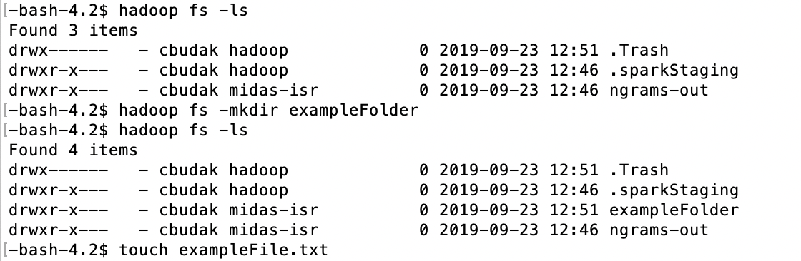
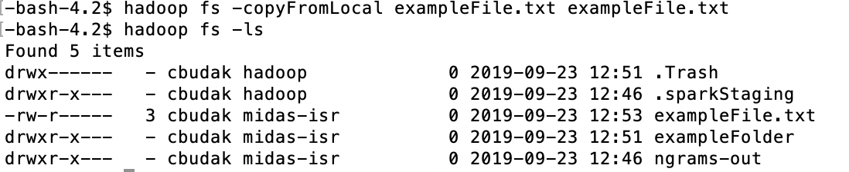

Slide 22
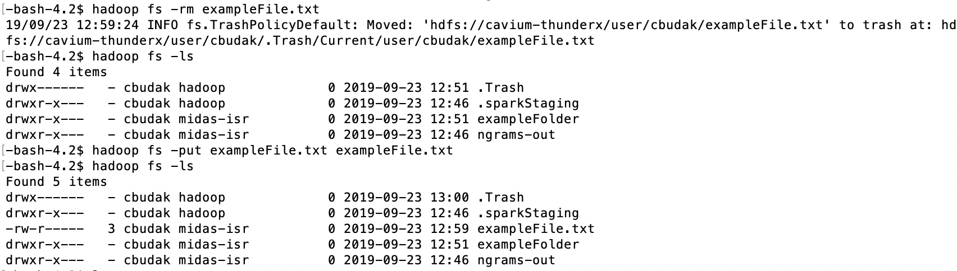

This is the folder where we will share data with you

Slide 23
Spark - Fast and general engine for large-scale data processing
Up to 100 times faster than Hadoop MapReduce
Written in Scala, providing Scala, Java and Python APIs
Supports both batch mode and real-time data stream processing
Write once, run everywhere
Spark runs on Hadoop, Mesos, standalone, or in the cloud. It can access diverse data sources including HDFS, Cassandra, HBase, S3.
http://spark.apache.org/docs/latest/quick-start.html
Sources: https://spark.apache.org, http://en.wikipedia.org/wiki/Apache_Spark

Slide 24
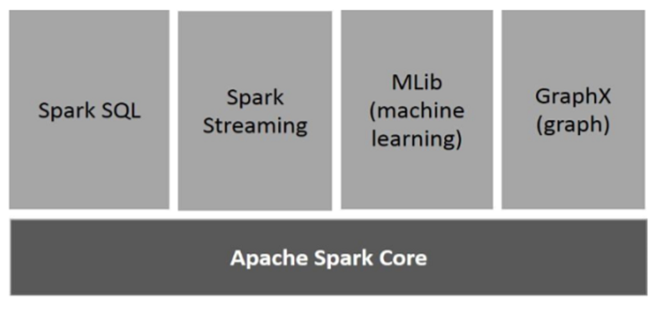
Spark Components
https://www.tutorialspoint.com/apache_spark/apache_spark_introduction.htm
Notes:
Apache Spark Core
Spark Core is the underlying general execution engine for spark platform that all other functionality is built upon. It provides In-Memory computing and referencing datasets in external storage systems.
Spark SQL
Spark SQL is a component on top of Spark Core that introduces a new data abstraction called SchemaRDD, which provides support for structured and semi-structured data.
Spark Streaming
Spark Streaming leverages Spark Core's fast scheduling capability to perform streaming analytics. It ingests data in mini-batches and performs RDD (Resilient Distributed Datasets) transformations on those mini-batches of data.
MLlib (Machine Learning Library)
MLlib is a distributed machine learning framework above Spark because of the distributed memory-based Spark architecture. It is, according to benchmarks, done by the MLlib developers against the Alternating Least Squares (ALS) implementations. Spark MLlib is nine times as fast as the Hadoop disk-based version of Apache Mahout (before Mahout gained a Spark interface).
GraphX
GraphX is a distributed graph-processing framework on top of Spark. It provides an API for expressing graph computation that can model the user-defined graphs by using Pregel abstraction API. It also provides an optimized runtime for this abstraction.

Slide 25
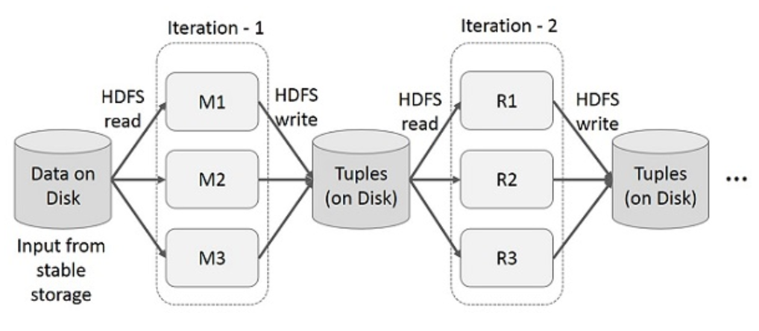
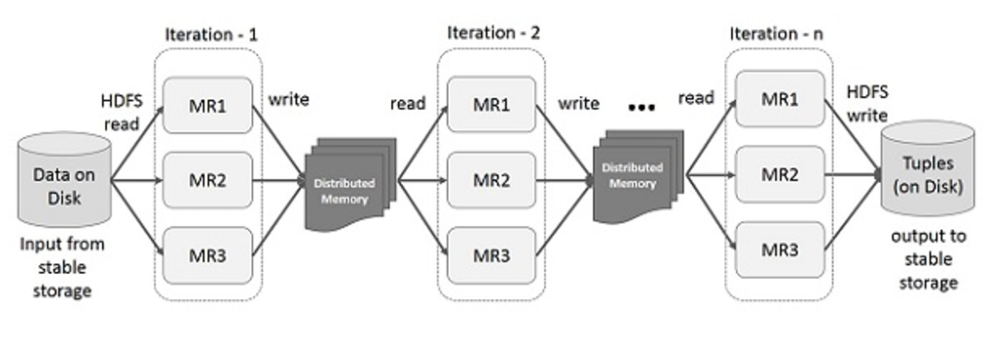
Traditional MapReduce vs. Spark: iterative operations
MapReduce
Spark
https://www.tutorialspoint.com/apache_spark/apache_spark_introduction.htm

Slide 26
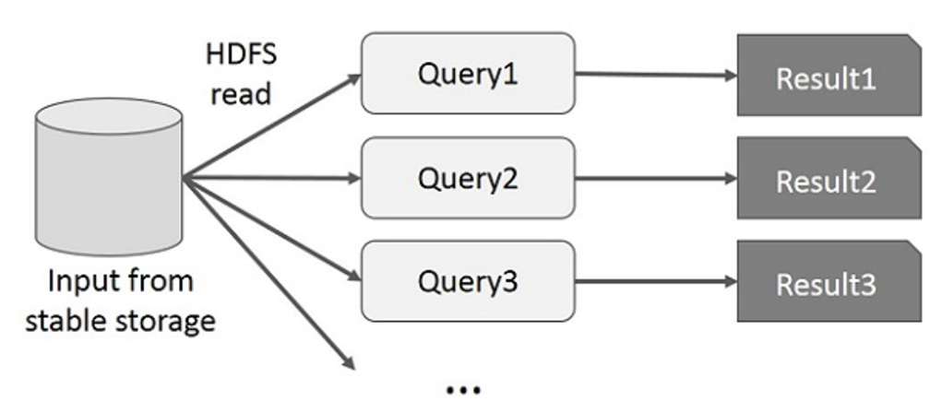
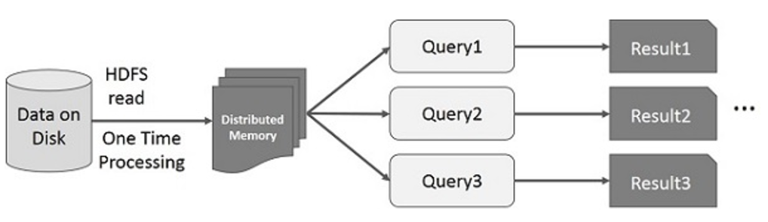
Traditional MapReduce vs. Spark: interactive operations
MapReduce
Spark
https://www.tutorialspoint.com/apache_spark/apache_spark_introduction.htm

Slide 27
Basic Spark Concepts
SparkContext
represents the connection to a Spark cluster, and can be used to create RDDs, accumulators and broadcast variables on that cluster.
Resilient Distributed Dataset (RDD)
RDDs have actions, which return values,
and transformations, which return new RDDs
Two code execution modes:
Interactive Python shell: PySpark
Running standalone applications: spark-submit
Notes:
Broadcast variables − used to efficiently, distribute large values.
Accumulators − used to aggregate the information of particular collection.
Broadcast variables allow the programmer to keep a read-only variable cached on each machine rather than shipping a copy of it with tasks. They can be used, for example, to give every node, a copy of a large input dataset, in an efficient manner. Spark also attempts to distribute broadcast variables using efficient broadcast algorithms to reduce communication cost.
Spark actions are executed through a set of stages, separated by distributed “shuffle” operations. Spark automatically broadcasts the common data needed by tasks within each stage.
The data broadcasted this way is cached in serialized form and is deserialized before running each task. This means that explicitly creating broadcast variables, is only useful when tasks across multiple stages need the same data or when caching the data in deserialized form is important.
Broadcast variables are created from a variable v by calling SparkContext.broadcast(v). The broadcast variable is a wrapper around v, and its value can be accessed by calling the value method. The code given below shows this −
scala> val broadcastVar = sc.broadcast(Array(1, 2, 3))
Accumulators are variables that are only “added” to through an associative operation and can therefore, be efficiently supported in parallel. They can be used to implement counters (as in MapReduce) or sums. Spark natively supports accumulators of numeric types, and programmers can add support for new types. If accumulators are created with a name, they will be displayed in Spark’s UI. This can be useful for understanding the progress of running stages (NOTE − this is not yet supported in Python).
An accumulator is created from an initial value v by calling SparkContext.accumulator(v). Tasks running on the cluster can then add to it using the add method or the += operator (in Scala and Python). However, they cannot read its value. Only the driver program can read the accumulator’s value, using its value method.

Slide 28
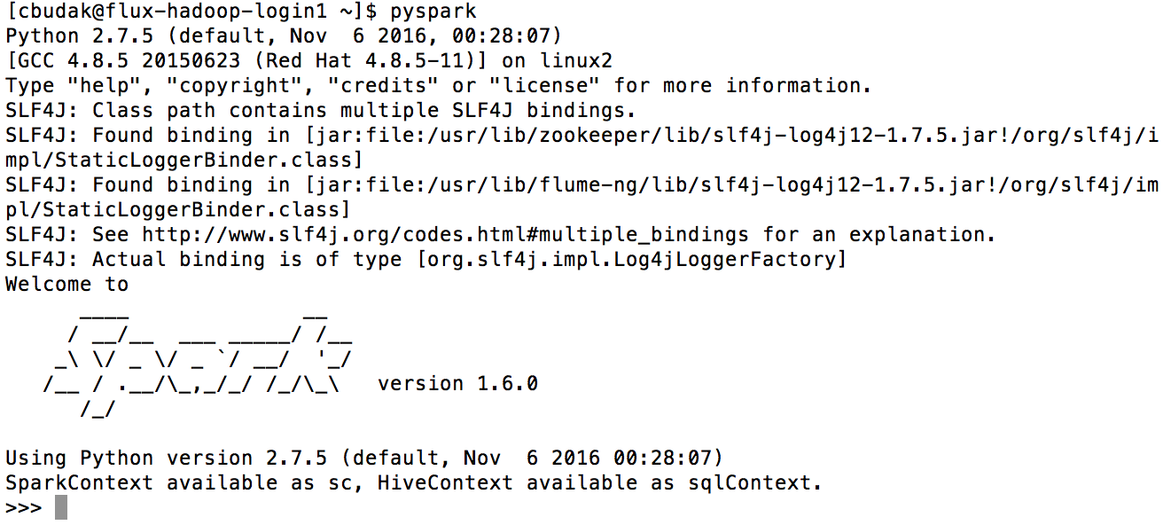
Pyspark: an interactive Python shell running on top of Spark

Slide 29
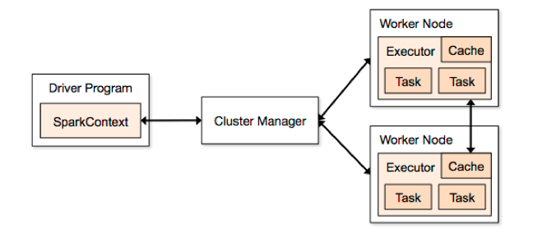
SparkContext
Represents a connection to a computing cluster
In PySpark, a SparkContext is auto-created for you in a variable called sc
Source: https://spark.apache.org/docs/1.1.1/cluster-overview.html

Slide 30
Resilient Distributed Dataset (RDD)
The fundamental abstraction for distributed data computation
An RDD is:
A immutable (read-only) collection of items
Partitioned across computing nodes
That can be manipulated in parallel
Once you have a SparkContext you can create RDDs
Example: A collection of lines from a text file
>>> lines = sc.textFile("input.txt") # Create an RDD called lines, input needs to be on HDFS
>>> lines.count() # Count the number of items in this RDD
3
>>> lines.first() # First item in this RDD, i.e. first line of input.txt
u'summer school 2012 in indiana'

Slide 31
In Spark, all work involves one of three kinds of operations on RDDs
Creating new RDDs
e.g. lines = sc.textFile("input.txt")
Input: various. Output: new RDD
2. Transforming existing RDDs
e.g. pigLines = lines.filter(lambda line: "pig" in line)
Input: one or more RDDs. Output: new RDD
3. Computing actions on RDDs to get a result
e.g. pigLines.first()
Input: one or more RDDs. Output: various non-RDD

Slide 32
Three kinds of operations on RDDs
Creating new RDDs
e.g. lines = sc.textFile("input.txt")
Input: various. Output: new RDD
2. Transforming existing RDDs
e.g. pigLines = lines.filter(lambda line: "pig" in line)
Input: one or more RDDs. Output: new RDD
3. Computing actions on RDDs to get a result
e.g. pigLines.first()
Input: one or more RDDs. Output: various non-RDD

Slide 33
Creation methods
Load data from external storage
lines = sc.textFile('./nyt/1985.txt’)
Parallelize an existing data structure
lines = sc.parallelize(["pandas", "i like pandas"])

Slide 34
Three kinds of operations on RDDs
Creating new RDDs
e.g. lines = sc.textFile("input.txt")
Input: various. Output: new RDD
2. Transforming existing RDDs
e.g. pigLines = lines.filter(lambda line: "pig" in line)
Input: one or more RDDs. Output: new RDD
3. Computing actions on RDDs to get a result
e.g. pigLines.first()
Input: one or more RDDs. Output: various non-RDD

Slide 35
Element-wise transformations: map and filter
The map() transformation takes in a function and applies it to each element in the RDD with the result of the function being the new value of each element in the resulting RDD.
nums = sc.parallelize([1, 2, 3, 4])
squared = nums.map(lambda x: x * x).collect()
for num in squared:
print "%i " % (num)
The magic of Spark: operations like ‘map’ are parallelized across the cluster.
Notes:
To print all elements on the driver, one can use the collect() method to first bring the RDD to the driver node

Slide 36
Digression: Lambda Function
nums = sc.parallelize([1, 2, 3, 4])
squared = nums.map(lambda x: x * x).collect()
for num in squared:
print "%i " % (num)
You can create anonymous functions in Python using lambda. For instance instead of:
You can have
You also do not have to assign lambda function to a variable:
1 2 | def multiply(x, y): return x * y
1 2 | r = lambda x, y: x * y r(12, 3) # call the lambda function
1 | (lambda x, y: x * y)(3,4)

Slide 37
Element-wise transformations: map and filter
The filter() transformation takes in a function and returns an RDD that only has elements that pass the filter() function.
pigLines = lines.filter(lambda line: "pig" in line)
Or
def containsError(s):
return "error" in s
word = rdd.filter(containsError)

Slide 38
Element-wise transformations: flatMap
Sometimes we want to produce multiple output elements for each input element. The operation to do this is called flatMap(). As with map(), the function we provide to flatMap() is called individually for each element in our input RDD. Instead of returning a single element, we return an iterator with our return values. Rather than producing an RDD of iterators, we get back an RDD that consists of the elements from all of the iterators.
lines = sc.parallelize(["hello world", "hi"])
words = lines.flatMap(lambda line: line.split(" "))
words.first() # returns "hello"

Slide 39
Set-like transformations
errorsRDD = inputRDD.filter(lambda x: "error" in x)
warningsRDD = inputRDD.filter(lambda x: "warning" in x)
badLinesRDD = errorsRDD.union(warningsRDD)
rdd1.union(rdd2)
rdd1.intersection(rdd2)
rdd1.subtract(rdd2)
rdd1.distinct()

Slide 40
Pair RDDs: collections of (key, value) pairs
reduceByKey(func)
sortByKey()
groupByKey()
mapValues(func)
flatMapValues(func)
keys()
values()

Slide 41
Pair RDDs: sortByKey()
Just like the Python sorted() function: sort (key, value) pairs alphabetically
word_counts_sorted = word_counts.sortByKey()

Slide 42
Pair RDDs: sortBy()
Just like the Python sorted() using a key= function
word_counts_sorted = word_count3.sortBy(lambda x: x[1], ascending = False)

Slide 43
Pair RDDs: reduceByKey(func)
Takes a function that operates on the values of two elements with the same key and returns a new RDD.
sumRDD = rdd.reduceByKey(lambda x, y: x + y)

Slide 44
Pair RDDs: reduce(func)
Reduce is an action that aggregates all the elements of the RDD using some function and returns the final result to the driver program
sumRDD = rdd.reduce(lambda x, y: x + y)
Notes:
reduce must pull the entire dataset down into a single location because it is reducing to one final value. reduceByKey on the other hand is one value for each key.

Slide 45
Three kinds of operations on RDDs
Creating new RDDs
e.g. lines = sc.textFile("input.txt")
Input: various. Output: new RDD
2. Transforming existing RDDs
e.g. pigLines = lines.filter(lambda line: "pig" in line)
Input: one or more RDDs. Output: new RDD
3. Computing actions on RDDs to get a result
e.g. pigLines.first()
Input: one or more RDDs. Output: various non-RDD

Slide 46
Actions
take(n) Gets the first k elements
for line in lines.take(10):
print line
collect() Gets all elements
Take an RDD and turn it into a local list
Be careful when using on a large RDD
first() Gets the first element
These operations create non-RDD objects. Be careful not to apply before you need to (it will take a while)

Slide 47
RDD operations we have learned:
map(f, preservesPartitioning=False)
flatMap(f, preservesPartitioning=False)
filter(f)
sortBy(keyfunc, ascending=True, numPartitions=None)
reduceByKey(func, numPartitions=None)
take(num)
collect()
saveAsTextFile(path, compressionCodecClass=None)

Slide 48
More about Spark
Basic statistic of RDDs:
max(key=None)
min(key=None)
mean()
count()
sum()
stdev()
How to join RDDs:
join(other, numPartitions=None)
leftOuterJoin(other, numPartitions=None)
rightOuterJoin(other, numPartitions=None)
fullOuterJoin(other, numPartitions=None)
https://spark.apache.org/docs/1.3.0/api/python/pyspark.html#pyspark.RDD

Slide 49
Resources
Spark Documentation
https://spark.apache.org/docs/latest/quick-start.html
https://spark.apache.org/docs/latest/programming-guide.html
https://spark.apache.org/docs/latest/api/python/index.html
Spark on Cavium
https://arc-ts.umich.edu/cavium/user-guide/

Slide 50
Example: Word Count
Let’s work on it together!

