Slide 1
SI 618: Large-scale distributed computation 3
Fall 2021
Instructor: Ceren Budak

Slide 2
Spark Components
Spark SQL (SQL)
Spark Streaming
(real-time)
GraphX
(graph)
MLlib
(machine learning)
Spark SQL(SQL on Spark)
Spark Streaming (stream processing)
GraphX (graph processing)
MLlib (machine learning library)
…
Spark Core

Slide 3
Spark vs. SQL
Two Paradigms
MapReduce
+ parallelism abstractions make it easy to run distributed computation
+ flexible, complete programming language
-programmer responsible for optimizations
-difficult/inefficient for many queries (join)
SQL
+ Easy for certain operations like filter, join
+ Optimizations built-in
+ Simple, declarative query statements
-must perform ETL on data
-doesn't scale well
-hard to perform iteration, row-by-row
Notes:
ETL: extract, transform, load

Slide 4
SparkSQL
What is Spark SQL?
Tries to allow users to have the advantages of both without the disadvantages of either
Make it easier to construct a “pipeline” or mix of SQL queries fed into procedural constructs, similar to FlumeJava or DryadLINQ
Transforms SQL operations into RDD operations
Data can be loaded from HDFS
Stores data in memory
Supports both relational and Spark-style queries
Provides a configurable optimization engine

Slide 5
SparkContext: Entry point to SQL functionality
The entry point into all SQL functionality in Spark is the SQLContext class. To create a basic instance, all we need is a SparkContext reference.
from pyspark.sql import SQLContext
sqlContext = SQLContext(sc)

Slide 6
Datasets and DataFrames
A Dataset is a distributed collection of data
A Dataset can be constructed from JVM objects and then manipulated using functional transformations (map, flatMap, etc.)
The Dataset API is available in Scala and Java
A DataFrame is a Dataset organized into named columns
It is conceptually equivalent to a table in a relational database or a data frame in R/Python, but with richer optimizations
An abstraction for selecting, filtering, aggregating and plotting structured data

Slide 7
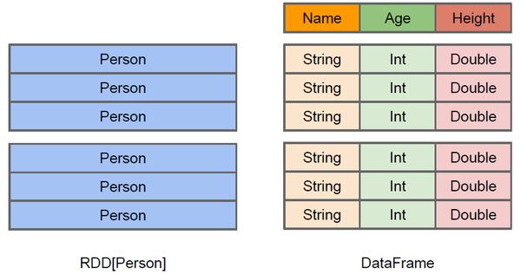
Difference between DataFrame and RDD
DataFrame more like a traditional database of two-dimensional form, in addition to data, but also to grasp the structural information of the data, that is, schema
RDD[Person] although with Person for type parameters, but the Spark framework itself does not understand internal structure of Person class
DataFrame has provided a detailed structural information, making Spark SQL aware of what columns are included in the dataset (the name and type of each column). Thus Spark SQL query optimizer can target optimization

Slide 8
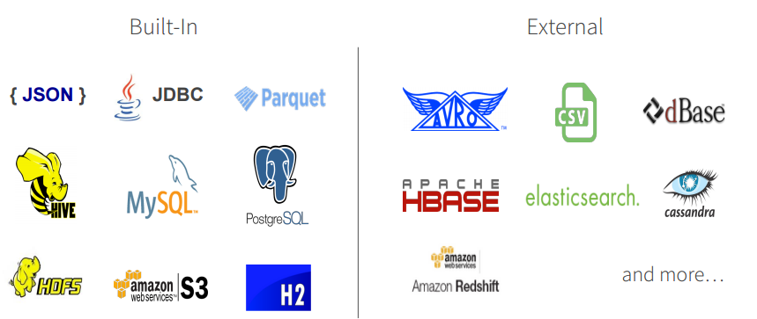
DataFrame Data Sources
Spark SQL’s Data Source API can read and write DataFrames using a variety of formats.
E.g., structured data files, tables in Hive, external databases, or existing RDDs
DataFrames can be created from RDDs, or loaded from data file: https://spark.apache.org/docs/1.3.0/sql-programming-guide.html
DataFrame operations: https://spark.apache.org/docs/1.3.0/api/python/pyspark.sql.html#pyspark.sql.DataFrame

Slide 9
DataFrames
Can embed relational style queries
Allows use of things like loop constructs and conditionals surrounding SQL-style queries
Can access, name, and use intermediate results of those queries
Spark-style lazy-eval allows optimization
Immediate error detection and response despite lazy-evaluation

Slide 10
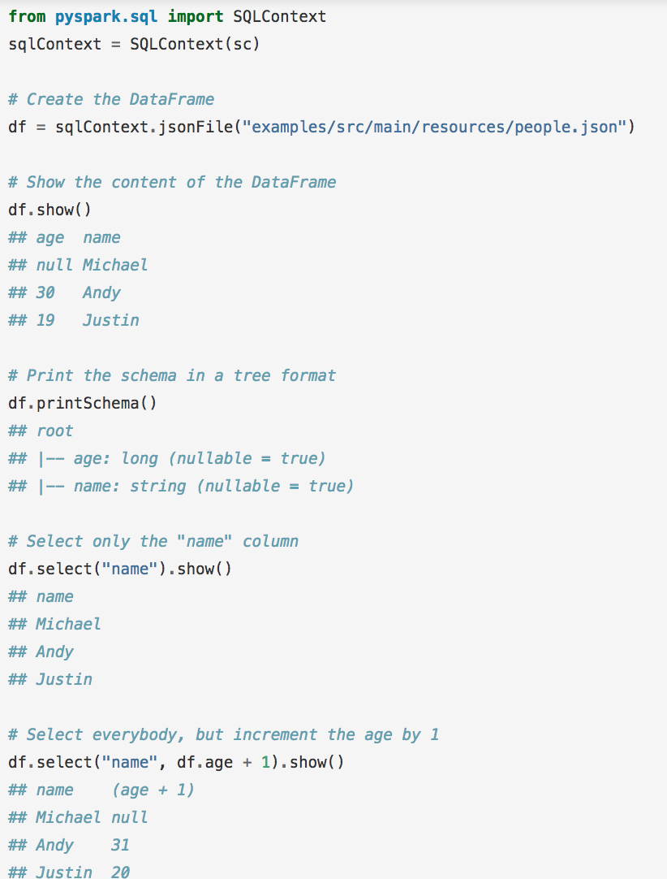
Spark SQL
sqlContext.read.json

Slide 11
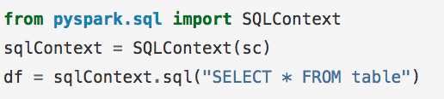
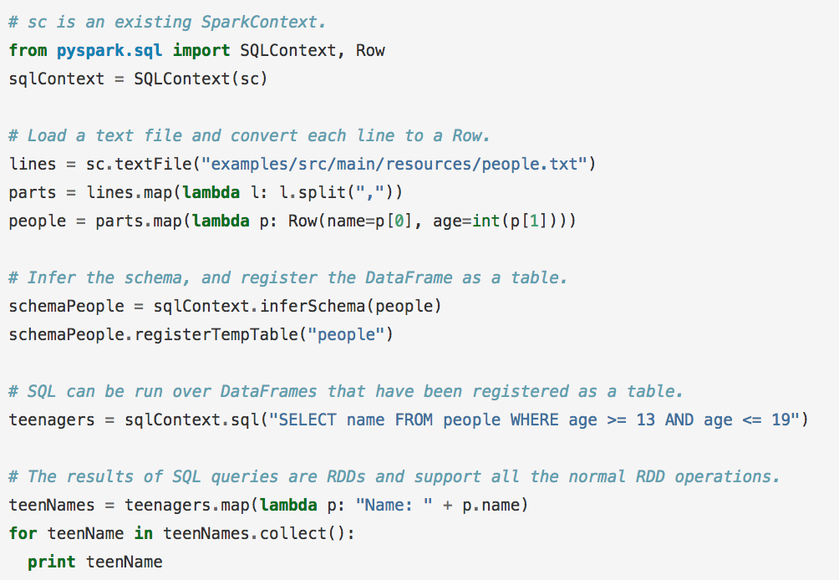
Spark SQL
Can infer a schema from semi-structured data (neat!)
Passes over data, finds the most specific but sufficient Spark SQL data-type that covers all instances of a field
Find all instances of field, find largest matching data type, and set that as the “type” of that column

Slide 12
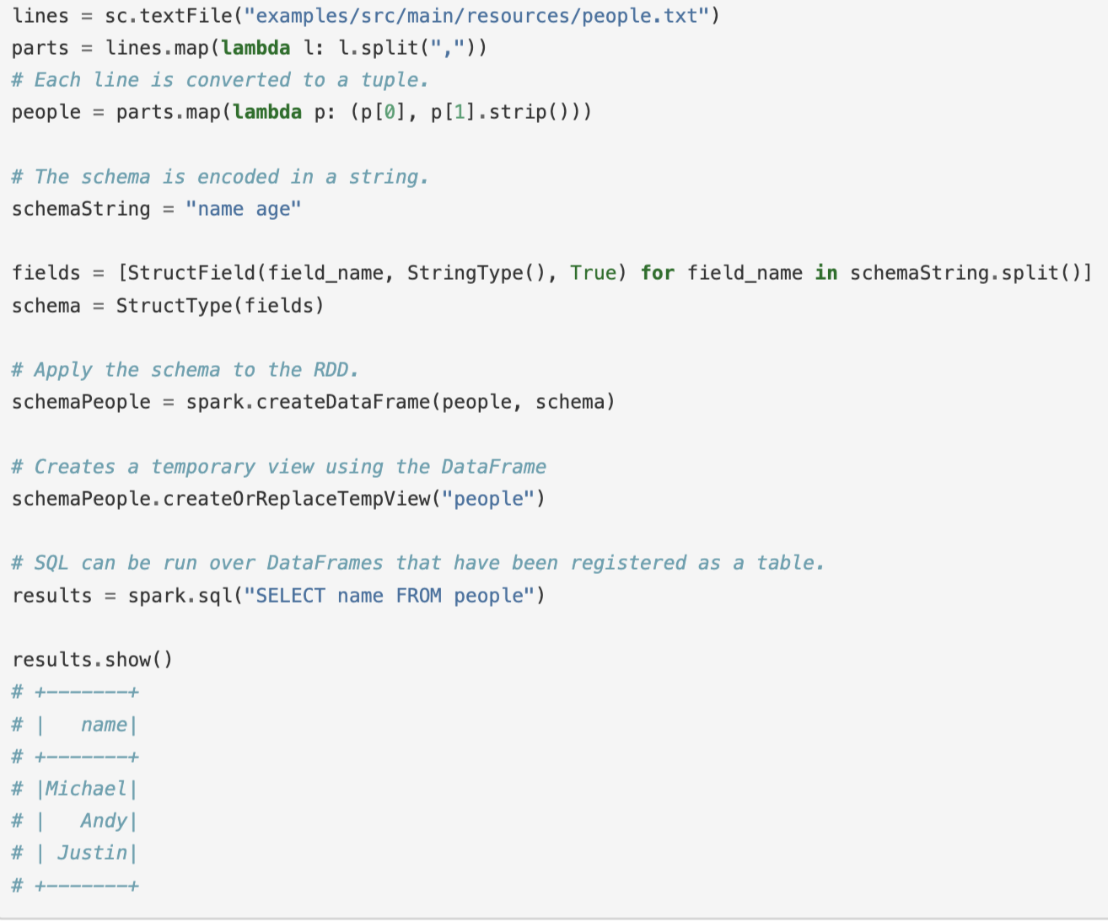
What is this third parameter? Check out StructField
You can also programmatically set the schema

Slide 13
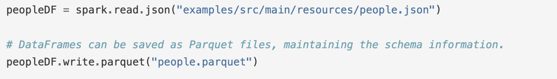
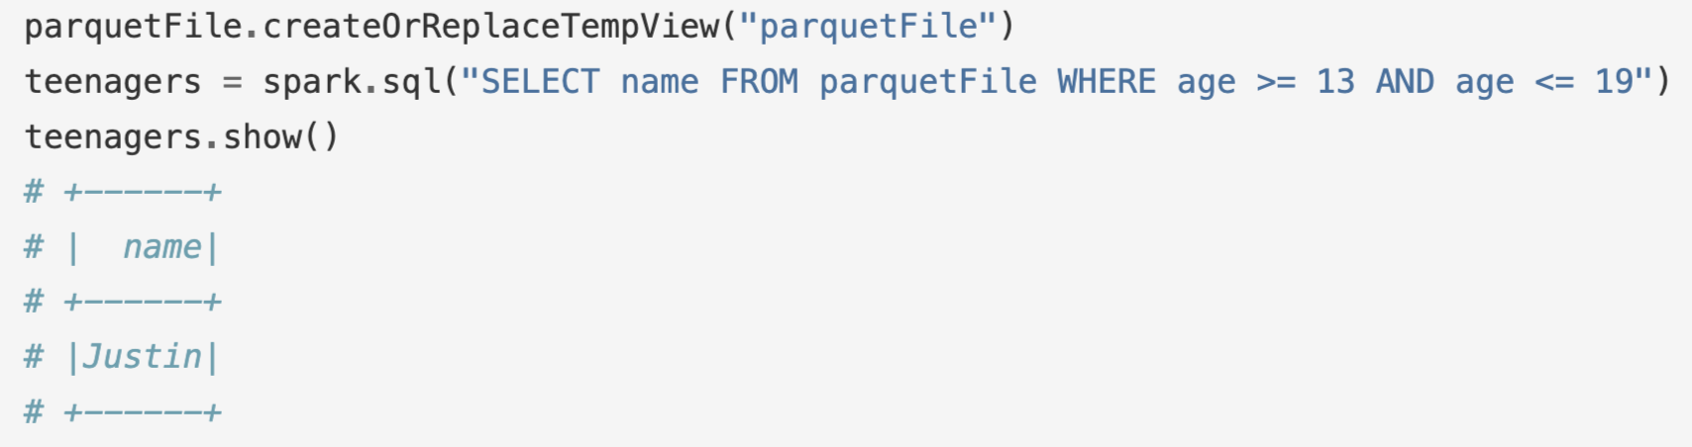
Parquet Files
Data can be saved as Parquet files to keep the schema
You can read parquet files as:
Parquet files can also be used to create a temporary view and then used in SQL statements.

Slide 14
Resources: Spark Documentation
https://spark.apache.org/docs/latest/quick-start.html
https://spark.apache.org/docs/latest/programming-guide.html
https://spark.apache.org/docs/latest/api/python/index.html

Slide 15
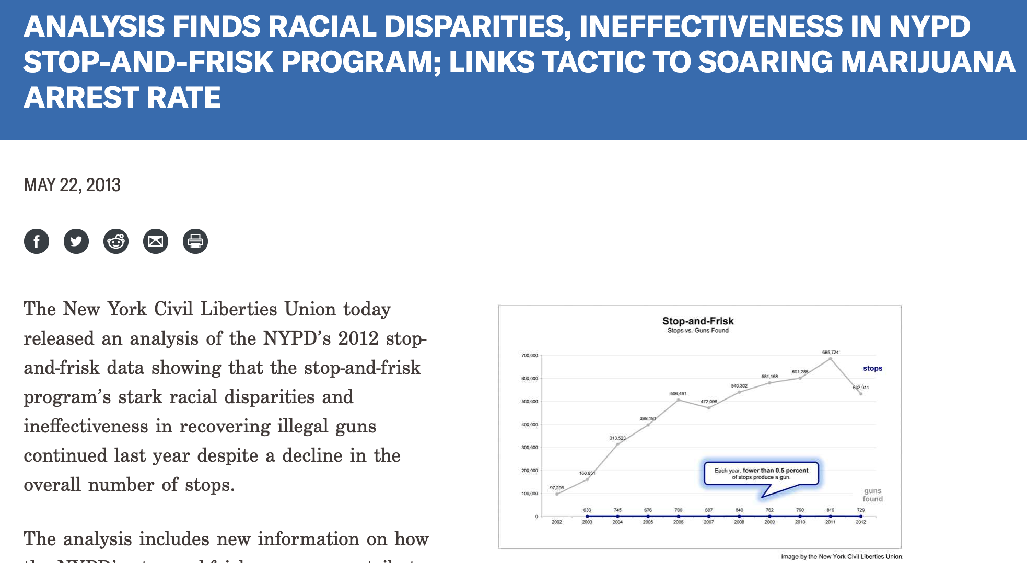

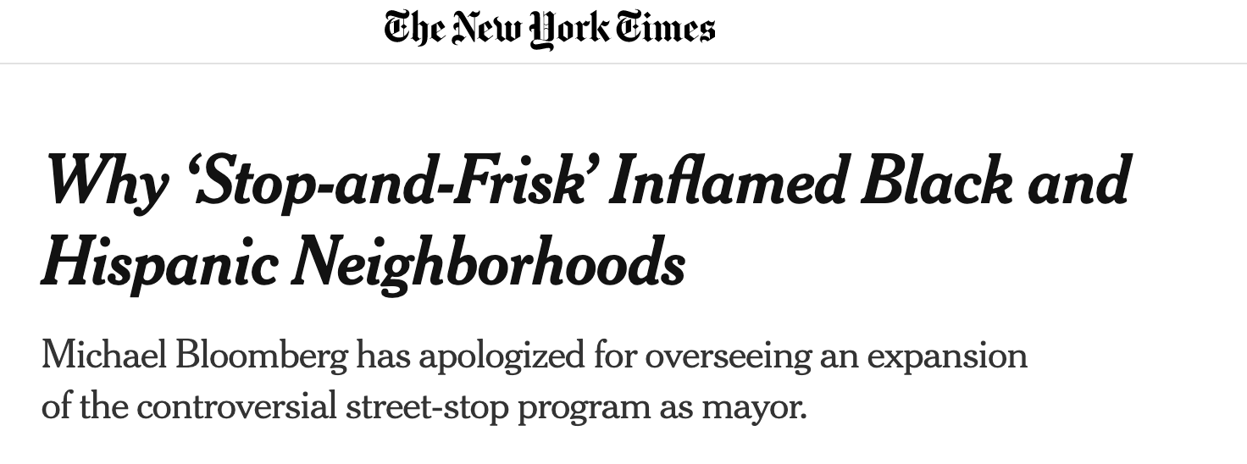
Now lets go through a SparkSQL example
Let’s delve into data about the NYC Stop-and-Frisk program
What is stop-and frisk? The practice of temporarily detaining, questioning, and at times searching civilians on the street. The police must have a reasonable suspicion that a crime has been, is being, or is about to be committed by the suspect.

