Slide 1
Goal Jiaqi Chen
Bottom-Up: finding spatial clusters where the measure is changed from density to degree of matching (jaccard coefficient).

Slide 2
Method
1.Use ‘Hilbert curve’ to map the centroid of the spatial objects to obtain the curve value.
(Hilbert curve has better clustering property for two dimensional objects.)
2.Sort the dataset based on the curve value.
3. Clustering the consecutive objects with similar jaccard coefficient.

Slide 3
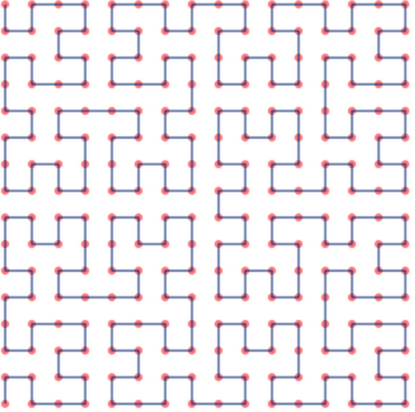
Hilbert Curve
#Map 2D to 1D.
#Consecutive objects in 1D array are close to each other in 2D.

Slide 4
Clustering
Clustering the consecutive objects with similar jaccard coefficient.
1.abs(cur_jac – average_jac) > jac_diff_bound
2.exceed_num < tolerant_num + cluster_num*20%
3.safety_distance: within d distance in 1D array, if exceed bound, will not be regarded as “exceed”

Slide 5
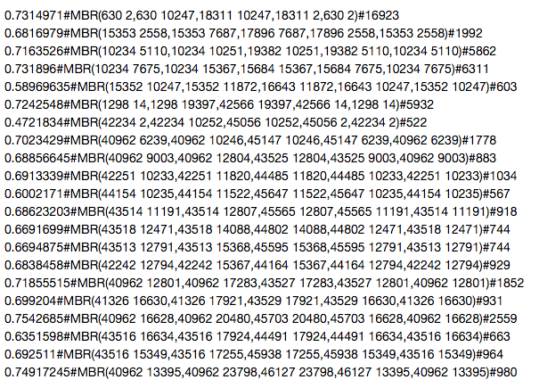
Result
AverageJaccard#MBR#ClusterSize

Slide 6
Thanks

