Slide 1
AdaptiveRes
Cloud Neural Network Optimization via Early-Exit
Implementation · Analysis · Conclusions · Recommendations
Cole Roberts · Matthew Watters · Henrik Evers
Dr. Ming-Hwa Wang | CSEN 241 – Cloud Computing | Santa Clara University | February 2026

Slide 2
6
Implementation
Code · Design · Flowchart

Slide 3
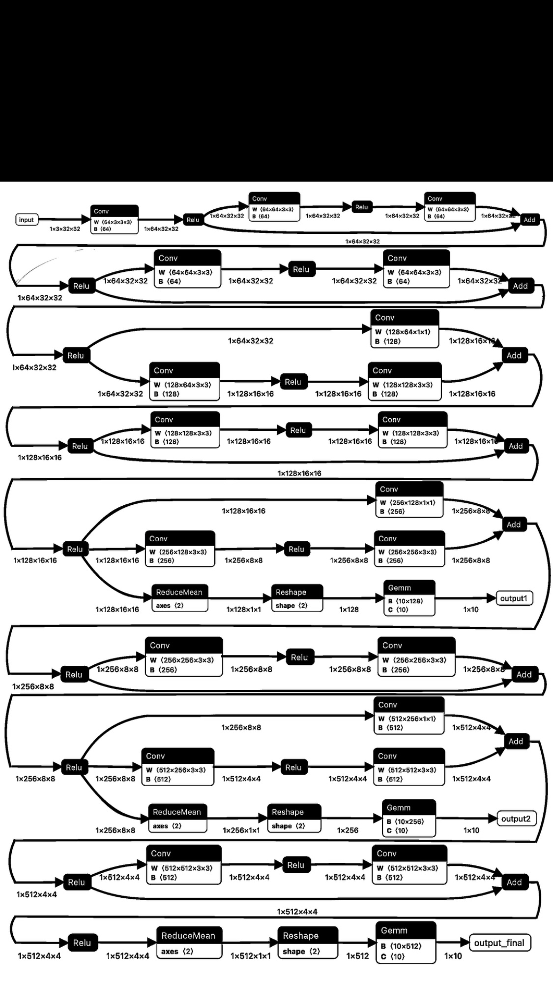
Model Architecture — AdaptiveRes
Backbone — ResNet-18 modified for CIFAR-10 (32×32). Initial 7×7 conv replaced with 3×3 (stride 1); MaxPool replaced with Identity to preserve spatial dims.
Exit 1 — After Residual Block 2 (~50% depth). GAP → Flatten → Linear(128, 10).
Exit 2 — After Residual Block 3 (~75% depth). GAP → Flatten → Linear(256, 10).
Final Exit — Standard ResNet-18 output head (AvgPool → FC → 10).
Joint Loss — L_total = L_exit1 + L_exit2 + L_final (λ=1.0 each). All exits trained end-to-end.
Optimizer — Adam (lr=0.001, weight_decay=1e-4), CosineAnnealingLR scheduler, 30 epochs.

Slide 4
Inference Strategy — Dynamic Exit Flowchart
Image Input
Stage 1: Conv + Block 1 + Block 2
Exit 1: Softmax Confidence > θ?
YES
✓ Exit Early
Low Cost (~33%)
θ threshold
(e.g. 0.95)
NO
Controls the
acuracy-cost
trade-off
Stage 2: Residual Block 3
Exit 2: Softmax Confidence > θ?
YES
✓ Exit Early
Med Cost (~66%)
NO
Final Layer — Full Cost (100%)

Slide 5
Key Code Implementation Highlights
# Modified ResNet backbone for CIFAR-10 32×32 input
self.backbone.conv1 = nn.Conv2d(3, 64, kernel_size=3, stride=1, padding=1, bias=False)
self.backbone.maxpool = nn.Identity() # no pooling on small images
# Exit 1 head (after layer2, feature dim 128)
self.exit1 = nn.Sequential(nn.AdaptiveAvgPool2d((1,1)), nn.Flatten(), nn.Linear(128, 10))
# Joint loss training — equal weight across all 3 exits
loss = criterion(o1, labels) + criterion(o2, labels) + criterion(o_final, labels)
# Adaptive inference — sample-level exit decision
if max_p1 > θ: exit at stage 1 (Low Cost)
elif max_p2 > θ: exit at stage 2 (Med Cost)
else: full network (Full Cost)

Slide 6
7
Data Analysis
& Discussion
Output · Hypothesis Comparison · Abnormal Cases

Slide 7
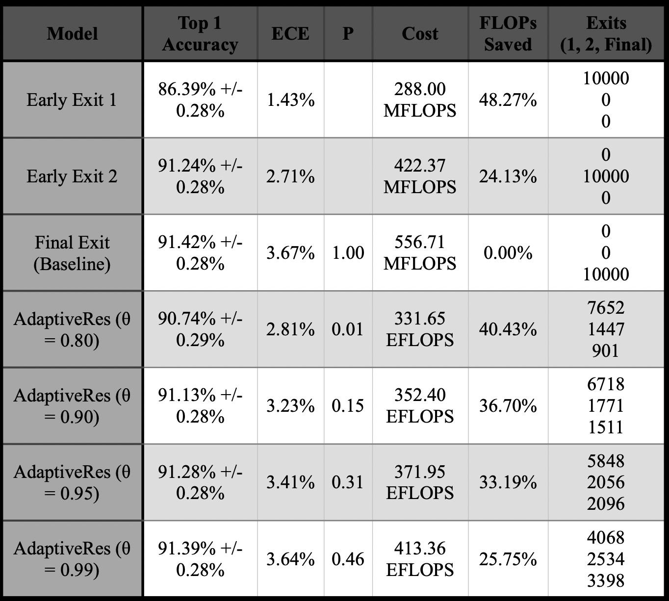
Output Results — Performance Summary

Slide 8
Hypothesis Verification
Hypothesis: ≥30% FLOPs reduction with Top-1 accuracy within 0.5% of baseline (91.42%) at θ = 0.95.
Computational Cost Reduction
Accuracy Retention
33.19%
0.16%
FLOPs saved vs baseline
(Target: ≥30% ✓ PASSED)
Accuracy loss (91.28% vs 91.42%)
(Target: ≤0.5% ✓ PASSED | p = 0.31)
Exit Distribution at θ=0.95 → 58.5% at Exit 1 | 20.6% at Exit 2 | 21.0% at Final
Key Insight: 58.5% of test images exit at Block 2 — confirming that the majority of cloud traffic is over-computed by static DNN deployments.

Slide 9
Accuracy–Cost Trade-off Across Thresholds
As θ increases, fewer samples exit early → FLOPs savings decrease but accuracy approaches baseline. Sweet spot: θ = 0.95 (33.2% savings, only 0.16% accuracy loss).
Hypothesis target: ≥30% FLOPs saved, ≤0.5% accuracy loss — all thresholds ≤0.95 meet both criteria simultaneously.

Slide 10
Abnormal Case Analysis
⚠ Premature Exits (Overconfidence)
⚠ Long-Tail Latency Spikes
Cause: Softmax probability ≠ true calibration. Hard/occluded/adversarial samples can still yield high confidence at shallow layers. Evidence: ECE at θ=0.80 is 2.81% vs baseline 3.67% — lower ECE, but overconfident early exits explain the 0.68% accuracy gap. Mitigation: Temperature scaling post-training to re-calibrate Softmax probabilities before threshold comparison.
Cause: ~21% of samples (at θ=0.95) traverse the full network PLUS the overhead of computing two intermediate exits first. Impact: These requests are ~5% slower than a pure baseline run, creating a bimodal latency distribution problematic for strict SLA adherence. Mitigation: Masked batching or asynchronous processing on GPU to parallelize partial and full-network paths, absorbing the overhead.
Statistical Note: P-values at θ=0.95 (p=0.31) and θ=0.99 (p=0.46) confirm no statistically significant accuracy degradation. θ=0.80 (p=0.01) shows marginal but measurable accuracy impact — a considered trade-off for 40.4% cost savings.

Slide 11
8
Conclusions &
Recommendations
Summary · Future Work

Slide 12
Summary & Conclusions
33.19%
0.16%
58.5%
FLOPs Reduced
Accuracy Loss
Samples Exit Early
(Target: ≥30%)
(Target: ≤0.5%)
at Stage 1 (θ=0.95)
1. Hypothesis Confirmed. AdaptiveRes achieved 33.19% FLOPs reduction with statistically insignificant accuracy loss (p=0.31) at θ=0.95.
2. Cloud Economics Validated. A 33% compute reduction in pay-as-you-go serverless environments directly translates to 33% lower OpEx at scale (millions of inferences/day).
3. Green Cloud Benefit. Fewer FLOPs = lower data center energy consumption, aligning with sustainable computing initiatives.
4. Bimodal Traffic Discovered. 58.5% of CIFAR-10 traffic is 'easy' — confirming that standard static DNNs drastically over-compute for average cloud workloads.

Slide 13
Recommendations for Future Studies
Dynamic Thresholding
Batch Processing Optimization
Replace fixed θ with learnable thresholds or Contextual Bandits (Ju et al. DEE). Auto-tune θ based on real-time server load and SLA requirements — e.g., lower θ during peak traffic to protect throughput.
Early exits break standard GPU batching (samples finish at different depths). Investigate masked batching or asynchronous processing to realize theoretical FLOP savings on high-throughput GPU inference servers.
01
02
Explainable AI at Exit Points
Temperature Scaling & Calibration
Incorporate XAI (Lin et al. E3) to diagnose why a given exit was triggered. Critical for high-stakes applications like financial trading or content moderation where auditability is required.
Post-training temperature scaling to improve Softmax calibration, reducing overconfident early exits on ambiguous samples — directly addressing the main identified abnormal case.
03
04

Slide 14
10
Appendices
Source Code · I/O Listing · Architecture Diagram

Slide 15
Appendix A — Source Code Documentation
Configuration
Data Preparation
BATCH_SIZE=256, LR=0.001, EPOCHS=30, θ=[0.80, 0.90, 0.95, 0.99], DEVICE=auto (GPU/CPU)
CIFAR-10 (60K train / 10K test). Augmentation: RandomCrop(32,p=4), HFlip, Rotation(±15°), ColorJitter. Normalize: μ=(0.491,0.482,0.447), σ=(0.202,0.199,0.201).
AdaptiveRes Class
Training Loop
Extends nn.Module over ResNet-18. Patches conv1→3×3 stride-1, maxpool→Identity. Adds exit1 (Linear 128→10) and exit2 (Linear 256→10) sequential heads.
Adam optimizer + CosineAnnealingLR. Joint loss = CE(o1) + CE(o2) + CE(final). 30 epochs, weight_decay=1e-4.
Adaptive Inference
Metrics
Per-sample loop: Softmax at exit1 → if max > θ, exit. Else Softmax at exit2 → if max > θ, exit. Else final layer. Tracks exit_counts per threshold.
compute_ece() — Expected Calibration Error over 10 bins. benchmark_flops() — fvcore FlopCountAnalysis with Exit1Model/Exit2Model sub-models. P-value via scipy.stats.norm.sf.

Slide 16
Appendix B — Input / Output Listing
INPUTS
OUTPUTS
▸ Dataset: CIFAR-10 (60K 32×32 RGB images, 10 classes)
▸ Top-1 Accuracy ± standard error for all 7 model configs
▸ Training Split: 50,000 images | Test Split: 10,000 images
▸ Expected Calibration Error (ECE, 10-bin) per config
▸ Classes: airplane, automobile, bird, cat, deer, dog, frog, horse, ship, truck
▸ P-value: significance test vs. Baseline Final Exit
▸ Input Tensor Shape: (N, 3, 32, 32) — batch × channels × H × W
▸ Cost (MFLOPS / EFLOPS) per inference averaged over 10K test images
▸ Preprocessing: Normalize to μ/σ of CIFAR-10 statistics
▸ FLOPs Saved (%) relative to 556.71 MFLOPS baseline
▸ Thresholds Evaluated: θ ∈ {0.80, 0.90, 0.95, 0.99}
▸ Exit Distribution: count of samples at Exit1/Exit2/Final

Slide 17
Thank You
AdaptiveRes demonstrates that confidence-based early-exit mechanisms deliver
meaningful cloud cost savings without compromising service quality.
Cole Roberts · Matthew Watters · Henrik Evers
Dr. Ming-Hwa Wang | CSEN 241 – Cloud Computing | Santa Clara University | February 2026
33.19%
0.16%
0.31
FLOPs Saved
Accuracy Loss
P-value

