Slide 1
Hardware & OpenGL
Aimee Avila, Bryan Jensen, Clayton Rieck & Robert Gutierrez

Slide 2
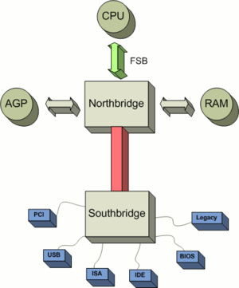
South Bridge
Southbridge is one of two chips in the core logic on PC.
Southbridge is named Input/output controller Hub
Southbridge is recognized because not directly connected to CPU

Slide 3
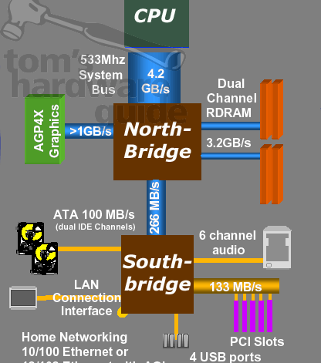
North Bridge
Northbridge is also known as graphics and memory Controller Hub
Many modern devices have Northbridge integrated in the CPU
Typically handles communication between CPU, RAM, PCI, Video Cards, and the Southbridge

Slide 4
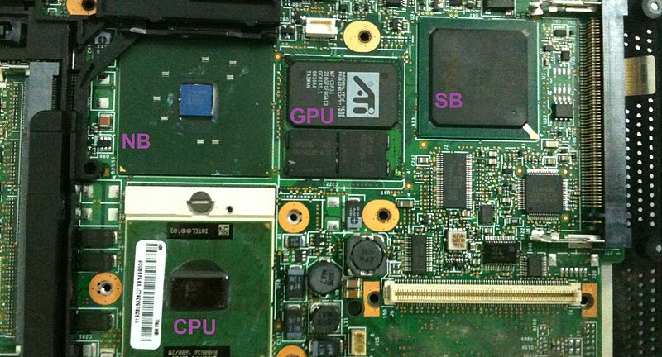
The Motherboard

Slide 5
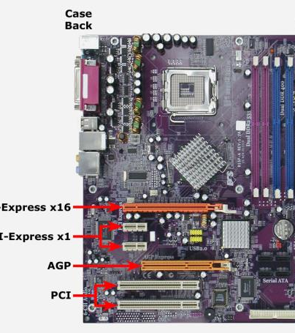
Peripheral Component Interconnect
Shortly known as PCI
Is a local computer bus for attaching hardware devices in a computer.
Devices connected to the bus appear to the processor bus and are assigned addresses in the processors address space.
Common PCI cards: Network cards, sound cards modems, disk controller, and video cards

Slide 6
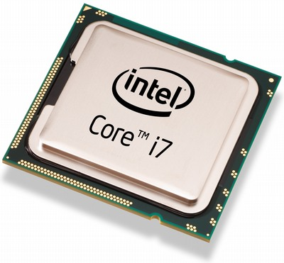
Central Processing Unit
Also known as CPU
The hardware within a computer that carries out the instructions of a computer program.
ALU: (Arithmetic Logic Unit) which uses arithmetic and logical operations.
CU: (Control Unit) which extracts instructions from memory and decodes and executes them calling the the ALU.

Slide 7

What is OpenGL?
OpenGL stands for Open Graphics Libraries. It allows API rendering usually within 3D graphics.
Generally, graphics cards use an OpenGL implementation.
OpenGL is not platform-specific so you can write on a platform and use it across several graphics cards.
Because it is not platform specific, our chances that the application will work on new hardware are high.
Typically used to interact with the GPU.

Slide 8
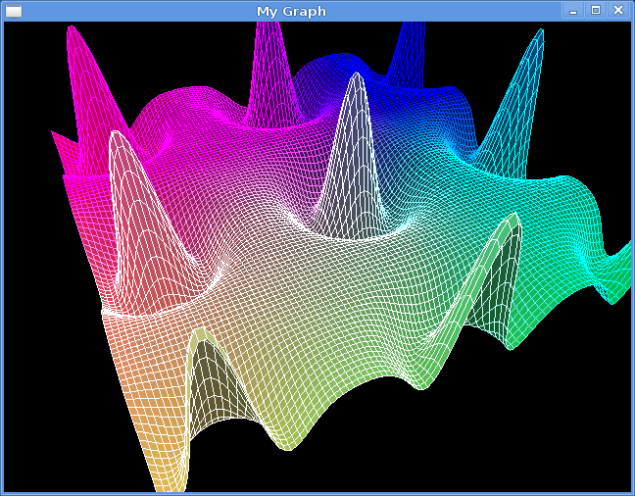
What OpenGL is not
The OpenGL API deals specifically with rendering graphics.
It does not deal with animation, I/O, file format processing or GUIs.
OpenGL does not have source code. Instead it is open specification.

Slide 9
CUDA
CUDA is used as a parallel computing platform which increases our computing performance in our GPU.
Supports multiple graphics cards on one system.
CUDA gives program developers direct access to the virtual set of instructions and memory of the parallel computational elements in CUDA GPUs.
It is used in a wide variety of fields including: - Astronomy - Biology - Chemistry - Text Mining - etc.
CUDA uses OpenGL as its way of communicating with the CPU.

Slide 10
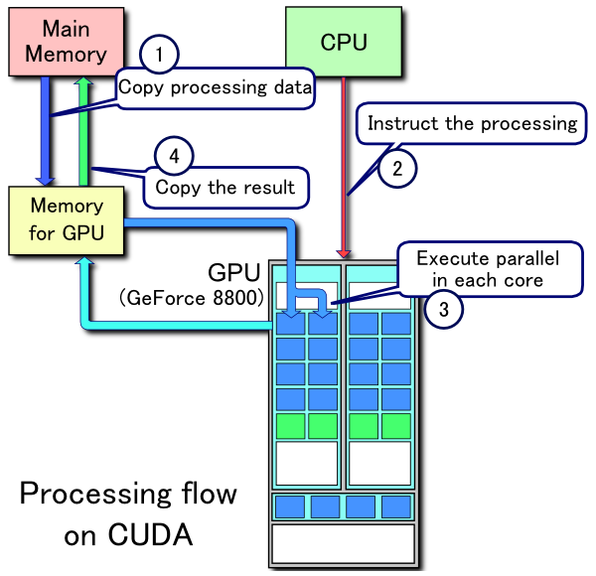

Slide 11
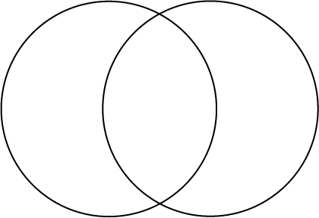
CUDA & OpenGL
CUDA is used mainly for calculations, image manipulation and data generation.
They share data through common memory in the frame buffer.
OpenGL is used to draw pixels and lines on a screen.

Slide 12
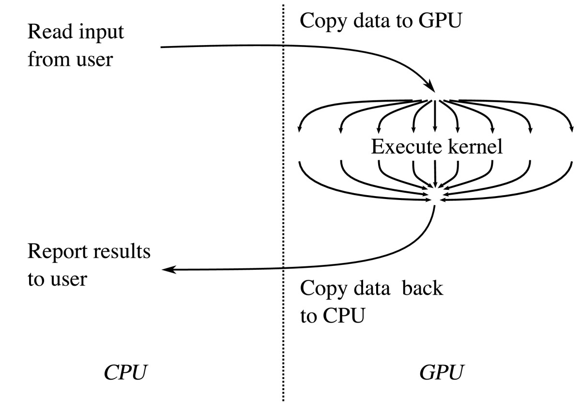
GPGPUs
The GPGPU handles computation specifically for computer graphics.
The computation is performed in the applications when generally it is handled by the CPU.

