Slide 1
Hardware

Slide 2
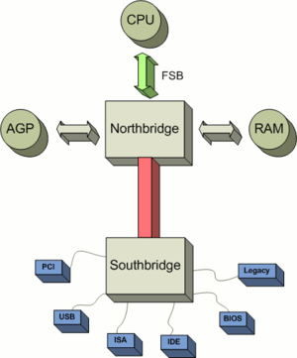
South Bridge
Southbridge is one of two chips in the core logic on PC.
Southbridge is named Input/output controller Hub
Southbridge is recognized because not directly connected to CPU

Slide 3
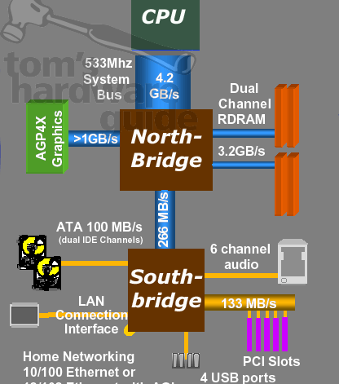
North Bridge
Northbridge is also known as graphics and memory Controller Hub
Many modern devices have Northbridge integrated in the CPU
Typically handles communication between CPU, RAM, PCI, Video Cards, and the Southbridge

Slide 4
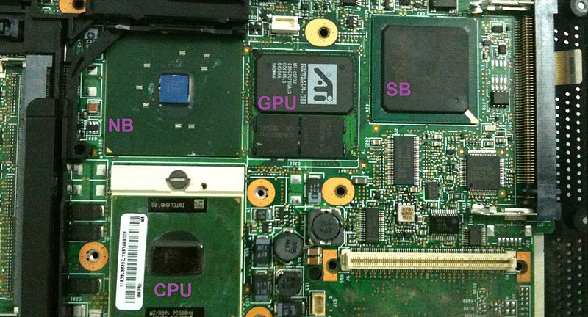
The Motherboard

Slide 5
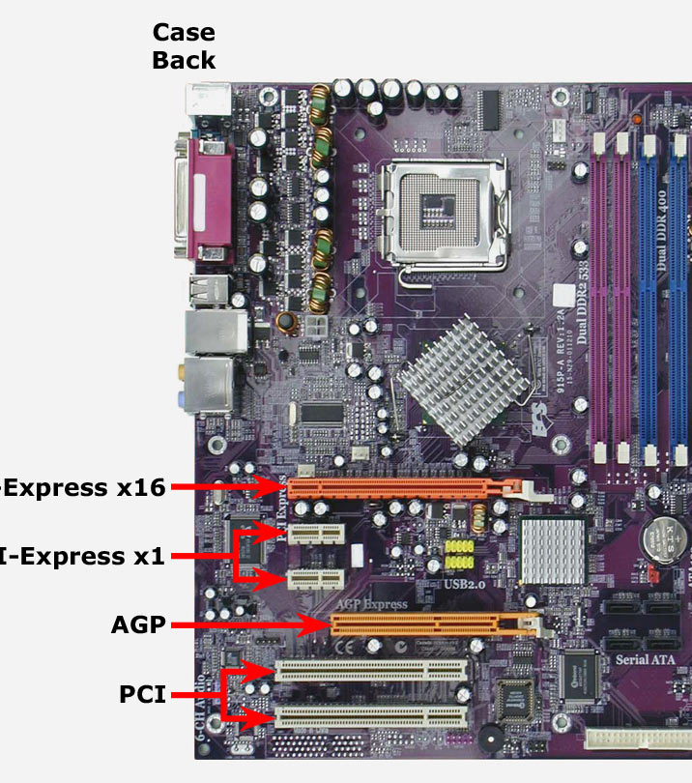
Peripheral Component Ineterconnect
Shortly known as PCI
Is a local computer bus for attaching hardware devices in a computer.
Devices connected to the bus appear to the processor bus and are assigned addresses in the processors address space.
Common PCI cards: Network cards, sound cards modems, disk controller, and video cards

Slide 6
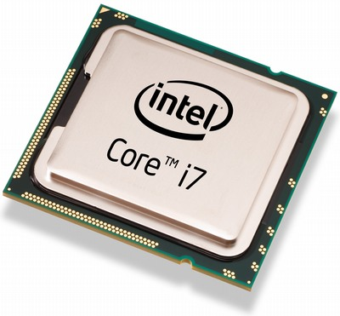
Central Processing Unit
Also known as CPU
The hardware within a computer that carries out the instructions of a computer program.
ALU: (Arithmetic Logic Unit) which uses arithmetic and logical operations.
CU: (Control Unit) which extracts instructions from memory and decodes and executes them calling the the ALU.

