Slide 1
Introduction and Section 1.1: The Structure of Data
Professor Kathryn Dobeck

Slide 2
What is Data?
Information that has been collected from observations, surveys, and experiments are the building blocks for statistical studies and are called data.”
The field of Statistics is all about data
Collecting it
Describing it – summarizing, visualizing
Analyzing it

Slide 3
Why Statistics?
Data are everywhere! The amount of new technical information is doubling every two years. It is estimated that over 7. 2 zettabytes (that’s 7.2 × 10²¹ bytes) of unique new information will be generated this year.¹
Regardless of your field, interests, lifestyle, etc., you will almost definitely have to make decisions based on data, or evaluate decisions someone else has made based on data.
“For Today’s Graduate, Just One Word: Statistics”²

Slide 4
Cases and Variables
The subjects/objects that we obtain information about are known as cases in a dataset
A characteristic that corresponds to each case in a dataset is known as a variable.
Usually data is stored and presented in a dataset, where each row represents one case, and each column represents one variable

Slide 5
Hollywood Movies
Research Question: Do movies that are comedies tend to get higher audience ratings than movies that are dramas?
1. In a dataset to answer this question, what are the cases?
2. In a dataset to answer this question, how many variables are there?

Slide 6
Countries of the World
Country | Land Area | Population | Rural | Health | Internet | Birth Rate | Life Expectancy | HIV
Afghanistan | 652230 | 29021099 | 76 | 3.7 | 1.7 | 46.5 | 43.9
Albania | 27400 | 3143291 | 53.3 | 8.2 | 23.9 | 14.6 | 76.6
Algeria | 2381740 | 34373426 | 34.8 | 10.6 | 10.2 | 20.8 | 72.4 | 0.1
American Samoa | 200 | 66107 | 7.7
Andorra | 470 | 83810 | 11.1 | 21.3 | 70.5 | 10.4
Angola | 1246700 | 18020668 | 43.3 | 6.8 | 3.1 | 42.9 | 47 | 2
Antigua and Barbuda | 440 | 86634 | 69.5 | 11 | 75
Argentina | 2736690 | 39882980 | 8 | 13.7 | 28.1 | 17.3 | 75.3 | 0.5
Armenia | 28480 | 3077087 | 36.1 | 7.2 | 6.2 | 15.3 | 73.5 | 0.1

Slide 7
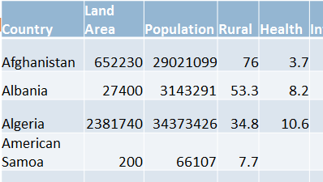
In the Countries of the World dataset, what are the cases?
Countries
Land Areas
Populations
Afghanistan

Slide 8
In the Countries of the World dataset, which of the options are the variables?
Countries
Land Areas
Populations
Percent Rural
Health
All of the above
Answers b) through e)

Slide 9
Cases
Variables
Data
Country | Land Area | Population | Rural | Health | Internet | Birth Rate | Life Expectancy | HIV
Afghanistan | 652230 | 29021099 | 76 | 3.7 | 1.7 | 46.5 | 43.9
Albania | 27400 | 3143291 | 53.3 | 8.2 | 23.9 | 14.6 | 76.6
Algeria | 2381740 | 34373426 | 34.8 | 10.6 | 10.2 | 20.8 | 72.4 | 0.1
American Samoa | 200 | 66107 | 7.7
Andorra | 470 | 83810 | 11.1 | 21.3 | 70.5 | 10.4
Angola | 1246700 | 18020668 | 43.3 | 6.8 | 3.1 | 42.9 | 47 | 2
Antigua and Barbuda | 440 | 86634 | 69.5 | 11 | 75
Argentina | 2736690 | 39882980 | 8 | 13.7 | 28.1 | 17.3 | 75.3 | 0.5
Armenia | 28480 | 3077087 | 36.1 | 7.2 | 6.2 | 15.3 | 73.5 | 0.1

Slide 10
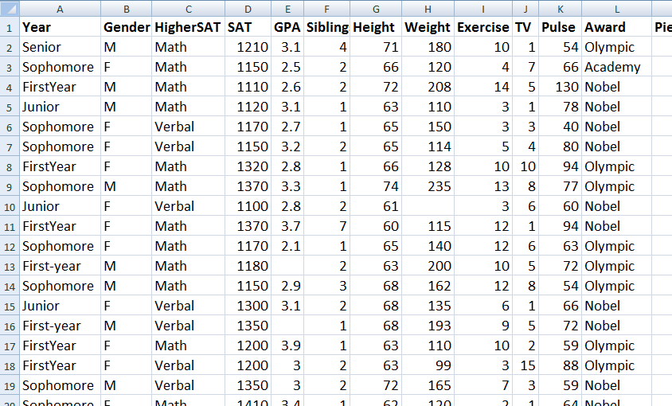
Intro Statistics Survey Data

Slide 11
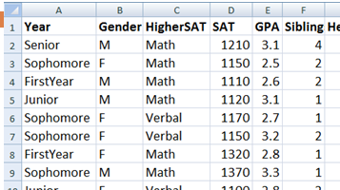
In the Intro Statistics Survey dataset, what are the cases?
Year
Gender
SAT
GPA
Siblings
Intro to Statistics Students

Slide 12
In the Intro Statistics Survey dataset, which of the options are the variables?
Year
Gender
SAT
GPA
Siblings
All of the Above

Slide 13
Cases = Intro to Stats Students (each row corresponds to one student)
Variables
Data

Slide 14
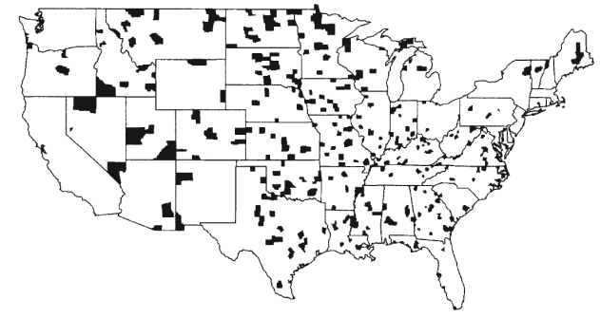
Kidney Cancer
Counties with the highest kidney cancer death rates
Source: Gelman et. al. Bayesian Data Anaylsis, CRC Press, 2004.
Notes:
For fun, ask students to hypothesize about kidney cancer risk factors

Slide 15
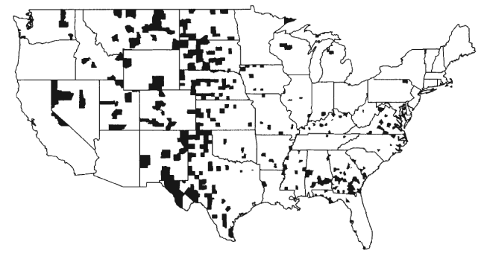
Kidney Cancer
Counties with the lowest kidney cancer death rates
Notes:
Key: sample size. Smaller counties are more likely to have more extreme death rates – tell them they will learn about this.

Slide 16
If the values in the kidney cancer dataset are rates of kidney cancer deaths, then what are the cases?
The people living in the US
The counties of the US

Slide 17
If the values in the kidney cancer dataset are yes/no, then what are the cases?
The people living in the US
The counties of the US

Slide 18
Variables: Categorical vs. Quantitative
A categorical variable divides the cases into groups, placing each case into exactly one of two or more categories
A quantitative variable measures or records a numerical quantity for each case.

Slide 19
Categorical
Quantitative

Slide 20
If the cases in the kidney cancer dataset are counties, then the measured variable is…
Categorical
Quantitative

Slide 21
If the cases in the kidney cancer dataset are individual people, then the measured variable is…
Categorical
Quantitative

Slide 22
Caution:
As we see in the previous examples, we need to think carefully about what the cases are and what is being recorded in each case in order to determine whether a variable is categorical or quantitative.

Slide 23
Explanatory and Response
If we are using one variable to help us understand or predict values of another variable, we call the former the explanatory variable and the latter the response variable.
Examples:
Does meditation help reduce stress?
explanatory variable: meditation
response variable: stress level
Does sugar consumption increase hyperactivity?
explanatory variable: sugar consumption
response variable: hyperactive behavior

Slide 24
Can eating a yogurt a day cause you to lose weight? Here, the explanatory variable is:
Eating yogurt
Weight loss

Slide 25
Do males find females more attractive if they wear red? Here, the explanatory variable is:
Attraction
Wearing Red

Slide 26
Summary
Data are everywhere, and pertain to a wide variety of topics
A dataset is usually comprised of variables measured on cases
Variables can be categorical or quantitative
Data can be used to provide information about essentially anything we are interested in and want to collect data on!

