Slide 1
Section 1.2:
Sampling from a Population
Professor Kathryn Dobeck

Slide 2
Sample vs. Population
A population includes all individuals or objects of interest
A sample is comprised of all of the cases on which we have collected data. A sample is a subset of the population
Statistical inference is the process of using data from a sample to gain information about the population

Slide 3
State whether the data in the following description are best described as a population or a sample. A survey to analyze student participation in LCCC’s Welcome Week is emailed to 50 LCCC students and all of them respond.
Population
Sample

Slide 4
Sampling
Population
Sampling
Sample
GOAL: Select a sample that resembles the population, only smaller

Slide 5
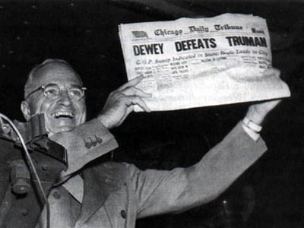
Dewey Defeats Truman
The 33rd president of the United States?

Slide 6
Dewey Defeats Truman?
The day after the 1948 presidential election, the Chicago Tribune ran the headline “Dewey Defeats Truman.” However, Harry S. Truman defeated Thomas E. Dewey. The newspaper went to press before all the results had come in and the headline was based on results of a large telephone poll which showed Dewey sweeping Truman.
a) What is the sample and what is the population?

Slide 7
Dewey Defeats Truman?
The day after the 1948 presidential election, the Chicago Tribune ran the headline “Dewey Defeats Truman.” However, Harry S. Truman defeated Thomas E. Dewey. The newspaper went to press before all the results had come in and the headline was based on results of a large telephone poll which showed Dewey sweeping Truman.
b) What did the pollsters want to infer about the population based on the sample?

Slide 8
Dewey Defeats Truman?
The day after the 1948 presidential election, the Chicago Tribune ran the headline “Dewey Defeats Truman.” However, Harry S. Truman defeated Thomas E. Dewey. The newspaper went to press before all the results had come in and the headline was based on results of a large telephone poll which showed Dewey sweeping Truman.
c) Why do you think the telephone poll yielded such inaccurate results?

Slide 9
Sampling Bias
Sampling bias occurs when the method of selecting a sample causes the sample to differ from the population in some relevant way
If sampling bias exists, we cannot trust generalizations from the sample to the population

Slide 10

Sampling
Population
Sample
Sample

Slide 11
In a study to determine the proportion of all students at our college that believe that they are talented in the subject of mathematics, we survey all students enrolled in Multivariable Calculus. Is this method of data collection biased?
Yes
No

Slide 12
Can you avoid sampling bias?
The next slide shows Lincoln’s Gettysburg Address. The entire population, all words in his address, will be shown to you.
Your task: Select a sample of 10 words that resemble the word lengths in the entire address. Write them down.
Calculate the average number of letters for the words in your sample
Place a dot above your sample average on the board

Slide 13
Lincoln’s Gettysburg Address
“Four score and seven years ago our fathers brought forth, on this continent, a new nation, conceived in Liberty, and dedicated to the proposition that all men are created equal. Now we are engaged in a great civil war, testing whether that nation, or any nation so conceived and so dedicated, can long endure. We are met on a great battle-field of that war. We have come to dedicate a portion of that field, as a final resting place for those who here gave their lives that that nation might live. It is altogether fitting and proper that we should do this. But, in a larger sense, we can not dedicate—we can not consecrate—we can not hallow—this ground. The brave men, living and dead, who struggled here, have consecrated it, far above our poor power to add or detract. The world will little note, nor long remember what we say here, but it can never forget what they did here. It is for us the living, rather, to be dedicated here to the unfinished work which they who fought here have thus far so nobly advanced. It is rather for us to be here dedicated to the great task remaining before us—that from these honored dead we take increased devotion to that cause for which they here gave the last full measure of devotion—that we here highly resolve that these dead shall not have died in vain—that this nation, under God, shall have a new birth of freedom—and that government of the people, by the people, for the people, shall not perish from the earth.”

Slide 14
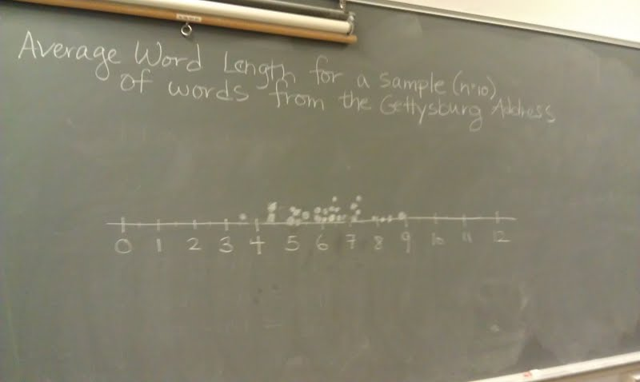
Dotplot of Sample Averages (Sample Chosen by MTHM 168 Students)

Slide 15
Can you avoid sampling bias?
Actual average: 4.29 letters
People are TERRIBLE at selecting a good sample, even when explicitly trying to avoid sampling bias!
We need a better way…

Slide 16
Random Sampling
How can we make sure to avoid sampling bias?
Imagine putting the names of all the units within the population into a hat, and drawing out names at random to be in the sample
Take a RANDOM sample!

Slide 17
Selecting a Random Sample
Option 1: Actually draw names out of a hat
Option 2: Number all units in the population, and generate random numbers
Online: http://www.random.org/integers/

Slide 18
“Random” Numbers
Write these numbers down.
Using the upcoming slide, write down the words that correspond to your numbers. Count the number of letters in each word and then calculate the average of those ten numbers.

Slide 19
My Randomly Selected Words
Randomly Selected Integers | Corresponding Words | Number of Letters in Word
249 | of | 2
142 | will | 4
109 | cannot | 6
225 | that | 4
212 | to | 2
42 | that | 4
77 | final | 5
91 | live | 4
245 | have | 4
225 | that | 4
 | Average Number of Letters for Sample: | 3.9

Slide 20
1 | Four | 35 | in | 69 | dedicate | 103 | But, | 137 | add | 171 | here | 205 | these | 239 | that
2 | score | 36 | a | 70 | a | 104 | in | 138 | or | 172 | to | 206 | honored | 240 | this
3 | and | 37 | great | 71 | portion | 105 | a | 139 | detract. | 173 | the | 207 | dead | 241 | nation,
4 | seven | 38 | civil | 72 | of | 106 | larger | 140 | The | 174 | unfinished | 208 | we | 242 | under
5 | years | 39 | war, | 73 | that | 107 | sense, | 141 | world | 175 | work | 209 | take | 243 | God,
6 | ago, | 40 | testing | 74 | field | 108 | we | 142 | will | 176 | which | 210 | increased | 244 | shall
7 | our | 41 | whether | 75 | as | 109 | cannot | 143 | little | 177 | they | 211 | devotion | 245 | have
8 | fathers | 42 | that | 76 | a | 110 | dedicate, | 144 | note, | 178 | who | 212 | to | 246 | a
9 | brought | 43 | nation, | 77 | final | 111 | we | 145 | nor | 179 | fought | 213 | that | 247 | new
10 | forth | 44 | or | 78 | resting | 112 | cannot | 146 | long | 180 | here | 214 | cause | 248 | birth
11 | upon | 45 | any | 79 | place | 113 | consecrate, | 147 | remember, | 181 | have | 215 | for | 249 | of
12 | this | 46 | nation | 80 | for | 114 | we | 148 | what | 182 | thus | 216 | which | 250 | freedom,
13 | continent | 47 | so | 81 | those | 115 | cannot | 149 | we | 183 | far | 217 | they | 251 | and
14 | a | 48 | conceived | 82 | who | 116 | hallow | 150 | say | 184 | so | 218 | gave | 252 | that
15 | new | 49 | and | 83 | here | 117 | this | 151 | here, | 185 | nobly | 219 | the | 253 | government
16 | nation: | 50 | so | 84 | gave | 118 | ground. | 152 | but | 186 | advanced. | 220 | last | 254 | of
17 | conceived | 51 | dedicated, | 85 | their | 119 | The | 153 | it | 187 | It | 221 | full | 255 | the
18 | in | 52 | can | 86 | lives | 120 | brave | 154 | can | 188 | is | 222 | measure | 256 | people,
19 | liberty, | 53 | long | 87 | that | 121 | men, | 155 | never | 189 | rather | 223 | of | 257 | by
20 | and | 54 | endure. | 88 | that | 122 | living | 156 | forget | 190 | for | 224 | devotion, | 258 | the
21 | dedicated | 55 | We | 89 | nation | 123 | and | 157 | what | 191 | us | 225 | that | 259 | people,
22 | to | 56 | are | 90 | might | 124 | dead, | 158 | they | 192 | to | 226 | we | 260 | for
23 | the | 57 | met | 91 | live. | 125 | who | 159 | did | 193 | be | 227 | here | 261 | the
24 | proposition | 58 | on | 92 | It | 126 | struggled | 160 | here. | 194 | here | 228 | highly | 262 | people,
25 | that | 59 | a | 93 | is | 127 | here | 161 | It | 195 | dedicated | 229 | resolve | 263 | shall
26 | all | 60 | great | 94 | altogether | 128 | have | 162 | is | 196 | to | 230 | that | 264 | not
27 | men | 61 | battlefield | 95 | fitting | 129 | consecrated | 163 | for | 197 | the | 231 | these | 265 | perish
28 | are | 62 | of | 96 | and | 130 | it, | 164 | us | 198 | great | 232 | dead | 266 | from
29 | created | 63 | that | 97 | proper | 131 | far | 165 | the | 199 | task | 233 | shall | 267 | the
30 | equal. | 64 | war. | 98 | that | 132 | above | 166 | living, | 200 | remaining | 234 | not | 268 | earth.
31 | Now | 65 | We | 99 | we | 133 | our | 167 | rather, | 201 | before | 235 | have
32 | we | 66 | have | 100 | should | 134 | poor | 168 | to | 202 | us, | 236 | died
33 | are | 67 | come | 101 | do | 135 | power | 169 | be | 203 | that | 237 | in
34 | engaged | 68 | to | 102 | this. | 136 | to | 170 | dedicated | 204 | from | 238 | vain,

Slide 21
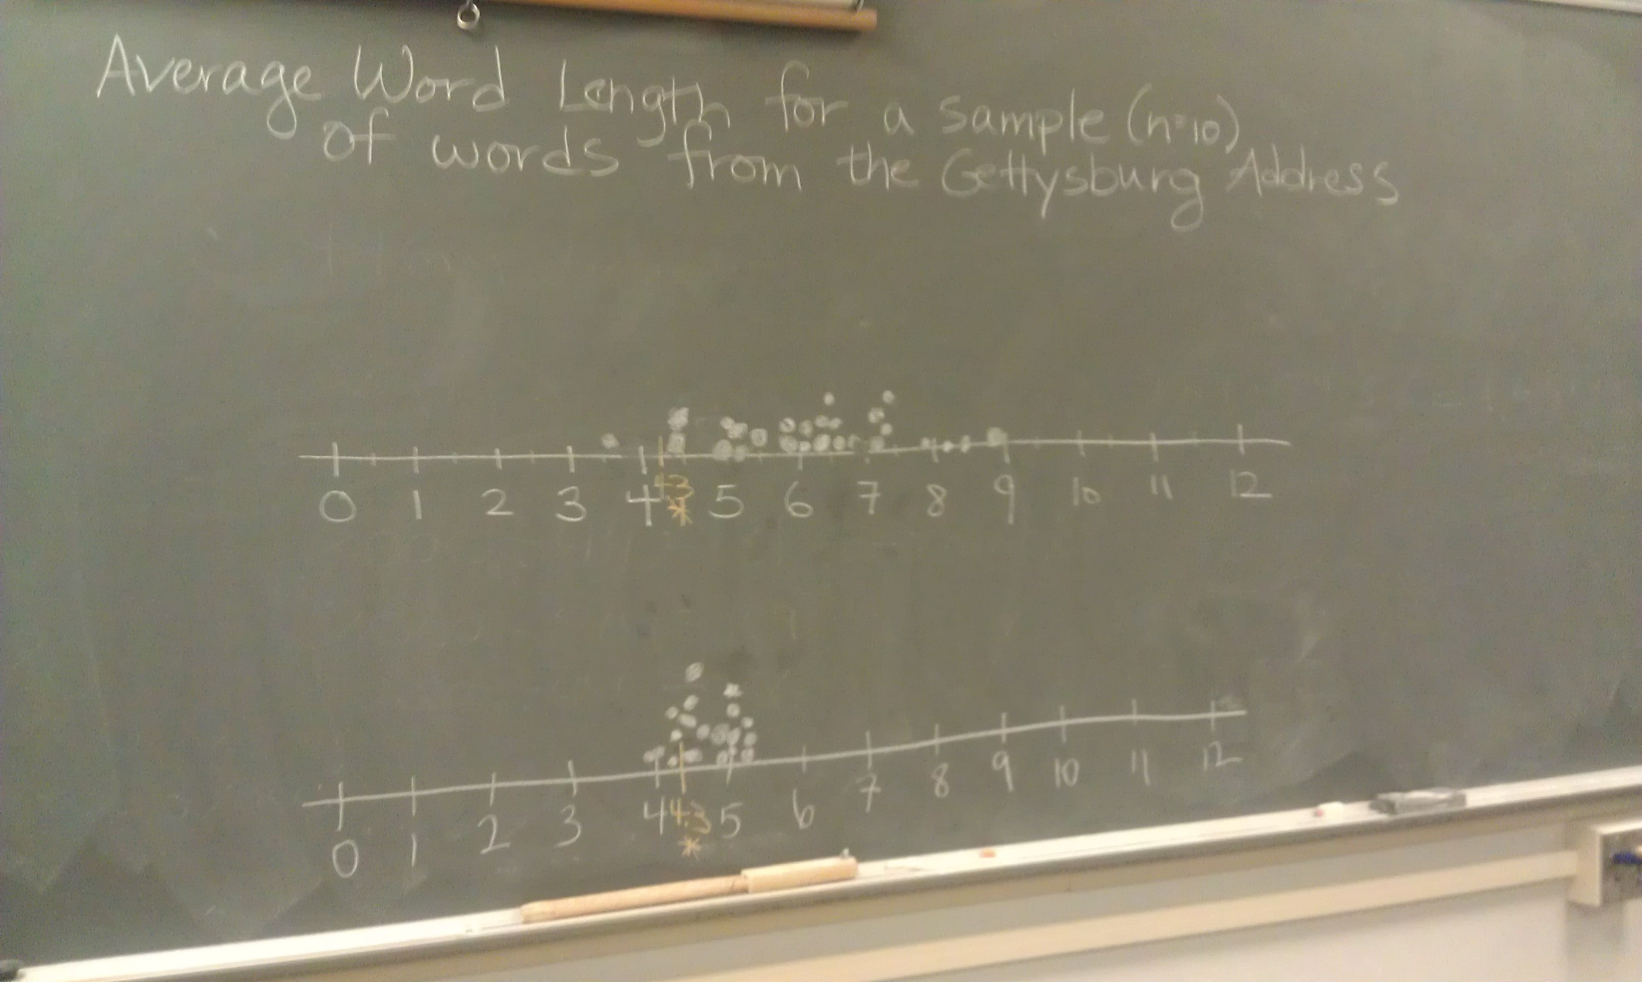
With and Without Random Sampling

Slide 22
Random vs. Non-Random Sampling
Random samples have averages that are centered around the correct number
Non-random samples may suffer from sampling bias, and averages may not be centered around the correct number
Only random samples can truly be trusted when making generalizations to the population!

Slide 23
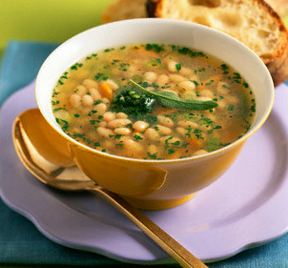
Bowl of Soup Analogy
Think of tasting a bowl of soup…
Population = entire bowl of soup
Sample = whatever is in your tasting bites
If you take bites non-randomly from the soup (if you stab with a fork, or prefer noodles to vegetables), you may not get a very accurate representation of the soup
If you take bites at random, only a few bites can give you a very good idea for the overall taste of the soup

Slide 24
Simple Random Sample
In a simple random sample, each unit of the population has the same chance of being selected, regardless of the other units chosen for the sample

Slide 25
Which of the following sampling methods produces a random sample from the given population?
The population is adults between the ages of 18 and 22. A sample of 100 students is collected from a local university, and each student at the university had an equal chance of being selected for the sample.
The population is all current undergraduate members of the Mathematical Association of America. Names of these members are placed in a box, mixed up, and 50 names are drawn by a blind-folded person.
The population is all boats docked in a particular marina. We walk along the docks and pick out boats that appear to be representative of all boats in the marina.

Slide 26
Realities of Sampling
While a random sample is ideal, often it isn’t feasible. A list of the entire population may not be available, or it may be impossible or too difficult to contact some members of the population.
Sometimes, your population of interest has to be altered to something more feasible to sample from. Generalization of results are limited to the population that was actually sampled from.
In practice, think hard about potential sources of sampling bias, and try your best to avoid them

Slide 27
Bad Methods of Sampling
Sampling units based on something obviously related to the variable(s) you are studying
Sampling only students in the library when asking how much they study, or sampling only students taking a statistics class
“Today’s Poll” on fitnessmagazine.com asked “Have you ever hired a personal trainer?”. 27% of respondents said “yes” – can we infer that 27% of all humans have hired a personal trainer?

Slide 28
Bad Methods of Sampling
Letting your sample be comprised of whoever chooses to participate (volunteer bias)
Emailing or mailing the entire population, and then making conclusions about the population based on whoever chooses to respond
People who chose to participate or respond are probably not representative of the entire population

Slide 29

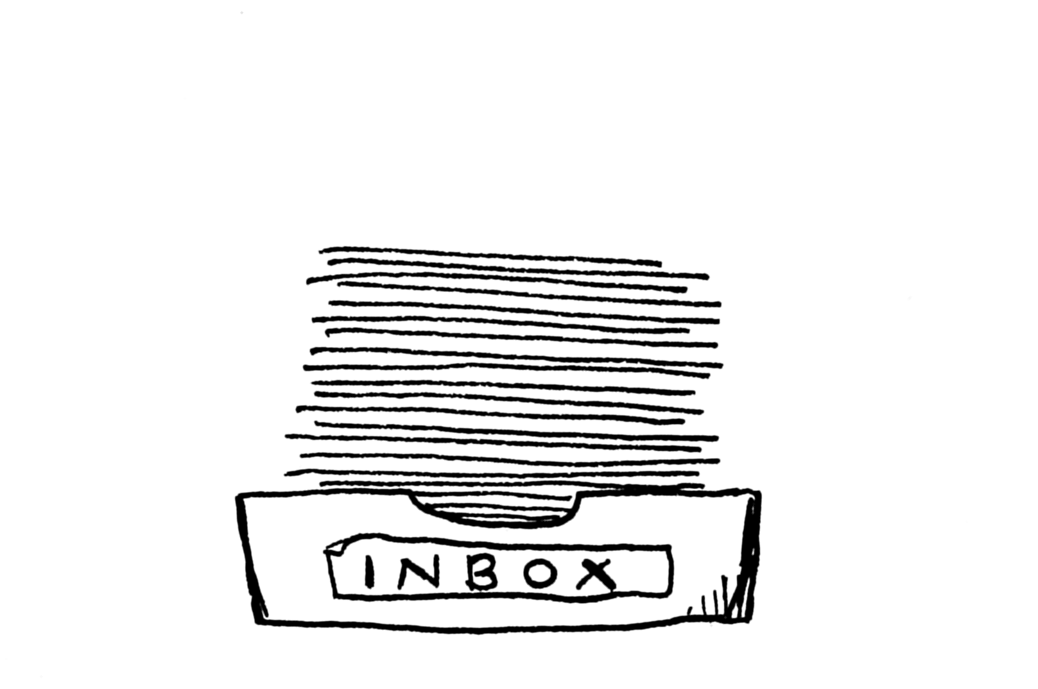
Volunteer Bias
Random Sampling
Population
Population
Randomly Select the Sample
Sample
Sample
92% response rate!
Source: 10ch, https://www.flickr.com/photos/10ch/3204310433. Used under CC BY-SA 2.0 https://creativecommons.org/licenses/by-sa/2.0/.
Source: AJC1, https://www.flickr.com/photos/ajc1/7543411458. Used under CC BY-SA 2.0 https://creativecommons.org/licenses/by-sa/2.0/.

Slide 30
Suppose you want to estimate the average number of hours that students at our college spend studying each week. Which of the following is the best method of sampling?
Go to the library and ask all the students there how much they study
Email all students asking how much they study, and use all the data you get
Stand outside the student center and ask everyone going in how much they study
Notes:
Note: students will probably give a variety of answers, making a good opportunity for rich discussion

Slide 31
Data Collection and Bias
Sampling Bias?
Population
Sample
Other forms of bias?
DATA

Slide 32
Other Forms of Bias
Even with a random sample, data can still be biased, especially when collected on humans
Other forms of bias to watch out for in data collection:
Question wording
Context
Inaccurate responses
Many other possibilities – examine the specifics of each study!

Slide 33
Question Wording
A random sample was asked: “Should there be a tax cut, or should money be used to fund new government programs?”
A different random sample was asked: “Should there be a tax cut, or should money be spent on programs for education, the environment, health care, crime-fighting, and military defense?”
Tax Cut: 60% Programs: 40%
Tax Cut: 22% Programs: 78%

Slide 34
Context
Ann Landers column asked readers
“If you had it to do over again, would you have children?
The first request for data contained a letter from a young couple which listed worries about parenting and various reasons not to have kids
30% said “yes”
The second request for data was in response to this number, in which Ann wrote how she was “stunned, disturbed, and just plain flummoxed”
95% said “yes”

Slide 35
If we were to run the question all by itself in the newspaper with a request for responses, could we trust the results?
Yes
No

Slide 36
Newsday conducted a random sample of all US adults, and asked them the same question, without any additional leading material 91% said “yes”. Do you think the true proportion of parents who are happy they had children is close to 91%?
Yes
No

Slide 37
Summary
Data is collected on a sample, and we would like to use the data to make inferences to the larger population
Sampling bias can occur when the sample does not resemble the population
Sampling bias can be avoided by random sampling
Bias exists when the sample data do not accurately reflect the true population data, and bias can occur in many ways

Slide 38
Summary
Always think critically about how the data were collected, and recognize that not all forms of data collection lead to valid inferences

