Slide 1
Section 1.3:
Experiments
Professor Kathryn Dobeck

Slide 2
To estimate the proportion of LCCC students who believe that LCCC should be a smoke-free campus, you compute the proportion that say yes after responding to an email sent to all students asking “Do you think LCCC should be a smoke-free campus?” The data collected is
Not biased
Biased because of wording bias
Biased because asked over email instead of in person
Biased because responses may be inaccurate
Biased because volunteer samples are almost always biased

Slide 3
Main Ideas in This Section
Association versus Causation
Confounding Variables
Observational Studies vs Experiments
Randomized Experiments

Slide 4
Explanatory and Response
If we are using one variable to help us understand or predict values of another variable, we call the former the explanatory variable and the latter the response variable

Slide 5
Association and Causation
Two variables are associated if values of one variable tends to be related to values of the other variable
Two variables are causally associated if changing the value of the explanatory variable influences the value of the response variable

Slide 6
College Education and Aging
“Education seems to be an elixir that can bring us a healthy body and mind throughout adulthood and even a longer life,” says Margie E. Lachman, a psychologist at Brandeis University who specializes in aging. For those in midlife and beyond, a college degree appears to slow the brain’s aging process by up to a decade, adding a new twist to the cost-benefit analysis of higher education — for young students as well as those thinking about returning to school.”
A Sharper Mind, Middle Age and Beyond
-NY Times, 1/19/12

Slide 7
“Education seems to be an elixir that can bring us a healthy body and mind throughout adulthood and even a longer life,” says Margie E. Lachman, a psychologist at Brandeis University who specializes in aging. “For those in midlife and beyond, a college degree appears to slow the brain’s aging process by up to a decade, adding a new twist to the cost-benefit analysis of higher education — for young students as well as those thinking about returning to school.” Which of the following is true?
Explanatory Variable = brain aging; Response Variable = elixir
Explanatory Variable = brain aging; Response Variable = college degree
Explanatory Variable = college degree; Response Variable = brain aging

Slide 8
Based on this passage, should we conclude that obtaining a college degree causes a slowdown in the brain’s aging process?
Yes
No

Slide 9
Explanatory, Response, Causation
For each of the following headlines:
Does the headline imply a causal association?
Identify the explanatory and response variables (if appropriate).
“Daily Exercise Improves Mental Performance”
“Want to lose weight? Eat more fiber!”
“Cat owners tend to be more educated than dog owners”

Slide 10
TVs and Life Expectancy
Should you buy more TVs to live longer?

Slide 11
Association and Causation
ASSOCIATION IS NOT NECESSARILY CAUSAL!

Slide 12
TVs and Life Expectancy
Wealth
Number of TVs per capita
Life
Expectancy
?

Slide 13
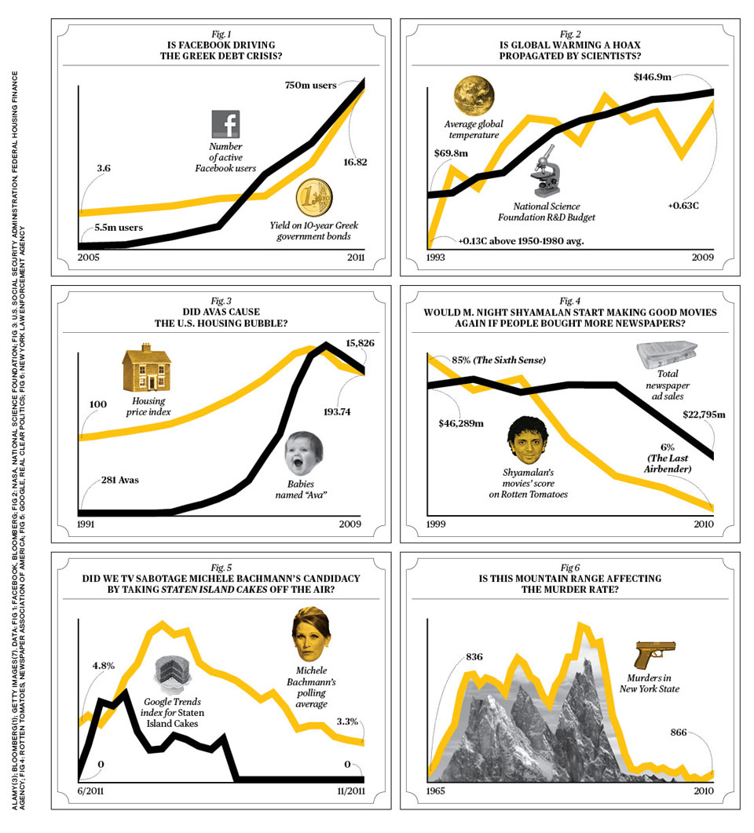
Data from Facebook and Bloomberg
http://www.businessweek.com/magazine/correlation-or-causation-12012011-gfx.html

Slide 14
Data from NASA and National Science Foundation
http://www.businessweek.com/magazine/correlation-or-causation-12012011-gfx.html

Slide 15
Data from US Social Security Administration and National Housing Finance Agency
http://www.businessweek.com/magazine/correlation-or-causation-12012011-gfx.html

Slide 16
Data from Rotten Tomatoes, Newspaper Association of America
http://www.businessweek.com/magazine/correlation-or-causation-12012011-gfx.html

Slide 17
It’s a Common Mistake!
“The invalid assumption that correlation implies cause is probably among the two or three most serious and common errors of human reasoning.”
Stephen Jay Gould,
(American geologist, paleontologist, evolutionary biologist and popular-science author)
http://scienceornot.net/2012/07/05/confusing-correlation-with-causation-rooster-syndrome/

Slide 18
Confounding Variable
A third variable that is associated with both the explanatory variable and the response variable is called a confounding variable
A confounding variable can offer a plausible explanation for an association between the two variables.
Whenever confounding variables are present (or may be present), a causal association cannot be determined.

Slide 19
Experiment vs Observational Study
An observational study is a study in which the researcher does not actively control the value of any variable, but simply observes the values as they naturally exist
An experiment is a study in which the researcher actively controls one or more of the explanatory variables

Slide 20
To examine whether playing music in a store increases the amount customers spend, we randomly assign some stores to play music and some to stay silent and compare the average amount spent by customers. Does this describe an experiment or an observational study?
Experiment
Observational Study

Slide 21
To examine whether farm-grown salmon contain more omega-3 oils if water is more acidic, we collect samples of salmon and water from multiple fish farms to see if the two variables are related.
Experiment
Observational Study

Slide 22
Observational Studies
There are almost always confounding variables in observational studies
Observational studies can almost never be used to establish causation!!

Slide 23
Randomization
How can we make sure to avoid confounding variables?
RANDOMLY assign values of the explanatory variable

Slide 24
Randomized Experiment
In a randomized experiment the explanatory variable for each unit is determined randomly, before the response variable is measured

Slide 25
Randomized Experiment
The different levels of the explanatory variable are known as treatments
Randomly divide the units into groups, and randomly assign a different treatment to each group
If the treatments are randomly assigned, the treatment groups should all look similar

Slide 26
Randomized Experiments
Because the explanatory variable is randomly assigned, it is not associated with any other variables. Confounding variables are eliminated!!!
Confounding Variable
RANDOMIZED EXPERIMENT
Explanatory Variable
Response Variable

Slide 27
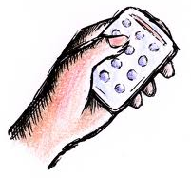
Exercise and the Brain
A sample of mice were divided randomly into two groups. One group was given access to an exercise wheel, the other group was kept sedentary
Reynolds, “Phys Ed: Your Brain on Exercise", NY Times, July 7, 2010.

Slide 28
“The brains of mice and rats that were allowed to run on wheels pulsed with vigorous, newly born neurons, and those animals then breezed through mazes and other tests of rodent IQ” compared to the sedentary mice Is this evidence that exercise causes an increase in brain activity and IQ, at least in mice?
Yes
No

Slide 29
Randomized Experiments
If a randomized experiment yields a significant association between the two variables, we can establish causation from the explanatory to the response variable
Randomized experiments are very powerful! They allow you to infer causality.

Slide 30
How to Randomize?
Option 1: As with random sampling, we can put all the names/numbers into a hat, and randomly pull out names to go into the different groups
Option 2: Put names/numbers on cards, shuffle, and deal out the cards into as many piles as there are treatments
Option 3: Use technology

Slide 31
Researchers conducted a study on the effectiveness of a knee surgery to cure arthritis. It was randomly determined whether people got the knee surgery. Everyone who underwent the surgery reported feeling less pain. Is this evidence that the surgery causes a decrease in pain?
Yes
No

Slide 32
Control Group
When determining whether a treatment is effective, it is important to have a comparison group, known as the control group
It isn’t enough to know that everyone in one group improved, we need to know whether they improved more than they would have improved without the surgery
All randomized experiments need either a control group, or two different treatments to compare

Slide 33
Knee Surgery for Arthritis
In the knee surgery study, those in the control group received a fake knee surgery. They were put under and cut open, but the doctor did not actually perform the surgery. All of these patients also reported less pain!
In fact, the improvement was indistinguishable between those receiving the real surgery and those receiving the fake surgery!
Source: “The Placebo Prescription,” NY Times Magazine, 1/9/00.

Slide 34
Placebo Effect
Often, people will experience the effect they think they should be experiencing, even if they aren’t actually receiving the treatment
This is known as the placebo effect
One study estimated that 75% of the effectiveness of anti-depressant medication is due to the placebo effect
For more information on the placebo effect (it’s pretty amazing!) read The Placebo Prescription

Slide 35
Types of Randomized Experiments
Randomizing cases into different treatment groups is called a randomized comparative experiment
“Knee Surgery” Example
We can also give each treatment to each case, and just randomize the order in which treatments are received: matched pairs experiment
We could adjust the “Exercise and the Brain” example to be a matched pairs experiment, by giving each mouse access to an exercise wheel and kept sedentary (with randomized order) prior to testing rodent IQ.
Either are valid randomized experiments!

Slide 36
To see if people read faster on paper or a kindle, a study was done in which 16 people read two sets of instructions of similar length, one on a kindle and one on paper. The order in which they read the instructions was randomized. (Reading was faster on paper.) This is a:
Observational study
Randomized comparative experiment
Matched pairs experiment
Concatenated experiment

Slide 37
Why not always randomize?
Randomized experiments are ideal, but sometimes not ethical or possible
Example: When designing a study to determine whether air pollution leads to adverse health consequences, it would not be appropriate to require some people to live in areas with more polluted air.
Often, you have to do the best you can with data from observational studies

Slide 38
Randomization in Data Collection
Was the explanatory variable randomly assigned?
Was the sample randomly selected?
Yes
No
Yes
No
Possible to generalize to the population
Should not generalize to the population
Possible to make conclusions about causality
Can not make conclusions about causality

Slide 39
Randomization
Doing a randomized experiment on a random sample is ideal, but rarely achievable
If the focus of the study is using a sample to estimate a statistic for the entire population, you need a random sample, but do not need a randomized experiment (example: election polling)
If the focus of the study is establishing causality from one variable to another, you need a randomized experiment and can settle for a non-random sample (example: drug testing)

Slide 40
Summary
Association does not imply causation!
In observational studies, confounding variables almost always exist, so causation cannot be established
Randomized experiments involve randomly determining the level of the explanatory variable
Randomized experiments prevent confounding variables, so causality can be inferred
A control or comparison group is necessary
The placebo effect exists, so a placebo and blinding should be used

