Slide 1
Section 2.5
Two Quantitative Variables: Scatterplot and Correlation
Professor Kathryn Dobeck

Slide 2
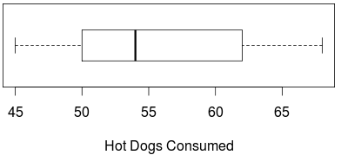
The boxplot below shows the number of hot dogs consumed in a 10 minute hot dog eating contest. What is the approximate median?
45
50
54
56
62

Slide 3
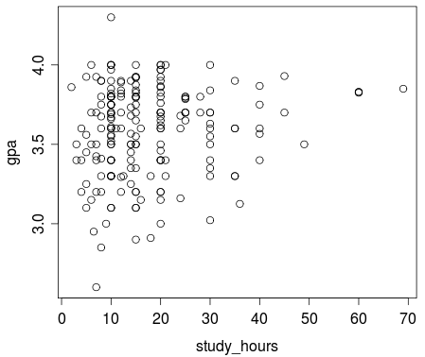
Visualization for Two Quantitative Variables: Scatterplot
A scatterplot is the graph of the relationship between two quantitative variables.

Slide 4
Direction of Association
A positive association means that values of one variable tend to be higher when values of the other variable are higher
A negative association means that values of one variable tend to be lower when values of the other variable are higher
Two variables are not associated if knowing the value of one variable does not give you any information about the value of the other variable

Slide 5
Cars Data
Quantitative Variables:
Weight (pounds)
City MPG
Fuel capacity (gallons)
Page number (in Consumer Reports)
Time to go ¼ mile (in seconds)
Acceleration time from 0 to 60 mph
Relationships
Weight vs. CityMPG
Weight vs. FuelCapacity
PageNum vs. Fuel Capacity
Weight vs. QtrMile
Acc060 vs. QtrMile
CityMPG vs. QtrMile

Slide 6
Car Associations

Slide 7
For the two variables: number of cigarettes smoked per day and lung capacity, we expect the association to be:
Positive
Negative
No association

Slide 8
For the two variables: age of the husband and age of the wife, we expect the association to be:
Positive
Negative
No association

Slide 9
For the two variables: depth of tire tread and number of miles driven on the tires, we expect the association to be:
Positive
Negative
No association

Slide 10
Summary Statistic for Two Quantitative Variables: Correlation Coefficient
The correlation, or correlation coefficient, is a measure of the strength and direction of linear association between two quantitative variables
Sample correlation: r
Population correlation: ρ (“rho”)

Slide 11
Car Correlations
(-.91)
(.89)
(-.45)
(.51)
(.99)
(-.08)
What are the properties of correlation?

Slide 12
Properties of Correlation
-1 ≤ r ≤ 1
The sign indicates the direction of association
positive association: r > 0
negative association: r < 0
no linear association: r ≈ 0
The closer r is to ±1, the stronger the linear association
r has no units and does not depend on the units of measurement
The correlation between X and Y is the same as the correlation between Y and X

Slide 13
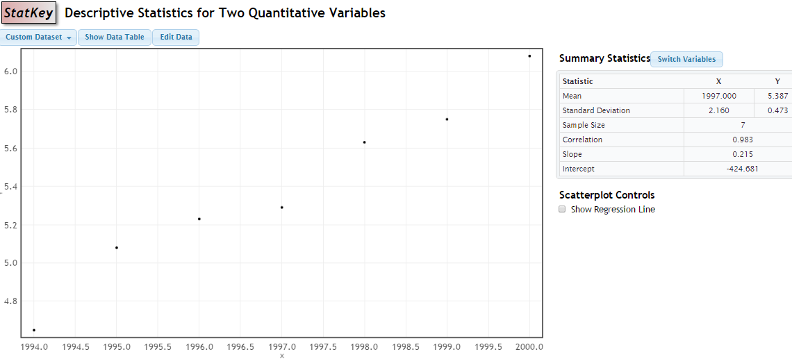
Obtaining the Correlation Coefficient
On the TI-83/84
Using StatKey
r = 0.983

Slide 14
For the scatterplot below, the correlation is closest to:
- 1
- ½
0
½
2

Slide 15
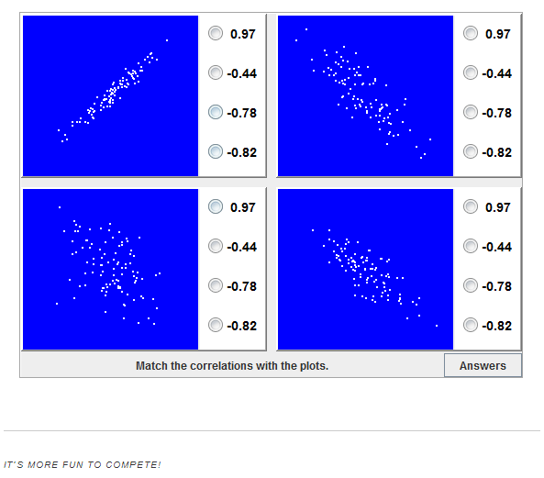
Correlation Guessing Game
http://istics.net/stat/Correlations/

Slide 16
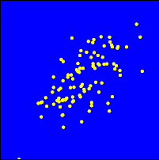
For the scatterplot below, the correlation is closest to:
0.91
0.61
-0.30
-0.46

Slide 17


Correlation
NFL Teams
r = 0.43

Slide 18
Correlation
r = 0.08
Same plot, but with Dolphins and Raiders (outliers) removed

Slide 19
Correlation Cautions
Correlation can be heavily affected by outliers. Always plot your data!
r = 0 means no linear association. The variables could still be otherwise associated. Always plot your data!
Correlation does not imply causation!

Slide 20
Summary: Two Quantitative Variables
Summary Statistics: correlation
Visualization: scatterplot

Slide 21
Variable(s) | Visualization | Summary Statistics
Categorical | bar chart, pie chart | frequency table, relative frequency table, proportion
Quantitative | dotplot, histogram, boxplot | mean, median, max, min, standard deviation, range, IQR, five number summary
Categorical vs Categorical | side-by-side bar chart, segmented bar chart | two-way table, difference in proportions
Quantitative vs Categorical | side-by-side boxplots | statistics by group, difference in means
Quantitative vs Quantitative | scatterplot | correlation

