Slide 1
Section 2.6
Two Quantitative Variables: Linear Regression
To accompany
Statistics: Unlocking the Power of Data
by Lock, Lock, Lock, Lock, and Lock
Video by: Professor Kathryn Dobeck

Slide 2
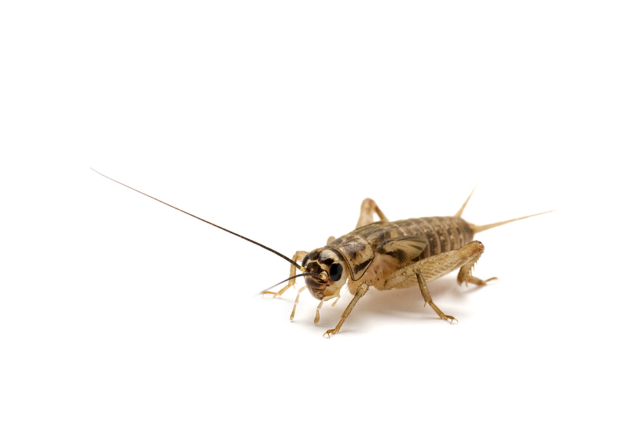
Crickets and Temperature
Can you estimate the temperature on a summer evening, just by listening to crickets chirp?
We will fit a model to predict temperature based on cricket chirp rate

Slide 3
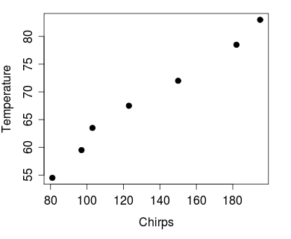
Crickets and Temperature
Goal: Find a straight line that best fits the data in a scatterplot
Response Variable, y
In Degrees Fahrenheit
Explanatory
Variable, x
in Chirps per Minute

Slide 4
Regression
The process of fitting a line to a set of data is called linear regression.
The line of best fit is called the regression line.

Slide 5

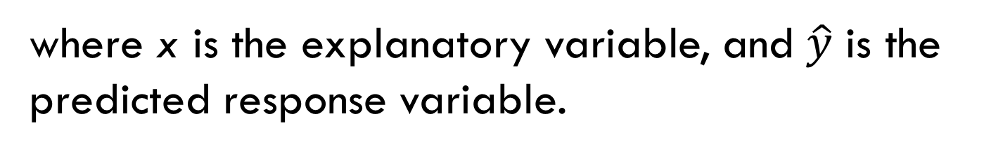
Equation of the Regression Line
The estimated regression line is
$$\hat{y}=a+bx$$
Intercept
Slope
where x is the explanatory variable, and $\hat{y}$ is the predicted response variable.
Slope: increase in predicted y for every unit increase in x
Intercept: predicted y value when x = 0

Slide 6

Prediction
The regression equation can be used to predict y for a given value of x
If you listen and hear crickets chirping about 140 times per minute, your best guess at the outside temperature is
$$\hat{Temp}=37.68+0.23Chirps$$

Slide 7
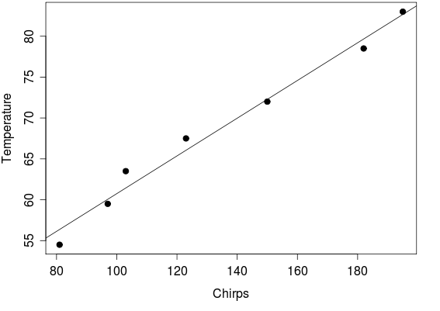
Prediction

Slide 8
If the crickets are chirping about 180 times per minute, your best guess at the temperature is
60°
70°
80°

Slide 9

Prediction
One of the cases in the cricket dataset is 103 chirps per minute at 63.5ºF
How far is the predicted temperature from the observed temperature for this case?

Slide 10
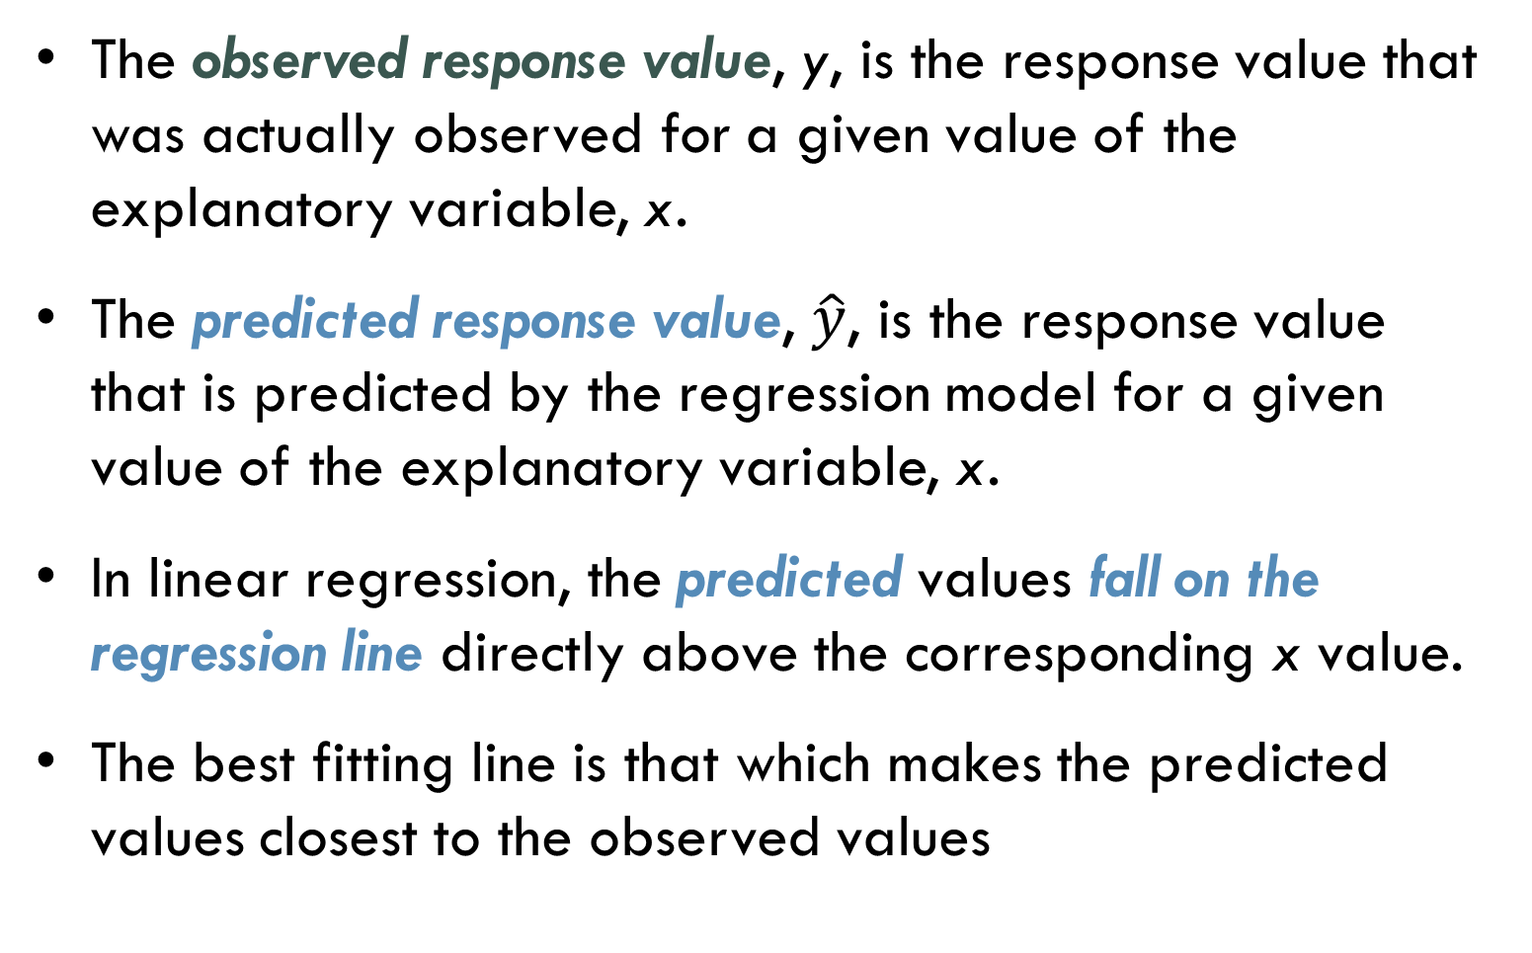
Predicted and Observed Values
The observed response value, y, is the response value that was actually observed for a given value of the explanatory variable, x.
The predicted response value, $\hat{y}$, is the response value that is predicted by the regression model for a given value of the explanatory variable, x.
In linear regression, the predicted values fall on the regression line directly above the corresponding x value.
The best fitting line is that which makes the predicted values closest to the observed values

Slide 11
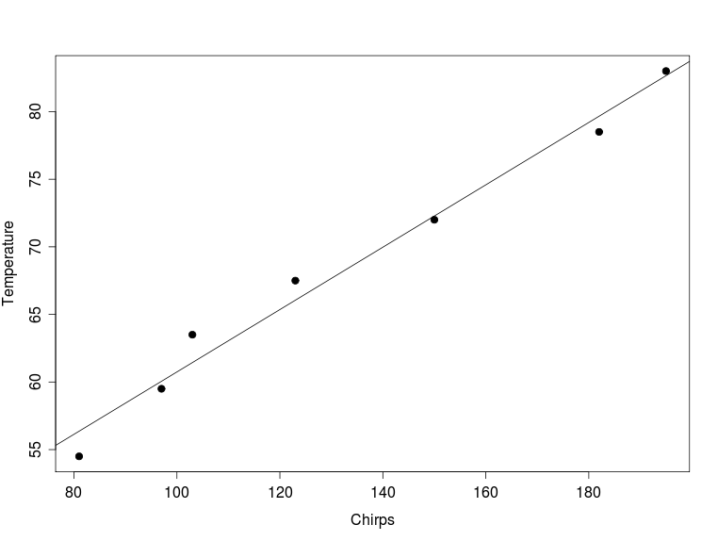

Predicted and Observed Values
y
$$\hat{y}$$

Slide 12
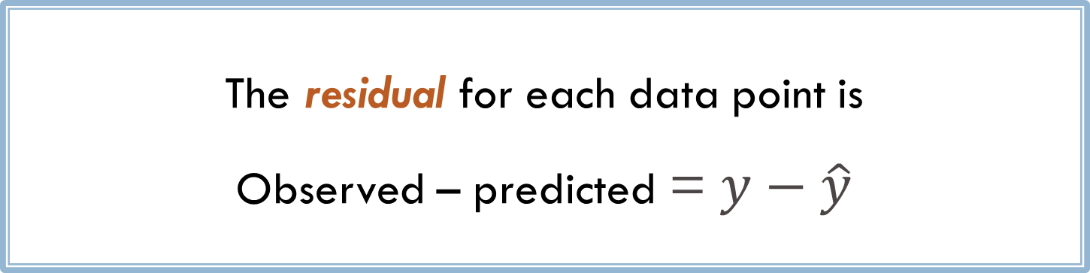
Residual
The residual for each data point is
Observed – predicted = $y−\hat{y}$
Geometrically speaking, the residual is the vertical distance from each point to the line

Slide 13

Residual
y
residual
$$\hat{y}$$
Here, the residual =
To find the regression line, we want to make all the residuals as small as possible.

Slide 14
Regression Line
How do we find the best fitting line???

Slide 15
Least Squares Line
The Least squares line is the line which minimizes the sum of squared residuals
We rely on technology for finding the least squares line.
“least squares line” = “regression line”

Slide 16
Least Squares Regression
Minimize the sum of squared residuals

Slide 17
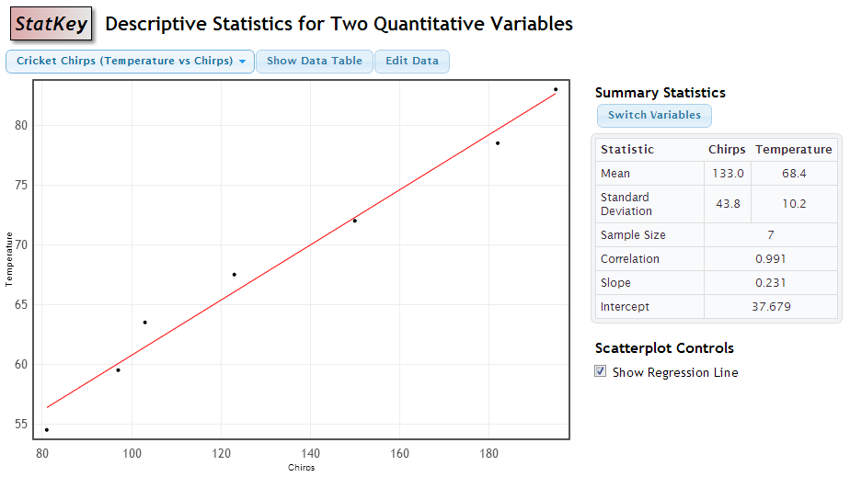
Regression in StatKey
$$\hat{Temp}=37.679+0.231Chirps$$

Slide 18


Units
It is helpful to think about units when interpreting a regression equation
$$\hat{Temp}=37.7+0.23Chirps$$
degrees
degrees
degrees/
chirps per min
chirps per minute
The predicted temperature goes up by about 0.23ºF for every increase of one in the chirp rate.

Slide 19
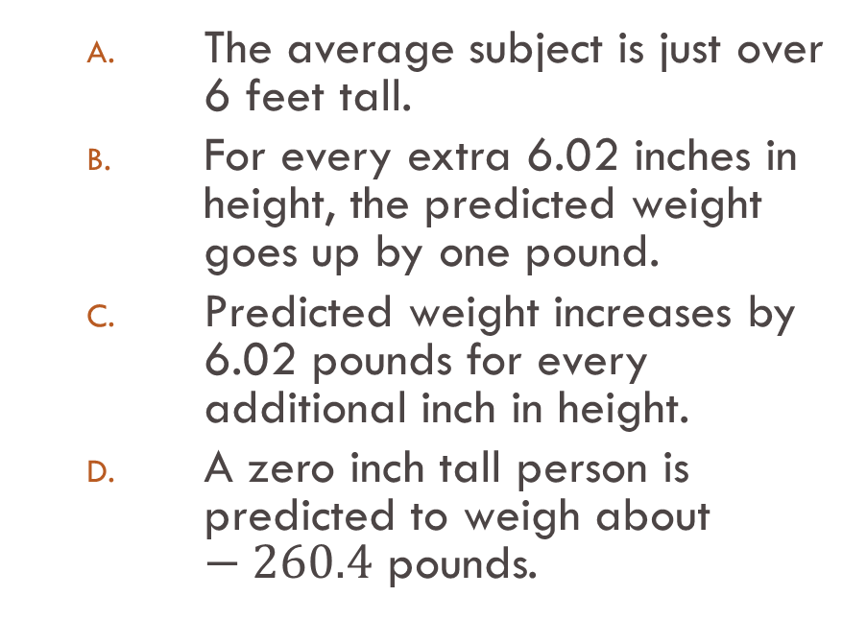
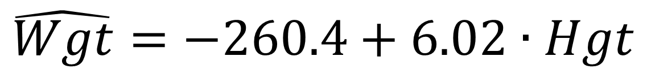
Which is a correct interpretation?
$$\hat{Wgt}=−260.4+6.02∙Hgt$$
The average subject is just over 6 feet tall.
For every extra 6.02 inches in height, the predicted weight goes up by one pound.
Predicted weight increases by 6.02 pounds for every additional inch in height.
A zero inch tall person is predicted to weigh about $−260.4$ pounds.

Slide 20
For a certain course, the regression line to predict grade G on the final exam based on number of hours studying H is One person studied 10 hours and received a 88 on the final. The predicted grade for this person is:
8
10
50
80
88

Slide 21
For a certain course, the regression line to predict grade G on the final exam based on number of hours studying H is One person studied 10 hours and received an 88 on the final. The residual for this person is:
8
10
50
80
88

Slide 22
For a certain course, the regression line to predict grade G on the final based on number of hours studying H is We can interpret the slope in context to mean that:
Predicted grade will go up by 1 point for a person who studies 3 more hours.
Predicted grade will go up by 3 points for a person who studies 1 more hour.
Three more hours of studying gives 3 more points on the final
The rise over the run is 3/1.
The response variable goes up by 1 if the explanatory variable goes up by 3.

Slide 23
For a certain course, the regression line to predict grade G on the final based on number of hours studying H is We can interpret the intercept in context to mean that:
If a person does not study at all, the predicted grade will be 50.
A predicted grade of zero goes with studying 50 hours.
The more someone studies, the higher the predicted grade.
The line crosses the axis at 50.
The response variable is 50 if the explanatory variable is 0.

Slide 24
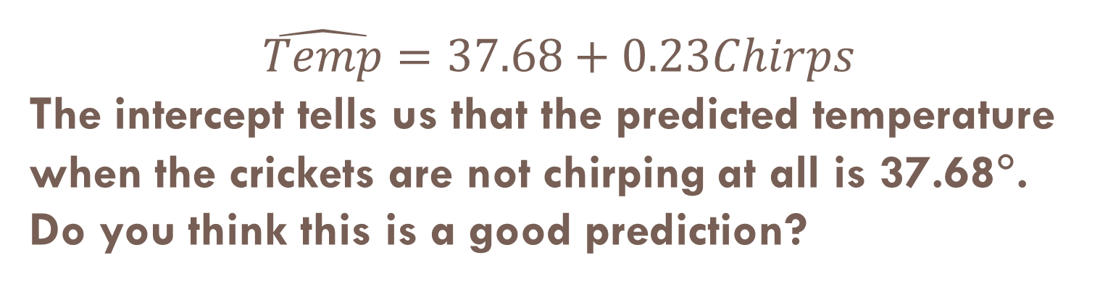
$$\hat{Temp}=37.68+0.23Chirps$$ The intercept tells us that the predicted temperature when the crickets are not chirping at all is 37.68°. Do you think this is a good prediction?
Yes
No

Slide 25

Regression Caution 1
Do not use the regression equation or line to predict values far from those that were used to create it. (do not extrapolate!)
If none of the x values are anywhere near 0, then the intercept is meaningless!

Slide 26
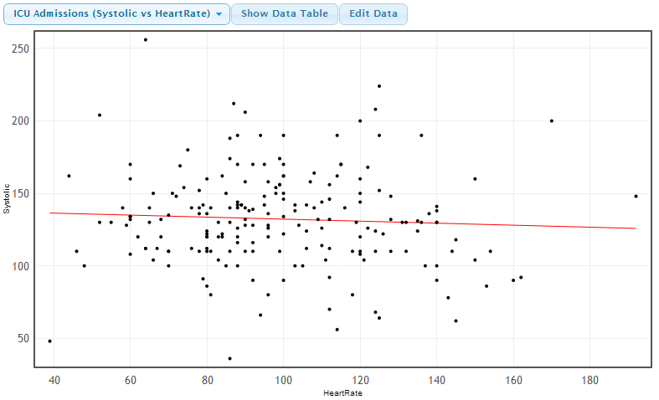
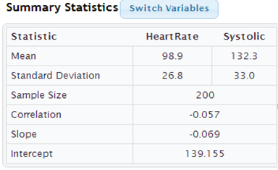
In this sample of 200 patients following admission to an adult ICU, the heart rates and systolic blood pressure measurements are:
positively associated
negatively associated
not associated

Slide 27
Regression Caution 2
Computers will calculate a regression line for any two quantitative variables, even if they are not associated or if the association is not linear
ALWAYS PLOT YOUR DATA!
The regression line/equation should only be used if the association is approximately linear

Slide 28


Regression Caution 3
Outliers (especially outliers in both variables) can be very influential on the regression line
ALWAYS PLOT YOUR DATA!

Slide 29
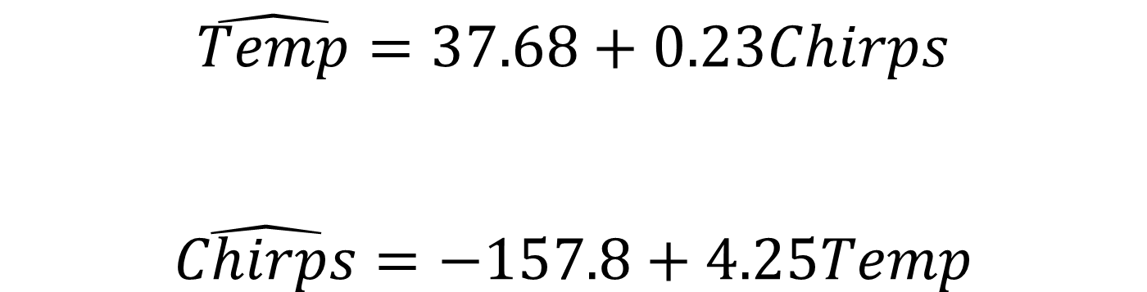
Regression Caution 4
Unlike correlation, for linear regression it does matter which is the explanatory variable and which is the response
$$\hat{Temp}=37.68+0.23Chirps$$
$$\hat{Chirps}=−157.8+4.25Temp$$

Slide 30
Example: Concentration of CO₂ in the Atmosphere
Levels of carbon dioxide in the atmosphere are rising rapidly, far above any levels ever before recorded. Levels were around 278 parts per million in 1800, before the Industrial Age and had never, in the hundreds of thousands of years before that, gone above 300 ppm. Levels are now nearing 400 ppm. The table on the next slide shows the rapid rise of CO₂ concentrations over the last 50 years.
Dr. Pieter Tans, NOAA/ESRL, www.esrl.noaa.gov/gmd/ccgg/trends/. Values recorded at the Mauna Loa Observatory in Hawaii.

Slide 31
Example: Concentration of CO₂ in the Atmosphere
Year | CO₂ (in ppm)
1960 | 316.91
1965 | 320.04
1970 | 325.68
1975 | 331.08
1980 | 338.68
1985 | 345.87
1990 | 354.16
1995 | 360.62
2000 | 369.40
2005 | 379.76
2010 | 389.78

Slide 32
Example: Concentration of CO₂ in the Atmosphere
a) What is the explanatory variable? What is the response variable?

Slide 33
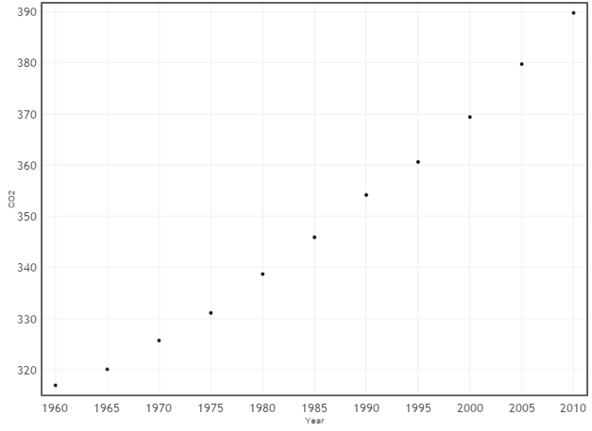
Example: Concentration of CO₂ in the Atmosphere
b) Draw a scatterplot of the data. Does there appear to be a linear relationship in the data? StatKey

Slide 34
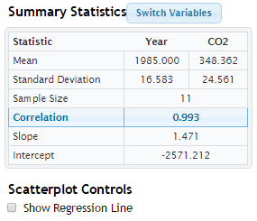
Example: Concentration of CO₂ in the Atmosphere
c) Use technology to find the correlation between year and CO₂ levels. Does the value of the correlation support your answer to part b?

Slide 35
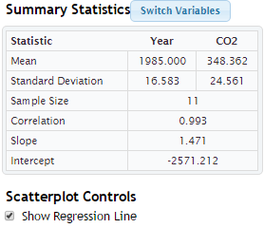
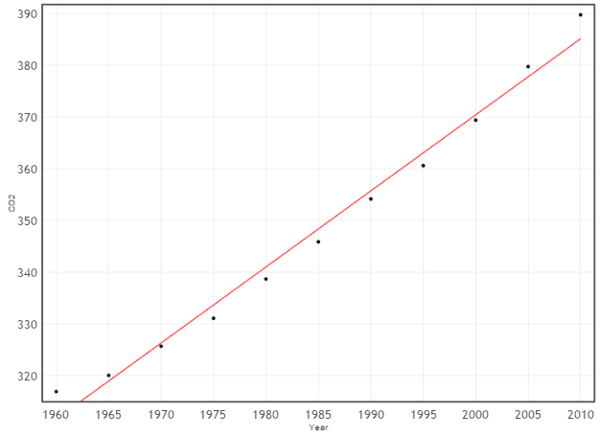
Example: Concentration of CO₂ in the Atmosphere
d) Use technology to calculate the regression line to predict CO₂ level from year.

Slide 36
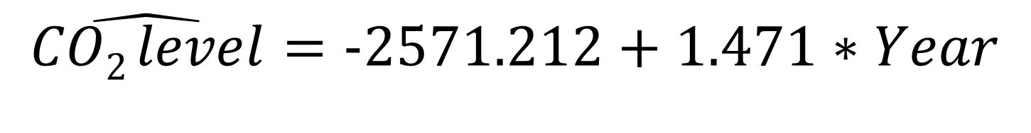
Example: Concentration of CO₂ in the Atmosphere
e) Interpret the slope of the regression line, in terms of carbon dioxide concentrations.
$$\hat{CO2 level}=\text{−2571.212}+1.471∗Year$$

Slide 37
Example: Concentration of CO₂ in the Atmosphere
f) What is the intercept of the line? Does it make sense in context? Why or why not?

Slide 38
Example: Concentration of CO₂ in the Atmosphere
g) Use the regression line to predict the CO₂ level in 2020.

Slide 39
Example: Concentration of CO₂ in the Atmosphere
h) Find the residual for 2010.

Slide 40
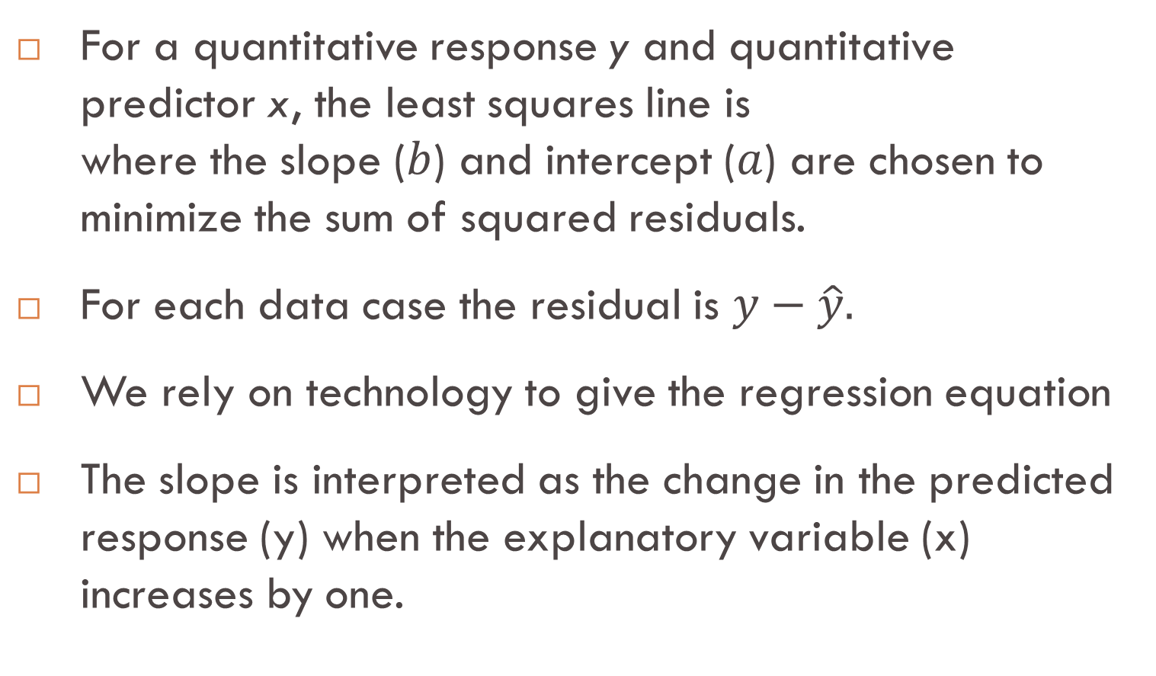

Summary: Least Squares Regression
For a quantitative response y and quantitative predictor x, the least squares line is
where the slope ($b$) and intercept ($a$) are chosen to minimize the sum of squared residuals.
For each data case the residual is $y−\hat{y}.$
We rely on technology to give the regression equation
The slope is interpreted as the change in the predicted response (y) when the explanatory variable (x) increases by one.
$$\hat{y}=a+bx,$$

Slide 41
Summary: Regression Cautions
Don’t extrapolate far beyond where the model is built.
Just because technology outputs an equation for a least squares line, it does not mean there is a linear trend in the data. ALWAYS PLOT YOUR DATA!
Watch out for outliers that don’t fit the pattern; they can greatly influence the line.
It matters which is the explanatory variable and which is the response. You will get a different regression line if you switch your x and y values!
Even a strong linear fit does not (necessarily) imply a cause/effect relationship.

