Slide 1
Section 3.1:
Sampling Distributions
Professor Kathryn Dobeck

Slide 2
You are interested in analyzing the relationship between political party and IQ. How would you visualize and summarize the data?
bar chart/pie chart, proportions, frequency table/relative frequency table
dotplot/histogram/boxplot, mean/median, sd/range/IQR, five number summary
side-by-side or segmented bar plots, difference in proportions, two-way table
side-by-side boxplots, stats by group
scatterplot, correlation

Slide 3
You are interested in analyzing the relationship between political party and gender. How would you visualize and summarize data?
bar chart/pie chart, proportions, frequency table/relative frequency table
dotplot/histogram/boxplot, mean/median, sd/range/IQR, five number summary
side-by-side or segmented bar plots, difference in proportions, two-way table
side-by-side boxplots, stats by group
scatterplot, correlation

Slide 4
You are interested in analyzing gender of Lorain County residents that voted in a recent election. How would you visualize and summarize the data?
bar chart/pie chart, proportions, frequency table/relative frequency table
dotplot/histogram/boxplot, mean/median, sd/range/IQR, five number summary
side-by-side or segmented bar plots, difference in proportions, two-way table
side-by-side boxplots, stats by group
scatterplot, correlation

Slide 5
The Big Picture
Population
Sampling
Sample
Statistical Inference

Slide 6
Statistical Inference
Statistical inference is the process of drawing conclusions about the entire population based on information in a sample.

Slide 7
Statistic and Parameter
A parameter is a number that describes some aspect of a population.
A statistic is a number that is computed from data in a sample.
We usually have a sample statistic and want to use it to make inferences about the population parameter

Slide 8
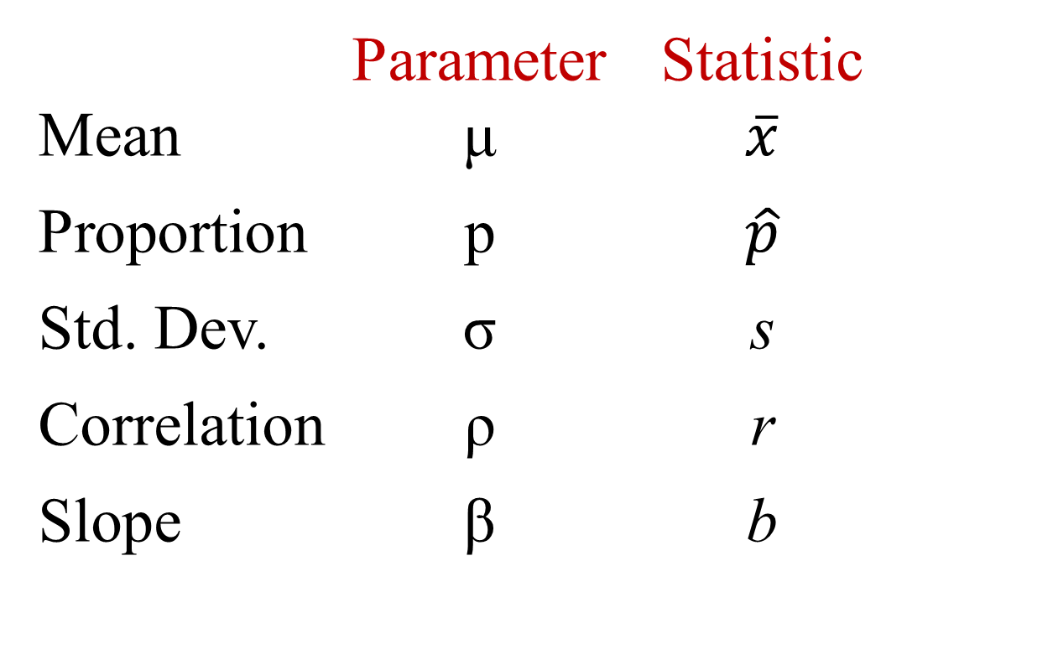
Parameter versus Statistic
mu
x-bar
p-hat
sigma
rho

Slide 9
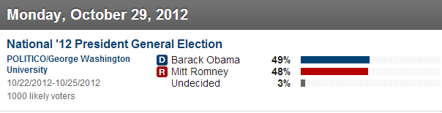

Election Polls
On October 29, 2012 (roughly 1 week before the election), 1000 registered voters were asked who they plan to vote for in the 2012 presidential election.
What proportion of voters planned to vote for Obama?
$$\hat{p}=0.49$$
p = ???
http://www.politico.com/p/2012-election/polls/president

Slide 10
Point Estimate
We use the statistic from a sample as a point estimate for a population parameter.
Point estimates will not match population parameters exactly, but they are our best guess, given the data.

Slide 11
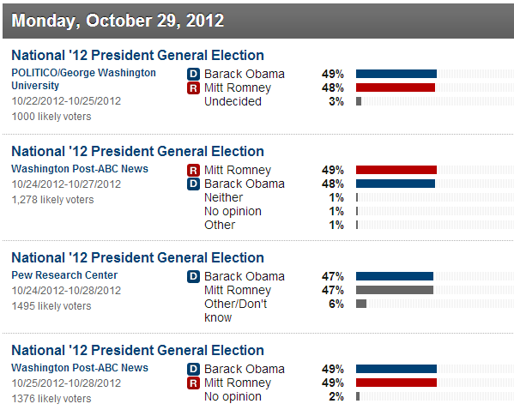
Election Polls
Actually, several polls were conducted that day:

Slide 12
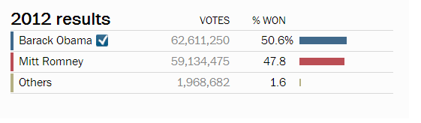
The Results…
http://www.washingtonpost.com/wp-srv/special/politics/election-map-2012/president/

Slide 13
Important Points
Sample statistics vary from sample to sample. (They will not match the parameter exactly.)
KEY QUESTION: For a given sample statistic, what are plausible values for the population parameter? How much uncertainty surrounds the sample statistic?
KEY ANSWER: It depends on how much the statistic varies from sample to sample!

Slide 14
Reese’s Pieces Experiment
QUESTION: What proportion of Reese’s pieces are orange?
Take a random sample of 10 Reese’s pieces
What is your sample proportion? ⇒ class dotplot

Slide 15
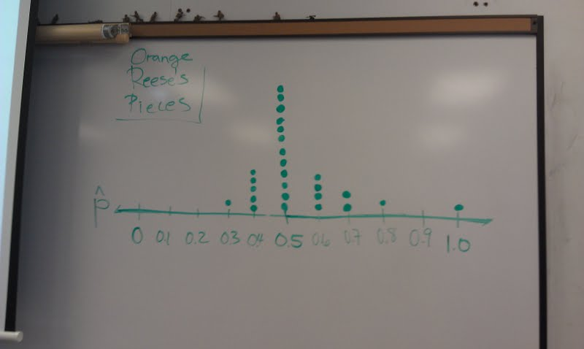
Give a range of plausible values for the population proportion
26 Students performed the experiment

Slide 16
Sampling Distribution
A sampling distribution is the distribution of sample statistics computed for different samples of the same size from the same population.
A sampling distribution shows us how the sample statistic varies from sample to sample

Slide 17
In the Reese’s Pieces sampling distribution, what does each dot represent?
One Reese’s piece
One sample statistic

Slide 18
Center and Shape
Center: If samples are randomly selected, the sampling distribution will be centered around the population parameter.
Shape: For most of the statistics we consider, if the sample size is large enough the sampling distribution will be symmetric and bell-shaped.
StatKey
Notes:
Use StatKey to illustrate center and shape for several different populations, both mean and proportion
Generate one sample at a time first to talk them through the process of a sampling distribution, then generate thousands of samples so they see shape and center
may have to increase the sample size to get a distribution that is symmetric and bell-shaped (although you don’t have to dwell on that here – CLT will be covered in chapter 5)

Slide 19
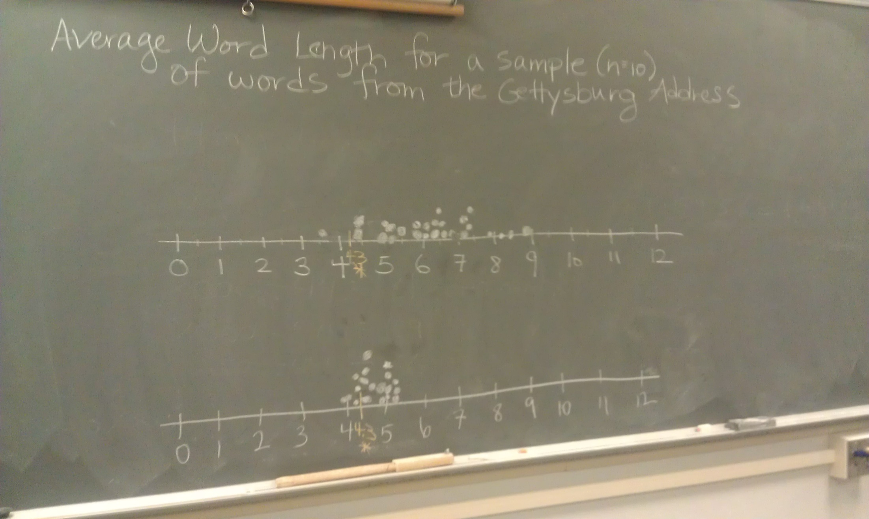
Lincoln’s Gettysburg Address

Slide 20
Random Samples
If you take many random samples of the same size from the same population, the sampling distribution will be centered around the true population parameter
If sampling bias exists (if you do not take random samples), your sampling distribution may give you bad information about the true parameter

Slide 21
Sampling Distribution
We’ve learned about center and shape, but remember what we really care about is variability of the sampling distribution
Remember our key question and answer: to assess uncertainty of a statistic, we need to know how much the statistic varies from sample to sample!
The variability of the sample statistic is so important that it gets it’s own name…

Slide 22
Standard Error
The standard error of a statistic, SE, is the standard deviation of the sample statistic
The standard error can be calculated as the standard deviation of the sampling distribution

Slide 23
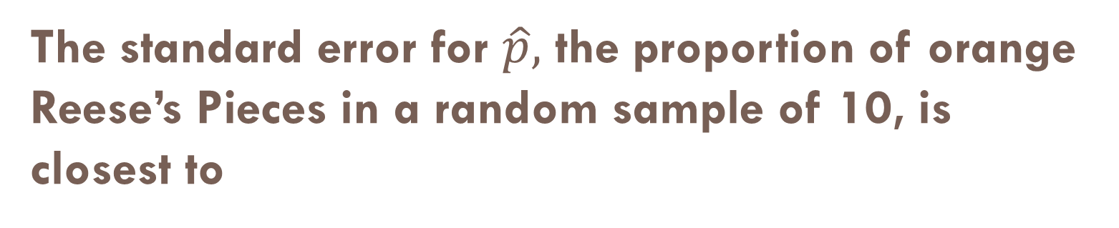
The standard error for $\hat{p},$ the proportion of orange Reese’s Pieces in a random sample of 10, is closest to
0.05
0.15
0.25
0.35

Slide 24
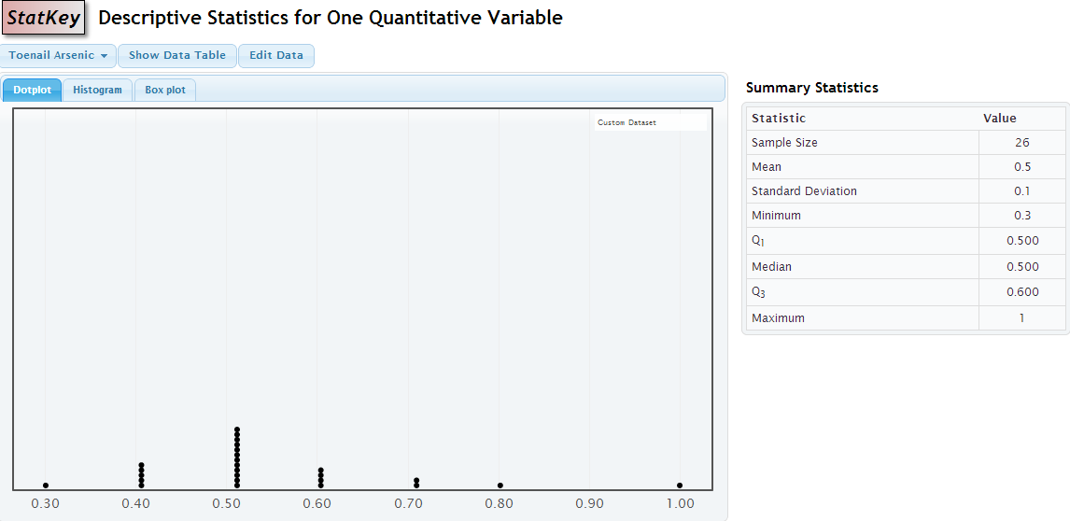
Reese’s Pieces
We can use StatKey to obtain the standard deviation of our class sample proportions to more precisely estimate the standard error.

Slide 25
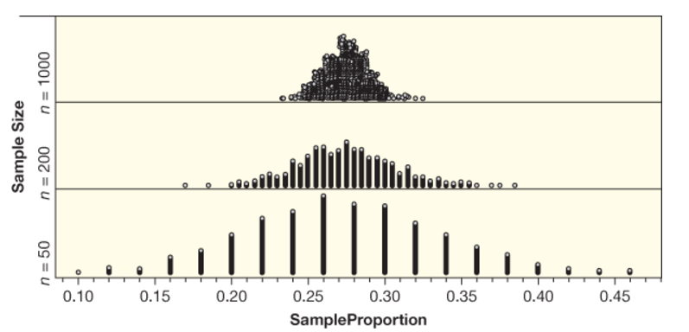
What Effect Does Sample Size Have on the Distribution?

Slide 26
Sample Size Matters!
For larger sample sizes, you get less variability in the statistics, so less uncertainty in your estimates
As the sample size increases, the variability of the sample statistics tends to decrease and the sample statistics tend to be closer to the true value of the population parameter!

Slide 27
Suppose we were to take samples of size 10 and samples of size 100 from the same population, and compute the sample means. Which sample means would have the higher standard error?
The sample means using n = 10
The sample means using n = 100

Slide 28
Suppose we were to take a sample of size 10 and a sample of size 100 from the same population, and compute the sample mean. Which sample mean would have higher uncertainty?
The sample mean from n = 10
The sample mean from n = 100

Slide 29
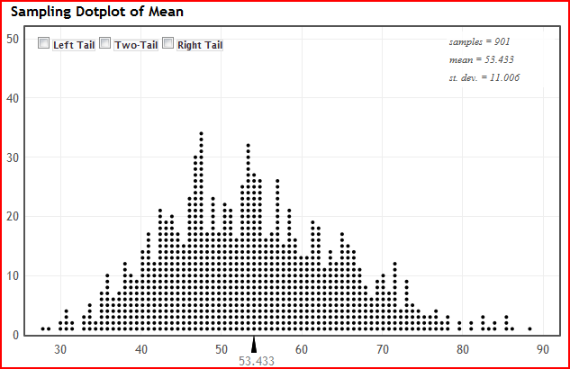
The sampling distribution is shown for enrollment in statistics grad schools. One dot represents:
Enrollment at one statistics grad program
One sample mean
1000 different enrollments
1000 sample means

Slide 30
The sampling distribution is shown for enrollment in statistics grad schools. The population parameter is closest to:
5
10
20
55
65

Slide 31
The sampling distribution is shown for enrollment in statistics grad schools. The standard error is closest to:
5
10
20
55
65

Slide 32
Summary
Statistical inference is drawing conclusions about a population based on a sample
We use a sample statistic to estimate a population parameter
To assess the uncertainty of a statistic, we need to know how much it varies from sample to sample
To create a sampling distribution, take many samples of the same size from the population, and compute the statistic for each
Standard error is the standard deviation of a statistic

