Slide 1
Section 3.2:
Understanding and Interpreting Confidence Intervals
Professor Kathryn Dobeck

Slide 2
The higher the standard error of a statistic, the _______ the uncertainty surrounding the statistic.
higher
lower

Slide 3
Interval Estimate
An interval estimate gives a range of plausible values for a population parameter.

Slide 4
Margin of Error
One common form for an interval estimate is
statistic ± margin of error
where the margin of error reflects the precision of the sample statistic as a point estimate for the parameter.

Slide 5

Text Messages
A 2011 random sample of n = 755 US cell phone users aged 18+ found that the average number of text messages sent or received per day is 41.5 messages, with a margin of error of 12.2.
Give an interval estimate for the average number of text messages sent or received per day for US adult cell phone users.
Smith, A. “Americans and Text Messaging,” Pew Research Center, http://www.pewinternet.org/Reports/2011/Cell-Phone-Texting-2011/Main-Report/How-Americans-Use-Text-Messaging.aspx , accessed 9/19/11.

Slide 6
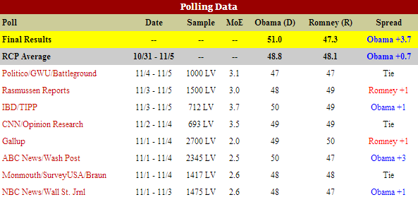
Election Polling
Why is the margin of error smaller for the Gallup poll than the CNN poll?
http://www.realclearpolitics.com/epolls/2012/president/us/general_election_romney_vs_obama-1171.html

Slide 7

Interval Estimate
Using the Gallup poll, find an interval estimate for the proportion of voters who plan to vote for Obama.

Slide 8
Margin of Error
How do we determine the margin of error???
We can use the spread of the sampling distribution (the standard error) to determine the margin of error for a statistic

Slide 9
The higher the standard deviation of the sampling distribution, the _______ the margin of error.
higher
lower

Slide 10
Confidence Interval
A confidence interval for a parameter is an interval computed from sample data by a method that will capture the parameter for a specified proportion of all samples
The success rate (proportion of all samples whose intervals contain the parameter) is known as the confidence level
A 95% confidence interval will contain the true parameter for 95% of all samples

Slide 11
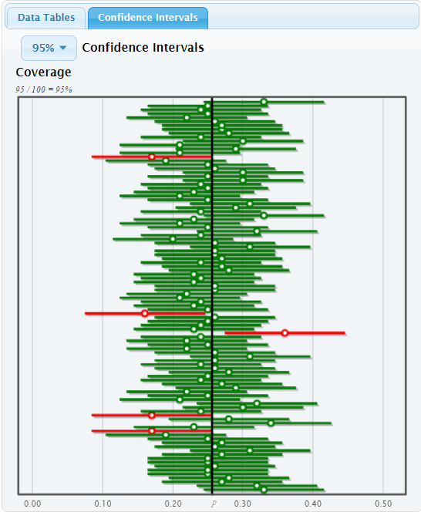
Confidence Intervals: Hollywood Movies (Comedies)
http://lock5stat.com/statkey/index.html
The parameter is fixed
The statistic is random
(It depends on the sample)
The interval is random
(It depends on the statistic)

Slide 12
95% Confidence Interval
If the sampling distribution is relatively symmetric and bell-shaped, a 95% confidence interval can be estimated using
statistic ± 2 × SE
Margin of Error!
This means that for a 95% confidence interval, we obtain the margin of error by calculating 2 * SE!

Slide 13
A survey of 1,502 Americans in January 2012 found that 86% consider the economy a “top priority” for the president and congress. The standard error for this statistic is 0.01. What is the 95% confidence interval for the true proportion of all Americans that considered the economy a “top priority” at that time?
(0.85, 0.87)
(0.84, 0.88)
(0.82, 0.90)
http://www.people-press.org/2012/01/23/public-priorities-deficit-rising-terrorism-slipping/

Slide 14
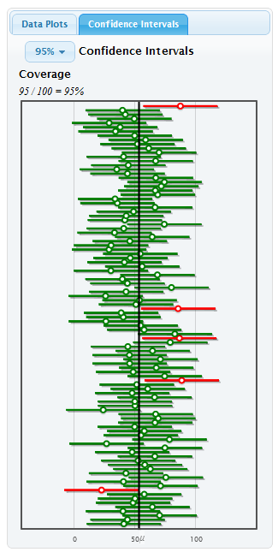
Interpreting a Confidence Interval
95% of all samples yield intervals that contain the true parameter, so we say we are “95% sure” or “95% confident” that one interval contains the truth.
“We are 95% confident that the true proportion of all Americans that considered the economy a ‘top priority’ in January 2012 is between 0.84 and 0.88”

Slide 15
Which of the following is an appropriate interpretation for a 95% confidence interval:
“we are 95% sure the interval contains the parameter”
“there is a 95% chance the interval contains the parameter”
Both A and B
Neither A nor B
Notes:
Good question for discussion.

Slide 16

Common Misinterpretations
Misinterpretation 1: “A 95% confidence interval contains 95% of the data in the population”
Misinterpretation 2: “I am 95% sure that the mean of a sample will fall within a 95% confidence interval for the mean”
Misinterpretation 3: “The probability that the population parameter is in this particular 95% confidence interval is 0.95”
Notes:
Talk through each of these with your students. For explanations, see page 187.

Slide 17
A 98% confidence interval for mean pulse rate is 65 to 71. The interpretation “I am 98% sure that all students will have pulse rates between 65 and 71.” is
Correct
Incorrect

Slide 18
A 98% confidence interval for mean pulse rate is 65 to 71. The interpretation “I am 98% sure that the mean pulse rate for this sample of students will fall between 65 and 71” is
Correct
Incorrect

Slide 19
A 98% confidence interval for mean pulse rate is 65 to 71. The interpretation “I am 98% sure that the mean pulse rate for the population of all students will fall between 65 and 71” is
Correct
Incorrect

Slide 20
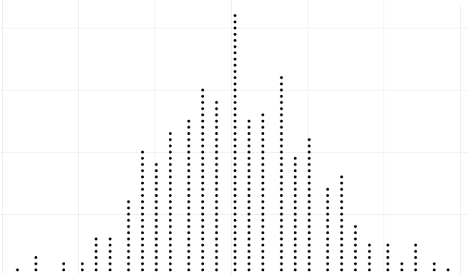
Brief Review
Confidence Interval:
statistic ± ME
Population
Sample
Sample
. . .
Sample
Sample
Sample
Sample
Margin of Error (ME):
(95% CI: ME = 2×SE)
Calculate statistic for each sample
Sampling Distribution
Standard Error (SE): standard deviation of sampling distribution

Slide 21
Summary
To create a plausible range of values for a parameter:
Take many random samples of the same size from the population, and compute the sample statistic for each sample
Compute the standard error as the standard deviation of all these statistics
Use statistic ± 2×SE
One small problem…

Slide 22
Reality
… WE ONLY HAVE ONE SAMPLE!!!!
How do we know how much sample statistics vary, if we only have one sample?!?
… to be continued

