Slide 1
Section 3.3:
Constructing Bootstrap Confidence Intervals
To accompany
Statistics: Unlocking the Power of Data
by Lock, Lock, Lock, Lock, and Lock
Video by: Professor Kathryn Dobeck

Slide 2
The probability that the population mean is in a particular 95% confidence interval is 0.95.
Correct
Incorrect

Slide 3
If we take many random samples from the population and use each one separately to compute the 95% confidence interval, in the long run about 95% of these intervals will capture the population parameter.
Correct
Incorrect

Slide 4
We are 95% sure that the population parameter is contained in the 95% confidence interval.
Correct
Incorrect

Slide 5
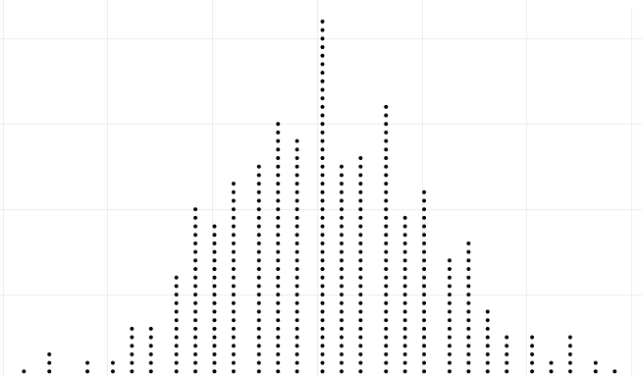
Brief Review
Confidence Interval:
statistic ± ME
Population
Sample
Sample
. . .
Sample
Sample
Sample
Sample
Margin of Error (ME):
(95% CI: ME = 2×SE)
Calculate statistic for each sample
Sampling Distribution
Standard Error (SE): standard deviation of sampling distribution

Slide 6
Brief Review
To create a plausible range of values for a parameter:
Take many random samples from the population, and compute the sample statistic for each sample
Compute the standard error as the standard deviation of all these statistics
Use statistic ± 2×SE
One small problem…

Slide 7
Brief Review
… WE ONLY HAVE ONE SAMPLE!!!!
How do we know how much sample statistics vary, if we only have one sample?!?
… to be continued
BOOTSTRAP!

Slide 8
One Reese’s Pieces Sample
Sample: 52/100 orange
What might the “true” p be?

Slide 9
“Population”
We can estimate the variability of a statistic using only the data in the original sample, by imagining that the “population” is many, many copies of the original sample
This technique, called bootstrapping, allows us to approximate a sampling distribution and estimate a standard error using just the information in one sample!

Slide 10
Reese’s Pieces “Population”

Slide 11
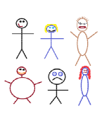
Suppose we have a random sample of 6 people:
Notes:
Patti

Slide 12
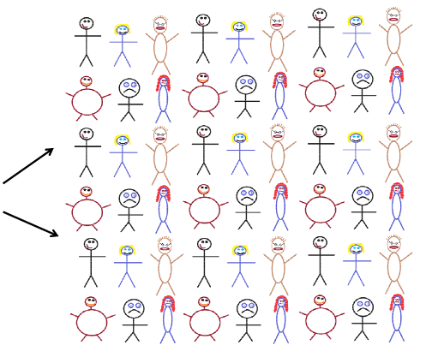
Original Sample
A simulated “population” to sample from
Notes:
Patti

Slide 13
Sampling with Replacement
To simulate a sampling distribution, we can just take repeated random samples from this “population” made up of many copies of the sample
In practice, rather than actually making many copies of the sample and sampling from that…
… we can obtain equivalent results by sampling with replacement from the sample we have. (Thus, each unit can be selected more than once.)

Slide 14




Bootstrap Sample: Sample with replacement from the original sample, using the same sample size.
Original Sample
Bootstrap Sample
Notes:
Patti

Slide 15
Bootstrap Definitions
A bootstrap sample is a random sample taken with replacement from the original sample, that is of the same size as the original sample
A bootstrap statistic is the statistic computed on a bootstrap sample
A bootstrap distribution is the distribution of many bootstrap statistics

Slide 16
BootstrapSample
Bootstrap Statistic
BootstrapSample
Bootstrap Statistic
Original Sample
Bootstrap Distribution
.
.
.
.
.
.
Sample Statistic
BootstrapSample
Bootstrap Statistic

Slide 17
Your original sample has data values 18, 19, 19, 20, 21 Is the following a possible bootstrap sample? 18, 19, 20, 21, 22
Yes
No

Slide 18
Your original sample has data values 18, 19, 19, 20, 21 Is the following a possible bootstrap sample? 18, 19, 20, 21
Yes
No

Slide 19
Your original sample has data values 18, 19, 19, 20, 21 Is the following a possible bootstrap sample? 18, 18, 19, 20, 21
Yes
No

Slide 20
You have a sample of size n = 50. You sample with replacement 1000 times to get 1000 bootstrap samples. What is the sample size of each bootstrap sample?
50
1000

Slide 21
You have a sample of size n = 50. You sample with replacement 1000 times to get 1000 bootstrap samples. How many bootstrap statistics will you have?
50
1000

Slide 22
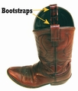
Why “bootstrap”?
“Pull yourself up by your bootstraps”
Lift yourself in the air simply by pulling up on your own boots
Metaphor for accomplishing an “impossible” task without any outside help

Slide 23
Reese’s Pieces
How would you take a bootstrap sample from your sample of Reese’s Pieces?

Slide 24
Reese’s Pieces “Population”

Slide 25
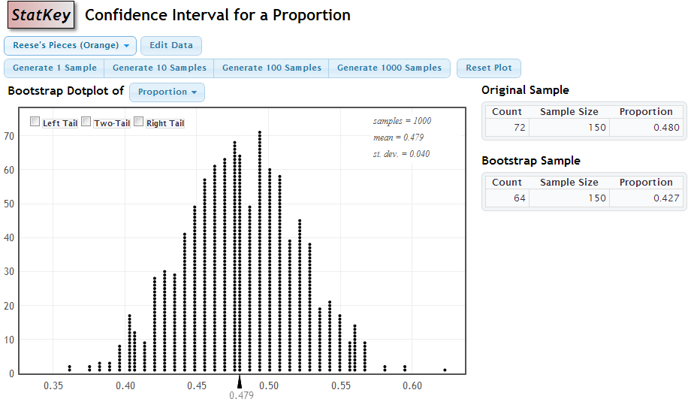
StatKey
http://lock5stat.com/statkey

Slide 26
Sampling Distribution
Population
BUT, in practice we don’t see the “tree” or all of the “seeds” – we only have ONE seed
µ

Slide 27

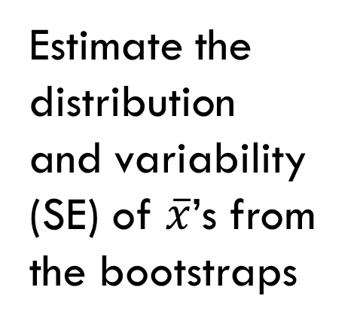
Bootstrap Distribution
What can we do with just one seed?
Bootstrap
“Population”
Estimate the distribution and variability (SE) of $\overline{x}$’s from the bootstraps
Grow a NEW tree!
$$\overline{x}$$
µ

Slide 28
Golden Rule of Bootstrapping
Bootstrap statistics are to the original sample statistic
as
the original sample statistic is to the population parameter

Slide 29
The sampling distribution is centered around the population parameter
The bootstrap distribution is centered around the ____________.
population parameter
sample statistic
bootstrap statistic
bootstrap parameter

Slide 30
Standard Error
The variability of the bootstrap statistics is similar to the variability of the sample statistics
Thus, the standard error of a sample statistic can be estimated using the standard deviation of the bootstrap distribution!

Slide 31
Using Bootstrapping to Obtain a C.I.
Confidence Interval:
Bootstrap
Sample
statistic ± ME
Sample
Bootstrap
Sample
. . .
Bootstrap
Sample
Bootstrap
Sample
Margin of Error (ME):
(95% CI: ME = 2×SE)
Bootstrap
Sample
Calculate statistic for each bootstrap sample
Bootstrap Distribution
Standard Error (SE): standard deviation of the bootstrap distribution

Slide 32
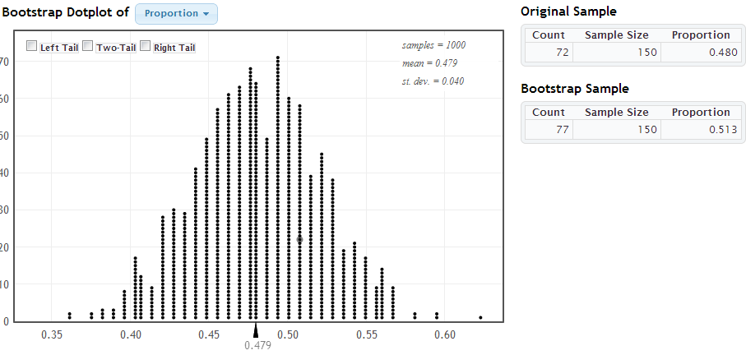
Based on this bootstrap distribution, give a 95% confidence interval for the true proportion of Reese’s Pieces that are orange.
(0.47, 0.55)
(0.44, 0.52)
(0.40, 0.56)
(0.43, 0.59)

Slide 33
Global Warming
What percentage of Americans believe in global warming?
A survey on 2,251 randomly selected individuals conducted in October 2010 found that 1328 answered “Yes” to the question
“Is there solid evidence of global warming?”
www.lock5stat.com/statkey
Source: “Wide Partisan Divide Over Global Warming”, Pew Research Center, 10/27/10. http://pewresearch.org/pubs/1780/poll-global-warming-scientists-energy-policies-offshore-drilling-tea-party

Slide 34
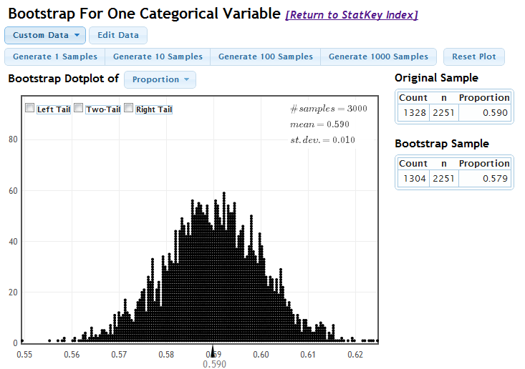
Global Warming

Slide 35
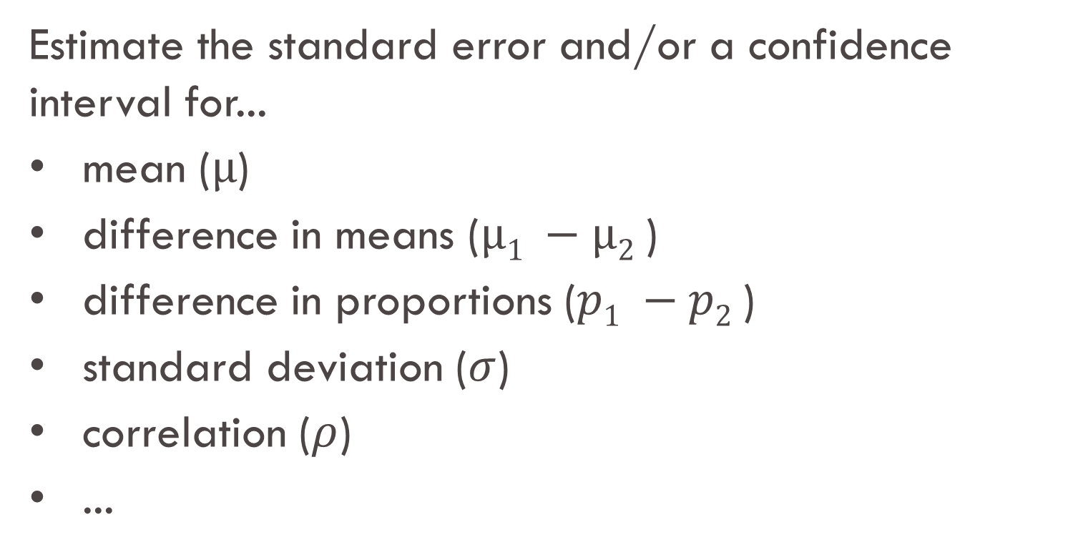
What about Other Parameters?
Estimate the standard error and/or a confidence interval for...
mean ($µ$)
difference in means ($µ1 −µ2$)
difference in proportions ($p1 −p2$)
standard deviation ($σ$)
correlation ($ρ$)
...
Generate samples with replacement
Calculate sample statistic
Repeat...

Slide 36
The Magic of Bootstrapping
We can use bootstrapping to assess the uncertainty surrounding ANY sample statistic!
If we have sample data, we can use bootstrapping to create a 95% confidence interval for any parameter!
(well, almost…)

Slide 37
Global Warming
Does belief in global warming differ by political party?
“Is there solid evidence of global warming?”
The sample proportion answering “yes” was 79% among Democrats and 38% among Republicans.
(exact numbers for each party not given, but assume n=1000 for each group)
Give a 95% CI for the difference in proportions.
www.lock5stat.com/statkey
Source: “Wide Partisan Divide Over Global Warming”, Pew Research Center, 10/27/10. http://pewresearch.org/pubs/1780/poll-global-warming-scientists-energy-policies-offshore-drilling-tea-party

Slide 38
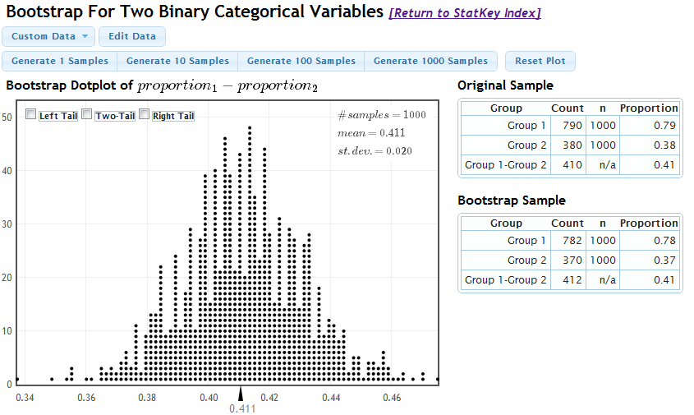
Global Warming

Slide 39
Based on the data just analyzed, can you conclude with 95% certainty that the proportion of people believing in global warming differs by political party?
Yes
No

Slide 40
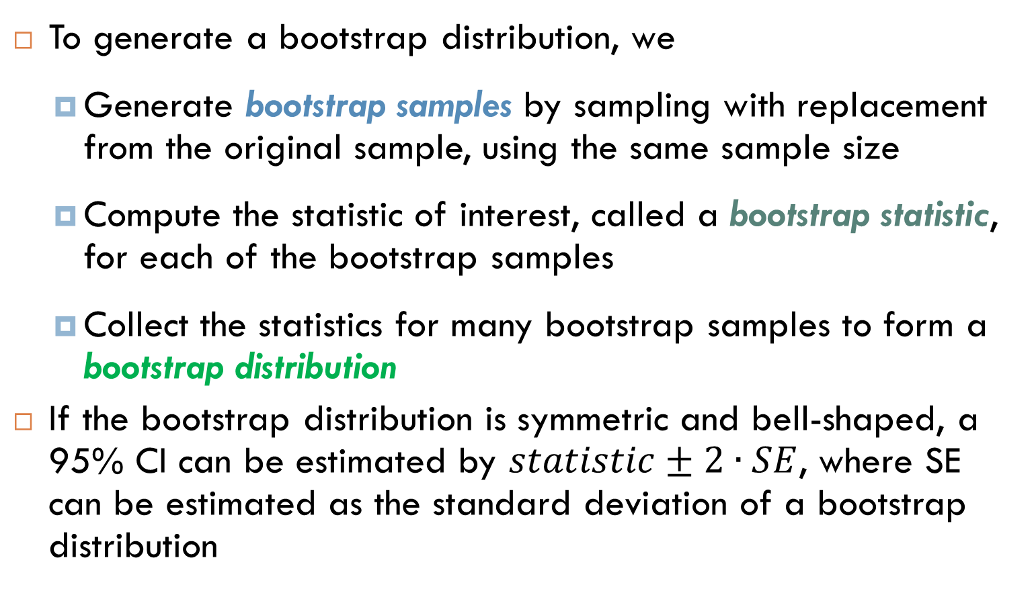
Summary
To generate a bootstrap distribution, we
Generate bootstrap samples by sampling with replacement from the original sample, using the same sample size
Compute the statistic of interest, called a bootstrap statistic, for each of the bootstrap samples
Collect the statistics for many bootstrap samples to form a bootstrap distribution
If the bootstrap distribution is symmetric and bell-shaped, a 95% CI can be estimated by $statistic±2∙SE$, where SE can be estimated as the standard deviation of a bootstrap distribution

