Slide 1
Section 3.4:
Bootstrap Confidence Intervals Using Percentiles
To accompany
Statistics: Unlocking the Power of Data
by Lock, Lock, Lock, Lock, and Lock
Video by: Professor Kathryn Dobeck

Slide 2
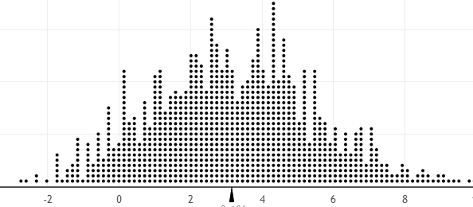
A bootstrap distribution is shown below. Each dot represents
One data value
One bootstrap statistic
n data values
1000 bootstrap statistics

Slide 3
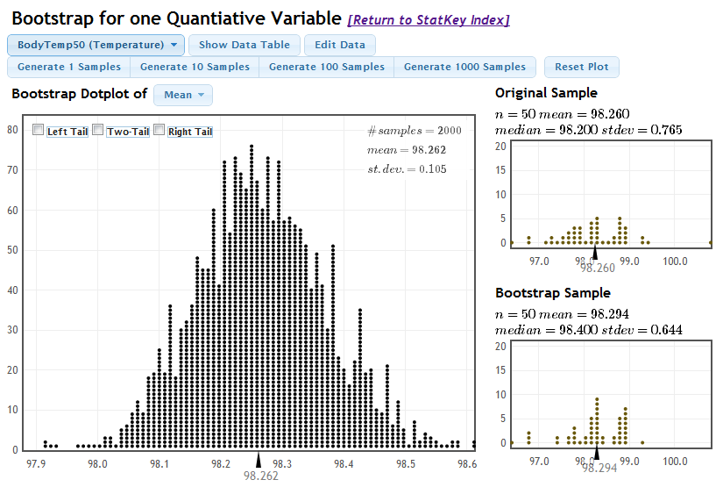
Body Temperature
What is the average body temperature of humans?
www.lock5stat.com/statkey
Shoemaker, What's Normal: Temperature, Gender and Heartrate, Journal of Statistics Education, Vol. 4, No. 2 (1996)

Slide 4

Other Levels of Confidence
What if we want to be more than 95% confident?
How might you produce a 99% confidence interval for the average body temperature?

Slide 5
Percentile Method
For a P% confidence interval, keep the middle P%
of bootstrap statistics
For a 99% confidence interval, keep the middle
99%, leaving 0.5% in each tail.
The 99% confidence interval would be:
(0.5th percentile, 99.5th percentile)
where the percentiles refer to the bootstrap distribution.

Slide 6
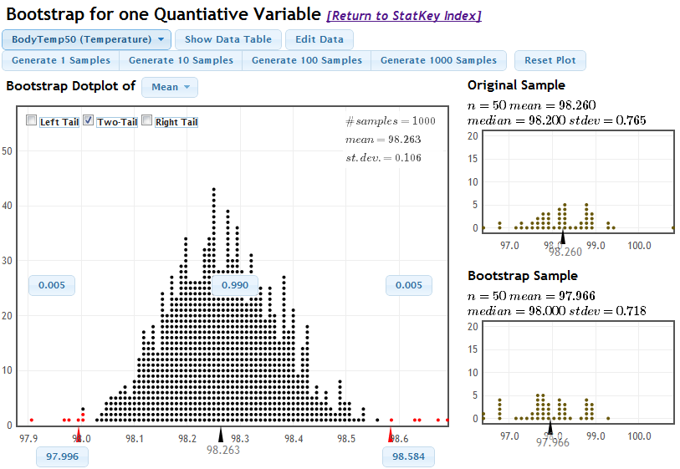
Body Temperature
www.lock5stat.com/statkey

Slide 7
Which is wider, a 90% confidence interval or a 95% confidence interval?
90% CI
95% CI

Slide 8
Identify the 92% confidence interval in terms of the percentiles of the bootstrap distribution.
(8th percentile, 92nd percentile)
(4th percentile, 92nd percentile)
(8th percentile, 96th percentile)
(4th percentile, 96th percentile)

Slide 9
Identify the 88% confidence interval in terms of the percentiles of the bootstrap distribution.
(6th percentile, 88th percentile)
(12th percentile, 88th percentile)
(6th percentile, 94th percentile)
(12th percentile, 94th percentile)

Slide 10

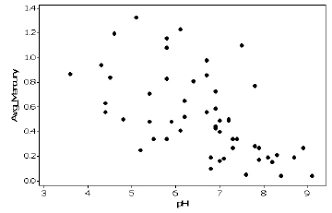

Mercury and pH in Lakes
For Florida lakes, what is the correlation between average mercury level (ppm) in fish taken from a lake and acidity (pH) of the lake? StatKey
$$r=−0.575$$
Give a 90% CI for ρ
Lange, Royals, and Connor, Transactions of the American Fisheries Society(1993)

Slide 11
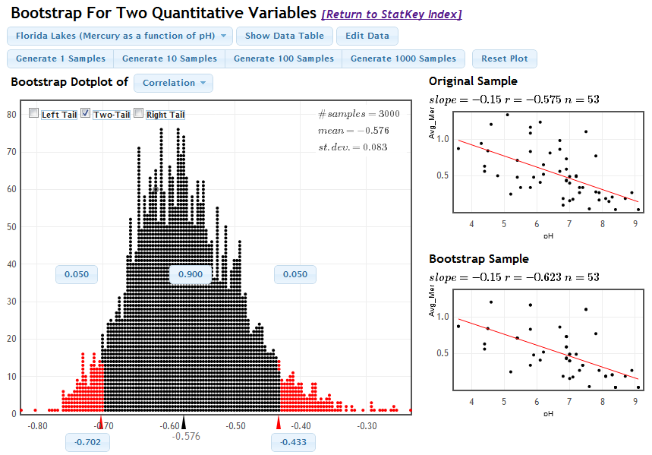
Mercury and pH in Lakes
www.lock5stat.com/statkey

Slide 12
The larger the sample size the ___________ the confidence interval.
wider
narrower

Slide 13
Bootstrap CI
Option 1: Estimate the standard error of the statistic by computing the standard deviation of the bootstrap distribution, and then generate a 95% confidence interval by
Option 2: Generate a P% confidence interval as the range for the middle P% of bootstrap statistics

Slide 14
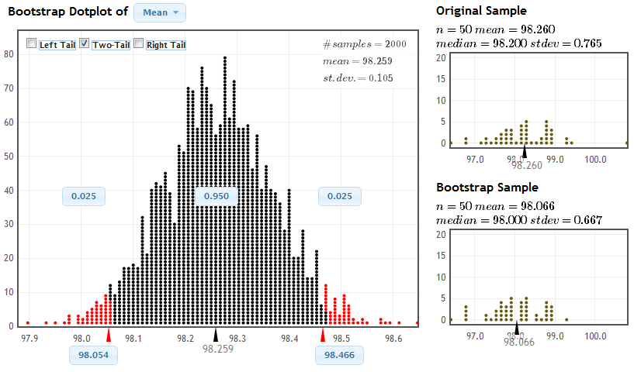
Two Methods for 95%

Slide 15
Two Methods
For a symmetric, bell-shaped bootstrap distribution, using either the standard error method or the percentile method will give similar 95% confidence intervals
If the bootstrap distribution is not bell-shaped or if a level of confidence other than 95% is desired, use the percentile method

Slide 16

Bootstrap Cautions
These methods for creating a confidence interval only work if the bootstrap distribution is smooth and symmetric
ALWAYS look at a plot of the bootstrap distribution!
If the bootstrap distribution is highly skewed or looks “spiky” with gaps, you will need to go beyond intro stat to create a confidence interval

Slide 17
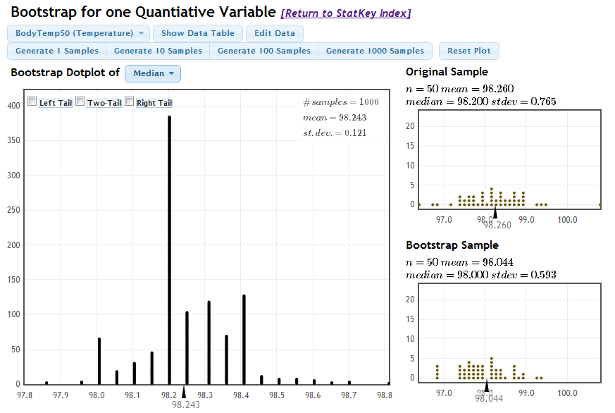
Criteria for Bootstrap CI

Slide 18
Number of Bootstrap Samples
When using bootstrapping, you may get a slightly different confidence interval each time. This is fine!
The more bootstrap samples you use, the more precise your answer will be.
For the purposes of this class, 1000 bootstrap samples is fine. In real life, you probably want to take 10,000 or even 100,000 bootstrap samples

Slide 19
Summary
95% confidence intervals can be created using the standard error or the percentiles of a bootstrap distribution
For any other desired level of confidence, the percentile method may be used
A confidence interval from bootstrap percentiles can be created for any parameter, as long as the bootstrap distribution is approximately smooth and symmetric

