Slide 1
Section 4.1:
Introducing Hypothesis Tests
To accompany
Statistics: Unlocking the Power of Data
by Lock, Lock, Lock, Lock, and Lock
Video by: Professor Kathryn Dobeck

Slide 2
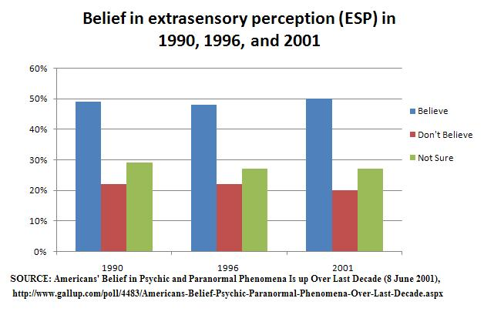
Extrasensory Perception

Slide 3
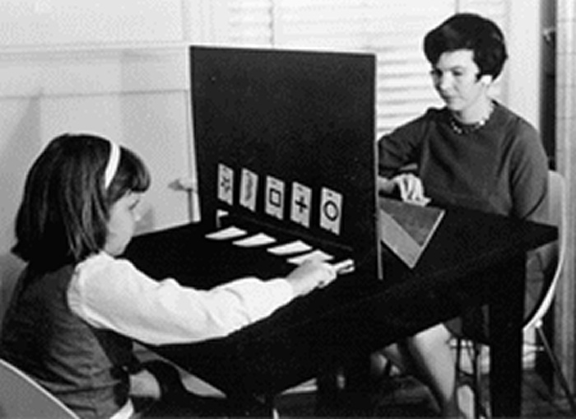
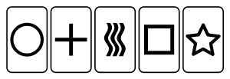
Extrasensory Perception
One way to test for ESP is with Zener cards:
Subjects draw a card at random and telepathically communicate this to someone who then guesses the symbol

Slide 4
There are five Zener cards with five different symbols. If there is no such thing as ESP, what proportion of guesses should be correct?
p = 0
p = 1/4
p = 1/5
p = 1/2

Slide 5
Extrasensory Perception
As we’ve learned, statistics vary from sample to sample
Even if the population proportion is 1/5, not every sample proportion will be exactly 1/5
How do we determine when a sample proportion is far enough above 1/5 to provide evidence of ESP?

Slide 6
Statistical Test
A statistical test uses data from a sample to assess a claim about a population
In the ESP experiment, we want to use sample data to determine whether the population proportion of correct guesses is really higher than 1/5

Slide 7
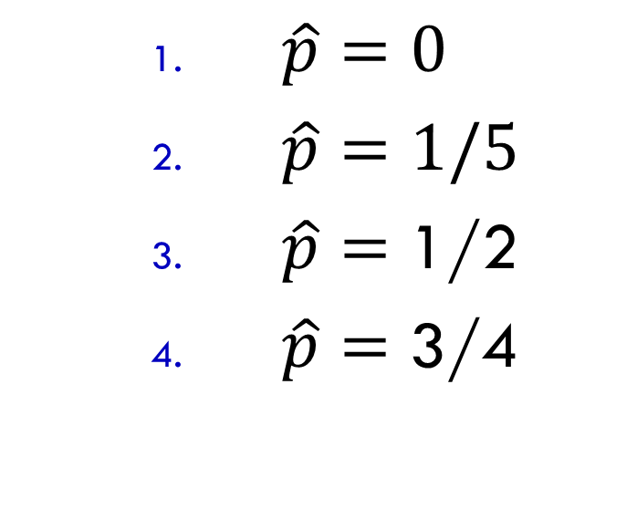
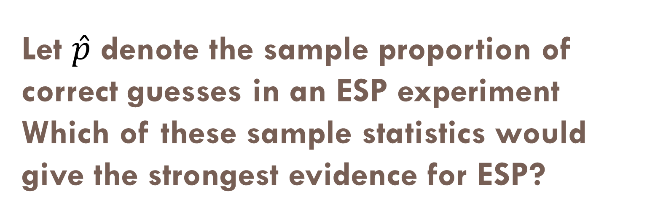
Let $\hat{p}$ denote the sample proportion of correct guesses in an ESP experiment Which of these sample statistics would give the strongest evidence for ESP?
$\hat{p}=0$
$\hat{p}=1/5$
$\hat{p}=$ 1/2
$\hat{p}=$ 3/4

Slide 8
Let’s create our own sample proportion! Randomly choose a Zener card and write it down (don’t show anyone!) Find a partner, telepathically communicate your card (no auditory or visual clues!), and have them guess your card. Switch roles. Did you guess correctly?
Yes
No

Slide 9
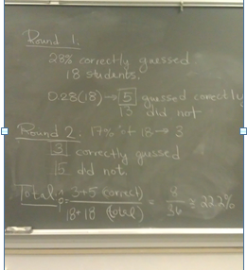

Slide 10
The sample proportion for our class provides:
Substantial evidence for ESP
Little to no evidence for ESP

Slide 11
Statistical Hypotheses
Statistical tests are framed formally in terms of two competing hypotheses:
Null Hypothesis (H₀): Claim that there is no effect or difference.
Alternative Hypothesis (H_{a}): Claim for which we seek evidence.

Slide 12
ESP Hypotheses
For the ESP experiment:
H_{o}: p = 1/5
H_{a}: p > 1/5
No effect or no difference
Claim we seek “evidence” for
Helpful hints:
H₀ usually includes =
H_{a} usually includes >, <, or ≠
The inequality in H_{a} depends on the question

Slide 13
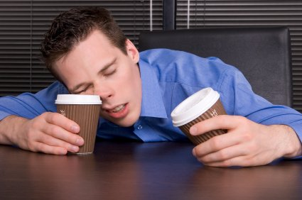
Sleep versus Caffeine
Students were given words to memorize, then randomly assigned to take either a 90 min nap, or a caffeine pill. 2 ½ hours later, they were tested on their recall ability.
Explanatory variable: sleep or caffeine
Response variable: number of words recalled
Is sleep or caffeine better for memory?
Mednick, Cai, Kanady, and Drummond (2008). “Comparing the benefits of caffeine, naps and placebo on verbal, motor and perceptual memory,” Behavioral Brain Research, 193, 79-86.

Slide 14
What is the parameter of interest in the sleep versus caffeine experiment?
Proportion
Difference in proportions
Mean
Difference in means
Correlation

Slide 15
Let μ_{s} and μ_{c} be the mean number of words recalled after sleeping and after caffeine. Is there a difference in average word recall between sleep and caffeine? What are the null and alternative hypotheses?
H₀: μ_{s} ≠ μ_{c}, H_{a}: μ_{s} = μ_{c}
H₀: μ_{s} = μ_{c}, H_{a}: μ_{s} ≠ μ_{c}
H₀: μ_{s} ≠ μ_{c}, H_{a}: μ_{s} > μ_{c}
H₀: μ_{s} = μ_{c}, H_{a}: μ_{s} > μ_{c}
H₀: μ_{s} = μ_{c}, H_{a}: μ_{s} < μ_{c}

Slide 16
Difference in Hypotheses
Note: the following two sets of hypotheses are equivalent, and can be used interchangeably:
H₀: μ₁ = μ₂
H_{a}: μ₁ ≠ μ₂
H₀: μ₁ – μ₂ = 0
H_{a}: μ₁ – μ₂ ≠ 0

Slide 17

Hypotheses
Take a minute to write down the hypotheses for each of the following situations:
Does the proportion of people who support gun control differ between males and females?

Slide 18
Hypotheses
Take a minute to write down the hypotheses for each of the following situations:
Is the average hours of sleep per night for college students less than 7?

Slide 19
Evidence
The goal of a hypothesis test is to determine whether the sample data provide enough evidence to refute the null hypothesis in favor of the alternative hypothesis.

Slide 20
Coming Attractions!
How do we measure strength of evidence against H₀ and in favor of H_{a}?
Next video!
How do we know whether we have enough evidence to reject H₀ in favor of H_{a}?
The following video!

Slide 21
Summary
Statistical tests use data from a sample to assess a claim about a population
Statistical tests are usually formalized with competing hypotheses:
Null hypothesis (H₀): no effect or no difference
Alternative hypothesis (H_{a}): what we seek evidence for

