Slide 1
Section 4.3:
Determining Statistical Significance
To accompany
Statistics: Unlocking the Power of Data
by Lock, Lock, Lock, Lock, and Lock
Video by: Professor Kathryn Dobeck

Slide 2
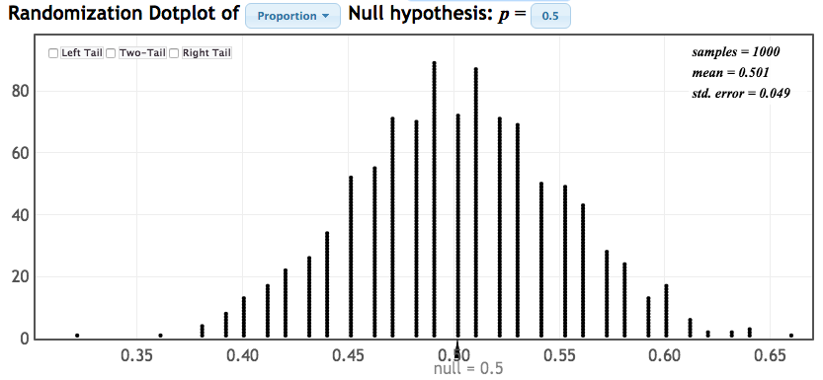
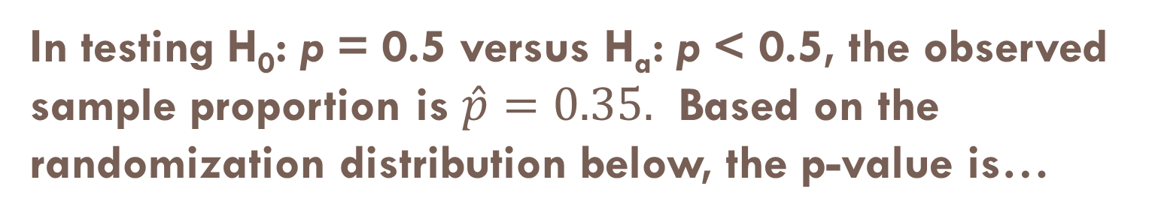
In testing H₀: p = 0.5 versus H_{a}: p < 0.5, the observed sample proportion is $\hat{p}=0.35.$ Based on the randomization distribution below, the p-value is…
0.000008
0.001
0.3
0.45
0.7

Slide 3

p-value
Using the randomization distribution below to test
H₀ : ρ = 0 vs H_{a} : ρ > 0
Which sample statistic shows the most evidence for the alternative hypothesis? r = 0.1, r = 0.3, or r = 0.5
Therefore, which p-value shows the most evidence for the alternative hypothesis? 0.35, 0.15, or 0.005
Notes:
r = 0.5 shows the most evidence and p = 0.005 shows the most evidence. Idea to get across: Sample statistics far out in the tail show the most evidence against the null, so small p-values show the most evidence.

Slide 4
The smaller the p-value the
stronger the evidence against the null hypothesis
stronger the evidence for the null hypothesis

Slide 5
p-value and H₀
If the p-value is small, then a statistic as extreme as that observed would be unlikely if the null hypothesis were true, providing strong evidence against H₀
The smaller the p-value, the stronger the evidence against the null hypothesis and in favor of the alternative hypothesis

Slide 6
Which of the following p-values gives the strongest evidence against H₀?
0.005
0.1
0.32
0.56
0.94

Slide 7
Which of the following p-values gives the strongest evidence against H₀?
0.22
0.45
0.03
0.8
0.71

Slide 8
Randomization Distributions
p-values can be calculated from randomization distributions:
simulate samples, assuming H₀ is true
calculate the statistic of interest for each sample
find the p-value as the proportion of simulated statistics at least as extreme as the observed statistic

Slide 9
Cocaine Addiction
In a randomized experiment on treating cocaine addiction, 48 people were randomly assigned to take either Desipramine (a new drug), or Lithium (an existing drug), and then followed to see who relapsed
Question of interest:
What are the variables?
What is the parameter of interest?

Slide 10
Cocaine Addiction
What are the null and alternative hypotheses?
What are the possible conclusions?
p_{D}, p_{L}: proportion of cocaine addicts who relapse after taking Desipramine or Lithium, respectively

Slide 11
R
R
R
R
R
R
R
R
R
R
R
R
R
R
R
R
R
R
R
R
R
R
R
R
R
R
R
R
R
R
R
R
R
R
R
R
R
R
R
R
R
R
R
R
R
R
R
R
1. Randomly assign units to treatment groups
Desipramine
Lithium
R
R
R
R
R
R
R
R
R
R
R
R
R
R
R
R
R
R
R
R
R
R
R
R
R
R
R
R
R
R
R
R
R
R
R
R
R
R
R
R
R
R
R
R

Slide 12
2. Conduct experiment
3. Observe relapse counts in each group
R = Relapse
N = No Relapse
1. Randomly assign units to treatment groups
Desipramine
Lithium
R
R
R
R
R
R
R
R
R
R
R
R
R
R
R
R
R
R
R
R
R
R
R
R
R
R
R
R
R
R
R
R
N
R
N
R
R
R
R
R
R
R
R
R
R
R
R
R
N
R
N
R
N
N
N
N
N
N
N
N
R
R
R
R
R
R
R
R
R
R
R
R
N
N
N
N
N
N
N
N
N
N
N
N
N
N
N
N
N
N
N
N
N
N
N
N
10 relapse, 14 no relapse
18 relapse, 6 no relapse

Slide 13
Measuring Evidence against H₀
To see if a statistic provides evidence against H_{0,} we need to see what kind of sample statistics we would observe, just by random chance, if H₀ were true

Slide 14
Cocaine Addiction
“by random chance” means by the random assignment to the two treatment groups
“if H₀ were true” means if the two drugs were equally effective at preventing relapses (equivalently: whether a person relapses or not does not depend on which drug is taken)
Simulate what would happen just by random chance, if H₀ were true…

Slide 15
R
R
R
R
R
R
R
R
R
R
R
R
R
R
R
R
N
N
R
R
R
R
R
R
N
N
N
N
N
N
R
R
R
R
R
R
N
N
N
N
N
N
N
N
N
N
N
N
10 relapse, 14 no relapse
18 relapse, 6 no relapse

Slide 16
R
R
R
R
R
R
R
R
R
R
R
R
R
R
R
R
N
N
R
R
R
R
R
R
N
N
N
N
N
N
R
R
R
R
R
R
N
N
N
N
N
N
N
N
N
N
N
N
Simulate another randomization
Desipramine
Lithium
R
N
R
N
N
N
N
R
R
R
R
R
R
R
N
R
R
N
N
N
R
N
R
R
R
N
N
R
N
R
R
N
R
N
N
N
R
R
R
N
R
R
R
R
16 relapse, 8 no relapse
12 relapse, 12 no relapse

Slide 17
Simulate another randomization
Desipramine
Lithium
R
R
R
R
R
R
R
N
R
N
R
N
R
N
R
R
N
N
R
R
R
N
N
N
R
R
N
R
N
R
N
N
R
N
N
R
R
N
R
N
R
R
R
N
N
N
R
R
17 relapse, 7 no relapse
11 relapse, 13 no relapse

Slide 18
Simulate Your Own Sample
In the experiment, 28 people relapsed and 20 people did not relapse. Create cards or slips of paper with 28 “R” values and 20 “N” values.
Pool these response values together, and randomly divide them into two groups (representing Desipramine and Lithium)
Calculate your difference in proportions
Plot your statistic on the class dotplot
To create an entire randomization distribution, we simulate this process many more times with technology: StatKey

Slide 19
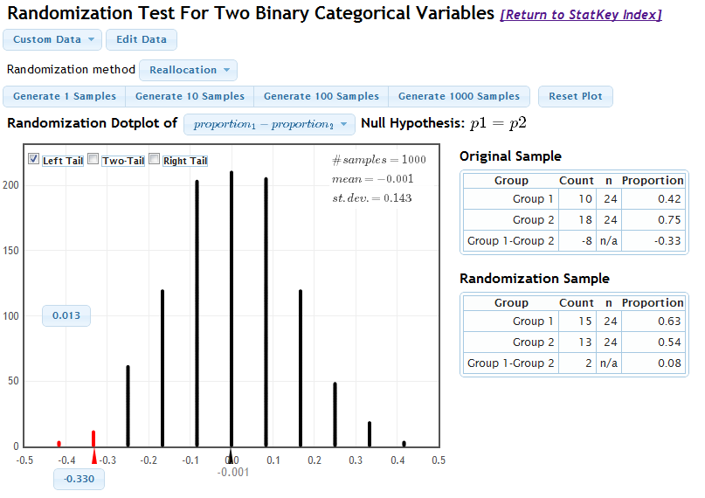
www.lock5stat.com/statkey

Slide 20
Formal Decisions
A formal hypothesis test has only two possible conclusions:
The p-value is small: reject the null hypothesis in favor of the alternative
The p-value is not small: do not reject the null hypothesis
How small?

Slide 21
Significance Level
The significance level, α, is the threshold below which the p-value is deemed small enough to reject the null hypothesis
p-value < α ⇒ Reject H₀
p-value > α ⇒ Do not Reject H₀

Slide 22
Significance Level
If the p-value is less than α, the results are statistically significant, and we reject the null hypothesis in favor of the alternative
If the p-value is not less than α, the results are not statistically significant, and our test is inconclusive
Often α = 0.05 by default, unless otherwise specified

Slide 23
p-value < α
p-value ≥ α
Results would be rare, if the null were true
Results would not be rare, if the null were true
Reject H₀
Do not reject H₀
We have statistically significant evidence that the alternative is true!
The results are not statistically significant. Our test is inconclusive.

Slide 24

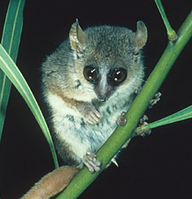
Red Wine and Weight Loss
Resveratrol, an ingredient in red wine and grapes, has been shown to promote weight loss in rodents, and has recently been investigated in primates (specifically, the Grey Mouse Lemur).
A sample of lemurs had various measurements taken before and after receiving resveratrol supplementation for 4 weeks
BioMed Central (2010, June 22). “Lemurs lose weight with ‘life-extending’ supplement resveratrol. Science Daily.

Slide 25

In the test to see if the mean resting metabolic rate is higher after treatment, the p-value is 0.013. Using α = 0.05, is this difference statistically significant? (should we reject H₀: no difference?)
Yes
No

Slide 26
In the test to see if locomotor activity changes after treatment, the p-value is 0.980. Using α = 0.05, is this difference statistically significant? (should we reject H₀: no difference?)
Yes
No

Slide 27
In the test to see if mean food intake changes after treatment, the p-value is 0.035. Using α = 0.05, is this difference statistically significant? (should we reject H₀: no difference?)
Yes
No

Slide 28
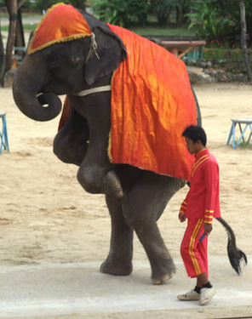
Elephant Example
H₀ : X is an elephant
H_{a} : X is not an elephant
What would you conclude, if you get the following data?
X walks on two legs
X has four legs
Although we can never be certain!

Slide 29

Never Accept H₀
“Do not reject H₀” is not the same as “accept H₀”!
Lack of evidence against H₀ is NOT the same as evidence for H₀!
“For the logical fallacy of believing that a hypothesis has been proved to be true, merely because it is not contradicted by the available facts, has no more right to insinuate itself in statistical than in other kinds of scientific reasoning…”
-Sir R. A. Fisher (1890 – 1962)
Statistician, Evolutionary Biologist, and Geneticis

Slide 30
In a hypothesis test of H₀: μ = 10 vs H_{a}: μ < 10 the p-value is 0.002. With α = 0.05, we conclude:
Reject H₀
Do not reject H₀
Reject H_{a}
Do not reject H_{a}

Slide 31
In a hypothesis test of H₀: μ = 10 vs H_{a}: μ < 10 the p-value is 0.002. With α = 0.01, we conclude:
There is evidence that μ = 10
There is evidence that μ < 10
We have insufficient evidence to conclude anything

Slide 32
In a hypothesis test of H₀: μ = 10 vs H_{a}: μ < 10 the p-value is 0.21. With α = 0.01, we conclude:
Reject H₀
Do not reject H₀
Reject H_{a}
Do not reject H_{a}

Slide 33
In a hypothesis test of H₀: μ = 10 vs H_{a}: μ < 10 the p-value is 0.21. With α = 0.01, we conclude:
There is evidence that μ = 10
There is evidence that μ < 10
We have insufficient evidence to conclude anything

Slide 34
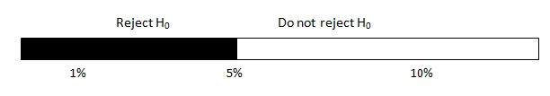
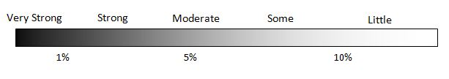
Statistical Conclusions
Formal decision of hypothesis test, based on α = 0.05 :
Informal strength of evidence against H₀:

Slide 35
Conclusions
p-value < α
p-value ≥ α
H₀
Generic conclusion:
Reject H₀
Generic conclusion:
Do not reject H₀
H_{a}
Conclusion in context:
We have (strong?) evidence that [fill in alternative hypothesis]
Conclusion in context:
We do not have enough evidence to conclude that [fill in alternative hypothesis]

Slide 36

Multiple Sclerosis and Sunlight
It is believed that sunlight offers some protection against multiple sclerosis, but the reason is unknown
Researchers randomly assigned mice to one of:
Control (nothing)
Vitamin D Supplements
UV Light
All mice were injected with proteins known to induce a mouse form of MS, and they observed which mice got it
Seppa, Nathan. “Sunlight may cut MS risk by itself”, Science News, April 24, 2010 pg 9, reporting on a study appearing March 22, 2010 in the Proceedings of the National Academy of Science.

Slide 37

Multiple Sclerosis and Sunlight
For each situation below, write down
Null and alternative hypotheses
Informal description of the strength of evidence against H₀
Formal decision about H₀, using α = 0.05
Conclusion in the context of the question
In testing whether UV light provides protection against MS (UV light vs control group), the p-value is 0.002.
In testing whether Vitamin D provides protection against MS (Vitamin D vs control group), the p-value is 0.47.

Slide 38
Multiple Sclerosis and Sunlight
In testing whether UV light provides protection against MS (UV light vs control group), the p-value is 0.002.

Slide 39
Multiple Sclerosis and Sunlight
In testing whether Vitamin D provides protection against MS (Vitamin D vs control group), the p-value is 0.47.

Slide 40
Summary
Results are statistically significant if the p-value is less than the significance level, α
In making formal decisions, reject H₀ if the p-value is less than α, otherwise do not reject H₀
Not rejecting H₀ is NOT the same as accepting H₀
Hypothesis test conclusions include a generic decision about H₀ (reject or do not reject) and a conclusion in context about H_{a}

