Slide 1
Section 4.4:
A Closer Look at Testing
To accompany
Statistics: Unlocking the Power of Data
by Lock, Lock, Lock, Lock, and Lock
Video by: Professor Kathryn Dobeck

Slide 2
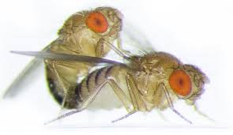
Question of the Day
Does choice of mate improve offspring fitness (in fruit flies)?

Slide 3
A study investigated whether mate choice can improve offspring fitness in fruit flies and obtained a p-value < 0.01. Their conclusion, based on ⍺ = 0.05, should be:
Reject H₀; mate choice improves offspring fitness
Reject H₀; cannot conclude that mate choice improves offspring fitness
Do not reject H₀; mate choice improves offspring fitness
Do not reject H₀; cannot conclude that mate choice improves offspring fitness
Partridge, L. Mate choice increases a component of offspring fitness in fruit flies Nature, 283: 290-291. 1/17/80.

Slide 4
Original Study
Paper published in Nature with p-value < 0.01
Concluded, based on the data, that mate choice improves offspring fitness
This went against conventional wisdom
Researchers tried to replicate the results…
Partridge, L. Mate choice increases a component of offspring fitness in fruit flies Nature, 283: 290-291. 1/17/80.

Slide 5
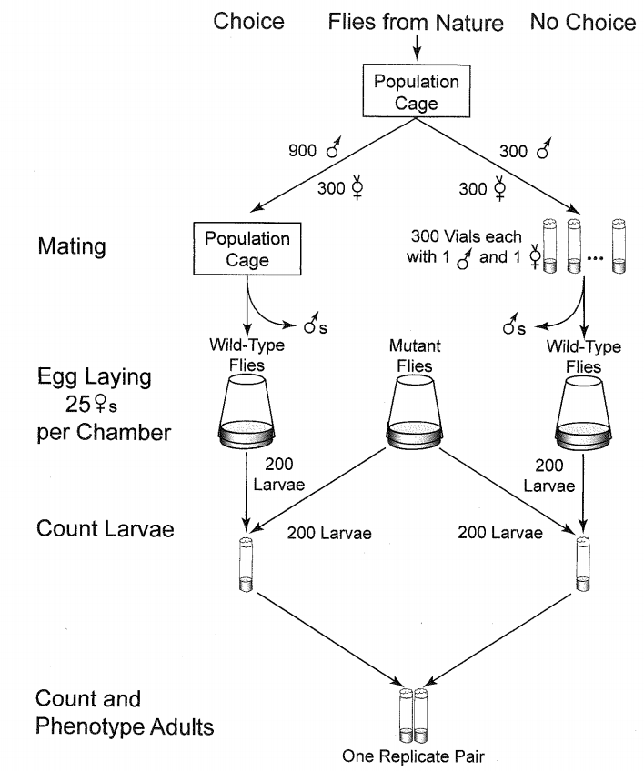

Slide 6
Fruit Fly Mate Choice Experiment
Took 600 female fruit flies and randomly divided them into two groups:
300 got put in a cage with 900 males (mate choice)
300 were placed in individual vials with only one male each (no mate choice)
After mating, females were separated from the males and put in egg-laying chambers
200 larvae from each chamber was taken and placed in a cage with 200 mutant flies (for competition)
This was repeated 10 times/day for 5 days (50 runs)
Schaeffer, S.W., Brown, C.J., Anderson, W.W. (1984). “Does mate choice affect fitness?” Genetics, 107: s94.

Slide 7
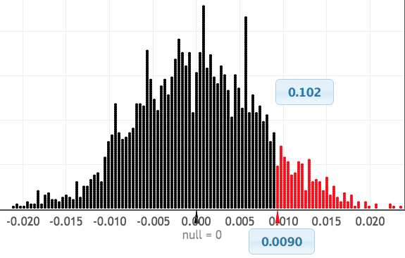
Mate Choice and Offspring Survival
6,067 of the 10,000 mate choice larvae survived and 5,976 of the 10,000 no mate choice larvae survived
p-value: 0.102

Slide 8
Mate Choice and Offspring Survival
Two studies investigated the same topic
One study found significant results
One study found insignificant results
Conflicting results?!?

Slide 9
Errors
There are four possibilities:
Decision
 | Reject H₀ | Do not reject H₀
H₀ true
H₀ false
TYPE I ERROR
☺
Truth
☺
TYPE II ERROR
A Type I Error is rejecting a true null
A Type II Error is not rejecting a false null

Slide 10
Analogy to Law
H_{o}
H_{a}
A person is innocent until proven guilty.
Evidence must be beyond the shadow of a doubt.
p-value from data
α
Types of mistakes in a verdict?
Convict an innocent
Type I error
Release a guilty
Type II error

Slide 11
Mate Choice and Offspring Fitness
Option #1: The original study (p-value < 0.01) made a Type I error, and H₀ is really true
Option #2: The second study (p-value = 0.102) made a Type II error, and H_{a} is really true
Option #3: No errors were made; different experimental settings yielded different results

Slide 12
A new blood thinning drug is being tested against the current drug in a double-blind experiment. Is there evidence that the mean blood thinness rating is higher for the new drug? Using n for the new drug and o for the old drug, which of the following are the null and alternative hypotheses?
H₀: µ_{n} > µ_{o} vs H_{a}: µ_{n} = µ_{o}
H₀: µ_{n} = µ_{o} vs H_{a}: µ_{n} ≠ µ_{o}
H₀: µ_{n} = µ_{o} vs H_{a}: µ_{n} > µ_{o}
H₀: vs H_{a}:
H₀: vs H_{a}:

Slide 13
A new blood thinning drug is being tested against the current drug in a double-blind experiment, and the hypotheses are: H₀: µ_{n} = µ_{o} vs H_{a}: µ_{n} > µ_{o} What does a Type 1 Error mean in this situation?
We reject H₀
We do not reject H₀
We find evidence the new drug is better when it is really not better.
We are not able to conclude that the new drug is better even though it really is.
We are able to conclude that the new drug is better.

Slide 14
A new blood thinning drug is being tested against the current drug in a double-blind experiment, and the hypotheses are: H₀: µ_{n} = µ_{o} vs H_{a}: µ_{n} > µ_{o} What does a Type 2 Error mean in this situation?
We reject H₀
We do not reject H₀
We find evidence the new drug is better when it is really not better.
We are not able to conclude that the new drug is better even though it really is.
We are able to conclude that the new drug is better.

Slide 15
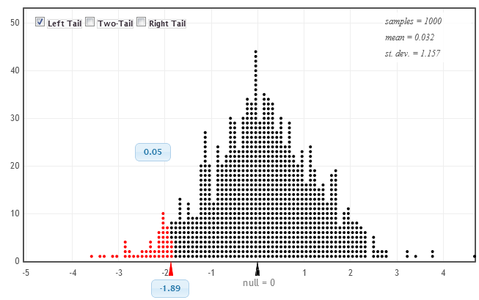
Probability of Type I Error
Distribution of statistics, assuming H₀ true:
If the null hypothesis is true:
5% of statistics will be in the most extreme 5%
5% of statistics will give p-values less than 0.05
5% of statistics will lead to rejecting H₀ at α = 0.05
If α = 0.05, there is a 5% chance of a Type I error

Slide 16
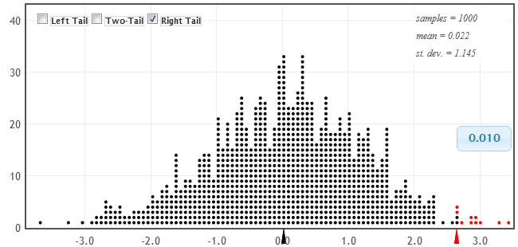
Probability of Type I Error
Distribution of statistics, assuming H₀ true:
If the null hypothesis is true:
1% of statistics will be in the most extreme 1%
1% of statistics will give p-values less than 0.01
1% of statistics will lead to rejecting H₀ at α = 0.01
If α = 0.01, there is a 1% chance of a Type I error

Slide 17
Probability of Type I Error
The probability of making a Type I error (rejecting a true null) is the significance level, α.

Slide 18
Multiple Testing
Because the chance of a Type I error is α…
α of all tests with true null hypotheses will yield significant results just by chance.
If 100 tests are done with α = 0.05 and nothing is really going on, 5% of them will yield significant results, just by chance
This is known as the problem of multiple testing

Slide 19
Multiple Comparisons
Consider a topic that is being investigated by research teams all over the world
⇒ Using α = 0.05, 5% of teams are going to find something significant, even if the null hypothesis is true

Slide 20
Mate Choice and Offspring Fitness
The experiment was actually comprised of 50 smaller experiments. What if we had calculated the p-value for each run?
0.9570 0.8498 0.1376 0.5407 0.7640 0.9845 0.3334 0.8437 0.2080 0.8912 0.8879 0.6615 0.6695 0.8764 1.0000 0.0064 0.9982 0.7671 0.9512 0.2730 0.5812 0.1088 0.0181 0.0013 0.6242 0.0131 0.7882 0.0777 0.9641 0.0001 0.8851 0.1280 0.3421 0.1805 0.1121 0.6562 0.0133 0.3082 0.6923 0.1925 0.4207 0.0607 0.3059 0.2383 0.2391 0.1584 0.1735 0.0319 0.0171 0.1082
50 p-values:
What if we just reported the run that yielded a p-value of 0.0001?
Is that ethical?

Slide 21
Publication Bias
Publication bias refers to the fact that usually only the significant results get published
The one study that turns out significant gets published, and no one knows about all the insignificant results
This combined with the problem of multiple comparisons, can yield very misleading results

Slide 22
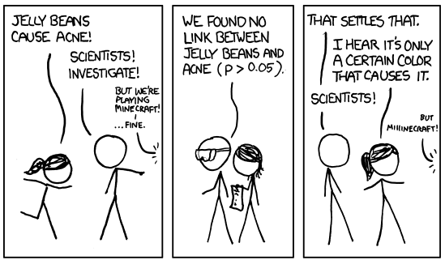
Jelly Beans Cause Acne!
http://xkcd.com/882/
Notes:
Consider having your students act this out in class, each reading aloud a different part. it’s very fun!

Slide 23
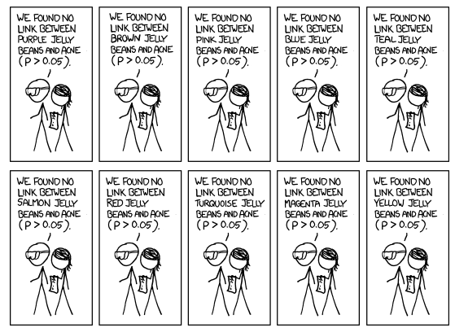

Slide 24
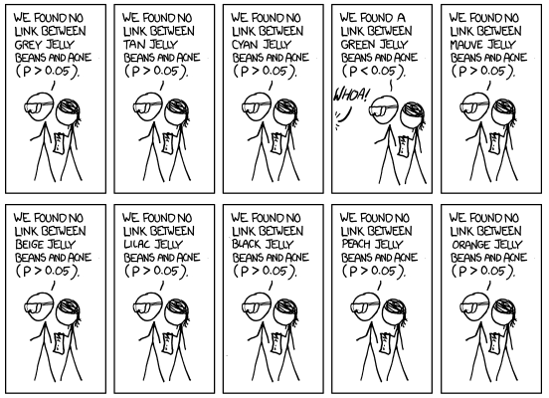

Slide 25
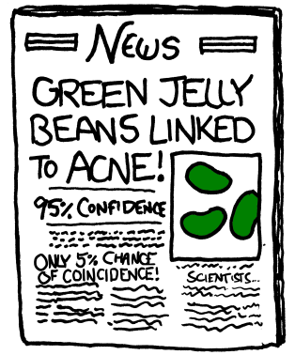
http://xkcd.com/882/

Slide 26
Multiple Testing and Publication Bias
α of all tests with true null hypotheses will yield significant results just by chance.
The one that happens to be significant is the one that gets published.
THIS SHOULD SCARE YOU.

Slide 27
Reproducibility Crisis
“There is increasing concern that most current published research findings are false.” Why most published research findings are false (8/30/05)
“Many researchers believe that if scientists set out to reproduce preclinical work published over the past decade, a majority would fail. This, in short, is the reproducibility crisis." Amid a Sea of False Findings, the NIH Tries Reform (3/16/15)
A recent study tried to replicate 100 results published in psychology journals: 97% of the original results were significant, only 36% of replicated results were significant Estimating the reproducibility of psychological science (8/28/15)

Slide 28
What Can You Do?
Point #1: Errors (type I and II) are possible
Point #2: Multiple testing and publication bias are a huge problem
Is it all hopeless? What can you do?
Recognize (and be skeptical) when a claim is one of many tests
Look for replication of results…

Slide 29
Replication
Replication (or reproducibility) of a study in another setting or by another researcher is extremely important!
Studies that have been replicated with similar conclusions gain credibility
Studies that have been replicated with different conclusions lose credibility
Replication helps guard against Type I errors AND helps with generalizability

Slide 30
Mate Choice and Offspring Fitness
?
Actually, the research attempting to replicate the mate choice result included 3 different experiments
Original study: Significant in favor of choice
p-value < 0.01
Follow-up study #1: Not significant
6067/10000 - 5976/10000 = 0.6067 - 0.5976 = 0.009
p-value = 0.1
Follow-up study #2: Significant in favor of no choice
4579/10000 – 4749/10000 = 0.4579 – 0.4749 = -0.017
p-value = 0.992 for choice, 0.008 for no choice
Follow-up study #3: Significant in favor of no choice
1641/5000 – 1758/5000 = 0.3282 – 0.3516 = -0.02
p-value = 0.993 for choice, 0.007 for no choice

Slide 31
How can we reduce the probability of making a Type I Error (rejecting a true null)?
Decrease the significance level
Increase the significance level

Slide 32
How can we reduce the probability of making a Type II Error (not rejecting a false null)?
Decrease the significance level
Increase the significance level

Slide 33
Significance Level and Errors
α
Reject H₀
Could be making a Type I error if H₀ true
Chance of Type I error
Do not reject H₀
Could be making a Type II error if H_{a} true
Related to chance of making a Type II error
Decrease α if Type I error is very bad
Increase α if Type II error is very bad

Slide 34
A new blood thinning drug is being tested against the current drug in a double-blind experiment, and the hypotheses are: H₀: µ_{n} = µ_{o} vs H_{a}: µ_{n} > µ_{o} If the new drug has potentially serious side effects, we should pick a significance level that is:
Relatively small (such as 1 %)
Middle of the road (5%)
Relatively large (such as 10%)

Slide 35
A new blood thinning drug is being tested against the current drug in a double-blind experiment, and the hypotheses are: H₀: µ_{n} = µ_{o} vs H_{a}: µ_{n} > µ_{o} If the new drug has no real side effects and costs less than the old drug, we might pick a significance level that is:
Relatively small (such as 1 %)
Middle of the road (5%)
Relatively large (such as 10%)

Slide 36
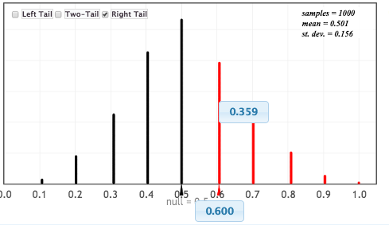
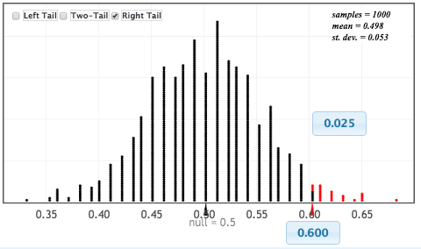
Larger sample size makes it easier to reject the null
n = 10
H₀: p = 0.5
H_{a}: p > 0.5
n = 100
So, increase n to decrease chance of Type II error

Slide 37
Effect of Sample Size
Larger sample size makes it easier to reject H₀
With small sample sizes, even large differences or effects may not be significant, and Type II errors are common
With large sample sizes, even a very small difference or effect can be significant…

Slide 38
Statistical vs Practical Significance
Suppose a weight loss program recruits 10,000 people for a randomized experiment.
A difference in average weight loss of only 0.5 lbs could be found to be statistically significant
Suppose the experiment lasted for a year. Is a loss of ½ a pound practically significant?
A statistically significant result is not always practically significant, especially with large sample sizes

Slide 39
Summary
Conclusions based off p-values are not perfect
Type I and Type II errors can happen
α of all tests will be significant just by chance and often, only the significant results get published
Replication of results is important
Larger sample sizes make it easier to get significant results
For more details, see the 2016 American Statistical Association’s Statement on p-values

