Slide 1
Section 4.5:
Making Connections
To accompany
Statistics: Unlocking the Power of Data
by Lock, Lock, Lock, Lock, and Lock
Video by: Professor Kathryn Dobeck

Slide 2
Suppose a pharmaceutical company is conducting trials for 100 different drugs, but all of them are actually worthless. How many trials do you expect to yield significant results, using ⍺ = 0.05?
None of them
About 1
About 5
About 10
All of them

Slide 3
Outline
Today we’ll see more ways to simulate randomization samples for a variety of situations:
Along the way we’ll make connections between…
Data collection and randomization distributions
Bootstrapping and randomization distributions
Confidence intervals and hypothesis tests

Slide 4
Generating Randomization Samples
The main criteria to consider when creating randomization samples for a statistical test are:
Be consistent with the null hypothesis
Use the data in the original sample.
Ideally, we also try to reflect the way the original data were collected.

Slide 5
Randomization Distribution
For a randomization distribution, each simulated sample should…
1. Be consistent with the null hypothesis
Randomized Experiment:
Cocaine Addiction Example
We simulated assuming that p_{D} = p_{L;} whether a person relapses or not does not depend on which drug is taken

Slide 6
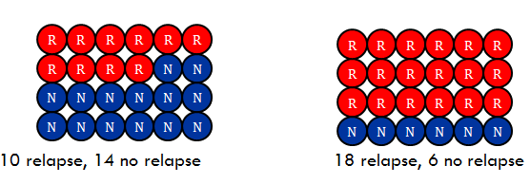
Randomization Distribution
For a randomization distribution, each simulated sample should…
2. Use the data in the observed sample
Randomized Experiment:
Cocaine Addiction Example

Slide 7
Randomization Distribution
For a randomization distribution, each simulated sample should…
3. reflect the way the data were collected
Randomized Experiment:
Cocaine Addiction Example
the “randomness” is the random allocation to treatment groups

Slide 8
Observational Studies
In observational studies, the “randomness” is random sampling from the population
To simulate what would happen, just by random chance, if H₀ were true:
Simulate resampling from a population in which H₀ is true
How do we simulate resampling from a population when we only have sample data?
Bootstrap!
How can we generate randomization samples for observational studies?
Make H₀ true, then bootstrap!

Slide 9

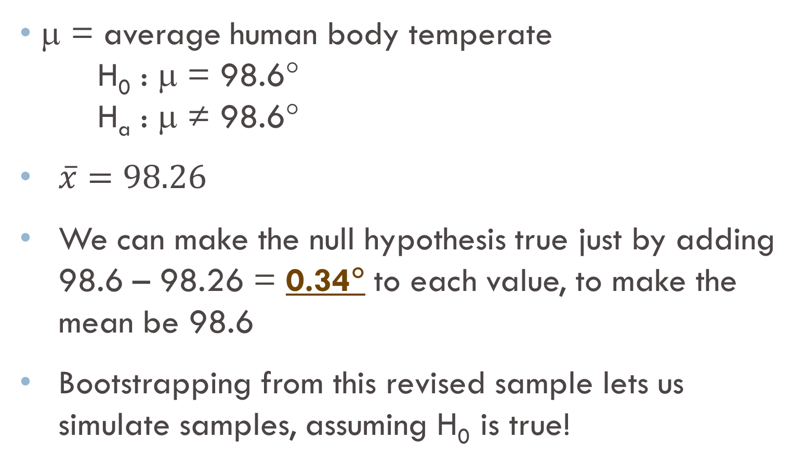
Body Temperatures
μ = average human body temperate
H₀ : μ = 98.6°
H_{a} : μ ≠ 98.6°
$\overline{x}=98.26$
We can make the null hypothesis true just by adding 98.6 – 98.26 = 0.34° to each value, to make the mean be 98.6
Bootstrapping from this revised sample lets us simulate samples, assuming H₀ is true!

Slide 10
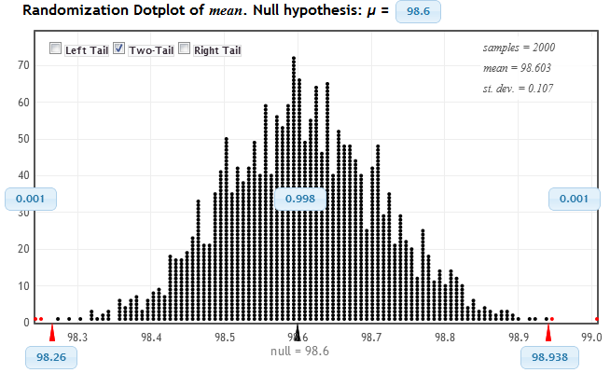
Body Temperatures
In StatKey, when we enter the null hypothesis, this shifting is automatically done for us
StatKey
p-value = 0.002

Slide 11


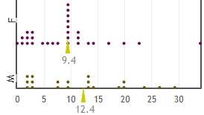

Creating Randomization Samples
Do males exercise more hours per week than females?
$${\overline{x}}_{m}−{\overline{x}}_{f}=3$$
State null and alternative hypotheses
Devise a way to generate a randomization sample that
Uses the observed sample data
Makes the null hypothesis true
Reflects the way the data were collected
Notes:
Ask them to share ideas. There are many possible answers.
If they have computers in class you can also ask them to use StatKey to create a randomization distribution, find the p-value, and interpret in context.

Slide 12
Exercise and Gender
H₀: μ_{m} = μ_{f} , H_{a}: μ_{m} > μ_{f}
To make H₀ true, we must make the means equal. One way to do this is to add 3 to every female value.
Although the default randomization method in StatKey is “reallocate groups”, we can accomplish this by selecting the “Shift Groups” option.
Bootstrap from this modified sample
StatKey

Slide 13
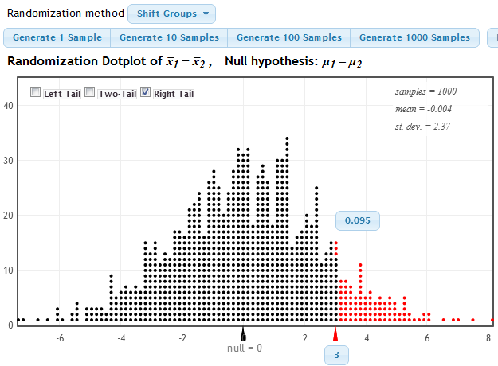
Exercise and Gender
p-value = 0.095

Slide 14
The p-value is 0.095. Using α = 0.05, we conclude….
Males exercise more than females, on average
Males do not exercise more than females, on average
Nothing

Slide 15
Randomization Distribution
Paul the Octopus (single proportion):
Flip a coin 8 times
Cocaine Addiction (randomized experiment):
Rerandomize cases to treatment groups, keeping response values fixed
Body Temperature (single mean):
Shift to make H₀ true, then bootstrap
Exercise and Gender (observational study):
Shift to make H₀ true, then bootstrap

Slide 16
Randomization Distributions: The Common Thread…
Randomization samples should be generated in a such a way that they:
Are consistent with the null hypothesis
Use the observed data
Reflect the way the data were collected
The specific method varies with the situation, but the general idea is always the same

Slide 17
Generating Randomization Samples
StatKey generates the randomizations for you, so although it is important to understand how to generate randomization samples, it is more important to understand why they are generated that way.

Slide 18
Bootstrap and Randomization Distributions
Bootstrap Distribution | Randomization Distribution
Our best guess at the distribution of sample statistics | Our best guess at the distribution of sample statistics, if H₀ were true
Centered around the observed sample statistic | Centered around the null hypothesized value
Simulate sampling from the population by resampling from the original sample | Simulate samples assuming H₀ were true
Big difference: a randomization distribution assumes H₀ is true, while a bootstrap distribution does not

Slide 19
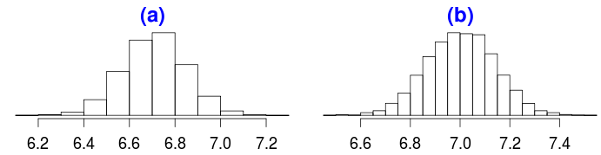
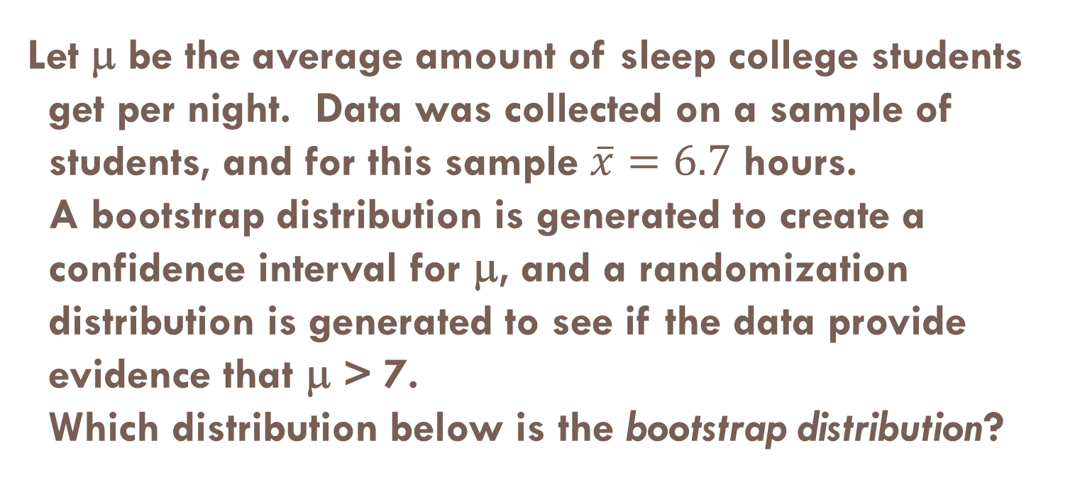
Let μ be the average amount of sleep college students get per night. Data was collected on a sample of students, and for this sample $\overline{x}=6.7$ hours. A bootstrap distribution is generated to create a confidence interval for μ, and a randomization distribution is generated to see if the data provide evidence that μ > 7. Which distribution below is the bootstrap distribution?
a.
b.

Slide 20
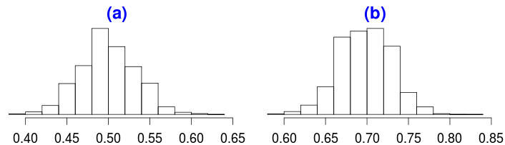
Intro stat students are surveyed, and we find that 152 out of 218 are female. Let p be the proportion of intro stat students at LCCC who are female. A bootstrap distribution is generated for a confidence interval for p, and a randomization distribution is generated to see if the data provide evidence that p > 1/2. Which distribution is the randomization distribution?
a.
b.

Slide 21
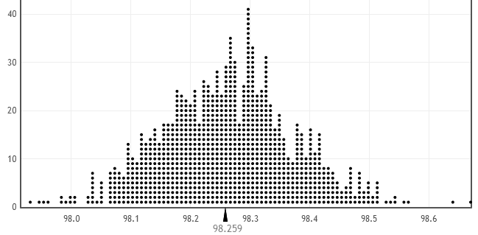

Body Temperature Confidence Interval
We created a bootstrap distribution for average body temperature by resampling with replacement from the original sample ($\overline{x}=98.26):$

Slide 22
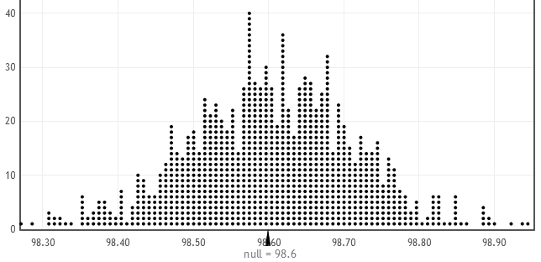
Body Temperature Hypothesis Test
We also created a randomization distribution to see if average body temperature differs from 98.6°F by adding 0.34 to every value to make the null true, and then resampling with replacement from this modified sample:

Slide 23
Body Temperature
These two distributions are identical (up to random variation from simulation to simulation) except for the center
The bootstrap distribution is centered around the sample statistic, 98.26, while the randomization distribution is centered around the null hypothesized value, 98.6
The randomization distribution is equivalent to the bootstrap distribution in shape and spread, but is shifted over

Slide 24
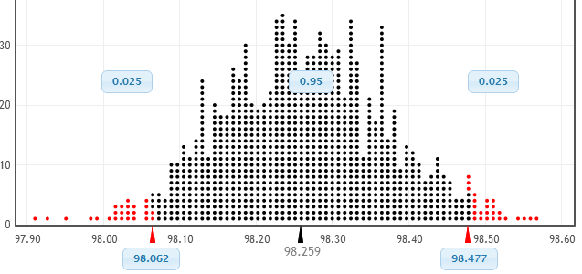
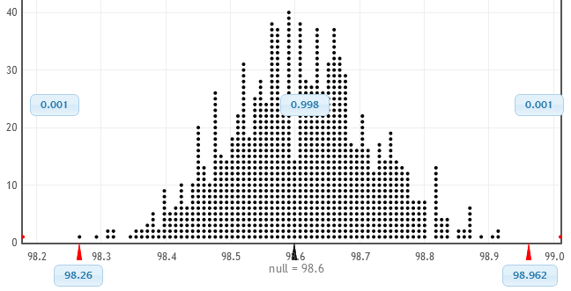
Body Temperature
Bootstrap Distribution
98.26
98.6
Randomization Distribution
H₀: μ = 98.6
H_{a}: μ ≠ 98.6
Notes:
Talk about the fact that the null hypothesized value is in the extremes of the bootstrap distribution, so the sample statistic is in the extremes of the randomization distribution

Slide 25
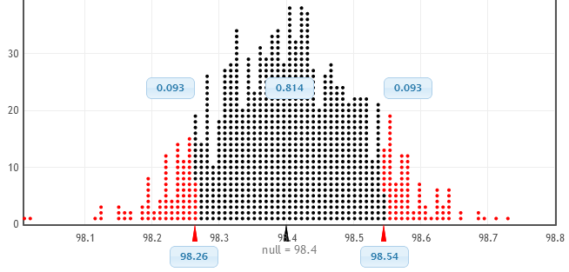
Body Temperature
Bootstrap Distribution
98.26
98.4
Randomization Distribution
H₀: μ = 98.4
H_{a}: μ ≠ 98.4
Notes:
Talk about the fact that the null hypothesized value is not in the extremes of the bootstrap distribution, so the sample statistic is not in the extremes of the randomization distribution

Slide 26
Intervals and Tests
If a 95% CI contains the parameter in H₀, then a two-tailed test should not reject H₀ at a 5% significance level.
If a 95% CI misses the parameter in H₀, then a two-tailed test should reject H₀ at a 5% significance level.

Slide 27
Intervals and Tests
A confidence interval represents the range of plausible values for the population parameter
If the null hypothesized value IS NOT within the CI, it is not a plausible value and should be rejected
If the null hypothesized value IS within the CI, it is a plausible value and should not be rejected

Slide 28
Body Temperatures
Using bootstrapping, we found a 95% confidence interval for the mean body temperature to be (98.05°, 98.47°)
This does not contain 98.6°, so at α = 0.05 we would reject H₀ for the hypotheses
H₀ : μ = 98.6°
H_{a} : μ ≠ 98.6°
StatKey

Slide 29
“Does a child need both a father and a mother to grow up happily?” Let p be the proportion of adults aged 18-29 in 2010 who say yes. A 95% CI for p is (0.487, 0.573). Testing H₀: p = 0.5 vs H_{a}: p ≠ 0.5 with α = 0.05, we
Reject H₀
Do not reject H₀
Reject H_{a}
Do not reject H_{a}
http://www.pewsocialtrends.org/2011/03/09/for-millennials-parenthood-trumps-marriage/#fn-7199-1

Slide 30
“Does a child need both a father and a mother to grow up happily?” Let p be the proportion of adults aged 18-29 in 1997 who say yes. A 95% CI for p is (0.533, 0.607). Testing H₀: p = 0.5 vs H_{a}: p ≠ 0.5 with α = 0.05, we
Reject H₀
Do not reject H₀
Reject H_{a}
Do not reject H_{a}
http://www.pewsocialtrends.org/2011/03/09/for-millennials-parenthood-trumps-marriage/#fn-7199-1

Slide 31
Intervals and Tests
Confidence intervals are most useful when you want to estimate population parameters
Hypothesis tests and p-values are most useful when you want to test hypotheses about population parameters
Confidence intervals give you a range of plausible values; p-values quantify the strength of evidence against the null hypothesis

Slide 32
Is the following question best assessed using a confidence interval, a hypothesis test, or is statistical inference not relevant? On average, how much more do adults who played sports in high school exercise than adults who did not play sports in high school?
Confidence interval
Hypothesis test
Statistical inference not relevant

Slide 33
Is the following question best assessed using a confidence interval, a hypothesis test, or is statistical inference not relevant? On average, were the 23 players on the 2010 Canadian Olympic hockey team older than the 23 players on the 2010 US Olympic hockey team?
Confidence interval
Hypothesis test
Statistical inference not relevant

Slide 34
Is the following question best assessed using a confidence interval, a hypothesis test, or is statistical inference not relevant? Do a majority of adults riding a bicycle wear a helmet?
Confidence interval
Hypothesis test
Statistical inference not relevant

Slide 35
Summary
Randomization samples should be generated
Consistent with the null hypothesis
Using the observed data
Reflecting the way the data were collected
If a null hypothesized value lies inside a 95% CI, a two-tailed test using α = 0.05 would not reject H₀
If a null hypothesized value lies outside a 95% CI, a two-tailed test using α = 0.05 would reject H₀

