Slide 1
Section 5.1:
Hypothesis Tests Using Normal Distributions
To accompany
Statistics: Unlocking the Power of Data
by Lock, Lock, Lock, Lock, and Lock
Video by: Professor Kathryn Dobeck

Slide 2
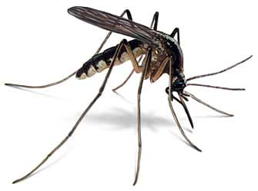
A Research Question
How do Malaria parasites impact mosquito behavior?

Slide 3
Malaria Parasites and Mosquitoes
Mosquitos were randomized to either eat from a malaria infected mouse (exposed group) or a healthy mouse (control group)
After infection, the parasites go through two stages:
Not yet infectious (Days 1-8)
Infectious (Days 9 – 28)
Response variable: whether the mosquito approached a human (in a cage with them)
Does this behavior differ by exposed vs control? Does it differ by infection stage?
Cator LJ, George J, Blanford S, Murdock CC, Baker TC, Read AF, Thomas MB. (2013). ‘Manipulation’ without the parasite: altered feeding behaviour of mosquitoes is not dependent on infection with malaria parasites. Proc R Soc B 280: 20130711.

Slide 4
Malaria Parasites and Mosquitoes
Does infecting mosquitoes with Malaria actually impact the mosquitoes’ behavior to favor the parasite?
Malaria parasites would benefit if:
Mosquitos approached humans less often after being exposed, but before becoming infectious, because humans are risky
Mosquitoes approached humans more often after becoming infectious, to pass on the infection

Slide 5
We’ll first look at the mosquitos before they become infectious (days 1–8). p_{C}: proportion of controls to approach human p_{E}: proportion of exposed to approach human What are the relevant hypotheses?
H₀: p_{E} = p_{C}, H_{a}: p_{E} < p_{C}
H₀: p_{E} = p_{C}, H_{a}: p_{E} > p_{C}
H₀: p_{E} < p_{C}, H_{a}: p_{E} = p_{C}
H₀: p_{E} > p_{C}, H_{a}: p_{E} = p_{C}

Slide 6
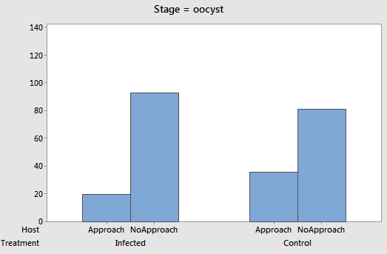
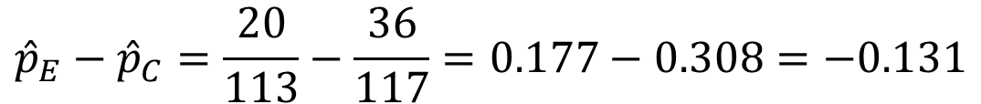
Data: Before Infectious
$${\hat{p}}_{E}−{\hat{p}}_{C}=\frac{20}{113}−\frac{36}{117}=0.177−0.308=−0.131$$

Slide 7
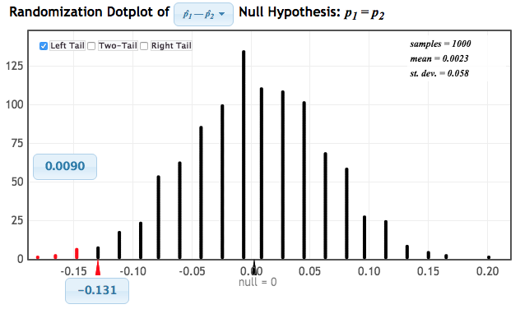
Randomization Test
p-value
observed statistic

Slide 8
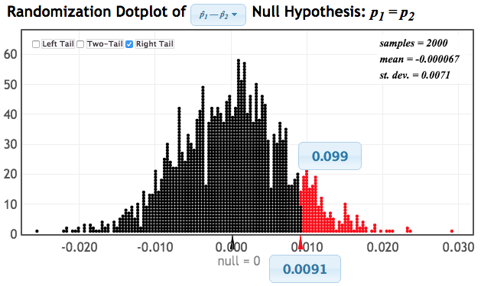
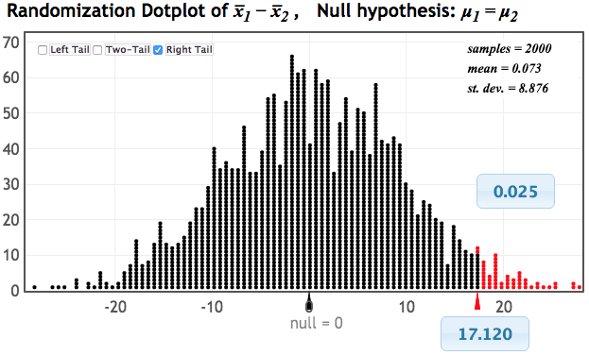
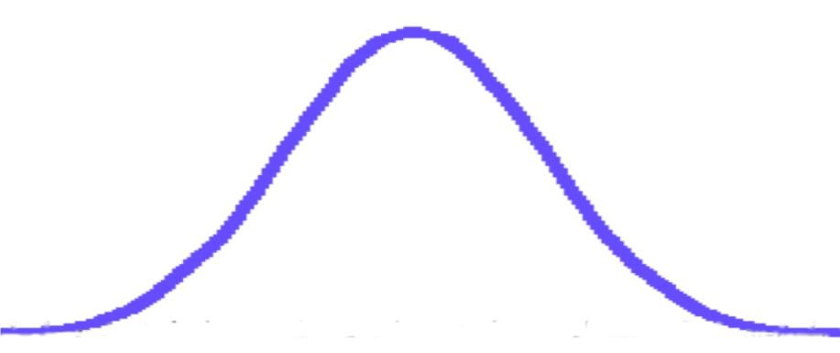
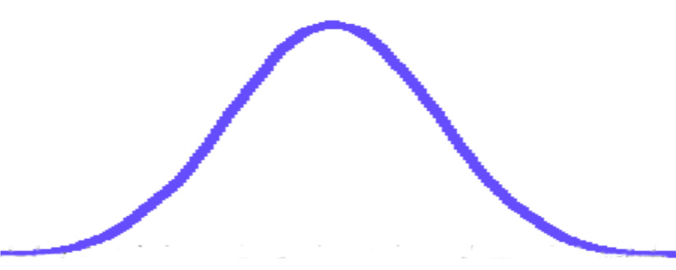
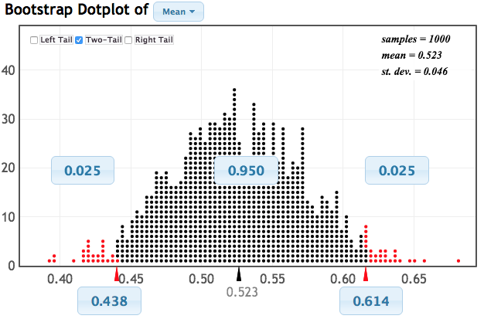
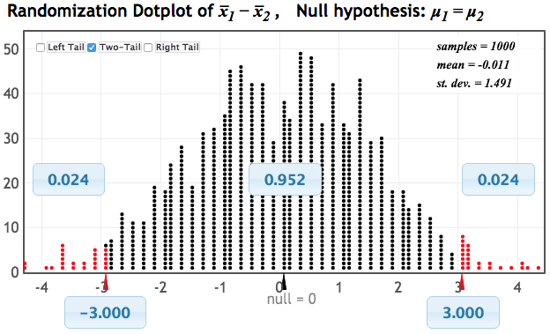
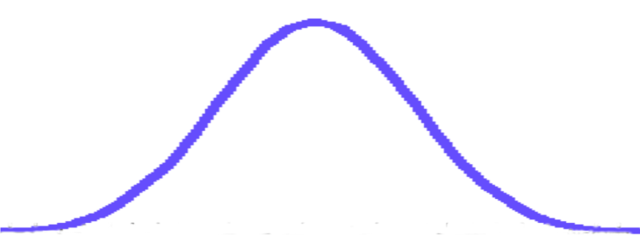

Randomization and Bootstrap Distributions
Mate choice and offspring fitness
Tea and immunity
Difference in proportions
Difference in means
All bell-shaped distributions!
What do you notice?
Mercury in fish
Sleep versus caffeine
Single mean
Difference in proportions

Slide 9
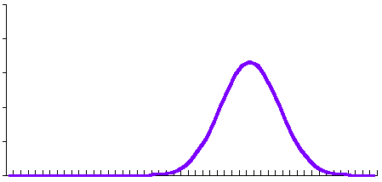
Normal Distribution
The symmetric bell-shaped curve we have seen for almost all of our distribution of statistics is called a normal distribution

Slide 10
Central Limit Theorem
For random samples with a sufficiently large sample size, the distribution of many common sample statistics can be approximated with a normal distribution.
The larger the sample sizes, the more normal the distribution of the statistic will be
“Sufficiently large” will be made more specific in Chapter 6

Slide 11
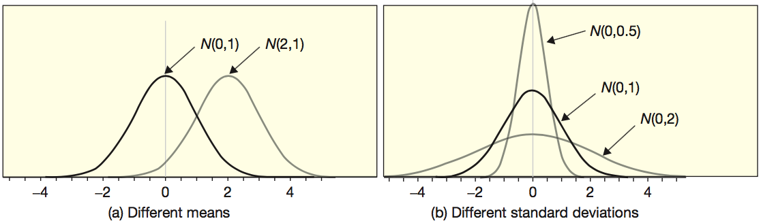
N(mean, standard deviation)
The normal distribution is fully described by it’s mean and standard deviation:
N(mean, standard deviation)

Slide 12
If a randomization distribution is normally distributed, we can write it as
N(null value, se)
N(statistic, se)
N(parameter, se)

Slide 13
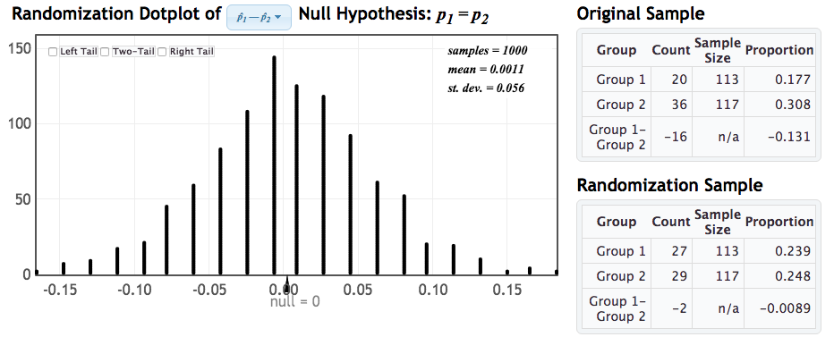
Which normal distribution should we use to approximate this?
N(0, -0.131)
N(0, 0.056)
N(-0.131, 0.056)
N(0.056, 0)

Slide 14
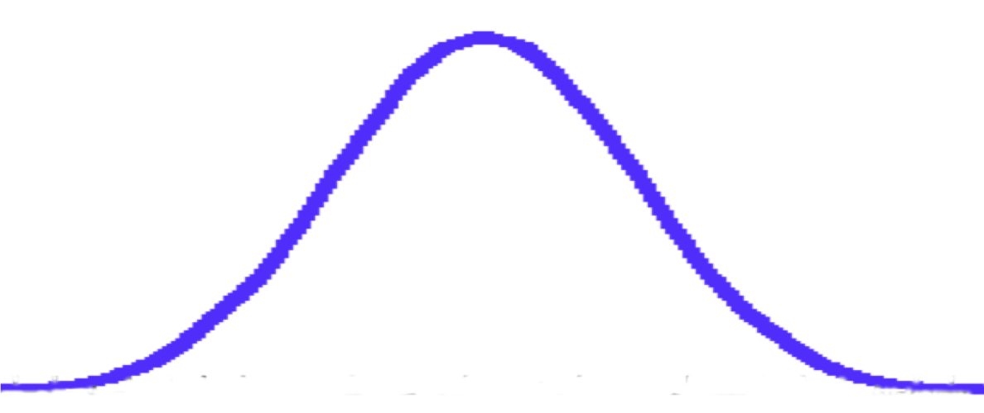
Normal Distribution
N(0, 0.056)
We can compare the original statistic to this Normal distribution to find the p-value!
StatKey
Notes:
Show in StatKey or technology of choice

Slide 15
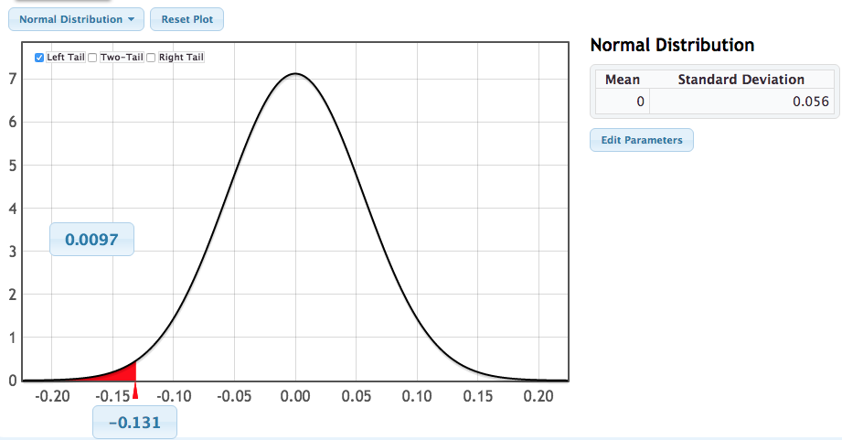
p-value from N(null, SE)
p-value
observed statistic

Slide 16
Standardized Data
Often, we standardize the statistics to have mean 0 and standard deviation 1
How? z-scores!
What does this become for the null distribution?
statistic
null value
SE

Slide 17
Standardized Statistic
The standardized test statistic (also known as a z-statistic) is
Calculating the number of standard errors a statistic is from the null lets us assess extremity on a common scale.

Slide 18
Standardized Statistic
Malaria and Mosquitoes:
From original data: statistic = -0.131
From null hypothesis: null value = 0
From randomization distribution: SE = 0.056
Compare to N(0,1) to find p-value…
StatKey

Slide 19
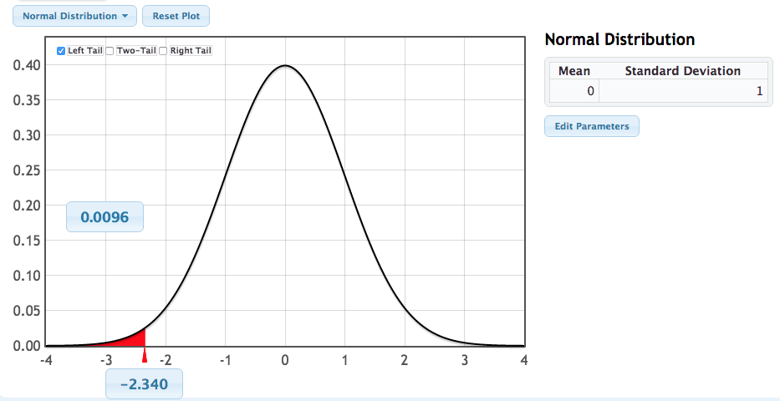
p-value from N(0,1)
p-value
standardized statistic

Slide 20
p-value from N(0,1)
If a statistic is normally distributed under H₀, the p-value can be calculated as the proportion of a standard normal distribution, N(0,1), beyond the standardized test statistic:

Slide 21
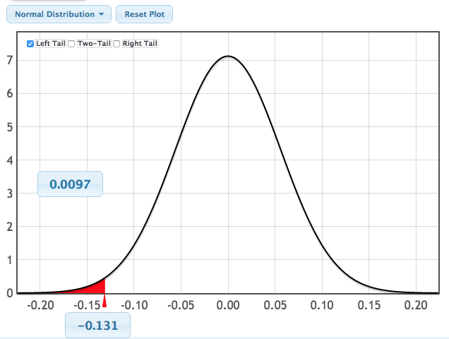
The p-value is always the proportion in the tail(s) beyond the relevant statistic!
Randomization test:
We have evidence that mosquitoes exposed to malaria parasites are less likely to approach a human before they become infectious than mosquitoes not exposed to malaria parasites.
Replace with a smooth curve
Standardize
N(null, SE)
N(0,1)

Slide 22
Malaria and Mosquitos
Does infecting mosquitoes with Malaria actually impact the mosquitoes’ behavior to favor the parasite?
After the parasite becomes infectious, do infected mosquitoes approach humans more often, so as to pass on the infection?

Slide 23
For the data after the mosquitos become infectious (Days 9 – 28), what are the relevant hypotheses? p_{C}: proportion of controls to approach human p_{E}: proportion of exposed to approach human
H₀: p_{E} = p_{C}, H_{a}: p_{E} < p_{C}
H₀: p_{E} = p_{C}, H_{a}: p_{E} > p_{C}
H₀: p_{E} < p_{C}, H_{a}: p_{E} = p_{C}
H₀: p_{E} > p_{C}, H_{a}: p_{E} = p_{C}

Slide 24
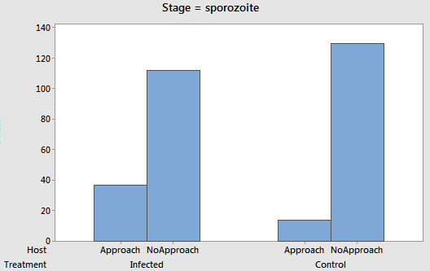
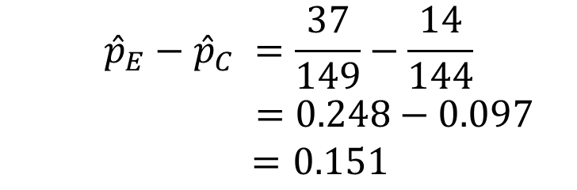
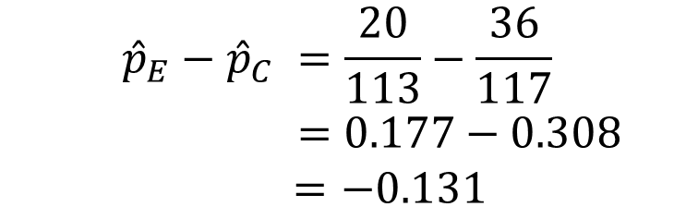
Before Infectious
Data
After Infectious
$${\hat{p}}_{E}−{\hat{p}}_{C} =\frac{20}{113}−\frac{36}{117}$$
$=0.177−0.308$
$=−0.131$
$${\hat{p}}_{E}−{\hat{p}}_{C} =\frac{37}{149}−\frac{14}{144}$$
$=0.248−0.097$
$=0.151$

Slide 25
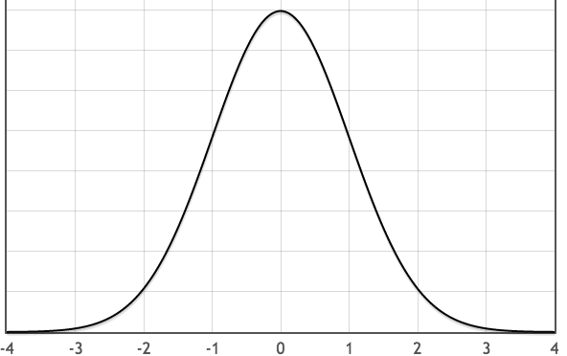
The difference in proportions is 0.151 and the standard error is 0.05. Is this significant?
Yes
No

Slide 26
Malaria and Mosquitoes
It appears that mosquitoes infected by malaria parasites do, in fact, behave in ways advantageous to the parasites!
Exposed mosquitos are less likely to approach before becoming infectious (so more likely to stay alive)
Exposed mosquitos are more likely to approach humans after becoming infectious (so more likely to pass on disease)
Toxoplasmosis parasites impact rat and human behavior, malaria parasites impact mosquito behavior… what else might parasites be impacting that we have yet to discover??

Slide 27
Formula for p-values Using N(0,1)
From original data
From H₀
From randomization distribution

Slide 28
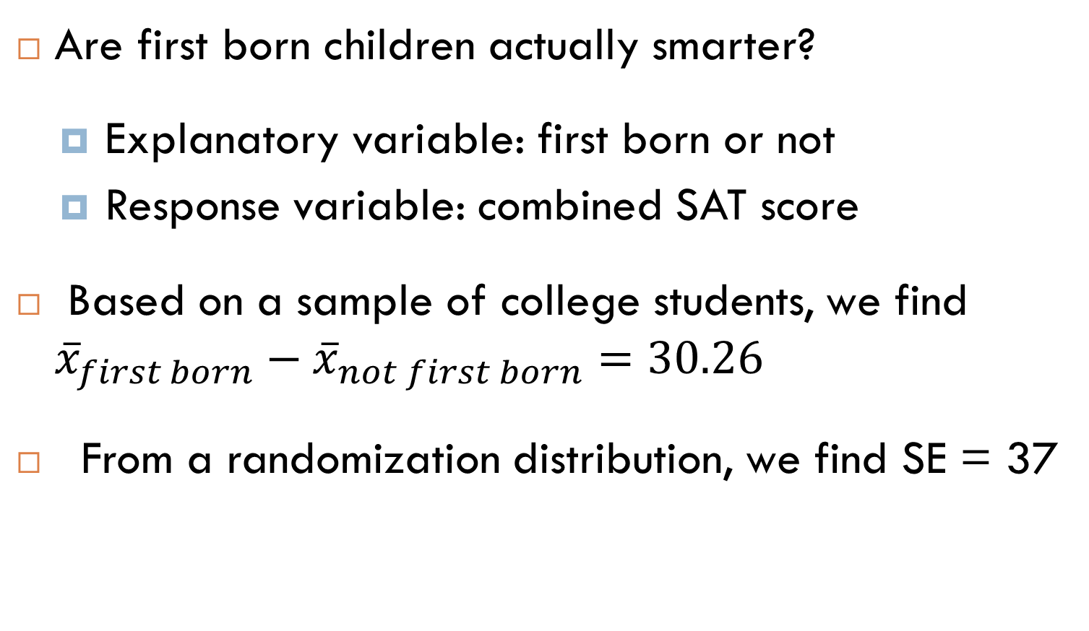
First Born Children
Are first born children actually smarter?
Explanatory variable: first born or not
Response variable: combined SAT score
Based on a sample of college students, we find ${\overline{x}}_{first born}−{\overline{x}}_{not first born}=30.26$
From a randomization distribution, we find SE = 37

Slide 29
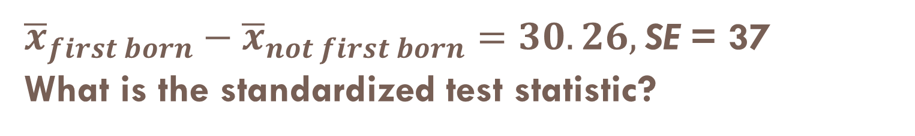
${\overline{x}}_{first born}−{\overline{x}}_{not first born}=30.26,$SE = 37 What is the standardized test statistic?
0.818
30.26
2.784
1.960

Slide 30
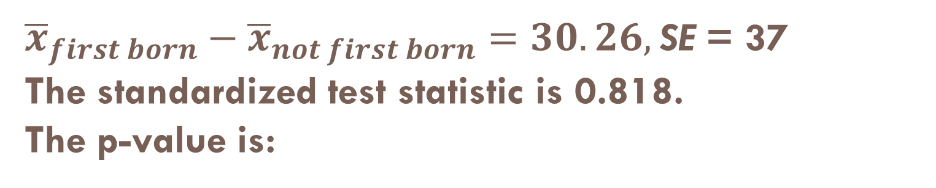
${\overline{x}}_{first born}−{\overline{x}}_{not first born}=30.26,$SE = 37 The standardized test statistic is 0.818. The p-value is:
StatKey
1.960
0.001
0.207
0.157

Slide 31
Summary
If the distribution of the statistic is normal, we can obtain the p-value by calculating:
From there, the p-value is the proportion of a standard normal distribution, N(0,1), that is beyond the standardized test statistic, z.

