Slide 1
Section 6.1:
Inference for a Proportion
To accompany
Statistics: Unlocking the Power of Data
by Lock, Lock, Lock, Lock, and Lock
Video by: Professor Kathryn Dobeck

Slide 2
The Central Limit Theorem applies to the distribution of the
statistic
parameter
null value
data
standard error

Slide 3
Central Limit Theorem!
For a sufficiently large sample size, the distribution of sample statistics for a mean or a proportion is normal

Slide 4
Interval Using N(0,1)
IF SAMPLE SIZES ARE LARGE…
A confidence interval can be calculated by
where z* is a N(0,1) percentile depending on the level of confidence.

Slide 5
Tests Using N(0,1)
IF SAMPLE SIZES ARE LARGE…
A p-value is the area in the tail(s) of a N(0,1) beyond

Slide 6
Standard Errors
Today, we’ll learn formulas for the standard errors!

Slide 7
SE of a Proportion
The standard error for a sample proportion can be calculated by
*Notice the sample size in the denominator… as the sample size increases, the standard error decreases

Slide 8
Paul the Octopus
If he is truly guessing randomly, then p = 0.5 so the SE of his sample proportion correct out of 8 guesses is

Slide 9
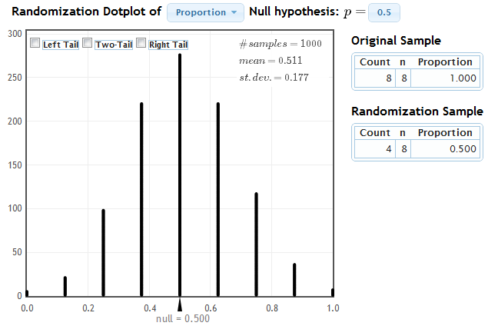
Paul the Octopus
This is the same value we get from a randomization distribution…
www.lock5stat.com/statkey

Slide 10
Paul the Octopus
If Paul really does have psychic powers, and can guess the correct team every time, then p = 1, and

Slide 11

Distribution of $\hat{p}$

Slide 12
CLT for a Proportion
If counts for each category are at least 10
(np ≥ 10 and n(1 – p) ≥ 10), then

Slide 13
Standard Error
One small problem… if we are doing inference for p, we don’t know p!
For confidence intervals, use your best guess for p:

Slide 14
Confidence Interval for a Single Proportion

Slide 15

Obama vs Romney
On 10/17/12, a random sample of 500 North Carolina likely voters were polled. 260 said they plan to vote for Mitt Romney.
Give a 95% CI for the proportion of likely voters in North Carolina that support Mitt Romney.
http://www.rasmussenreports.com/public_content/politics/elections/election_2012/election_2012_presidential_election/north_carolina/election_2012_north_carolina_president

Slide 16

Obama vs Romney
Counts are greater than 10 in each category
For a 95% confidence interval, z* = 1.96
We are 95% confident that between 47.6% and 56.4% of likely voters in North Carolina support Romney.

Slide 17
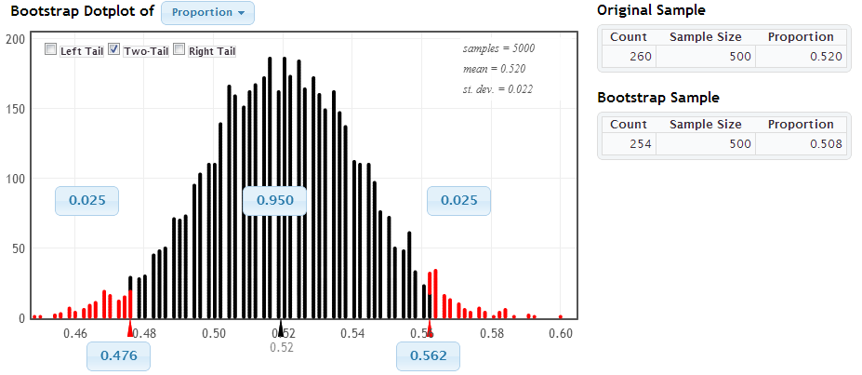
Obama vs Romney

Slide 18
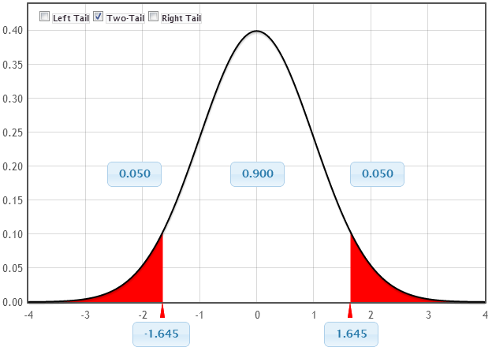
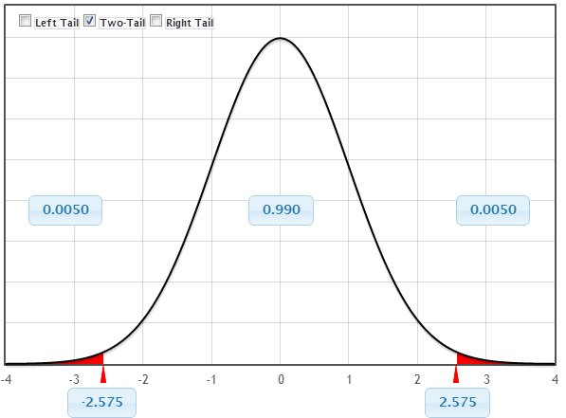
Other Levels of Confidence
www.lock5stat.com/statkey

Slide 19
For a single proportion, what is the margin of error?

Slide 20
Margin of Error and Sample Size
You can choose your sample size in advance, depending on your desired margin of error!
Given this formula for margin of error, solve for n.

Slide 21
Margin of Error and Sample Size

Slide 22
Suppose we want to estimate a proportion with a margin of error of 0.03 with 95% confidence. How large a sample size do we need?
About 100
About 500
About 1000
About 5000

Slide 23
Hypothesis Testing
For hypothesis testing, we want the distribution of the sample proportion assuming the null hypothesis is true
What should we use for p when calculating the SE?

Slide 24
Hypothesis Testing
The p-value is the area in the tail(s) beyond z in a N(0,1)

Slide 25
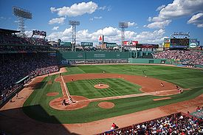
Baseball Home Field Advantage
Of the 2430 Major League Baseball (MLB) games played in 2009, the home team won in 54.9% of the games.
If we consider 2009 as a representative sample of all MLB games, is this evidence of a home field advantage in Major League Baseball?

Slide 26
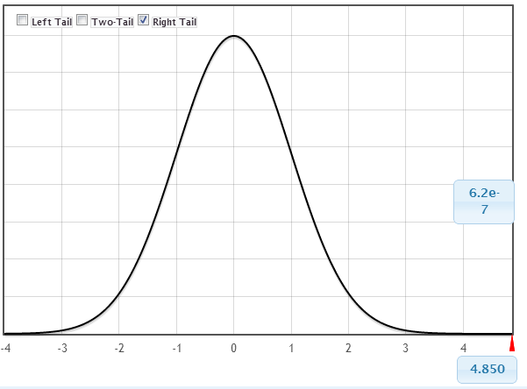
Baseball Home Field Advantage
Counts are greater than 10 in each category
Based on this data, there is strong evidence of a home field advantage in major league baseball.

Slide 27
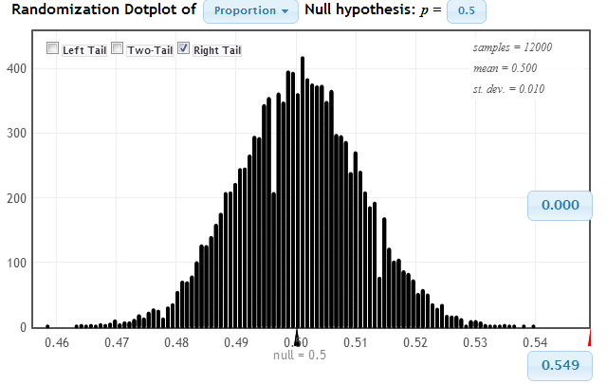
Baseball Home Field Advantage

Slide 28
In a random sample of 500 US citizens, 280 plan to vote in the upcoming election. We want to test to see if this provides evidence that the proportion of US citizens who plan to vote is greater than half. Is this test:
Right-tailed
Left-tailed
Two-tailed
No-tailed

Slide 29
In a random sample of 500 US citizens, 280 plan to vote in the upcoming election. We want to test to see if this provides evidence that the proportion of US citizens who plan to vote is greater than half. What is the standard error for the test?
0.0222
0.0365
0.02236
0.04
0.06329

Slide 30
In a random sample of 500 US citizens, 280 plan to vote in the upcoming election. We want to test to see if this provides evidence that the proportion of US citizens who plan to vote is greater than half. What is the test statistic?
2.703
25.225
25.045
2.683
0.05

Slide 31
In a random sample of 500 US citizens, 280 plan to vote in the upcoming election. We want to test to see if this provides evidence that the proportion of US citizens who plan to vote is greater than half. The test statistic is z= . What is the p-value?
0.0072
0.0036
0.036
0.072
0.05
StatKey

Slide 32
In a random sample of 500 US citizens, 280 plan to vote in the upcoming election. We want to test to see if this provides evidence that the proportion of US citizens who plan to vote is greater than half. What is the conclusion at a 5% level?
Reject H₀ and conclude that more than half of US citizens plan to vote.
Reject H₀ and conclude that it is not true that more than half of US citizens plan to vote.
Do not reject H₀ and conclude that more than half of US citizens plan to vote.
Do not reject H₀ and conclude that it is not true that more than half of US citizens plan to vote.

Slide 33
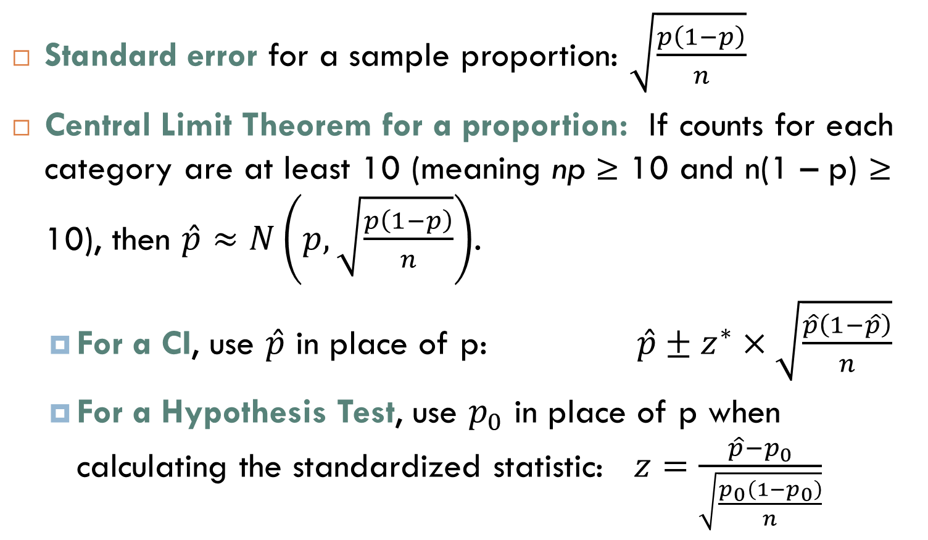
Summary
Standard error for a sample proportion: $\sqrt{\frac{p\left(1−p\right)}{n}}$
Central Limit Theorem for a proportion: If counts for each category are at least 10 (meaning np ≥ 10 and n(1 – p) ≥ 10), then $\hat{p}≈N\left(p,\sqrt{\frac{p\left(1−p\right)}{n}}\right)$.
For a CI, use $\hat{p}$ in place of p: $\hat{p}±z^{∗}×\sqrt{\frac{\hat{p}\left(1−\hat{p}\right)}{n}}$
For a Hypothesis Test, use $p_{0}$ in place of p when calculating the standardized statistic: $z=\frac{\hat{p}−p_{0}}{\sqrt{\frac{p_{0}\left(1−p_{0}\right)}{n}}}$

