Slide 1
Section 6.2:
Inference for a Mean
To accompany
Statistics: Unlocking the Power of Data
by Lock, Lock, Lock, Lock, and Lock
Video by: Professor Kathryn Dobeck

Slide 2
Inference Using N(0,1)
If the distribution of the sample statistic is normal:
A confidence interval can be calculated by
where z* is a N(0,1) percentile depending on the level of confidence.
A p-value is the area in the tail(s) of a N(0,1) beyond

Slide 3
CLT for a Mean
Population
Distribution of Sample Means
n = 10
n = 30
n = 50

Slide 4
SE of a Mean
The standard error for a sample mean can be calculated by

Slide 5
The standard deviation of the population is
σ
s

Slide 6
The standard deviation of the sample is
σ
s

Slide 7
The standard deviation of the sample mean is
σ
s

Slide 8
CLT for a Mean
If n ≥ 30*, then
*Smaller sample sizes may be sufficient for symmetric distributions, and 30 may not be sufficient for very skewed distributions or distributions with high outliers

Slide 9
Standard Error
We don’t know the population standard deviation σ, so estimate it with the sample standard deviation, s

Slide 10
t-distribution
Replacing σ with s changes the distribution of the z-statistic from a normal distribution to a t-distribution
The t distribution is very similar to the standard normal, but with slightly fatter tails to reflect this added uncertainty

Slide 11
Degrees of Freedom
The t-distribution is characterized by its degrees of freedom (df)
Degrees of freedom are calculated based on the sample size
The higher the degrees of freedom, the closer the t-distribution is to the standard normal

Slide 12
t-distribution

Slide 13
…But What Are Degrees of Freedom?
In statistics, the number of degrees of freedom is the number of values in the final calculation of a statistic that are free to vary.
Example:
There are 4 values in a particular sample.
The sample mean is 5.
Three of the values in the sample are 3, 4, and 6.
…Then the fourth value must be 7. Only three of the values (4 – 1) are free to vary before the fourth is determined!

Slide 14
Normality Assumption
Using the t-distribution requires an extra assumption: the data comes from a normal distribution
Note: this assumption is about the original data, not the distribution of the statistic
For large sample sizes we do not need to worry about this, because s will be a very good estimate of σ, and t will be very close to N(0,1)
For small sample sizes (n < 30), we can only use the t-distribution if the distribution of the data is approximately normal

Slide 15
Normality Assumption
One small problem: for small sample sizes, it is very hard to tell if the data actually comes from a normal distribution!
Population
Sample Data, n = 10

Slide 16
Small Samples
If sample sizes are small, only use the t-distribution if the data looks reasonably symmetric and does not have any extreme outliers.
Even then, remember that it is just an approximation!
In practice/life, if sample sizes are small, you should just use simulation methods (bootstrapping and randomization)

Slide 17
Confidence Intervals
df = n – 1
t* is found as the appropriate percentile on a t-distribution with n – 1 degrees of freedom
IF n is large or the data is normal

Slide 18
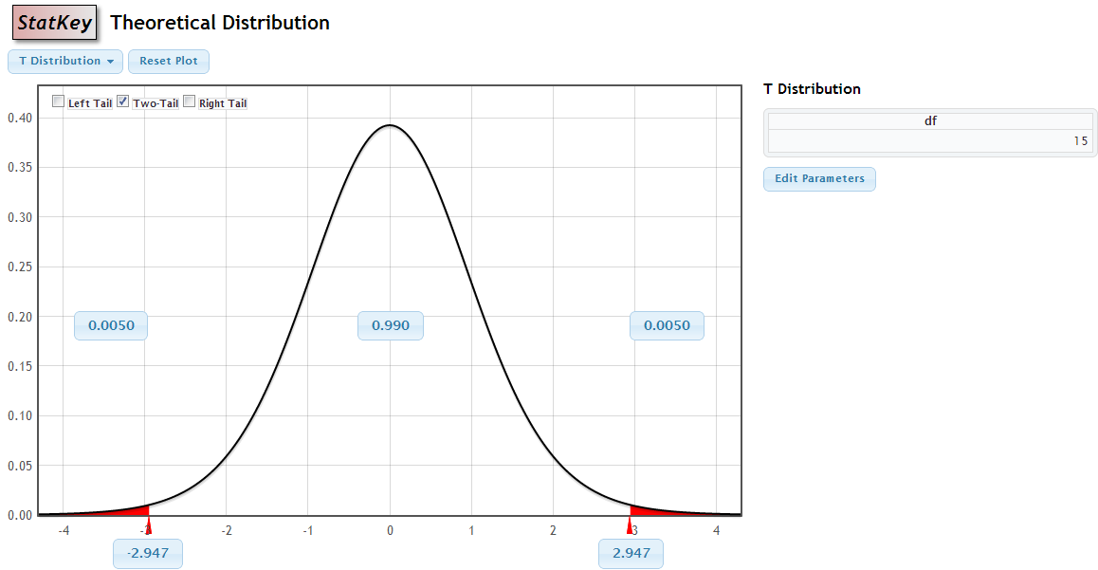
How to Obtain t*
Confidence Level: 99%
- t*
t*

Slide 19
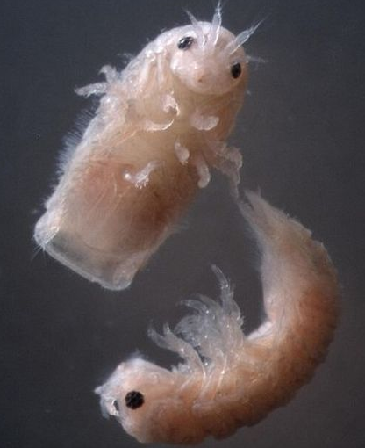
Gribbles
Gribbles are small marine worms that bore through wood, and the enzyme they secrete may allow us to turn inedible wood and plant waste into biofuel
A sample of 50 gribbles finds an average length of 3.1 mm with a standard deviation of 0.72 mm.
Give a 90% confidence interval for the average length of gribbles.

Slide 20
A sample of 50 gribbles finds an average length of 3.1 mm with a standard deviation of 0.72 mm. For a 90% confidence interval for the average length of gribbles, what is t*?
StatKey
1.645
1.677
1.960
1.690

Slide 21
A sample of 50 gribbles finds an average length of 3.1 mm with a standard deviation of 0.72 mm. For a 90% confidence interval for the average length of gribbles, what is the standard error.
0.171
0.720
1.960
0.102

Slide 22
A sample of 50 gribbles finds an average length of 3.1 mm with a standard deviation of 0.72 mm. For a 90% confidence interval for the average length of gribbles, what is the margin of error?
0.171
0.720
1.960
0.102

Slide 23

Gribbles
statistic ± t*⋅ SE
$\overline{x}±t$* ⋅ $\frac{s}{\sqrt{n}}$
Notes:
Walk them through finding t* with technology

Slide 24


Margin of Error
ME = $t$* ⋅ $\frac{s}{\sqrt{n}}$
You can choose your sample size in advance, depending on your desired margin of error!
Given this formula for margin of error, solve for n.

Slide 25


Margin of Error
$n={\left(\frac{\text{t}\text{∗} s}{ME}\right)}^{2}$
$n={\left(\frac{\text{z}\text{∗} s}{ME}\right)}^{2}$
Problem 1: For t*, need to know n.
Solution: Use z* instead of t* (they are usually close)
Problem 2: For s, need data.
Solution: estimate s.
Use data from a previous study or similar population
Take a small pre-sample to estimate s
Estimate the range (max – min) and use s ≈ range/4
Make a reasonable guess.

Slide 26
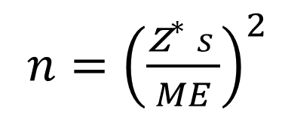
Suppose we want to estimate average GPA at a college (where GPA’s go from 0 to 4.0), with a margin of error of 0.1 with 95% confidence. How large a sample size do we need?
$n={\left(\frac{\text{z}\text{∗} s}{ME}\right)}^{2}$
About 100
About 400
About 800
About 1000
Notes:
They may have other estimates of s, which will lead to slightly different answers. This is only to get a rough estimate.
Also, GPA probably left skewed so 95% rule doesn’t apply so estimate of s may be bad… probably better to estimate with other data if possible.

Slide 27
Hypothesis Testing
df = n – 1
The p-value is the area in the tail(s) beyond t in a t-distribution with n – 1 degrees of freedom,
IF n is large or the data is normal

Slide 28

Chips Ahoy!
?
A group of Air Force cadets bought bags of Chips Ahoy! cookies from all over the country to verify this claim. They hand counted the number of chips in 42 bags.
Source: Warner, B. & Rutledge, J. (1999). “Checking the Chips Ahoy! Guarantee,” Chance, 12(1).

Slide 29

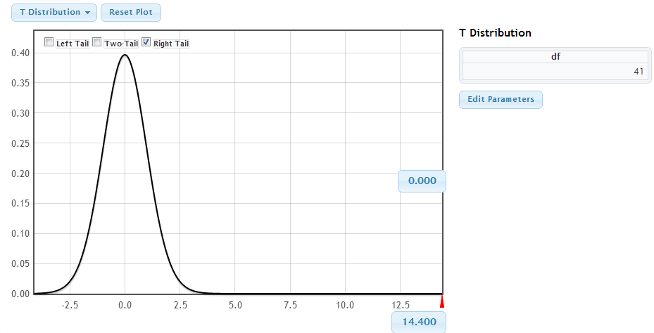
Chips Ahoy! Hypothesis Test
1. State hypotheses:
2. Check conditions:
3. Calculate test statistic:
4. Compute p-value:
5. Interpret in context:
This provides extremely strong evidence that the average number of chips per bag of Chips Ahoy! cookies is significantly greater than 1000.

Slide 30
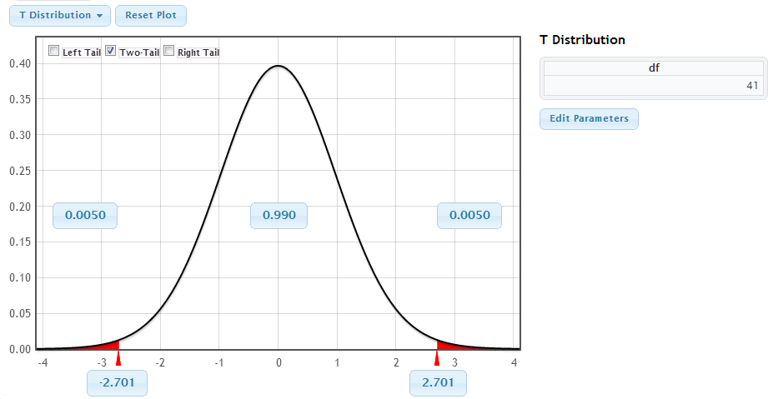
Chips Ahoy! Give a 99% confidence interval for the average number of chips in each bag.
1. Check conditions:
2. Find t*:
4. Compute confidence interval:
5. Interpret in context:
We are 99% confident that the average number of chips per bag of Chips Ahoy! cookies is between 1212.6 and 1310.6 chips.

Slide 31
Which of the following properties is/are necessary for to have a t-distribution?
the data is normal
the sample size is large
the null hypothesis is true
a or b
d and c

Slide 32
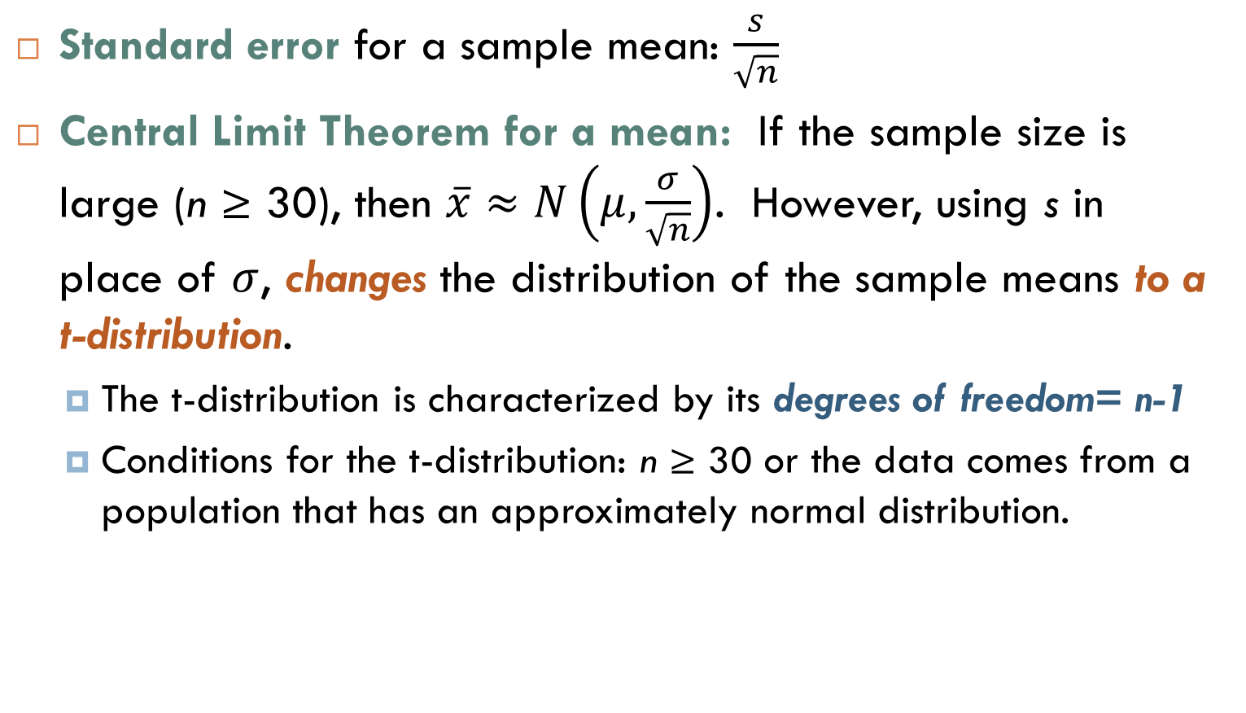
Summary
Standard error for a sample mean: $\frac{s}{\sqrt{n}}$
Central Limit Theorem for a mean: If the sample size is large (n ≥ 30), then $\overline{x}≈N\left(μ,\frac{σ}{\sqrt{n}}\right)$. However, using s in place of $σ$, changes the distribution of the sample means to a t-distribution.
The t-distribution is characterized by its degrees of freedom= n-1
Conditions for the t-distribution: n ≥ 30 or the data comes from a population that has an approximately normal distribution.

