Slide 1
Section 6.3:
Inference for a Difference in Proportions
To accompany
Statistics: Unlocking the Power of Data
by Lock, Lock, Lock, Lock, and Lock
Video by: Professor Kathryn Dobeck

Slide 2
One Proportion or Two?
Two proportions: there are two separate categorical variables
One proportion: there is only one categorical variable

Slide 3
You want to compare the proportion of students who use a Windows-based PC to the proportion who use a Mac. This is:
Inference for one proportion
Inference for two proportions

Slide 4
You want to compare the proportion of students who study abroad between those attending public universities and those at private universities. This is:
Inference for one proportion
Inference for two proportions

Slide 5
You want to compare the proportion of in-state students at a university to the proportion from outside the state. This is:
Inference for one proportion
Inference for two proportions

Slide 6
You want to compare the proportion of in-state students who get financial aid to the proportion of out-of-state students who get financial aid. This is:
Inference for one proportion
Inference for two proportions

Slide 7

Standard Error for ${\hat{p}}_{1}−{\hat{p}}_{2}$

Slide 8

CLT for ${\hat{p}}_{1}−{\hat{p}}_{2}$
If counts within each category (each cell of the two-way table) are at least 10

Slide 9


Metal Tags and Penguins
Are metal tags detrimental to penguins? A study looked at the 10 year survival rate of penguins tagged either with a metal tag or an electronic tag. 20% of the 167 metal tagged penguins survived, compared to 36% of the 189 electronic tagged penguins.
Give a 90% confidence interval for the difference in proportions.
Source: Saraux, et. al. (2011). “Reliability of flipper-banded penguins as indicators of climate change,” Nature, 469, 203-206.

Slide 10

Metal Tags and Penguins
We are 90% confident that the survival rate is between 8.3% and 23.7% lower for metal tagged penguins, as opposed to electronically tagged.

Slide 11
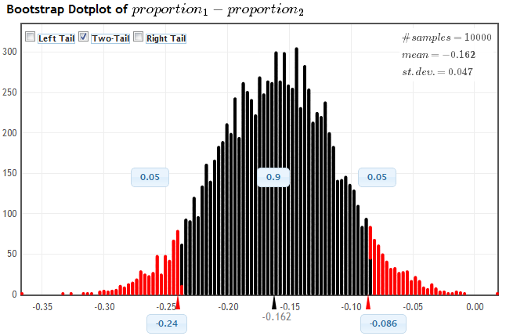
Metal Tags and Penguins
www.lock5stat.com/statkey

Slide 12

Hypothesis Testing
What should we use for p₁ and p₂ in the formula for SE for hypothesis testing?

Slide 13
Pooled Proportion
Overall sample proportion across both groups. It will be in between the two observed sample proportions.

Slide 14
Hypothesis Testing
The p-value is the area in the tail(s) beyond z in a N(0,1)

Slide 15
Metal Tags and Penguins
20% of the 167 metal tagged penguins survived, compared to 36% of the 189 electronic tagged penguins.
Are metal tags detrimental to penguins?

Slide 16
Metal Tags and Penguins
Are metal tags detrimental to penguins?

Slide 17
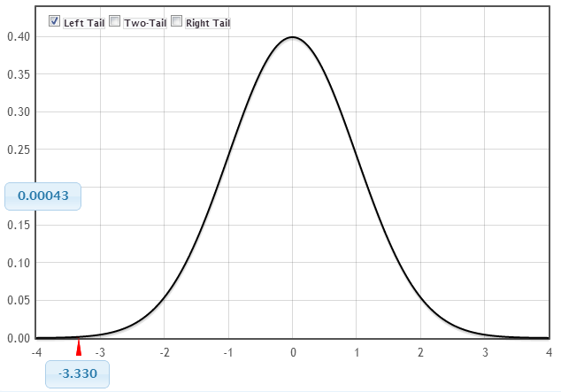
Metal Tags and Penguins
This is very strong evidence that metal tags are detrimental to penguins.

Slide 18
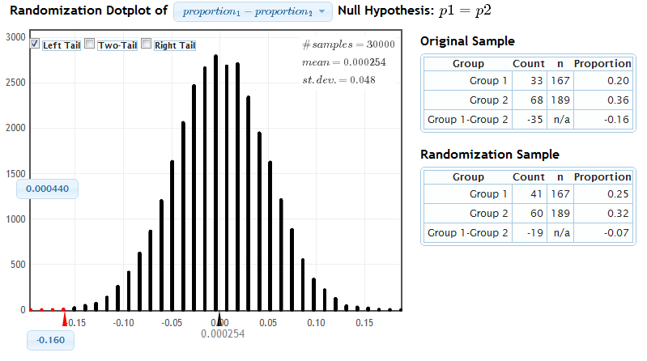
Metal Tags and Penguins
www.lock5stat.com/statkey

Slide 19
Accuracy
The accuracy of intervals and p-values generated using simulation methods (bootstrapping and randomization) depends on the number of simulations (more simulations = more accurate)
The accuracy of intervals and p-values generated using formulas and the normal distribution depends on the sample size (larger sample size = more accurate)
If the distribution of the statistic is truly normal and you have generated many simulated randomizations, the p-values should be very close

Slide 20
In a randomized double-blind experiment, a sample of 150 patients were either given a treatment or a placebo. We want to test to see if the treatment is significantly better than a placebo at relieving pain. Using the data in the two-way table below, calculate the pooled proportion of patients that experienced pain relief.
 | Treatment | Placebo | Total
Relieved pain | 36 | 21 | 57
Did not relieve pain | 39 | 54 | 93
Total | 75 | 75 | 150
0.2
0.212
0.38
0.5

Slide 21
In a randomized double-blind experiment, a sample of 150 patients were either given a treatment or a placebo. We want to test to see if the treatment is significantly better than a placebo at relieving pain. Calculate the test statistic. (Group 1 = Treatment, Group 2 = Placebo).
 | Treatment | Placebo | Total
Relieved pain | 36 | 21 | 57
Did not relieve pain | 39 | 54 | 93
Total | 75 | 75 | 150
1.57
1.65
1.96
2.52

Slide 22
In a randomized double-blind experiment, a sample of 150 patients were either given a treatment or a placebo. We want to test to see if the treatment is significantly better than a placebo at relieving pain. What is the p-value? (Group 1 = Treatment, Group 2 = Placebo).
StatKey
 | Treatment | Placebo | Total
Relieved pain | 36 | 21 | 57
Did not relieve pain | 39 | 54 | 93
Total | 75 | 75 | 150
0.0059
0.059
0.05
0.842

Slide 23
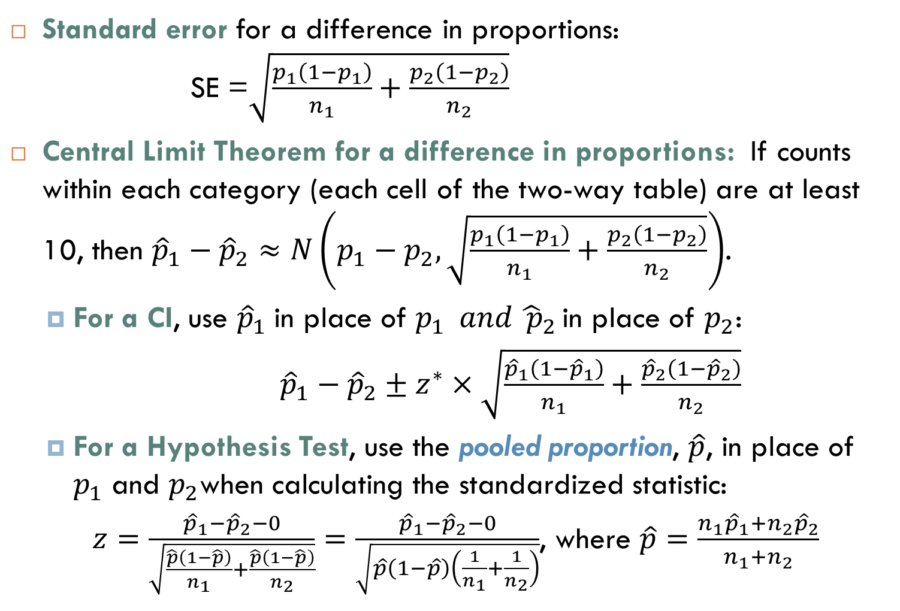
Summary
Standard error for a difference in proportions: SE =$\sqrt{\frac{p_{1}\left(1−p_{1}\right)}{n_{1}}+\frac{p_{2}\left(1−p_{2}\right)}{n_{2}}}$
Central Limit Theorem for a difference in proportions: If counts within each category (each cell of the two-way table) are at least 10, then ${\hat{p}}_{1}−{\hat{p}}_{2}≈N\left(p_{1}−p_{2},\sqrt{\frac{p_{1}\left(1−p_{1}\right)}{n_{1}}+\frac{p_{2}\left(1−p_{2}\right)}{n_{2}}}\right)$.
For a CI, use ${\hat{p}}_{1} \text{in} \text{place} \text{of} p_{1} and {\hat{ p}}_{2 }$in place of $p_{2}$:
${\hat{p}}_{1}−{\hat{p}}_{2}±z^{∗}×\sqrt{\frac{{\hat{p}}_{1}\left(1−{\hat{p}}_{1}\right)}{n_{1}}+\frac{{\hat{p}}_{2}\left(1−{\hat{p}}_{2}\right)}{n_{2}}}$
For a Hypothesis Test, use the pooled proportion, $\hat{p}$, in place of $p_{1}$ and $p_{2}$when calculating the standardized statistic:
$z=\frac{{\hat{p}}_{1}−{\hat{p}}_{2}−0}{\sqrt{\frac{\hat{p}\left(1−\hat{p}\right)}{n_{1}}+\frac{\hat{p}\left(1−\hat{p}\right)}{n_{2}}}}=\frac{{\hat{p}}_{1}−{\hat{p}}_{2}−0}{\sqrt{\hat{p}\left(1−\hat{p}\right)\left(\frac{1}{n_{1}}+\frac{1}{n_{2}}\right)}}$, where $\hat{p}=\frac{n_{1}{\hat{p}}_{1}+n_{2}{\hat{p}}_{2}}{n_{1}+n_{2}}$

